Slide 1
Shortest pending time

Slide 2
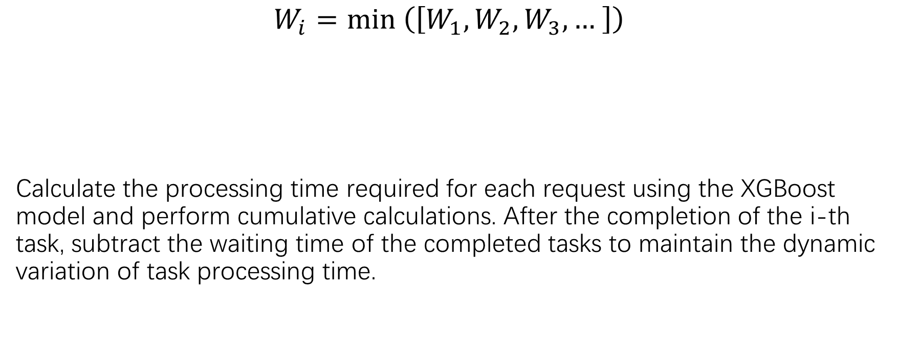
Shortest pending time
$$W_{i}=min \left(\left[W_{1},W_{2},W_{3}, … \right]\right)$$
Calculate the processing time required for each request using the XGBoost model and perform cumulative calculations. After the completion of the i-th task, subtract the waiting time of the completed tasks to maintain the dynamic variation of task processing time.

Slide 3
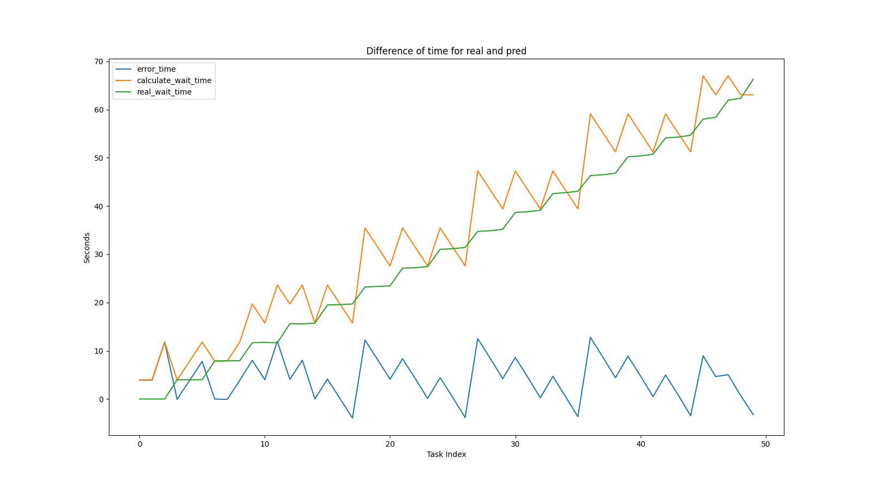
Result

Slide 4
Dynamic weight

Slide 5
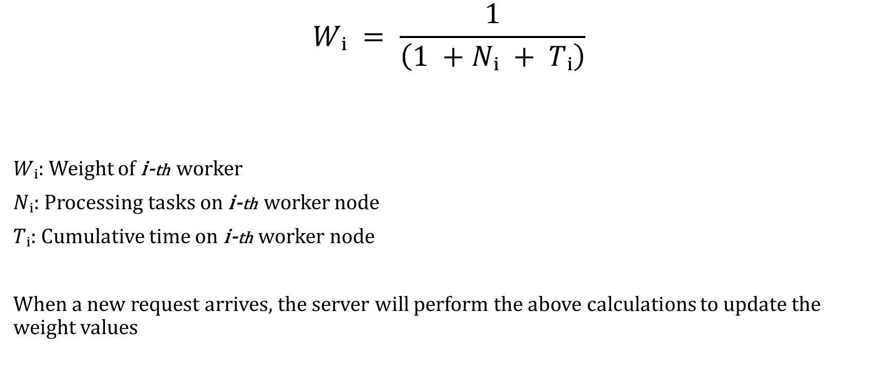
Dynamic weight algorithm
$$Wᵢ = \frac{1}{\left(1 +Nᵢ + Tᵢ\right)}$$
$Wᵢ$: Weight of i-th worker
$Nᵢ$: Processing tasks on i-th worker node
$Tᵢ$: Cumulative time on i-th worker node
When a new request arrives, the server will perform the above calculations to update the weight values

Slide 6
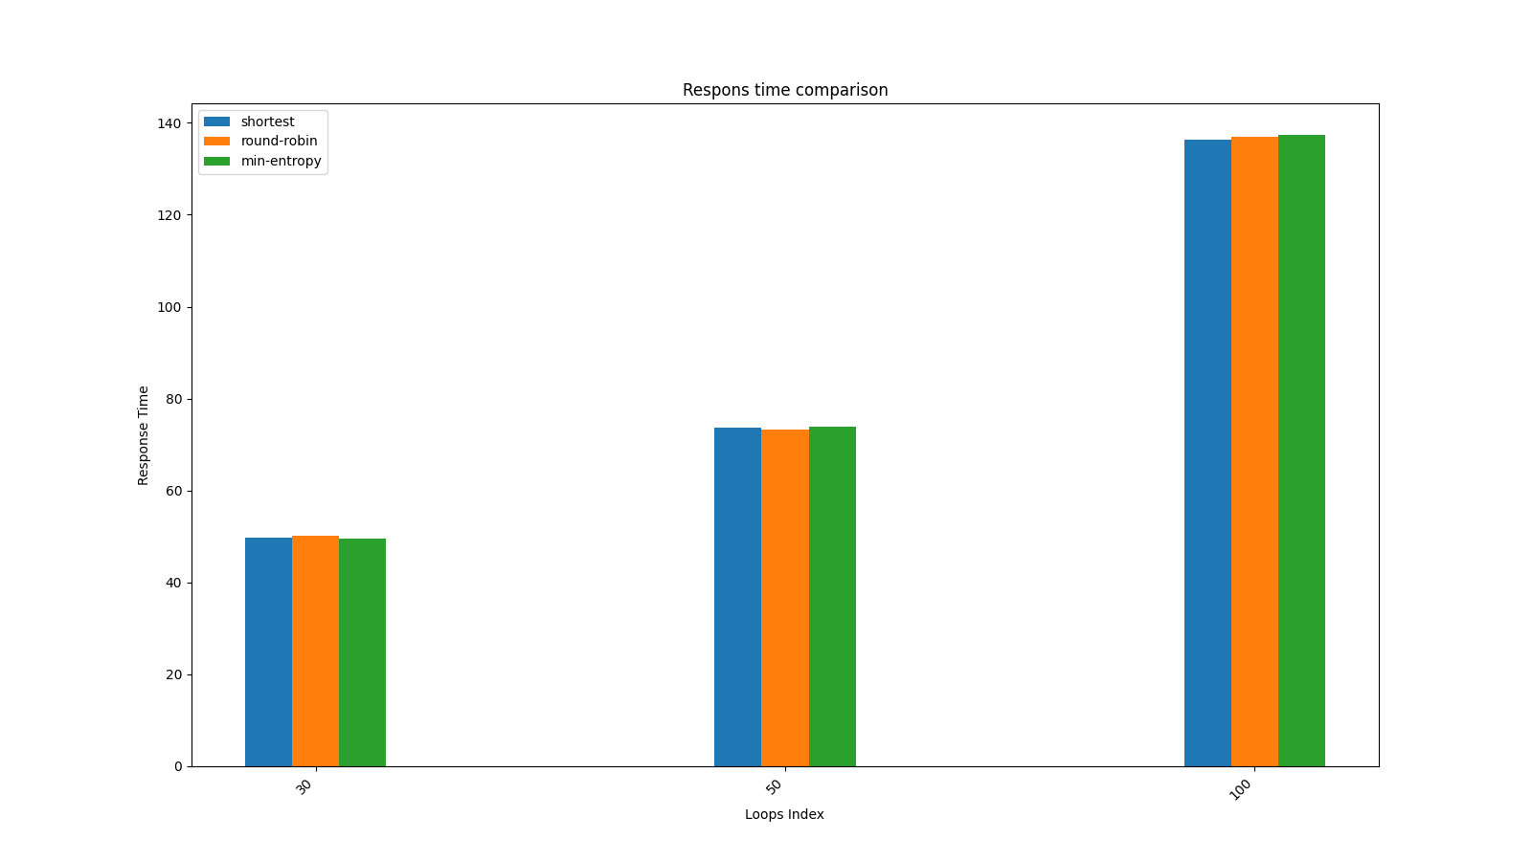
Compare

Slide 7
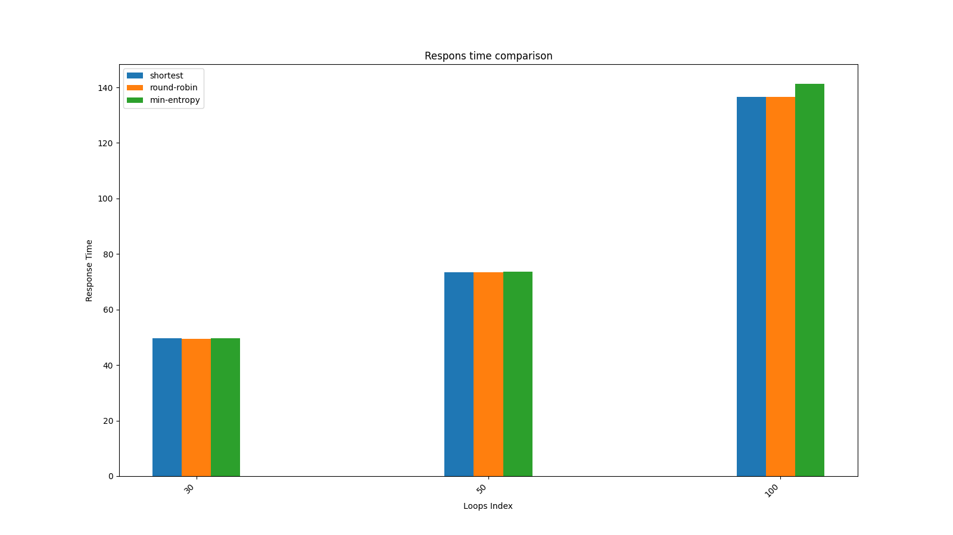
Compare

Slide 8
Compare

