Slide 1
Shortest pending time

Slide 2
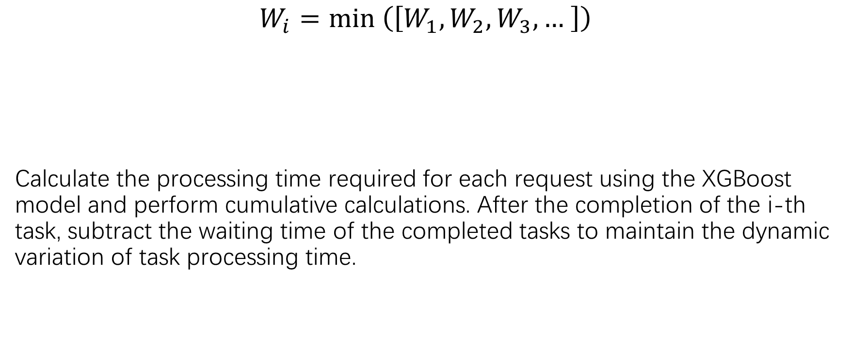
Shortest pending time
$$W_{i}=min \left(\left[W_{1},W_{2},W_{3}, … \right]\right)$$
Calculate the processing time required for each request using the XGBoost model and perform cumulative calculations. After the completion of the i-th task, subtract the waiting time of the completed tasks to maintain the dynamic variation of task processing time.

Slide 3
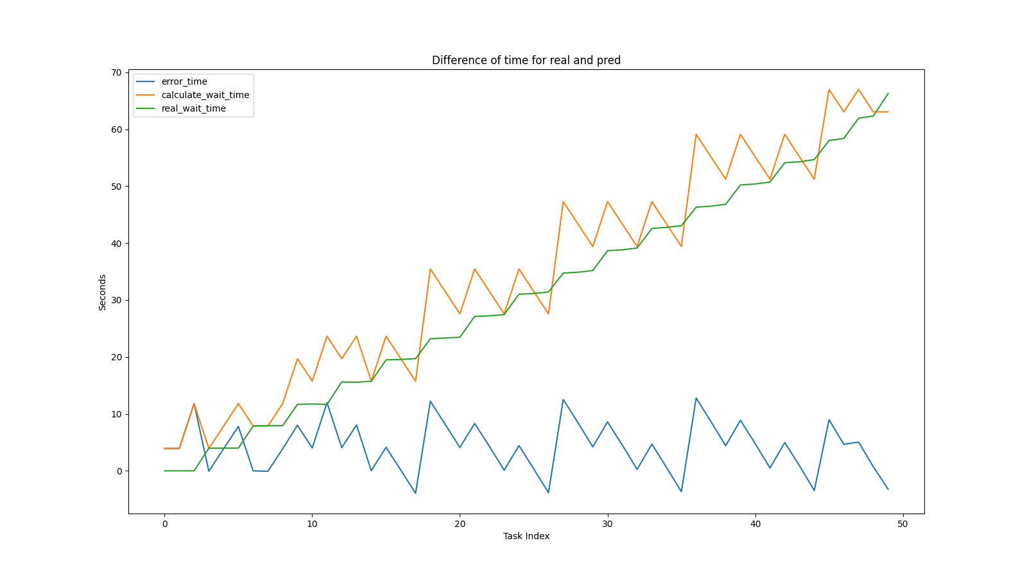
Wait time error graph (algorithm: shortest)

Slide 4
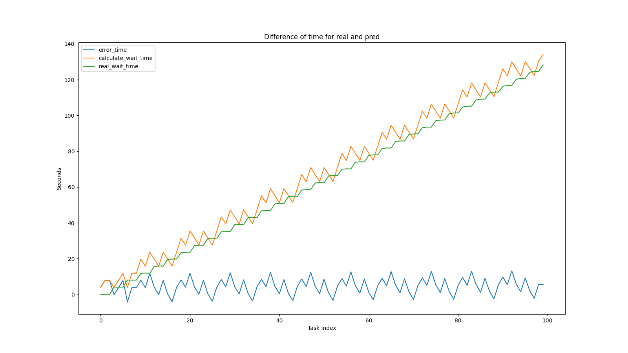
Wait time error graph (algorithm: shortest)

Slide 5
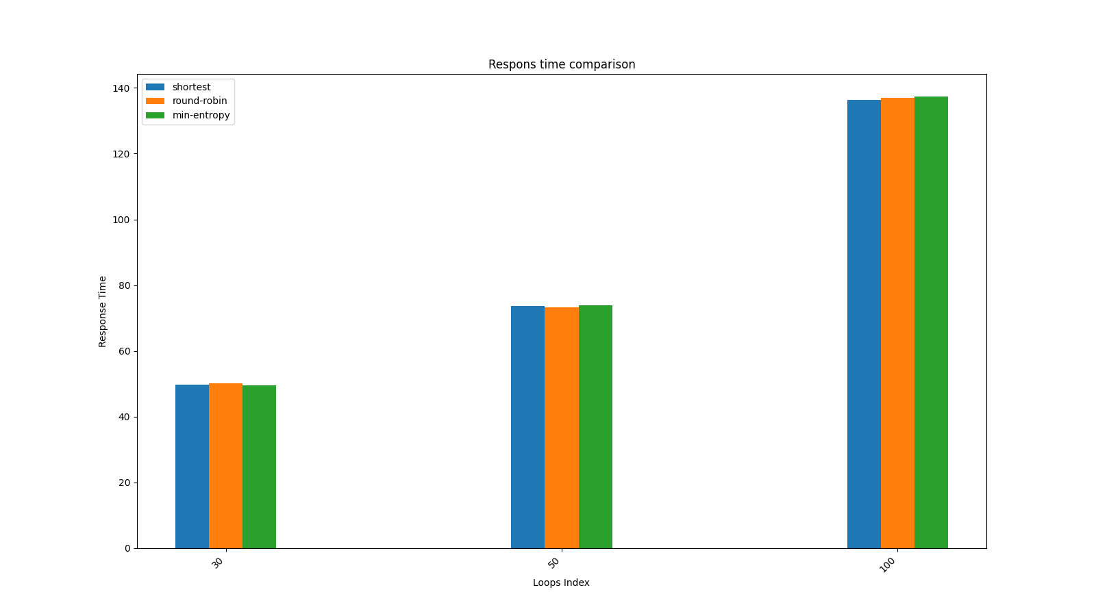
Sum of all requests’ response time by every algorithm

Slide 6
Dynamic weight

Slide 7
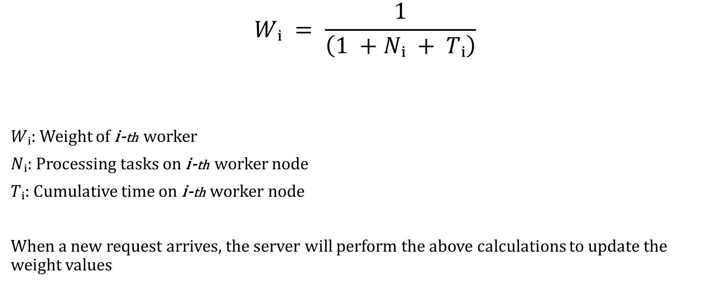
Dynamic weight algorithm
$$Wᵢ = \frac{1}{\left(1 +Nᵢ + Tᵢ\right)}$$
$Wᵢ$: Weight of i-th worker
$Nᵢ$: Processing tasks on i-th worker node
$Tᵢ$: Cumulative time on i-th worker node
When a new request arrives, the server will perform the above calculations to update the weight values

Slide 8
Compare

Slide 9
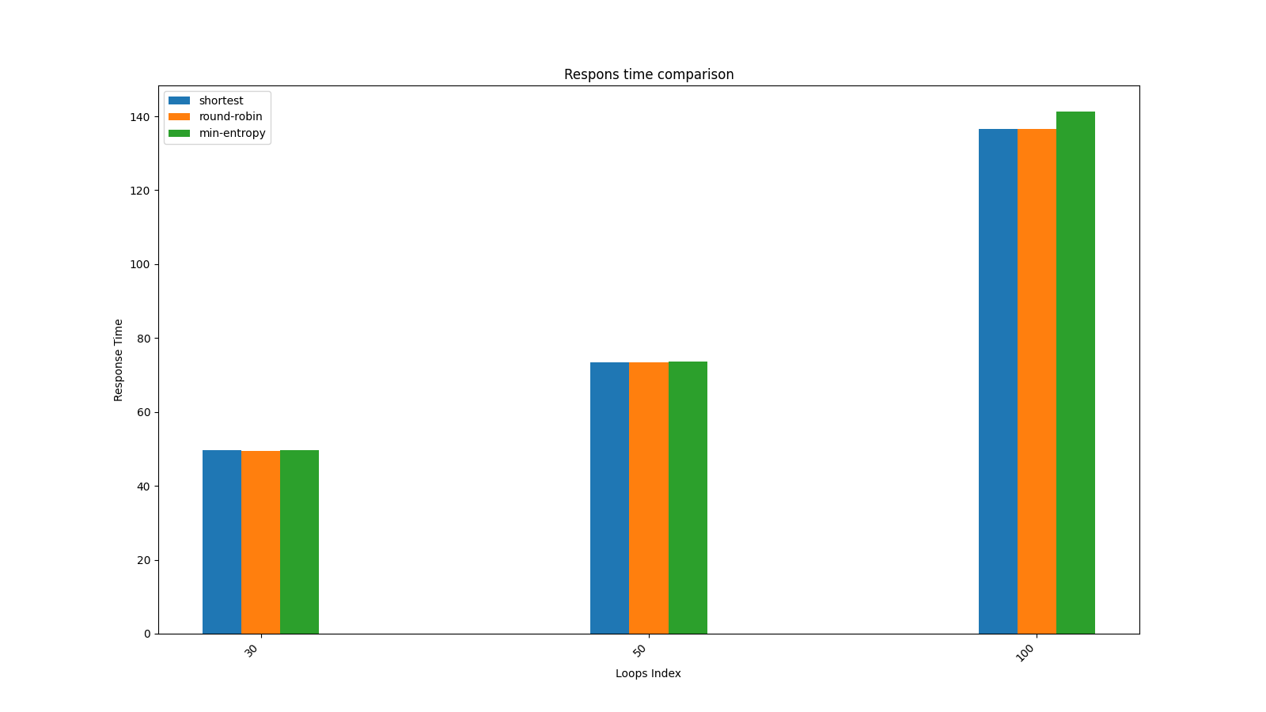
Compare

Slide 10
Formula for Weight Calculation
The weight for each worker is calculated using the formula:
new_weight = 1 / (1 + α * T + β * N + γ * C)
Where:
- new_weight : New weight for the worker
- T: Task complexity (processing time)
- N: Current queue size
- C: Current active connections
- α: Impact factor for task complexity
- β: Impact factor for queue size
- γ: Impact factor for active connections

Slide 11
Parameter Details
Key Parameters:
- α (alpha): Adjusts the influence of task complexity.
- β (beta): Adjusts the influence of queue size.
- γ (gamma): Adjusts the influence of active connections.
- δ (delta): Smoothing factor for historical and new weights.
- ε (epsilon): Minimum weight to ensure no worker is skipped.
Smoothing Update:
w_new = max(ε, w_old * (1 - δ) + w_calculated * δ)

Slide 12
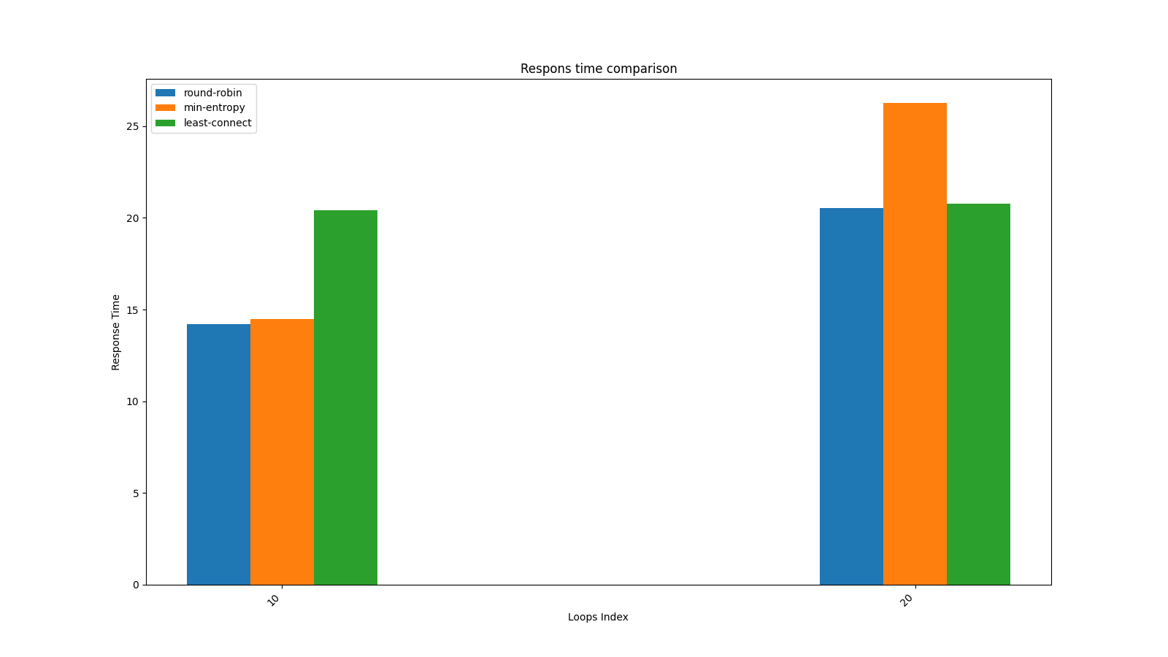
Result

Slide 13
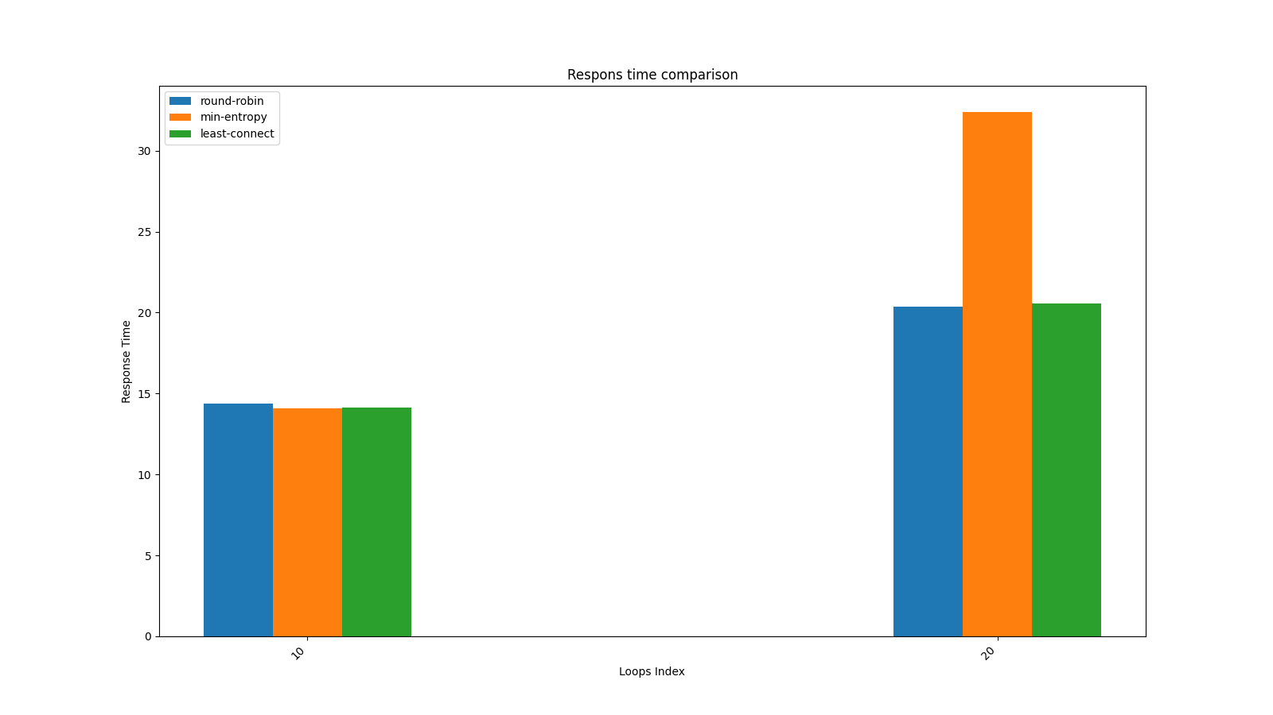
Result

