Slide 1

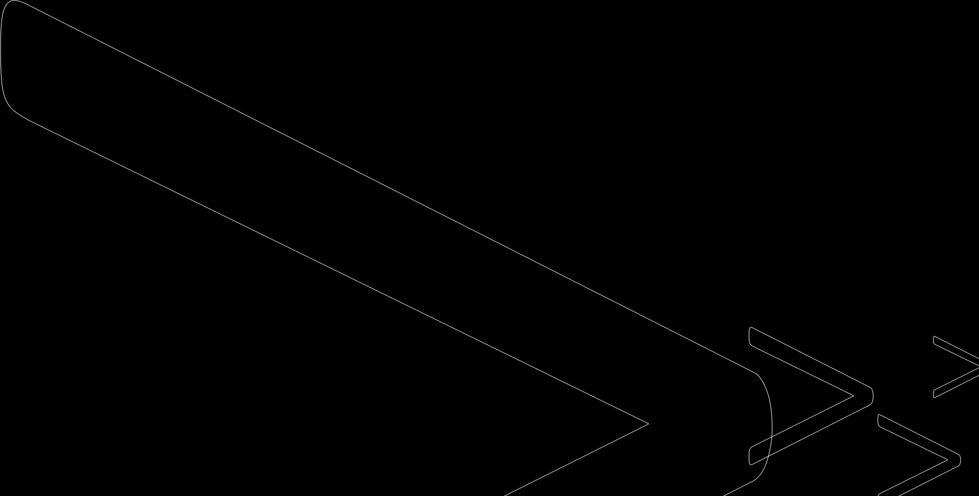
Optimization of Neural Networks
z
Daniel Pająk
Przemysław Świtecki
Patryk Pietranek
Filip Wawrzyniak

Slide 2
Task description
The goal of our project is to create convolutional neural network which recognize sign language and to compare result of traditional aproach with binarization. We took "Sign Language MNIST" from kaggle.com as a dataset to learn our network. This set contains 27,455 training data and 7172 testing data. Every input data is 28x28 pixel image with grayscale values between 0-255.

Slide 3
Team Structure
Filip Wawrzyniak – implementation of neural network, part "Our model" in Latex paper, creating github repository
Patryk Pietranek – implementation of binarization, testing network, part "Test" in Latex paper, preparing presentations
Daniel Pająk - part "Conclusions" in Latex paper, preparing presentations
Przemysław Świtecki - rest of Latex paper, editing text

Slide 4
What are Convolutional
Neural Networks?
Convolutional Neural Networks are very similar to ordinary Neural Networks. The basic construction of these networks are almost the same, they are made up of neurons and perfom same tasks. The main diffrence is that CNNs take images as an input.

Slide 5

Why use the binarization?
To allow use of CNNs on wearable devices.
To improve speed of computation.
To save time and energy.

Slide 6
Types of binarization
Binarization of Input Data
Binarization of Weights
Binarization of Activations

Slide 7

Binarization by thresholding
The idea is to divide input into parts containing less data. First step is to set threshold ranges. Next for every pixel, the same threshold value is applied. If the pixel value is smaller than the threshold, it is set to 0, otherwise it is set to a maximum value. Then another threshold range is taken and proccess is repeated.

Slide 8

Binarization by thresholding
In our implementation to threshold input we used OpenCv library. For example, we set the ranges of threshold to [0;70], [71;150] and [151; 255]. In python black is represented as violet and white as yellow. Example output:

Slide 9
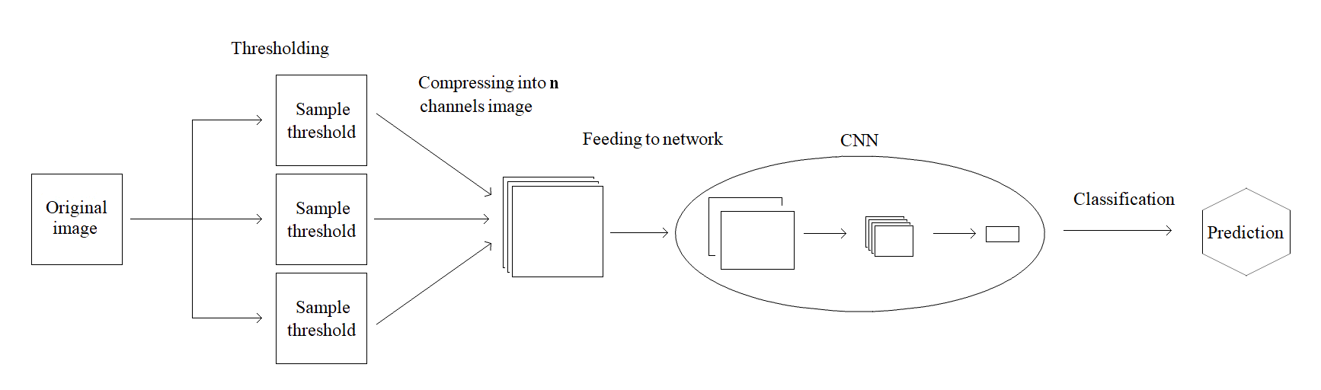
Proposed model of our implementation
z

Slide 10
Test results
Threshold ranges | Accuracy
Original | 94,9%
[0,150,255] | 90,3%
[0,200,255] | 62,5%
[0,150,170,255] | 92,7%
[0,150,170,200,255] | 91,7%
[0,90,150,170,255] | 94,8%
[0,90,150,170,210,255] | 95,6%
[0,150,170,190,210,230,255] | 93,4%
[0,90,120,150,180,210,230,255] | 94,7%

Slide 11
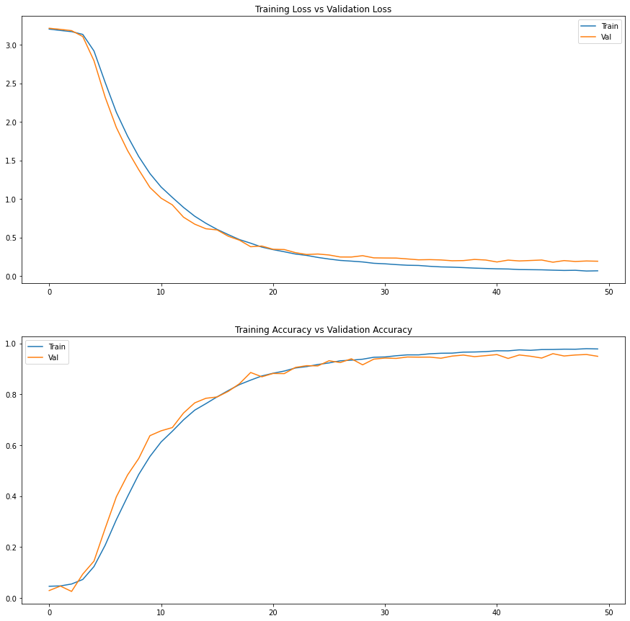
Diagram of original results

Slide 12
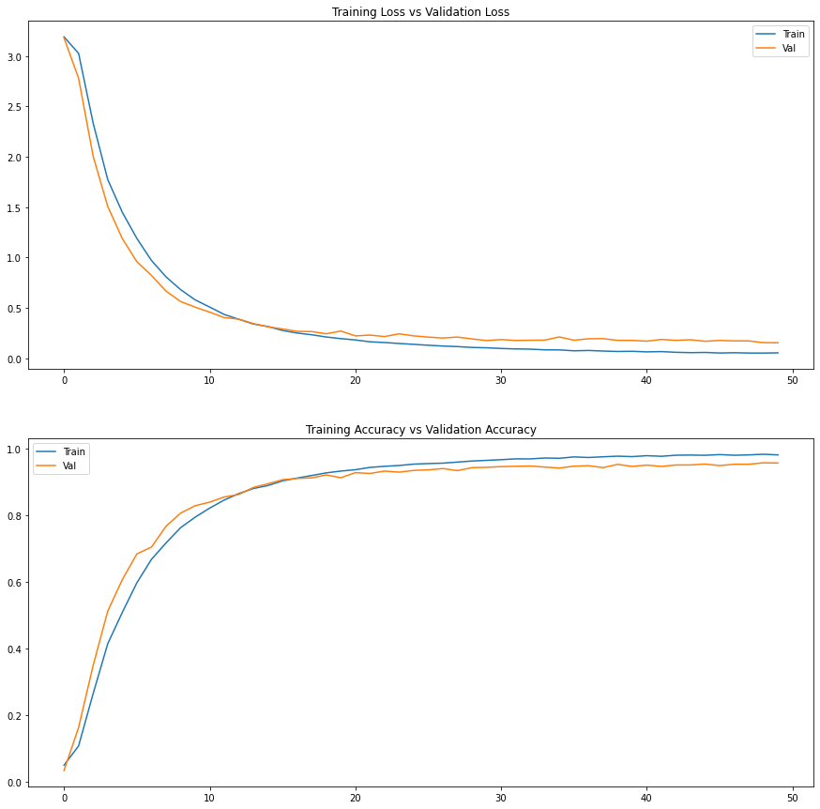
Diagram of best results
We received the best results for 5 thresholds with ranges [0,90,150,170,210,255].

Slide 13
Problems
Problems with merging thresholding images
We had to use Google Colaboratory due to no available high quality GPU's
Limitted RAM capacity on Google Colaboratory
Long time spedning on testing due to slow GPU's

Slide 14
Conclusions
To reach the best results, we observed that the network should not be learned with too many thresholds and the ranges should be quite small. To sum up binarization by thresholding could improve speed of training network and the results are very promising. Accuracy was very close to original one and in one case accuracy was even higher.

Slide 15
Thank you for your attention

