Slide 1

IQOO HACKATHON 2026 · HYDERABAD CITY BATTLE
Chetaka
The on-device scam shield that follows the call into the payment app.
TRACK · FINTECH & COMMERCE
FRAUD PREVENTION
TEAM MATRIX · MAHATMA GANDHI INSTITUTE OF TECHNOLOGY
Stephen Raj
Team lead · Android & call pipeline
ystephenraj24@gmail.com
Pranav
On-device AI & scam dataset
pranavbaddam17@gmail.com
Sujit Reddy
Product, UX & demo
sujitreddy78@gmail.com

Slide 2

PROBLEM STATEMENT
Digital-arrest scams turn one phone call
into a UPI transfer within minutes.
02 / 10
2,41,537
Digital-arrest cases in India, 2022–2025
₹3,012 cr
Lost to those cases in the same period
46%
Of operations run from Cambodia, Myanmar and Laos
WHERE THE FRICTION IS
01
Protection looks at the wrong thing
Caller-ID apps judge who is calling. Scammers rotate clean numbers and pass every check.
02
Protection stops at the wrong moment
Call warnings end when the call ends. The money moves minutes later, inside the payment app.
03
Protection speaks the wrong language
Scam calls in Hyderabad mix Telugu, Hindi and English. Most tools understand English only.
WHO GETS HURT
Parents at home and first-time UPI users — people who trust authority, are isolated in the moment, and are pushed to act before they can check with anyone [4][6].
Source: MHA and I4C data cited by Chetry (2026), Observer Research Foundation [7]
CHETAKA
FINTECH & COMMERCE · FRAUD PREVENTION

Slide 3
CASE STUDY · THIS ALREADY HAPPENED
₹24 crore, 26 transfers, 73 days of fear.
03 / 10
BENGALURU · FEBRUARY–APRIL 2026
Lakshmi Ramamurthy, 74
Targeted after a property sale. Callers posing as CBI and Enforcement Directorate officers kept her under “digital arrest” from 10 February to 24 April 2026.
The call
Impersonated federal investigators; threatened arrest and asset seizure.
The pressure
Weeks of daily check-ins. She told nobody — isolation is the tactic.
The money
₹24 crore moved in 26 transactions to 23 mule accounts across 10 banks.
The end
Police intervened on 24 April, saving ₹3 crore. Six arrested; ₹5.5 crore recovered.
Source: The Federal, 25 May 2026 [9]
HOW MANY PEOPLE FACE THIS
2,41,537
Digital-arrest cases reported in India, 2022–2025
₹3,012 cr
Lost in those cases (Ministry of Home Affairs data)
₹1.25 lakh
Average loss per reported case (derived from the two MHA figures)
6,998
Indians rescued from scam compounds abroad, 2022–2025
WHO IS TARGETED
— Retirees holding one large, recently liquid sum.
— First-time digital payment users who trust authority.
— People alone at home, told to keep the call secret.
— 46% of the operations run from Cambodia, Myanmar and Laos.
Figures as cited by Chetry (2026), Observer Research Foundation [7]
WHERE CHETAKA WOULD HAVE STEPPED IN
Transaction 1. An unknown number, a long call, then a banking app — the payment guard fires before the first rupee moves, and her son is alerted the same minute.
CHETAKA
FINTECH & COMMERCE · FRAUD PREVENTION

Slide 4
PROPOSED SOLUTION
Warn during the call. Pause the payment after it.
04 / 10
One shield across the whole scam path — call, payment, family.
UNDERSTANDS
What the caller says, in Telugu, Hindi and English — on the phone.
INTERVENES
Before the money moves — the payment guard needs no call audio.
INVOLVES FAMILY
A trusted person is alerted at critical risk, in real time.
1 · DURING CALL
Warn mid-call
1. Unknown number calls.
2. Tap speaker: live listening needs speakerphone.
3. On-device transcript scored live.
4. High risk: full-screen alert + haptics.
2 · AFTER CALL
Pause the payment
1. Call ends; length and caller kept.
2. UPI or bank app opens within 15 min.
3. 10-second pause screen.
4. One tap to skip if the payee is known.
5. Skip reason logged: known person, delivery, cab.
3 · FAMILY
Bring family in
1. Risk reaches critical.
2. Paired family phone notified.
3. One tap to call back.
4. Opt-in per contact; no audio shared.
CHETAKA
FINTECH & COMMERCE · FRAUD PREVENTION

Slide 5
ON-DEVICE & AI ARCHITECTURE
Three AI tiers on the phone. Zero cloud AI calls.
05 / 10
PHONE SIGNALS
TIER 0 · ALWAYS ON
TIER 1 · RISK ≥ 20
TIER 2 · RISK ≥ 60
PHONE ACTIONS
Voice · speaker only
MediaRecorder VOICE_RECOGNITION
CPU
Offline speech-to-text
Android SpeechRecognizer
SNAPDRAGON NPU
Whisper (open-source)
Code-mixed Telugu · Hindi · English transcription [1]
Risk engine
Explainable 0–100 score with reasons
Alert + haptics
Overlay over the call
Telephony
Call state, caller, duration
Payment pause
10-second guard, one-tap skip
CPU
Rules & phrases
Unknown caller, call length, multilingual scam phrases
SNAPDRAGON NPU
Scam classifier
Small transformer, LiteRT + Qualcomm NPU delegate
ON-DEVICE SLM · STRETCH
Gemma 3 1B
Explains the scam tactic in the user's language
App usage
UPI / bank app in foreground
Family alert
Paired phone notified
ON-DEVICE VS CLOUD
FALLBACK LADDER
— NPU loads: full tiers, latency shown on screen.
— NPU fails: models on GPU or CPU.
— Models fail: rules + phrases; all flows still work.
PHONE HARDWARE USED
Snapdragon NPU · Microphone · Haptics · Telephony · Overlays · Camera (QR check)
HOW WE GET CALL AUDIO
No app gets the downlink stream. We record the room on speakerphone (MediaRecorder, VOICE_RECOGNITION). AccessibilityService rejected — Play policy risk. CallScreeningService is metadata only, so it feeds the guard, not the transcript.
Need | On-device | Cloud API
Private call audio | Never leaves phone | Uploaded
Mid-call latency | No network hop | Network-bound
Weak signal areas | Works offline | Fails
Running cost | Zero per call | Per request
CHETAKA
FINTECH & COMMERCE · FRAUD PREVENTION

Slide 6
TECHNICAL STACK
Native Android. Local AI runtime. No backend for AI.
06 / 10
MOBILE PLATFORM
Native Android
Direct access to telephony, overlays and the NPU.
Kotlin 2.0 · Language
Jetpack Compose · UI and overlays
Coroutines + Flow · Real-time pipeline
Foreground Service · Listening during calls
minSdk 29 · targetSdk 35 · Android 15 on the loaner
Android Studio + Gradle KTS · Build and profiling
JUnit + Compose UI test · Metrics harness
LOCAL AI RUNTIME
On-device models
Open-source models, quantised for the phone.
LiteRT + QNN delegate · Classifier on NPU
whisper.cpp · Whisper small · Speech-to-text
MediaPipe LLM Inference · Gemma 3 1B (stretch)
SpeechRecognizer · Offline fallback
int8 quantisation · Classifier ~25 MB · Whisper ~180 MB
Gemma 3 1B int4 · ~550 MB, loaded only at tier 2
All weights shipped in APK · No model download at runtime
DATA & SERVICES
Local first
Only the family alert touches the network. Office Kit mirrors the debug HUD — per-segment inference latency in ms and the live risk score — without interrupting the call.
Room + SQLCipher · Encrypted local store
TelephonyManager · Call state
UsageStatsManager · Payment app watch
Firebase Cloud Messaging · Family alert relay
iQOO Office Kit · Debug HUD mirrored to laptop
ANDROID PERMISSIONS — EACH TIED TO ONE FEATURE
READ_PHONE_STATE
Call start and end
READ_CONTACTS
Unknown-number check
RECORD_AUDIO
Listening on speaker
PACKAGE_USAGE_STATS
Payment app detection
SYSTEM_ALERT_WINDOW
Alert and pause overlays
FOREGROUND_SERVICE_MICROPHONE
Background listening
POST_NOTIFICATIONS
Alerts on Android 13+
VIBRATE
Haptic warning
CHETAKA
FINTECH & COMMERCE · FRAUD PREVENTION

Slide 7
KEY FEATURES & INNOVATION
Others protect the call. Chetaka protects the money.
07 / 10
Payment-app guard — our core innovation
Links a risky call to the payment app opened after it, and pauses before money moves. Content-independent, so it still works when the scam script fools a classifier [5]. Every skip is logged with a reason, so the guard learns.
Capability | Truecaller | Google scam detect | Bank SMS alert | Chetaka
Judges who is calling | Yes | Yes | No | Yes
Understands what is said | No | Varies | No | Yes
Telugu · Hindi · English mix | No | Limited | No | Yes
Guards payment app after call | No | No | No | Yes
Acts before money moves | Partly | Partly | After | Yes
Real-time family alert | No | No | No | Yes
Fully on-device AI | Varies | Varies | — | Yes
Live vernacular detection
Telugu, Hindi and English code-mix, understood on-device mid-call.
Explainable risk score
Every alert names its reason: authority, OTP request, urgency, isolation.
Family Shield
Real-time alert to a trusted person. Opt-in per contact, no audio shared.
Private by design
No audio stored, no server AI, one-tap delete.
RESEARCH GAP
Voice-phishing classifiers judge the transcript alone, and LLM-written scam scripts cut their accuracy by more than 30% [5]. Chetaka pairs AI detection with a second check at the payment step.
CHETAKA
FINTECH & COMMERCE · FRAUD PREVENTION

Slide 8
HACKATHON IMPLEMENTATION PLAN
A working prototype on the iQOO phone in 30 hours.
08 / 10
MINIMUM VIABLE PROTOTYPE
Must work in the demo
— Unknown-call detection and call log
— Payment-app guard with pause + skip log
— Live transcription + scam scoring
— In-call alert with haptics
— Family alert on a second phone
Stretch goals
— Scam classifier on the NPU, latency on screen
— Gemma 3 1B explanation in Telugu / Hindi
— Camera UPI-QR check
30-HOUR BUILD ORDER
0–5 h Call monitor, contact check, local store
5–9 h App watcher + payment pause — core innovation first
9–14 h Listening service, speech-to-text, risk engine
14–17 h In-call alert and haptics
17–20 h Family alert and pairing
20–24 h NPU classifier, Whisper, SLM — stretch
24–30 h Test set, polish, demo rehearsal
LIVE DEMO · 3 PHONES
1. Phone B calls Phone A as “police”.
2. Chetaka alerts mid-call on Phone A.
3. Repeat without speaker; Phone A opens a UPI app.
4. Pause screen holds the payment; skip shown.
5. Phone C gets the family alert; debug HUD mirrored to the companion screen via Office Kit.
HONEST EVALUATION
Measured live on scripted calls, both languages. Recall on scam calls, false-positive rate on normal calls, and median alert latency. Targets: recall ≥ 0.80, false positives ≤ 10%, alert under 3 s. A wrong block costs more than a missed one, so the false-positive target is the hard one.
20
scam calls
20
normal calls
3
metrics
CHETAKA
FINTECH & COMMERCE · FRAUD PREVENTION

Slide 9
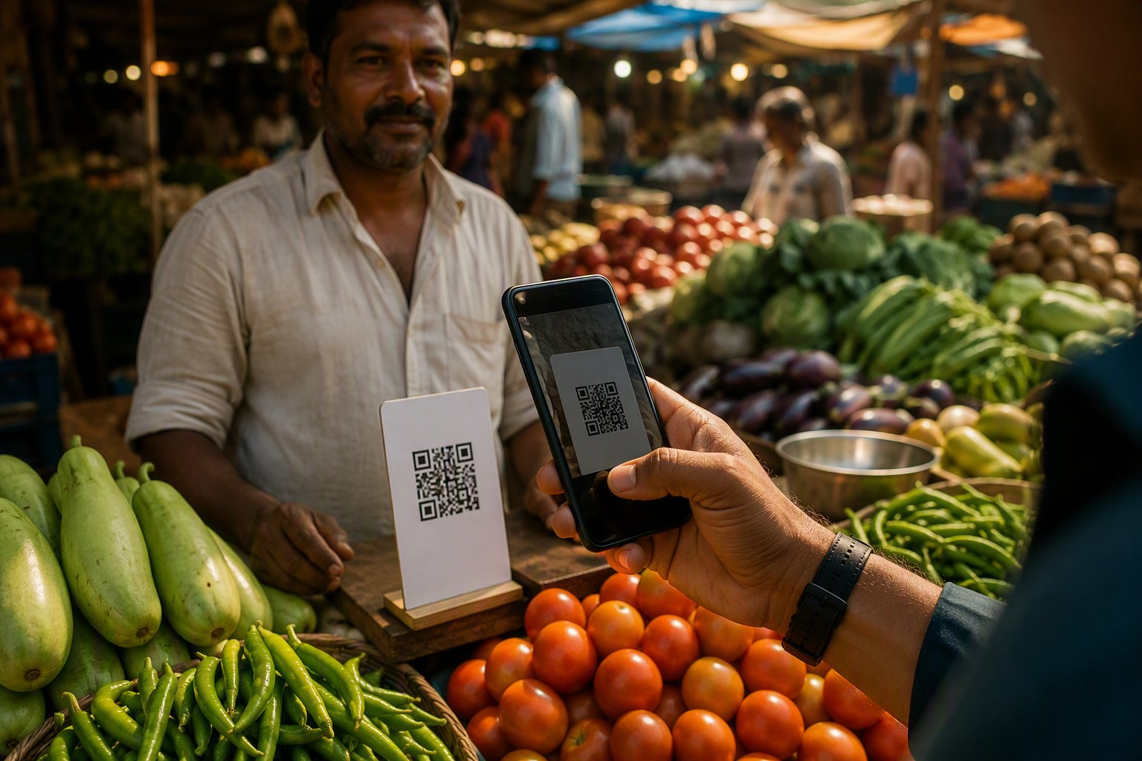
UTILITY & IMPACT
Buildable today. Useful to millions of families.
09 / 10
01 Feasibility
— Every signal uses public Android APIs.
— All AI models are open-source.
— The core guard needs no AI model.
— Fallback ladder keeps flows working.
02 Benefits
— Stops payment before the loss.
— Payment guard works with speakerphone off.
— Private: nothing leaves the phone.
— Zero cloud cost at any scale.
03 Target users
04 Why Chetaka should be selected
— Practical utility: acts at the exact moment money is lost.
— Novel: the only approach guarding call-to-payment end to end.
— Phone-first: voice, telephony, haptics and NPU AI on-device.
— Feasible: model-free core first, AI tiers layered on top.
— Parents at home receiving impersonation calls.
— First-time UPI users in tier-2, tier-3 and rural India.
— Adult children protecting family remotely.
— Partners: phone makers, banks, telcos, cyber cells.
CHETAKA
FINTECH & COMMERCE · FRAUD PREVENTION

Slide 10
REFERENCES
Research and data behind Chetaka.
10 / 10
[1] Radford, A., Kim, J. W., Xu, T., Brockman, G., McLeavey, C., & Sutskever, I. (2023). Robust speech recognition via large-scale weak supervision. ICML, PMLR 202.
Open source
[2] He, Y., Sainath, T. N., Prabhavalkar, R., McGraw, I., Alvarez, R., et al. (2018). Streaming end-to-end speech recognition for mobile devices. arXiv:1811.06621.
Open source
[3] Kim, K., Lee, K., Gowda, D., Park, J., Kim, S., et al. (2019). Attention based on-device streaming speech recognition with large speech corpus. IEEE ASRU 2019.
Open source
[4] Shang, Y., Wu, Z., Du, X., Jiang, Y., Ma, B., & Chi, M. (2022). The psychology of the internet fraud victimization of older adults: A systematic review. Frontiers in Psychology, 13.
Open source
[5] Li, W., Manickam, S., Chong, Y.-W., & Karuppayah, S. (2025). Talking like a phisher: LLM-based attacks on voice phishing classifiers. EAI ICDF2C 2025. arXiv:2507.16291.
Open source
[6] Han, S. D., Barnes, L. L., Leurgans, S., Yu, L., Stewart, C. C., Lamar, M., et al. (2021). Susceptibility to scams in older Black and White adults. Frontiers in Psychology, 12, 685258.
Open source
[7] Chetry, S. (2026, July 18). Digital arrest scams and the limits of domestic enforcement. Observer Research Foundation, Expert Speak.
Open source
[8] NITI Aayog. (2025). Digital arrest: The modern day cyber scam. Government of India.
Open source
[9] The Federal. (2026, May 25). Bengaluru digital arrest scam: Elderly woman loses Rs 24 crore, six held.
Open source
Thank you
CHETAKA · THE SCAM SHIELD THAT FOLLOWS THE CALL
CHETAKA
FINTECH & COMMERCE · FRAUD PREVENTION

