Slide 1

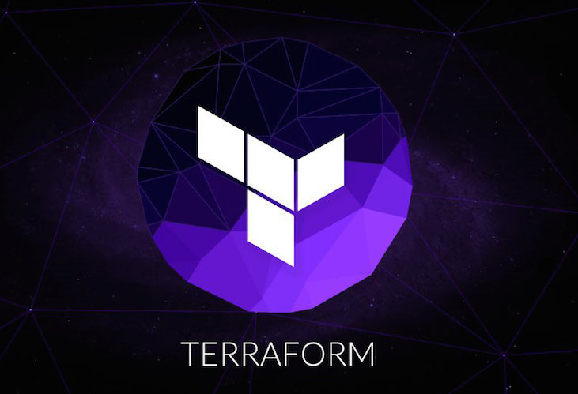
Terraform on Azure – Why and how?
Vladimir Stefanovic, Microsoft Azure MVP, Cloud Architect

Slide 2

Who am I
vladimir@Azure:~$ az speaker show –output json
{
"speakerName": "Vladimir Stefanovic",
"location": „Amsterdam, Netherlands",
"titles": "Microsoft MVP, MCT RL",
"position": „Azure Cloud Architect @Cognizant",
„community": „Azure Serbia UG, AzureSaturaday.rs",
"twitter": "@wladinho31"
}

Slide 3
What the Terraform is and why we need it?
Terraform is a tool for building, changing, and versioning infrastructure
One of the most popular IaC tools for infrastructure deployment and management
Terraform is platform agnostic which is helpful in multi-cloud environments
Infrastructure deployment is easy and efficient, while code is reusable

Slide 4
Terraform Compoments
Terraform executable
HashiCorp distributes Terraform as a binary package that needs to be installed
Terraform files
Described infrastructure can be divided into more files
Terraform plugins
Expose an implementation for a specific service or provisioner
Terraform state
Storing state about managed infrastructure and configuration

Slide 5
Terraform vs. ARM Templates
HCL
Variables
Local variables
Resources
Functions
Modules
Automatic dependency
JSON
Parameters
Variables
Resources
Functions
Nested Templates
Explicit Dependency

Slide 6
Terraform on Azure
Azure Providers
Azure
Azure Stack
Azure Active Directory
Authentication
Azure CLI
Service principal with client secret
Service principal with client certificate
Managed Service Identity

Slide 7

Terraform Workflow
Write
Init
Apply
Plan

Slide 8
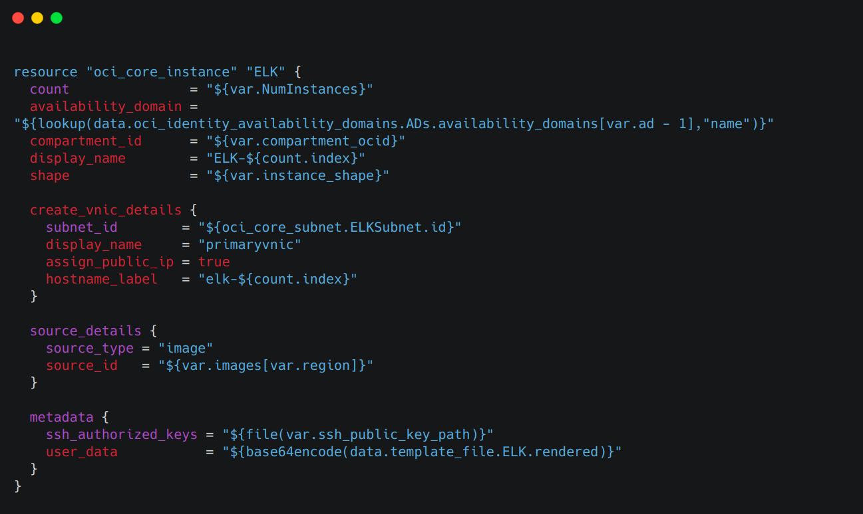
Demo time!

Slide 9
Useful Links
Get Started - Azure | Terraform - HashiCorp Learn
Using Terraform with Azure | Microsoft Docs
Ned Bellavance’s courses on Pluralsight

