Slide 1

KAKO PODIĆI DOSTUPNOST APLIKACIJE U AZURE?
Vladimir Stefanović, Azure MVP, MCT, MCT RL

Slide 2

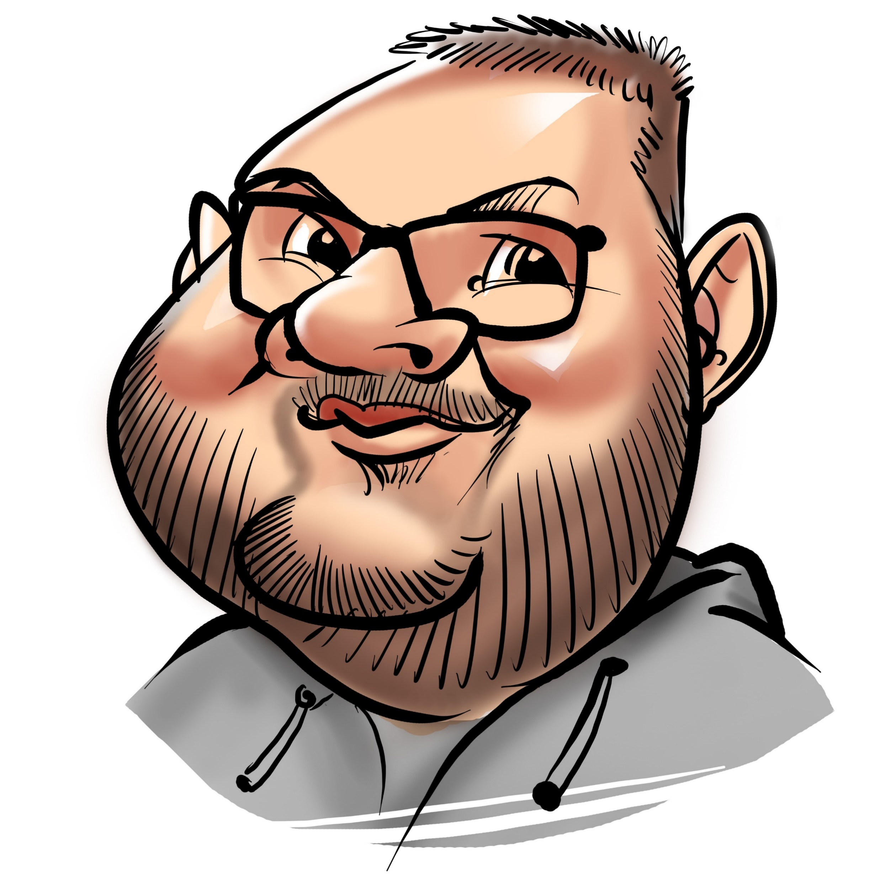
About speaker
vladimir@Azure:~$ az speaker show
{
"speakerName": "Vladimir Stefanovic",
"location": "Belgrade, Serbia",
"titles": "Microsoft Azure MVP, MCT Regional Lead",
"position": "Cloud Solution Architect @SuperAdmins",
"twitter": "@wladinho31"
}

Slide 3




Case 1 – An application that requires custom dependencies
Old school mindset

Slide 4
Case 1 – An application that requires custom dependencies
Old school mindset on steroids
Old school mindset

Slide 5




Case 2 – Cloud native application

Slide 6
Case 2 – Cloud native application

Slide 7
Case 2 – Cloud native application

Slide 8



Slide 9

HVALA NA PAŽNJI!

