Slide 1
实验三 汇编程序设计
2023春季
zjx@ustc.edu.cn
https://docs.oracle.com/en/java/javase/15/index.html(JDK)

Slide 2
实验目标
理解RISC-V常用32位整数指令功能
掌握RISC-V简单汇编程序设计，以及下载测试数据(COE文件) 的生成方法
熟悉RISC-V汇编程序仿真运行环境和调试基本方法

Slide 3
实验内容
设计汇编程序，自动测试以下指令功能
add, addi, sub, auipc, lui
and, or, xor
slli, srli, srai
lw, sw
beq, blt, bltu, jal, jalr
设计汇编程序，实现可变长数组排序
数据结构：数组大小，数据元素，
数据类型：大小和元素均为32位无符号数
排序算法：算法不限，升序或降序排序

Slide 4
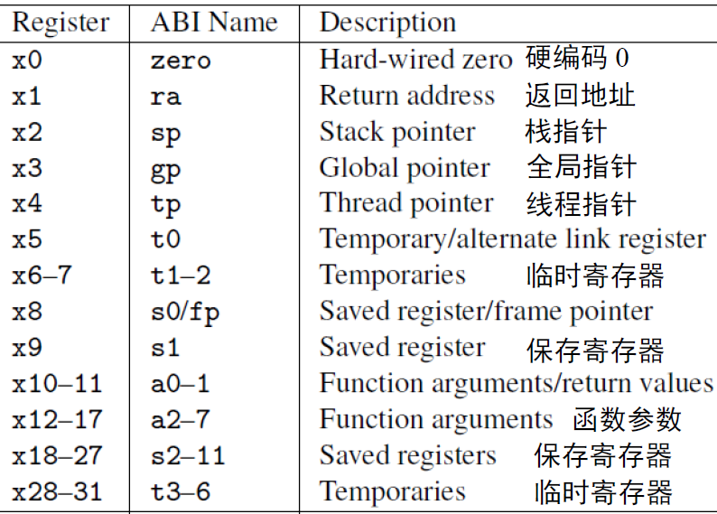
RISC-V寄存器
PC和32个通用寄存器（合称寄存器堆）
Notes:
In practice, the programmer doesn't use this notation for the registers. Though x1 to x31 are all equally general-use registers as far as the processor is concerned, by convention certain registers are used for special tasks. In assembler, they are given standardized names as part of the RISC-V application binary interface (ABI). This is what you will usually see in code listings. If you really want to see the numeric register names, the -M argument to objdump will provide them.
As a general rule, the saved registers s0 to s11 are preserved across function calls, while the argument registers a0 to a7 and the temporary registers t0 to t6 are not. The use of the various specialized registers such as sp by convention will be discussed later in more detail.

Slide 5
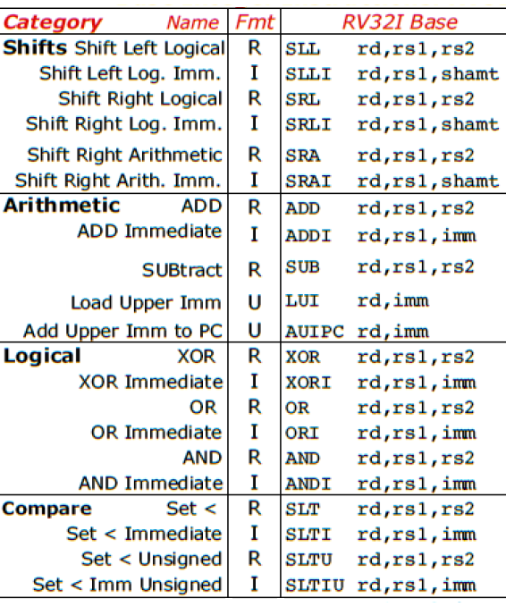
RV32I指令类型
运算类
算术：add, sub, addi, auipc, lui
逻辑：and, or, xor, andi, ori, xori
移位(shift)：sll, srl, sra, slli, srli, srai
比较(set if less than)：slt, sltu, slti, sltiu

Slide 6
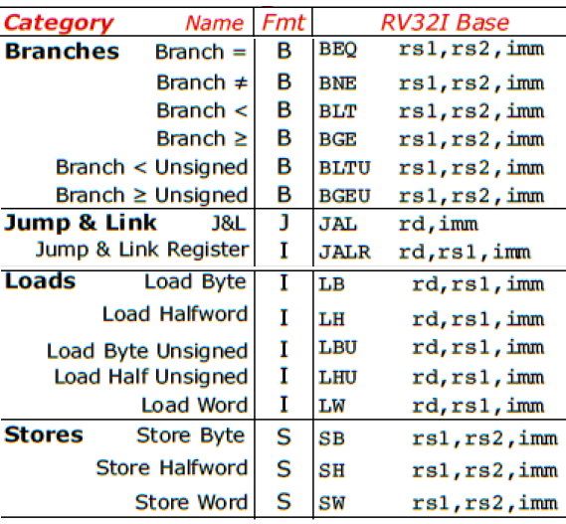
RV32I指令类型 (续)
访存类
加载(load)：lw, lb, lbu, lh, lhu
存储(store)：sw, sb, sh
转移类
分支(branch)：beq, blt, bltu, bne, bge, bgeu
跳转(jump)：jal, jalr
Notes:
RV32I provides two types of control transfer instructions: unconditional jumps and conditional branches. Control transfer instructions in RV32I do not have architecturally visible delay slots.

Slide 7
RV32I指令功能
add rd, rs1, rs2 # x[rd] = x[rs1] + x[rs2]
addi rd, rs1, imm # x[rd] = x[rs1] + sext(imm)
sub rd, rs1, rs2 # x[rd] = x[rs1] - x[rs2]
auipc rd, imm # x[rd] = pc + imm[31:12] << 12
lui rd, imm # x[rd] = imm[31:12] << 12
and rd, rs1, rs2 # x[rd] = x[rs1] & x[rs2]
or rd, rs1, rs2 # x[rd] = x[rs1] | x[rs2]
xor rd, rs1, rs2 # x[rd] = x[rs1] ^ x[rs2]
slli rd, rs1, shamt # x[rd] = x[rs1] ≪ shamt
srli rd, rs1, shamt # x[rd] = x[rs1] ≫_{𝑢} shamt
srai rd, rs1, shamt # x[rd] = x[rs1] ≫_{s} shamt

Slide 8
RV32I指令功能
lw rd, offset(rs1) # x[rd] = M[x[rs1] + sext(offset)]
sw rs2, offset(rs1) # M[x[rs1] + sext(offset)] = x[rs2]
beq rs1, rs2, offset # if (rs1 == rs2) pc += sext(offset)
blt rs1, rs2, offset # if (rs1 < _{s} rs2) pc += sext(offset)
bltu rs1, rs2, offset # if (rs1 < _{u} rs2) pc += sext(offset)
jal rd, offset # x[rd] = pc+4, pc += sext(offset)
jalr rd, offset(rs1) # t = pc + 4; pc = (x[rs1] + sext(offset)) & ~1; x[rd]=t

Slide 9
汇编指示符和伪指令
汇编指示符（Assembly Directives）
.data, .text
.word, .half, .byte, .string
.align
……
伪指令（Pseudo Instructions）
li, la, mv
nop, not, neg
j, jr, call, ret
……
参考资料：RISC-V Assembly Programmer's Manual
https://github.com/riscv-non-isa/riscv-asm-manual/blob/master/riscv-asm.md#risc-v-assembly-programmers-manual
Notes:
RISC-V Assembly Programmer's Manual
https://github.com/riscv/riscv-asm-manual

Slide 10
测试指令功能
指令功能检查
人工检查指令执行结果，正确则继续下条指令测试
或者通过程序，自动判断指令测试结果
指令测试顺序
根据待测指令与已测试指令的依赖关系，确定测试先后顺序
开始
测试第1条指令
错误
功能检查
结束
正确
测试第2条指令
… …

Slide 11
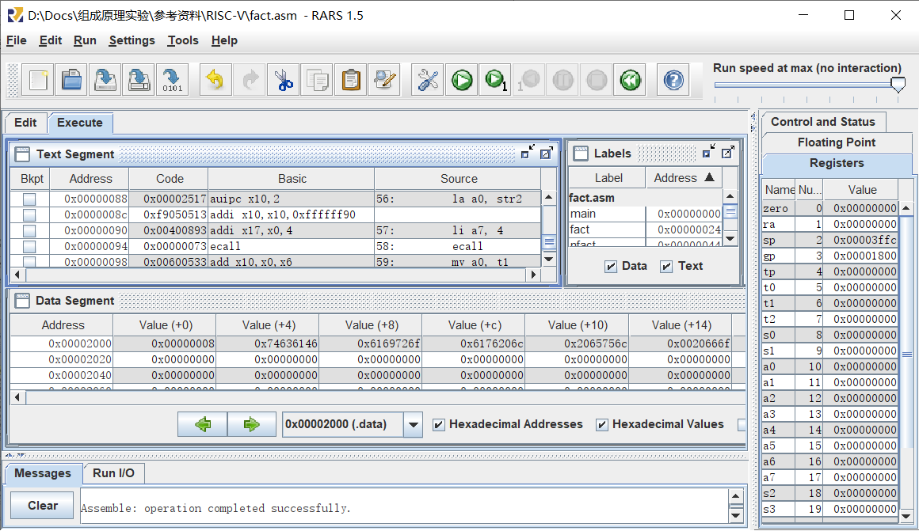
RARS
RISC-V Assembler & Runtime Simulator

Slide 12
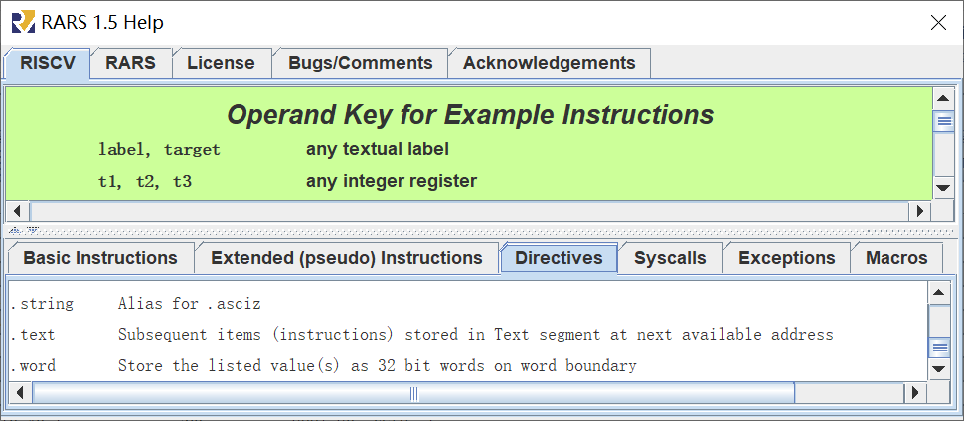
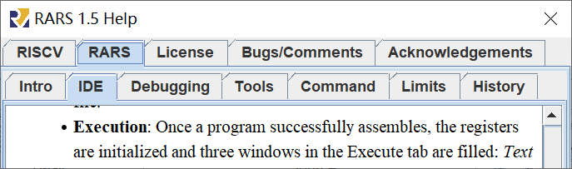
Help
RISCV：指令、伪指令、指示符、系统调用……
RARS：IDE、调试、工具……

Slide 13
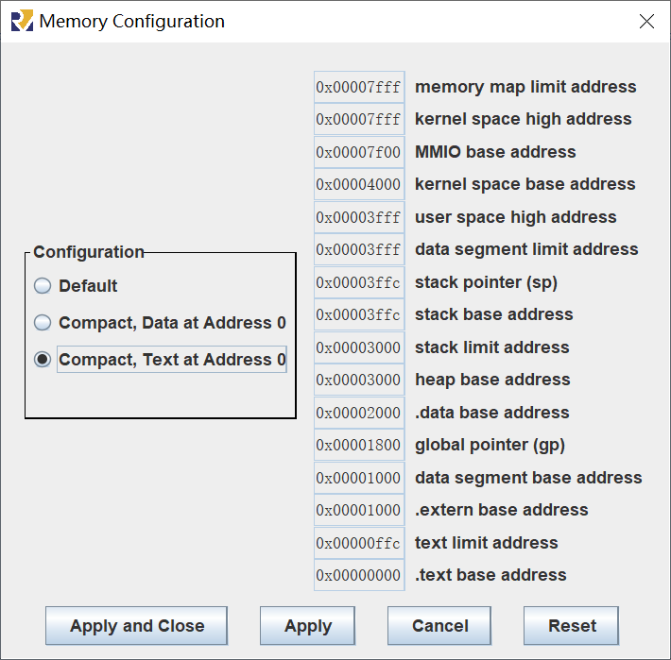
存储器配置
Setting >> Memory Configuration…
假定配置为紧凑型
代码地址：
0x0000 ~ 0xffc
数据地址：
0x2000 ~ 0x2ffc

Slide 14
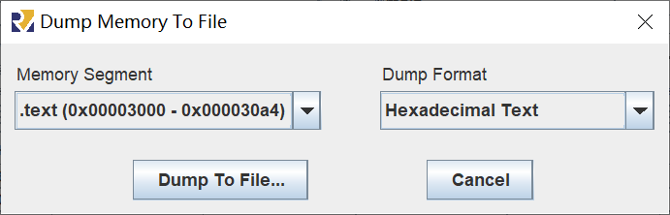
汇编程序转COE文件
配置存储器：Setting >> Memory Configuration…
汇编程序：Run >> Assemble
导出代码和数据：File >> Dump Memory…
生成COE文件：导出文本的开头添加以下两行
memory_initialization_radix = 16;
memory_initialization_vector =

Slide 15
实验步骤
熟悉RISC-V汇编程序仿真调试环境
设计汇编程序，实现自动测试前述18条的指令功能，并生成COE文件
设计汇编程序，实现数组排序，并生成COE文件

Slide 16
The End

