Slide 1
EDES 301 Classroom Data Logger Proposal
10/05/2025
Michael Wu

Slide 2
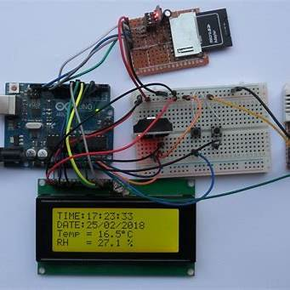
Background Information
What is being proposed?
Pictures
Links to existing projects / libraries
What improvements / additions over existing project
One press creates a timestamped CSV row with validated readings. Daily file rotation, consistent column order, and units make it usable for labs without having to edit code
Better error handling with partial rows safety
PocketLab gets rid of the delay in working on classroom experiments by making data capture quick and accessible. Students see live status on the LCD and get a timestamped CSV they can plot immediately. Instructors get consistent results across sections; students get a platform they can extend without having to stress about getting the information accurate or taking too long to code.
What is your story?

Slide 3
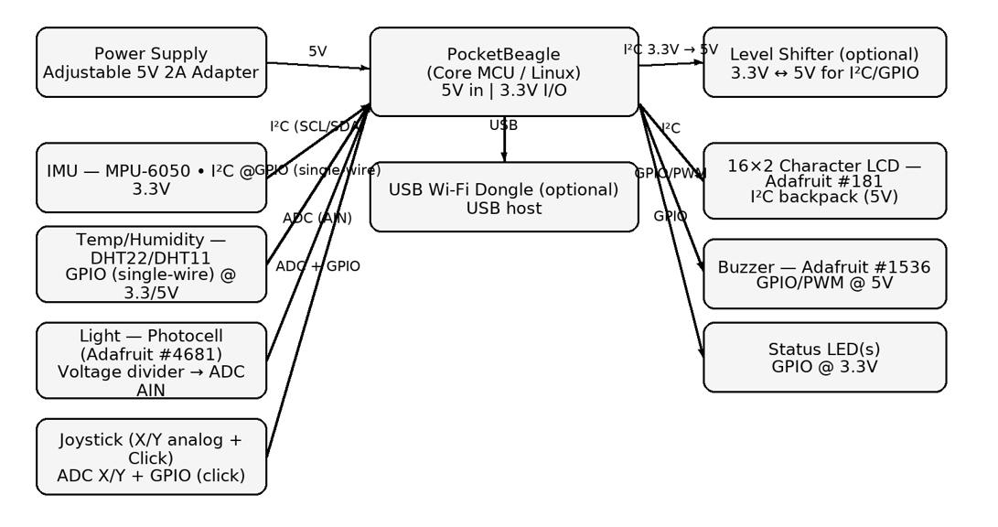
System Block Diagram
Create a System Block Diagram
Label interfaces (I2C, SPI, GPIO, etc.; You do not need to know all of the connections)
Components (part numbers if possible)

Slide 4
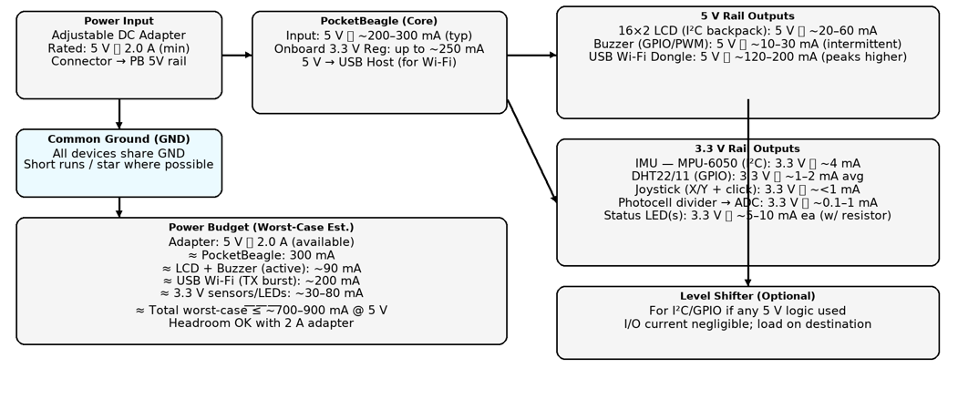
Power Block Diagram
Create a Power Block Diagram
Label voltages / currents of components

Slide 5
Components / Budget
Component | EDES301 to Buy? | Cost
LCD – 16x2 | No | 9.95
MPU | No | 2.10
Temp/Humidity | No | 1.70
Light Sensor | No | 4.50
Joysticks | No | 1.33
Buzzer | No | .95
LEDs | No | 16.99

