Slide 1
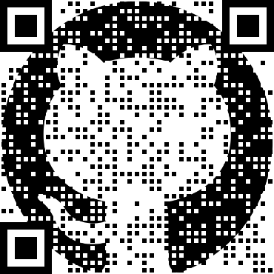
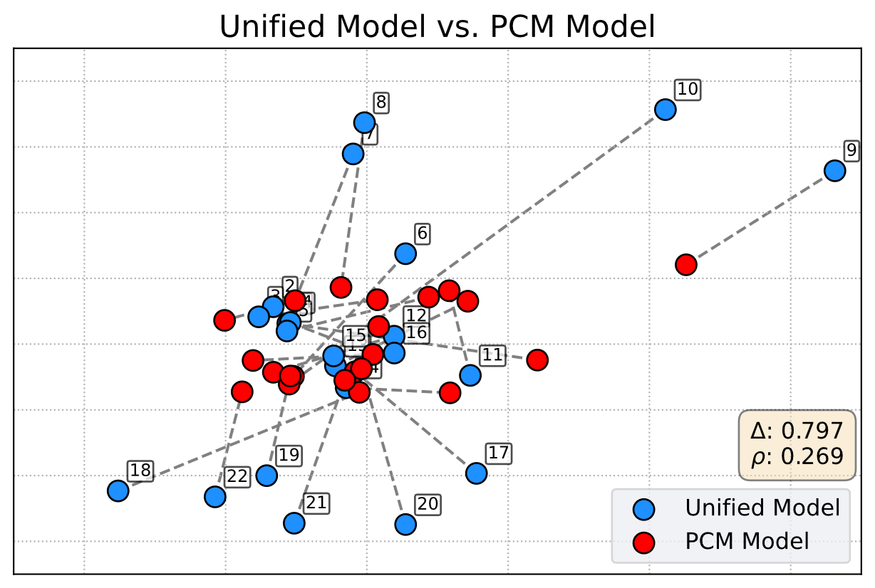
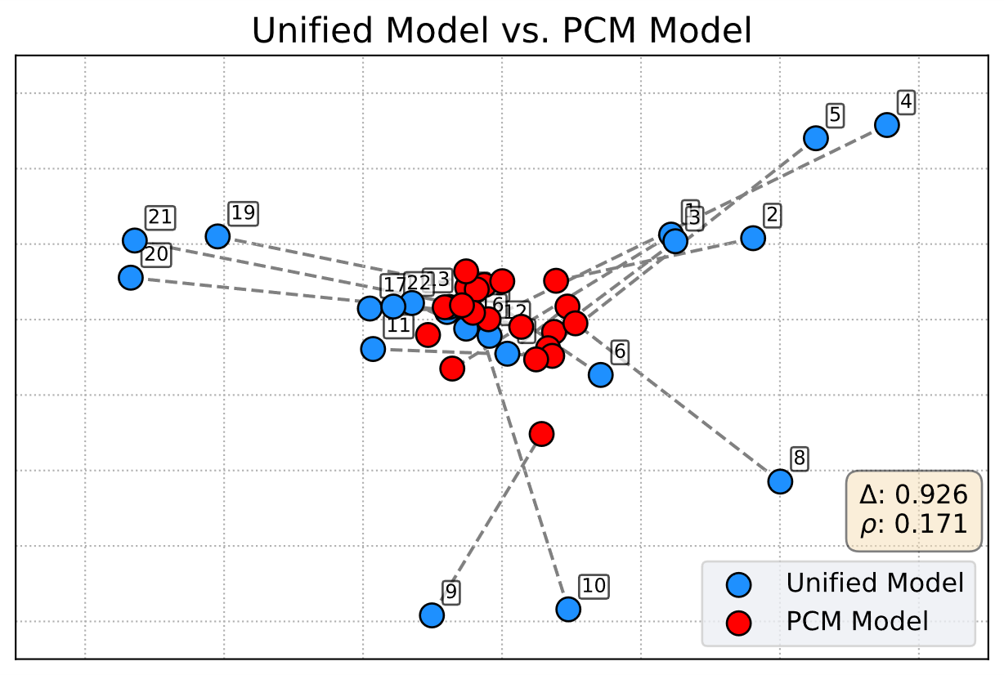
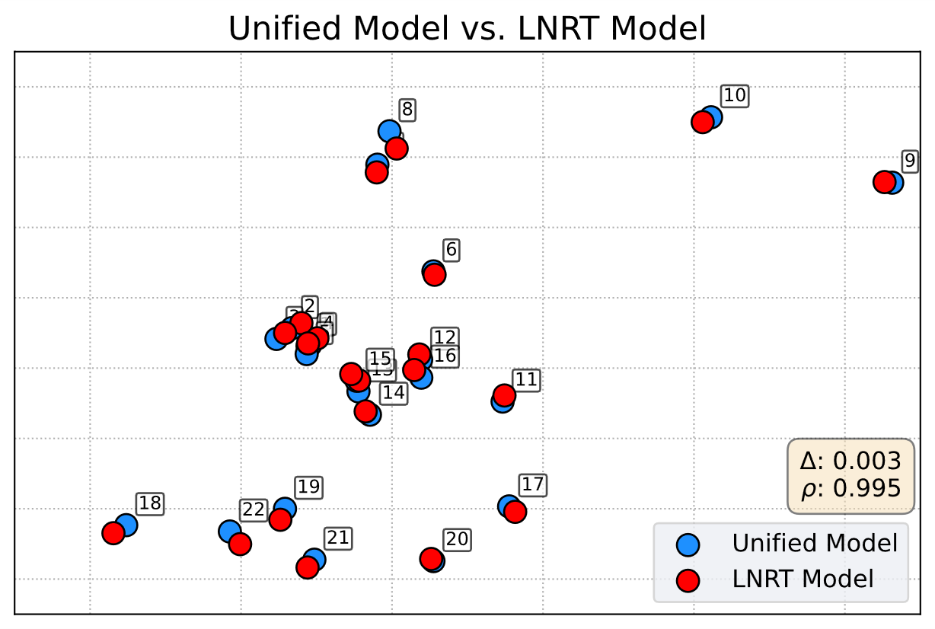
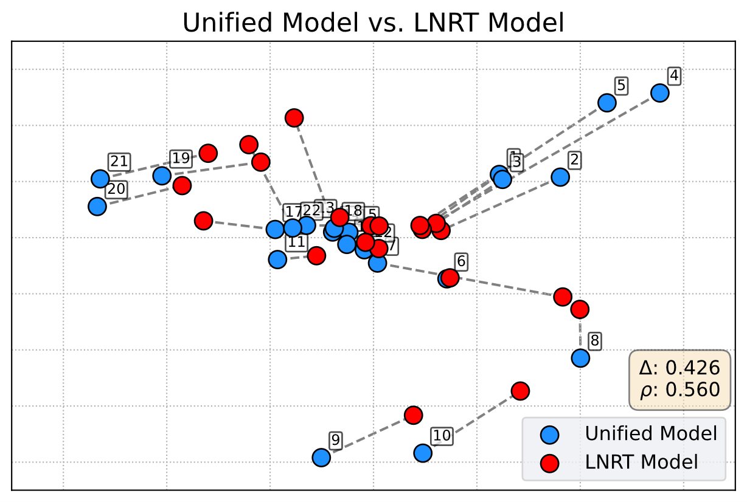
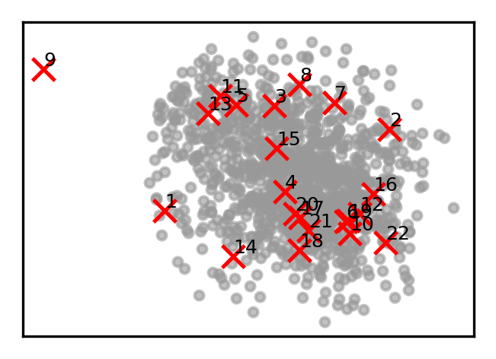
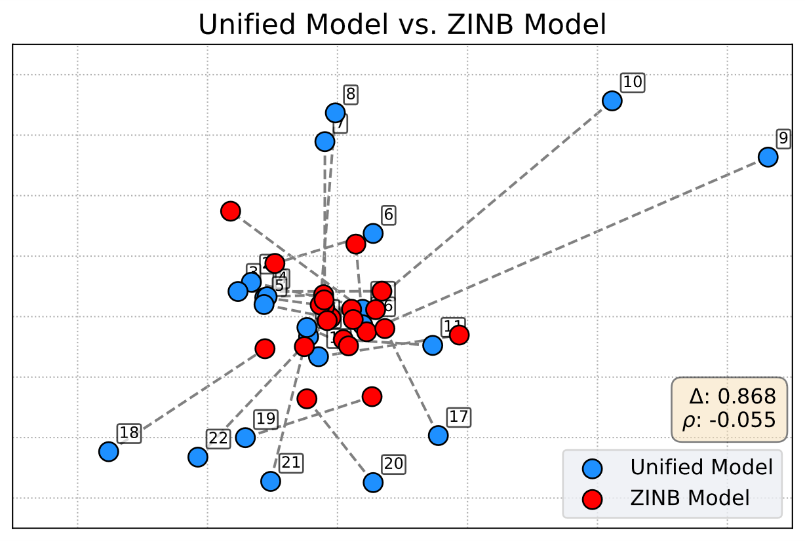
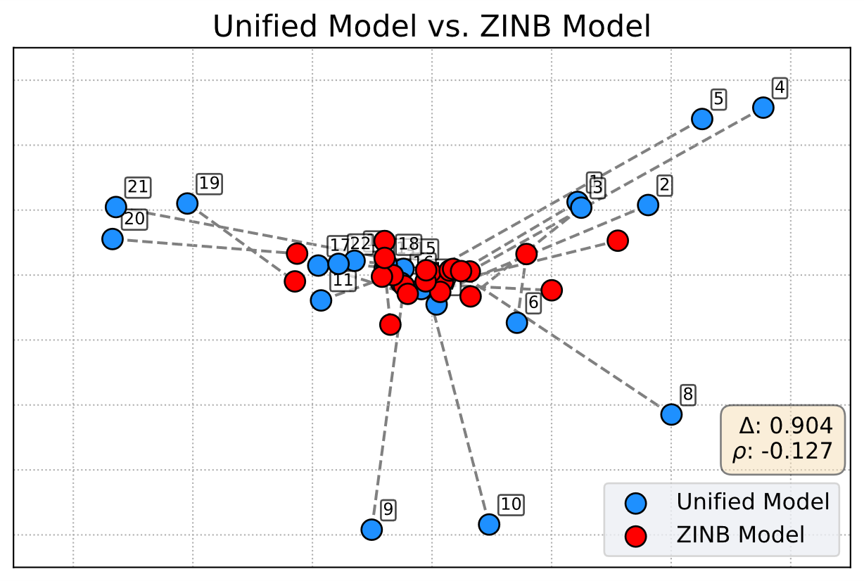
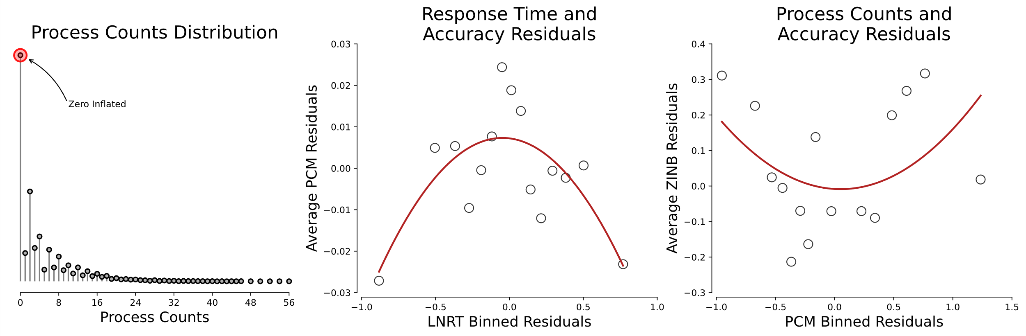
A Unified Latent Space Item Response Model for Test Security Diagnostics
William Muntean, PhD; Zhuoran Wang, PhD; and Joseph Betts, PhD, EdS, MMIS
Multi-Modal Siloes
Unified Latent Space Framework
Unified-LS Separate Gamma
Unified-LS Single Gamma
The integrity of high-stakes assessments is threatened by security breaches like item pre-knowledge and leakage.
Traditional detection methods are often siloed, analyzing item responses, response times, and computer-interaction data in isolation.
This siloed approach creates critical blind spots, as it fails to capture complex behavioral patterns that span across these multiple data streams
We introduce a novel latent space item response model that unifies these multi-modal data streams into a single, cohesive framework.
The model positions both persons and items in a shared geometric space, allowing for a holistic view of examinee behavior.
This integrated approach is specifically designed to uncover subtle person-by-item interactions, which serve as powerful diagnostic indicators of item compromise.
Unifying Modalities
Item Responses: Modeled using the Rasch Partial Credit Model (PCM), person abilities are anchored on known scale.
Response Times: Modeled with a Log-Normal Response Time (LNRT) model, capturing the characteristic speed of persons and time intensity of items.
Process Data: Interaction counts (e.g., answer changes) are modeled via a Zero-Inflated Negative Binomial (ZINB) model to handle sparse and overdispersed data.
Modeling Framework
Observed Data
Latent Trait Model
Probability of
Inclusion
Gamma
Latent Space
Item Responses
Rasch
Response Times
Log-Normal RT
True
Separate
Process Data
Zero Inflated
Negative Binomial
False
Single
Descriptive Motivation
3-gamma LS is highly congruent with the RT-only space, indicates they provide the most salient signal of local item dependencies.
Single gamma attenuates the structural alignment with the RT-only space; single parameter forced to average the strong RT dependency with the weaker signals.
Contact: William Muntean, PhD, wmuntean@ncsbn.org

