Slide 1
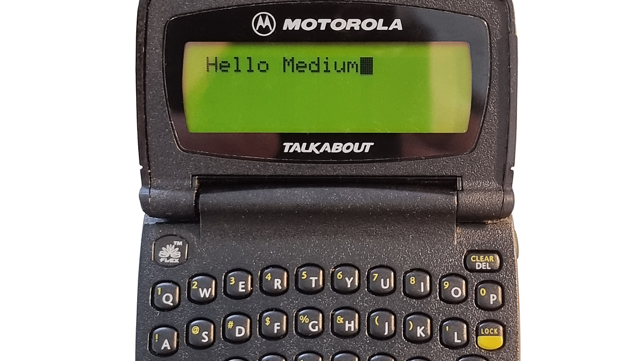
Pager Rotation Duties & DevOps
Kyle Marlia-Conner
07/05/2025
Module 7

Slide 2

What is Pager Rotation Duty?
A shared responsibility model where engineers rotate on-call to handle incidents.
Helps detect and resolve production issues quickly.
Core to DevOps culture: “You build it, you run it.”

Slide 3

Why a Shared Pager Rotation Matters
Avoids downstream Ops burnout.
Surfaces problems upstream as developers feel the impact of their code in production.
Reduces finger-pointing; improves collaboration across the value stream.

Slide 4
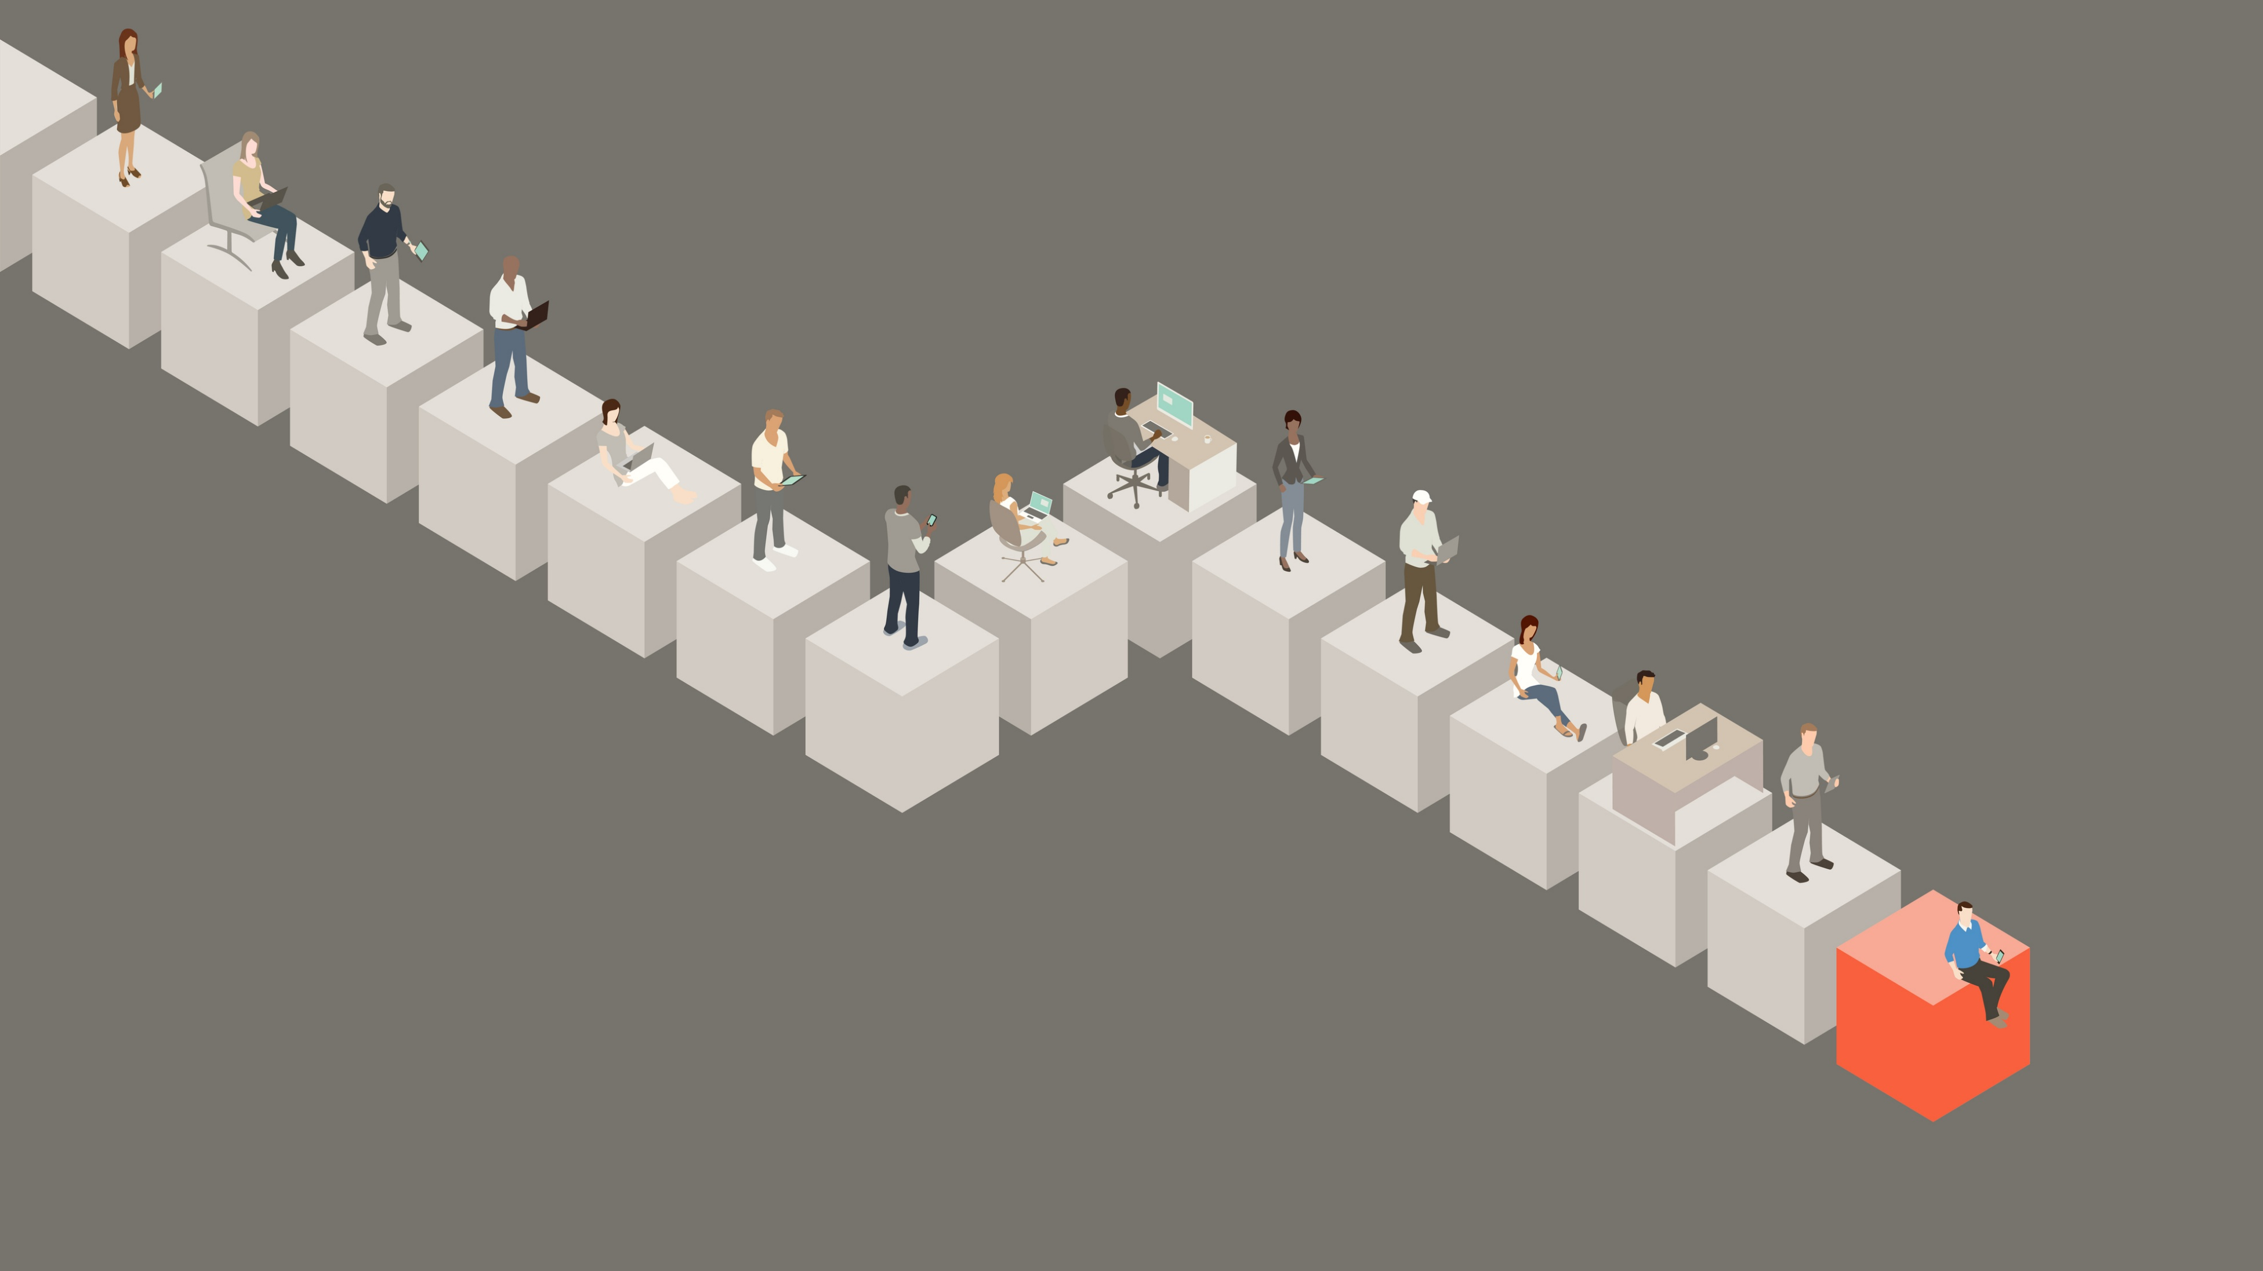
Benefits of Pager Rotation
Faster resolution of issues
Greater code quality and accountability.
Builds empathy between teams.
Aligns business goals with production realities.

Slide 5

Best Practices (from Google SRE)
Keep
Keep rotations sustainable: max 12 hours/day, limit night calls.
Minimize
Minimize alert fatigue with SLOs and alert tuning.
Review
Regularly review incidents and adjust load accordingly.
Avoid
Avoid overload with backup responders.

Slide 6

Best Practices (from Squadcast)
Define
Define escalation policies clearly.
Use
Use analytics to optimize schedules.
Encourage
Encourage post-incident reviews (blameless).
Rotate
Rotate fairly and automate reminders.

Slide 7

Real-World Implementation
Netflix: Implements a "full-cycle developer" model where engineers are responsible for building/supporting their own services, including on-call rotations.
Etsy: All engineers in on-call rotations and even developed the open-source tool Opsweekly to survey and optimize schedules
DevOps Handbook: “Feature is only done when it performs in production.”

Slide 8
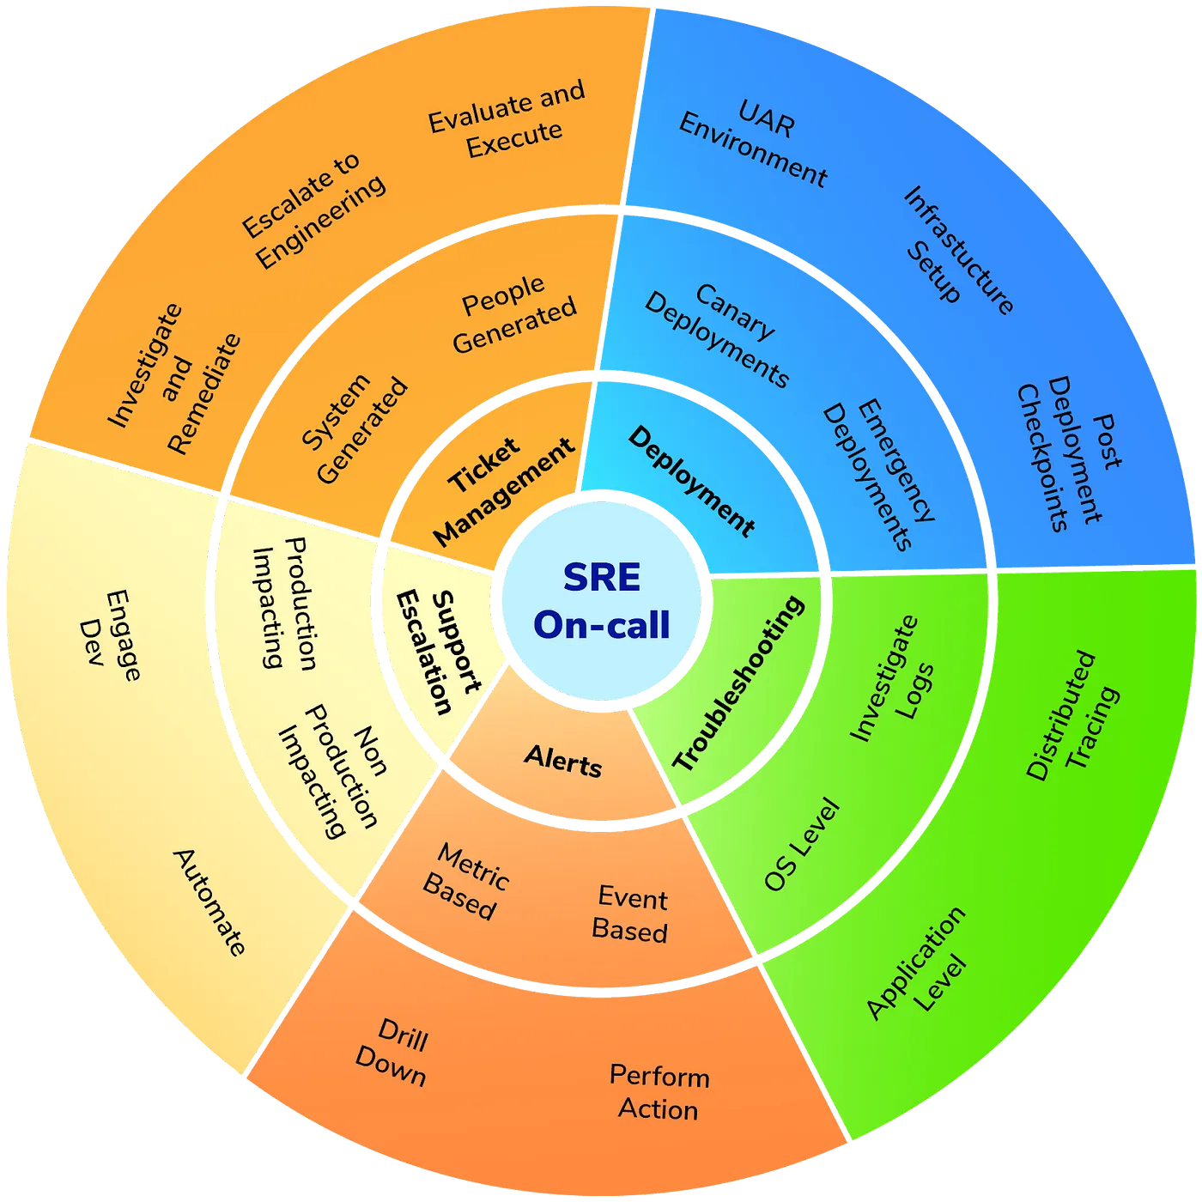
Common Challenges and Mitigations
Challenges:
Alert fatigue and burnout.
Poor handoff communication.
Lack of training for junior engineers.
Mitigations:
Runbooks & documentation.
Shadowing before live rotations.
Automated triage tooling.

Slide 9

References
Squadcast. (2025, February 27). On-call rotation: A complete guide to best practices. Medium. https://medium.com/@squadcast/on-call-rotation-a-complete-guide-to-best-practices-997b0da54499
Wade, J. (2020, August 21). Who’s bug is it anyway? AKA handling the on-call rota. DEV Community. https://dev.to/jpswade/who-s-bug-is-it-anyway-aka-handling-the-on-call-rota-11m6
Blog, N. T. (2018, May 17). Full cycle developers at Netflix. Medium. https://netflixtechblog.com/full-cycle-developers-at-netflix-a08c31f83249
Cook, O., Smollett, S., & Spadaccini, A. (n.d.). On-call. Google SRE - On-Call Rotations: A Comprehensive Guide. https://sre.google/workbook/on-call/
Kim, G., Humble, J., Debois, P., Willis, J., Forsgren, N., & Allspaw, J. (2021a). The devops handbook: How to create world-class agility, reliability, & Security in Technology Organizations. IT Revolution Press.
Atlassian. (n.d.-a). Is “you built it, you run it” living up to the hype?? https://www.atlassian.com/incident-management/devops/you-built-it-you-run-it

