Slide 1
Machine Learning and Data Mining Project A
Group D_16
Wojciech Sekula, A54219
Keira Barazzoli, A54213
Jakub Wilk, A53995
Sipos Máté, A54216

Slide 2
Agenda
Problem & goal
Dataset & DB schema
Pipeline & preprocessing
Models implemented (1R, ID3, Naive Bayes)
Results & comparison
How to run + files submitted
Conclusion

Slide 3
Problem & Goal
Task: Build an automated decision-support tool that suggests a contact lens type (soft, hard, none) for a patient, based on a single examination record.
Input: exam features (categorical):
  age_group — categorical (young | pre-presbyopic | presbyopic)
  disease_name — categorical (myope | hypermetrope | astigmatic)
  astigmatic — categorical (yes | no)
  tear_rate — categorical (normal | reduced)
Goal: Implement three classifiers from scratch: OneR, ID3 (decision tree), Naive Bayes and provide deployable solution for suggesting contact lens type.

Slide 4
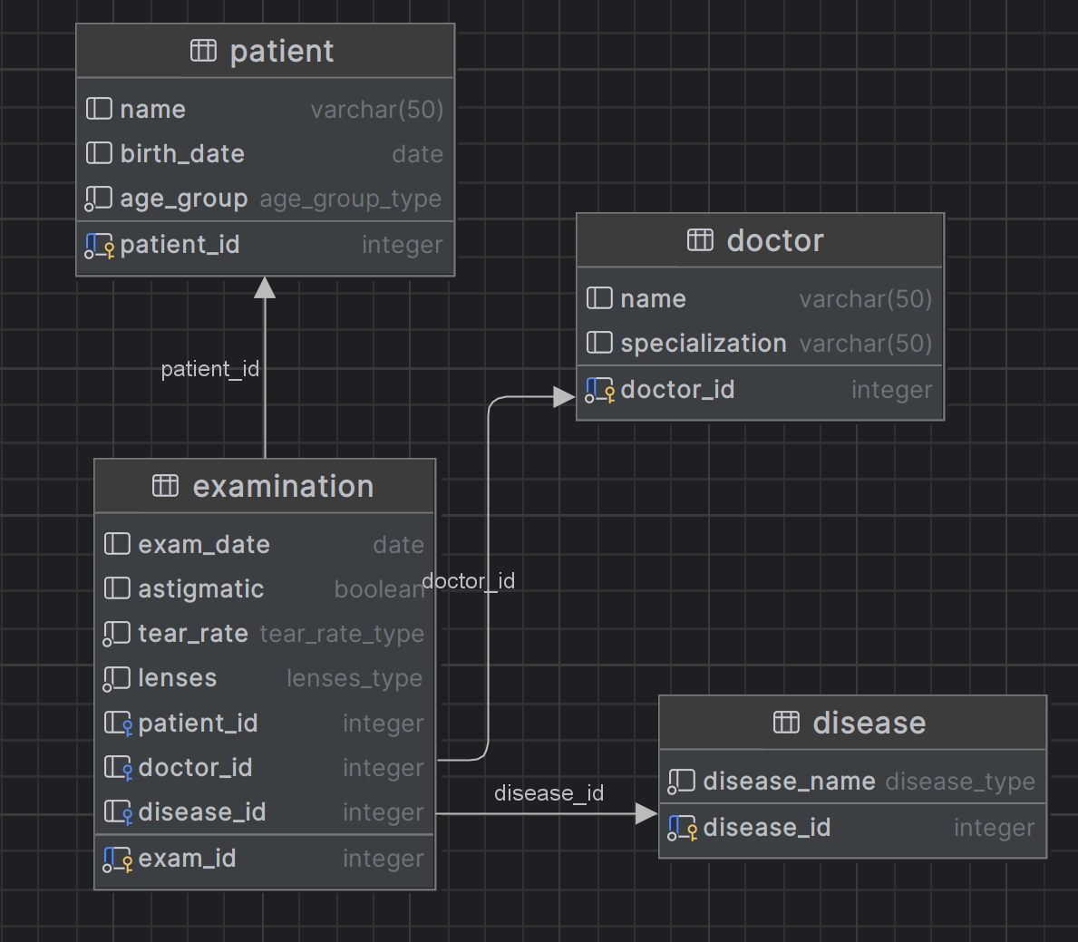
Dataset & DB Schema
Synthetic dataset — dataset.py generates medically-consistent categorical records (configurable size)
Logical model: EXAMINATION is the central fact table linking PATIENT, DOCTOR, and DISEASE.

Slide 5
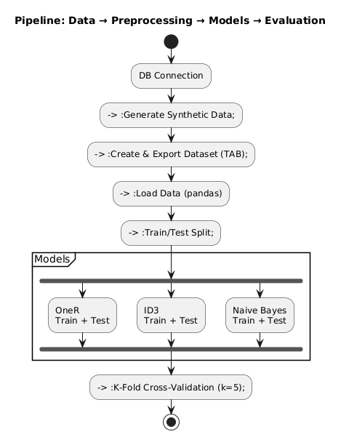
Pipeline & preprocessing

Slide 6
Models implemented (1R, ID3, Naive Bayes)
Three classification models were implemented and evaluated on the categorical lens dataset:
Model | Idea
One Rule (1R) | Selects a single attribute and builds one simple decision rule based on majority class per value.
ID3 Decision Tree | Recursively splits data using Information Gain, producing a human-interpretable decision tree.
Naive Bayes | Probabilistic model using Bayes’ theorem with independence assumption between features.

Slide 7
Results & comparison
Model | Train Acc | Test Acc | CV Mean | Notes
One Rule (1R) | 96.25% | 96.67% | 0.963 | Very simple rule, surprisingly strong baseline.
ID3 Decision Tree | 100% | 100% | 1.000 | Perfect accuracy; tree matches underlying data logic.
Naive Bayes | 96.25% | 96.67% | 0.963 | Stable and fast, performs simmilar to 1R model.

Slide 8
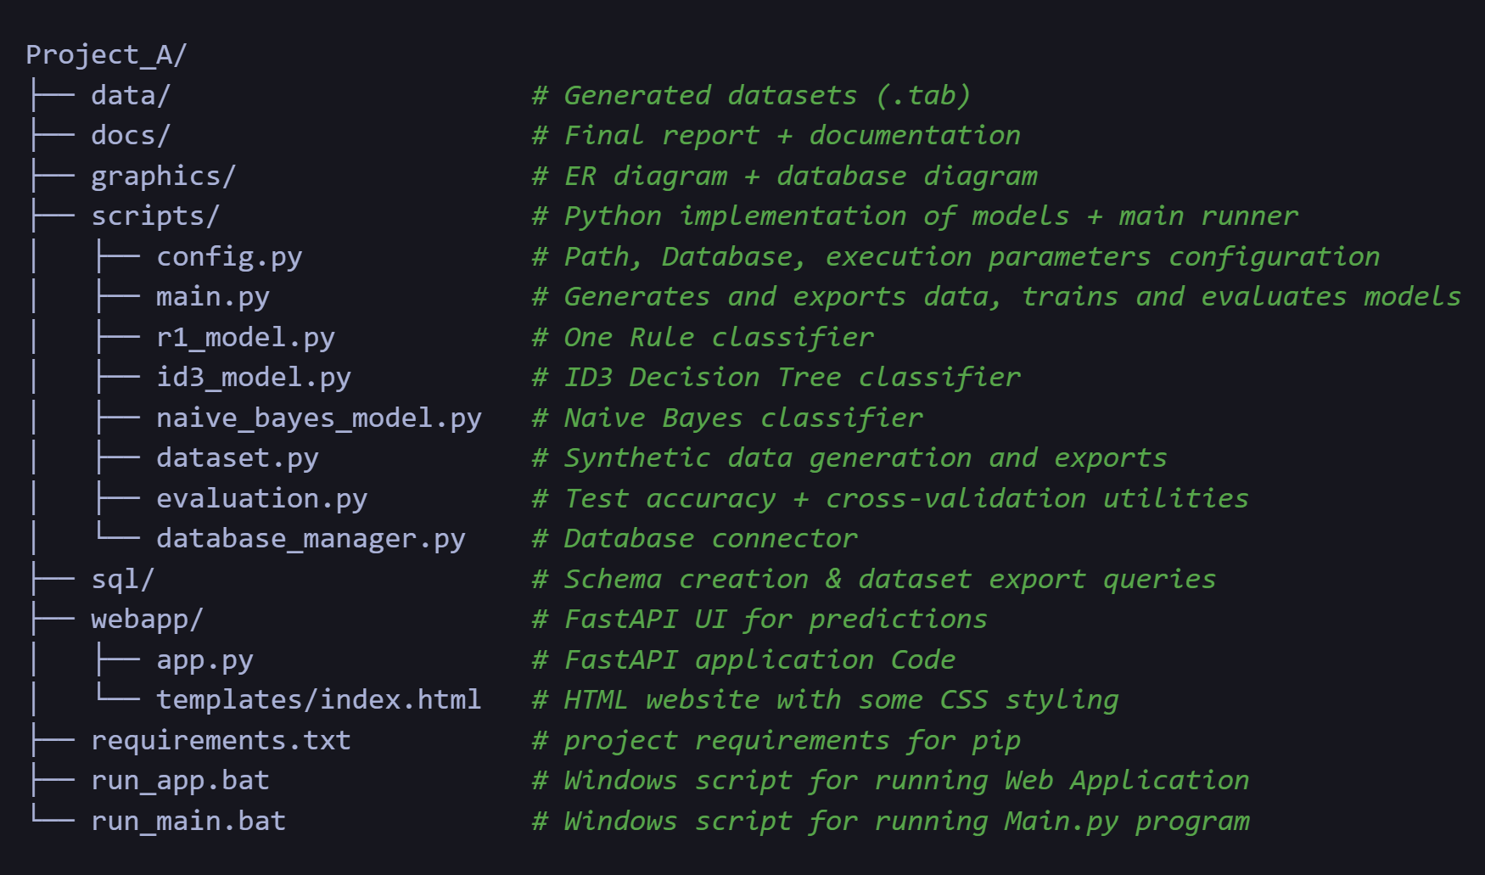
How to run + files submitted
Configure database in src/config.py file (set host, name, password etc).
Generate and export data + train models: Run run_main.bat script.
Launch Web Application: Run run_app.bat script.

Slide 9
Conclusion
The ID3 decision tree achieved the highest and most stable performance (100% accuracy), fully capturing the underlying decision logic.
1R and Naive Bayes provided strong and interpretable baseline models, confirming that the dataset has clear and separable decision patterns.
The pipeline covers the full workflow: data modeling → synthetic data generation → training and evaluation → deployment via web interface.
The system can be integrated into daily ophthalmology workflows to provide decision support and can be improved further by retraining on real clinical data.

Slide 10
Dodaj tytuł slajdu — 4

Slide 11
Dodaj tytuł slajdu — 5

