Slide 1
Money Tracker
5-Software Design
By Wout Van Uytsel and Ruben Nietvelt
17/01/2022

Slide 2
Functionalities
Add/remove user
Add ticket
Requires:
Type of ticket (Airplane, Restaurant,…)
Price of the ticket
Split evenly or unevenly?
Names of all participants
Remove ticket
Overview of all tickets
Bill overview
Transfer money between users
Dark and light mode
Tests

Slide 3
Patterns
Singleton
Used for user and ticket database
Observer
Used for the GUI to automaticly refresh overviews
The observers watch the databases for change
Abstract factory
Ticketfactory
MVC
GUI interacts through the controller
State
GUI has a light and dark theme

Slide 4
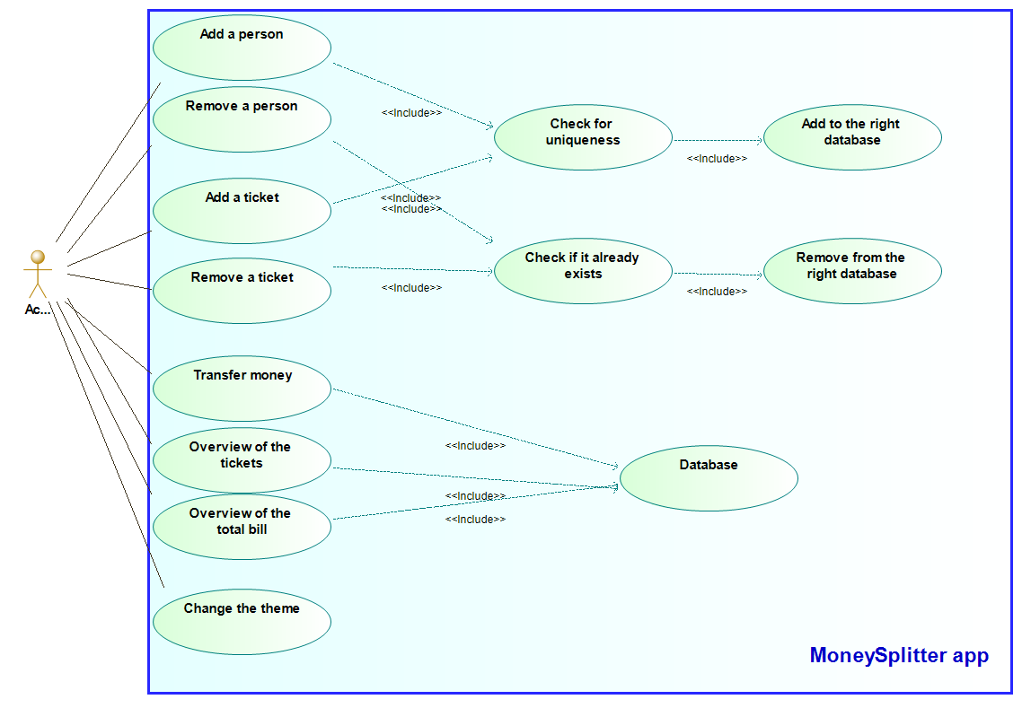
Use case diagram

Slide 5
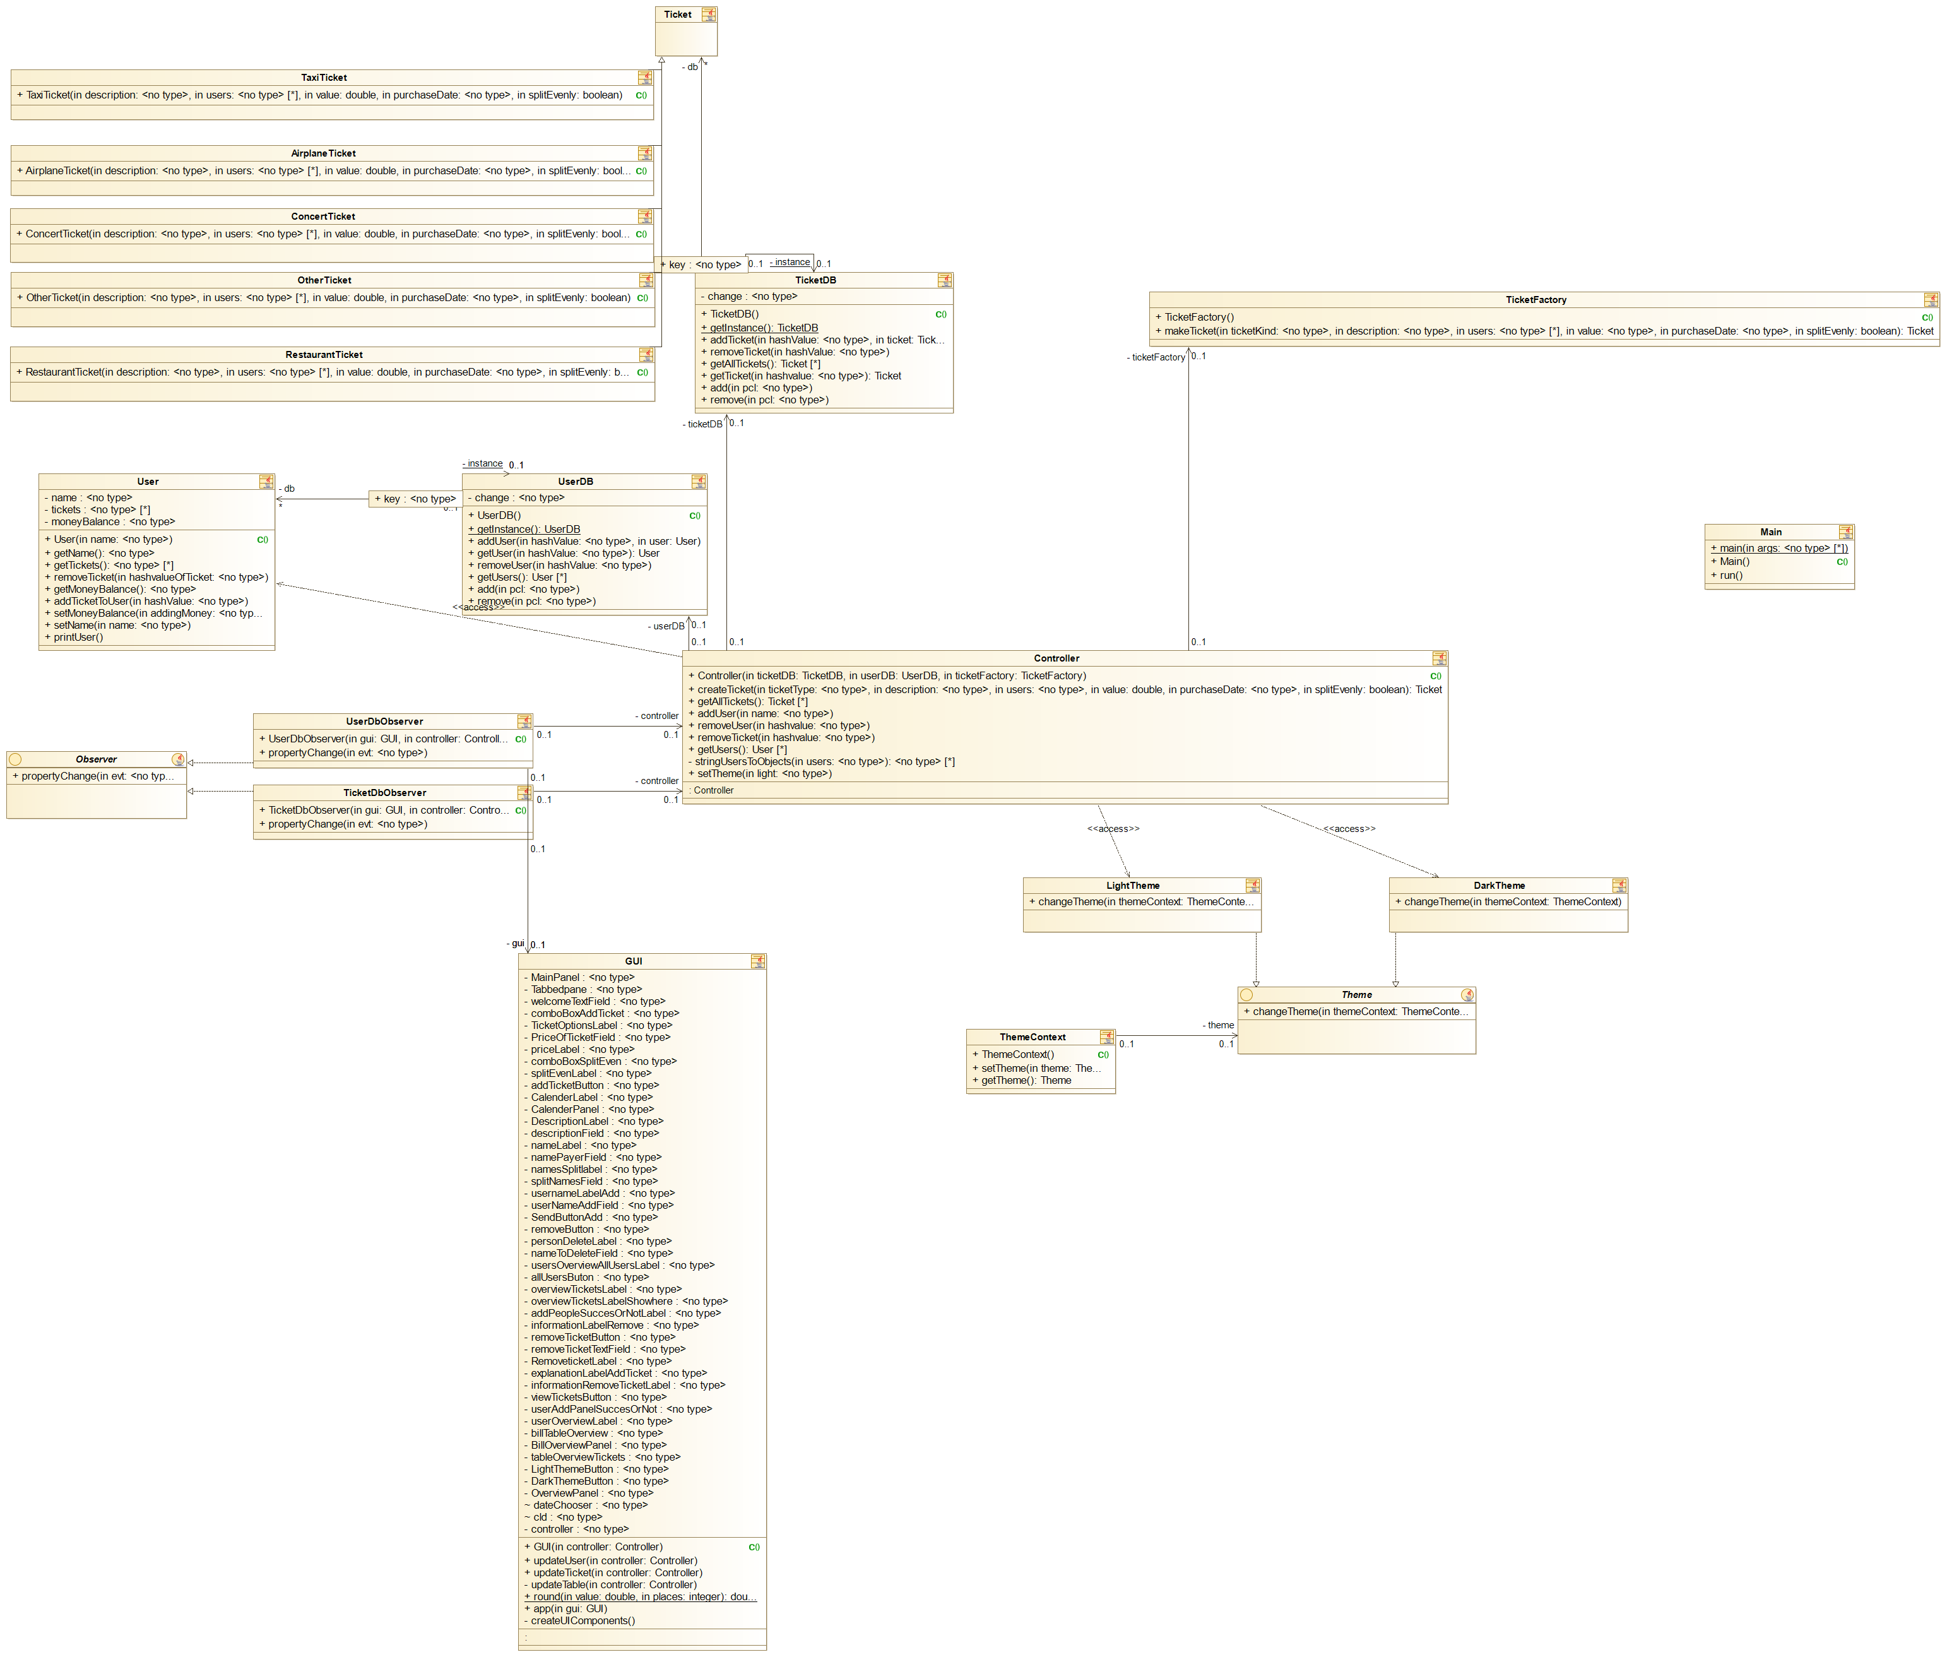
Class diagram
Let’s dive in…

Slide 6
Observers
Observers work with PropertychangeEvent
They implement the interface Observer
Update the GUI

Slide 7
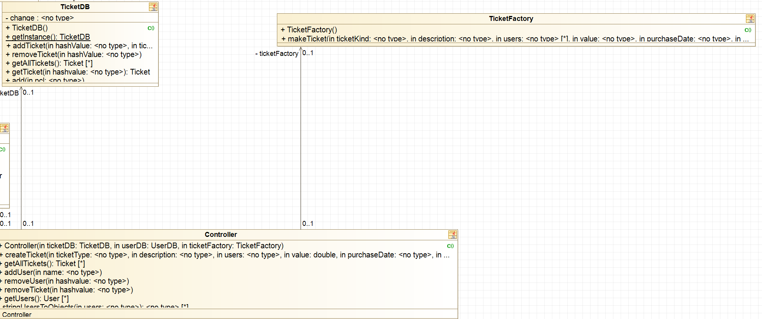
Factory
Create ticket using a method of the Factory class

Slide 8
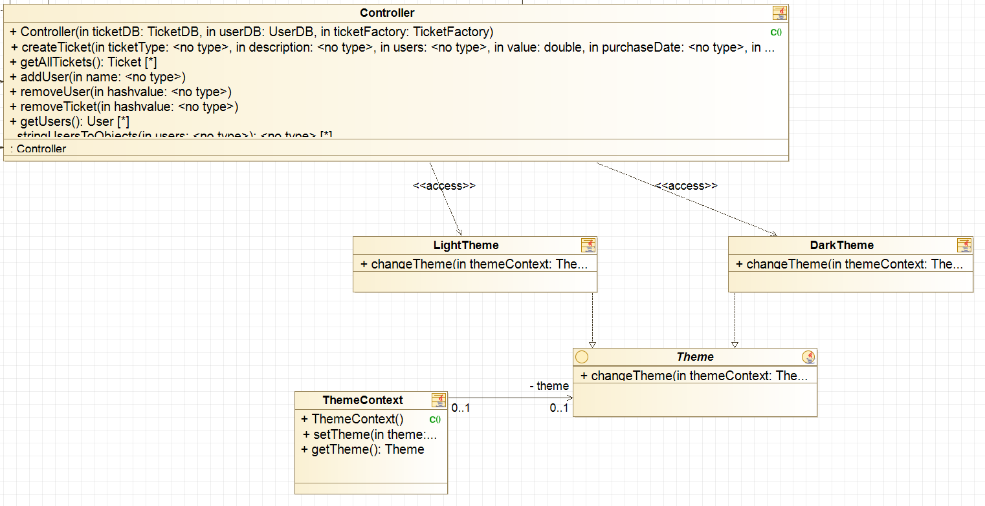
State
Set a theme by using a Context class

Slide 9
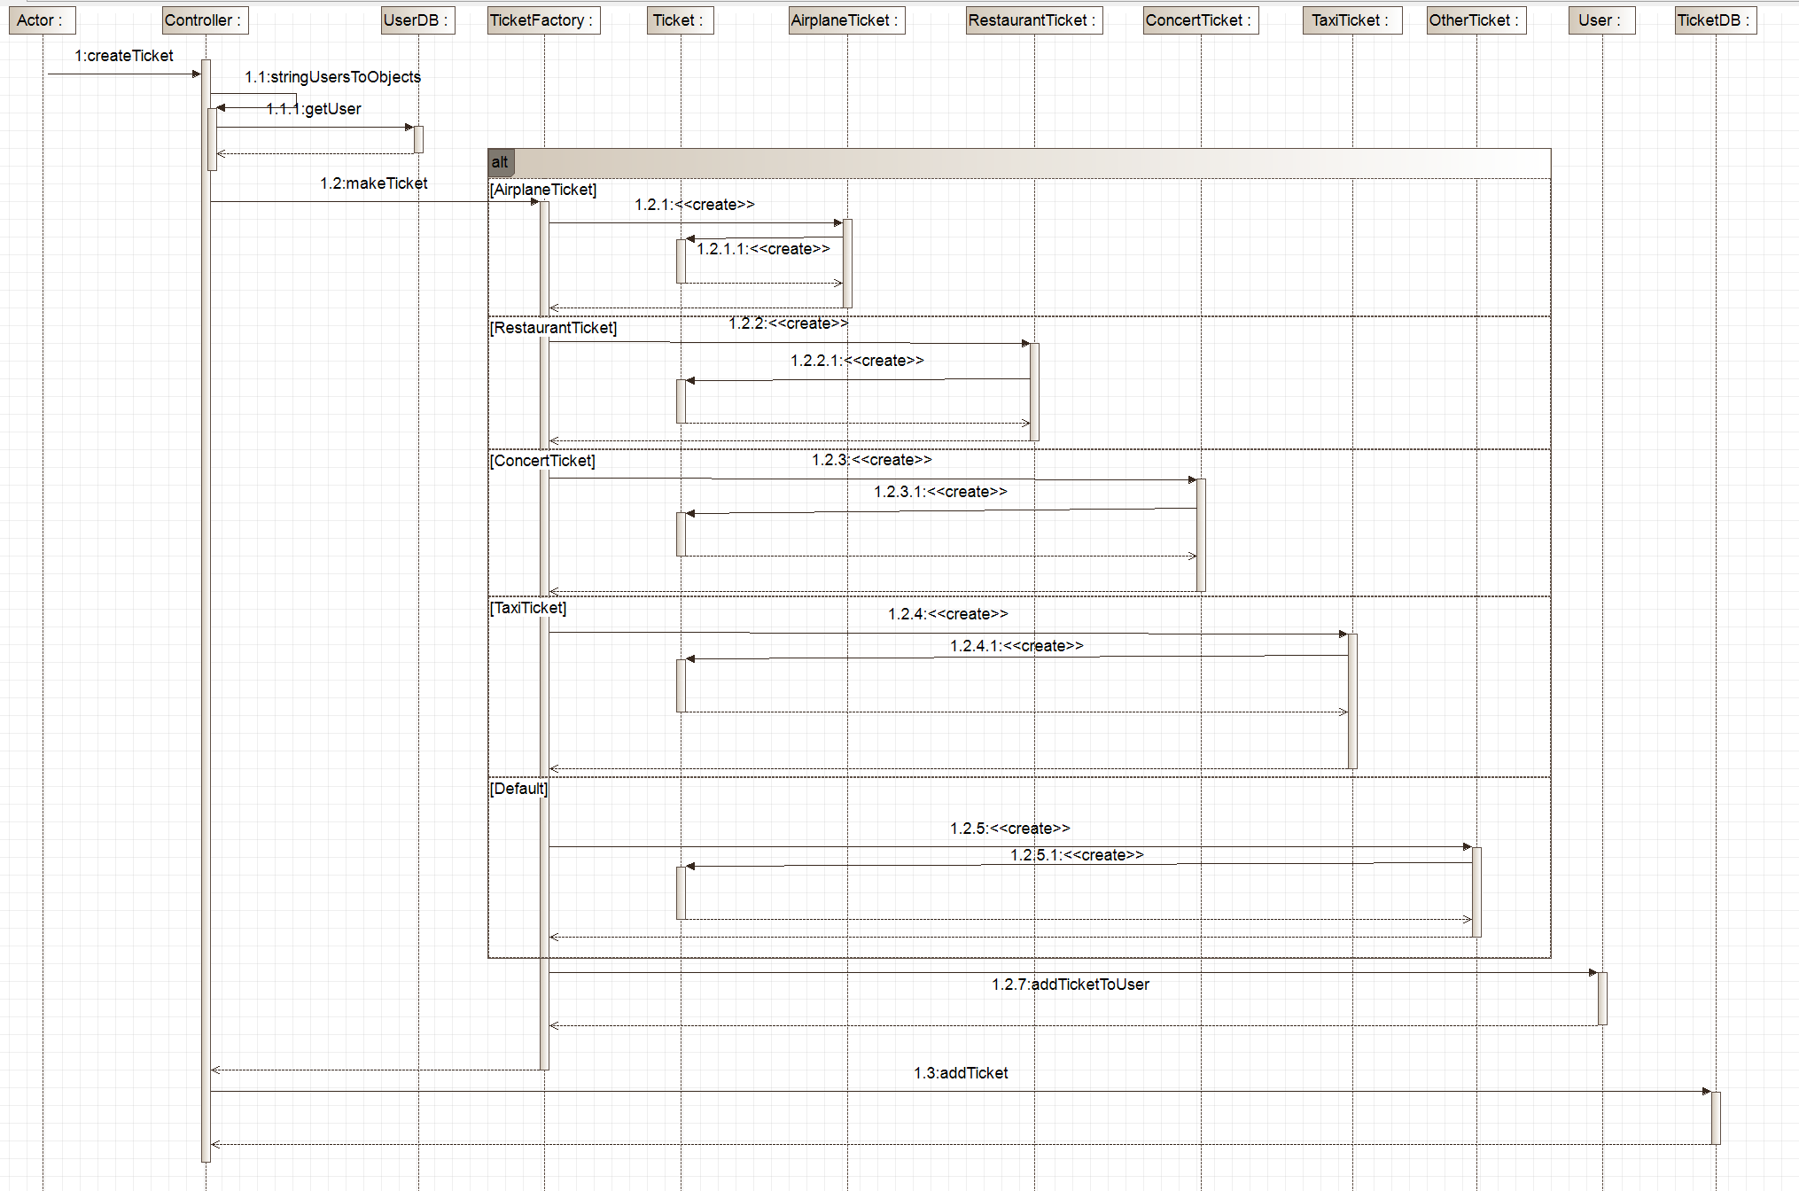
Sequence diagram for calculating the bill

Slide 10
Testing
Unit test
Separated test on Users and Tickets
Integration test
Test on Tickets combined with Users

Slide 11
Varia
Made use of Github (Github, Github Projects, Pull requests,…)
Java doc for the whole project
Testing if text fields aren’t empty

Slide 12
Demonstration

Slide 13



