Slide 1
GPP Exam: Zombie AI

Slide 2
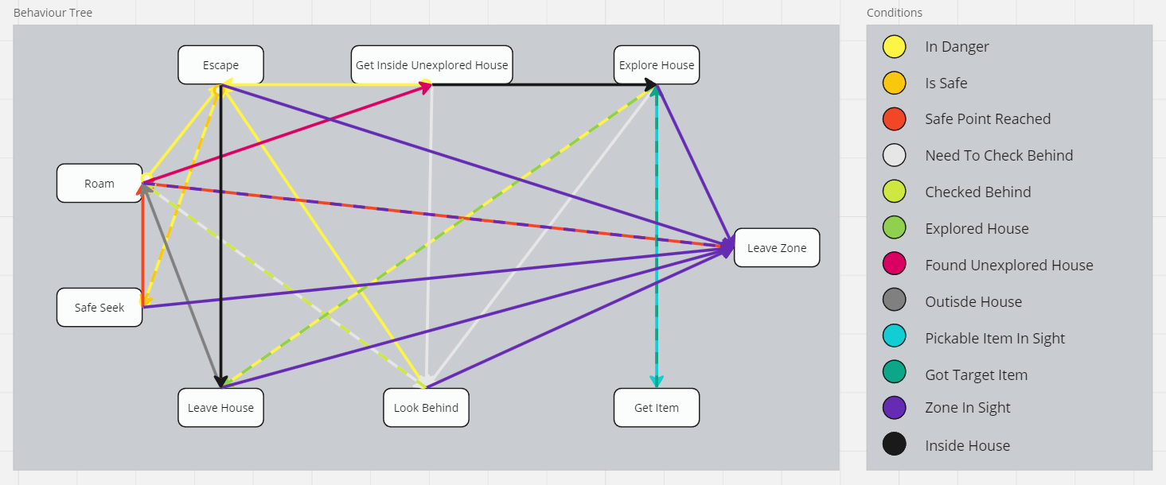
Decision Making

Slide 3
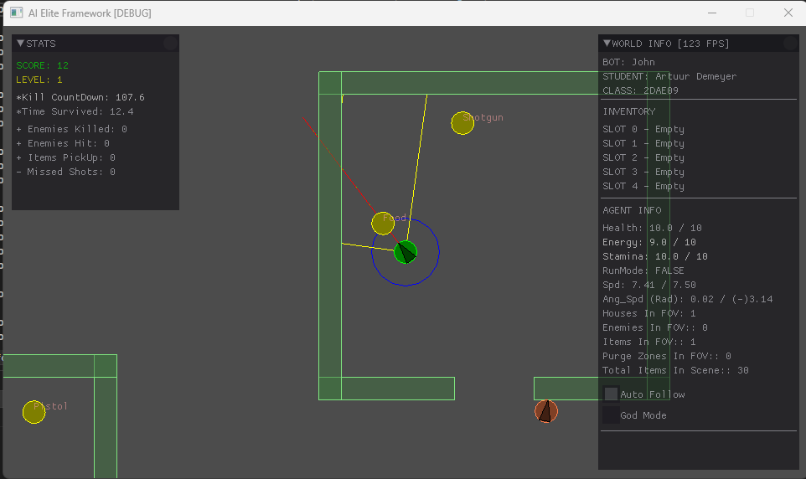
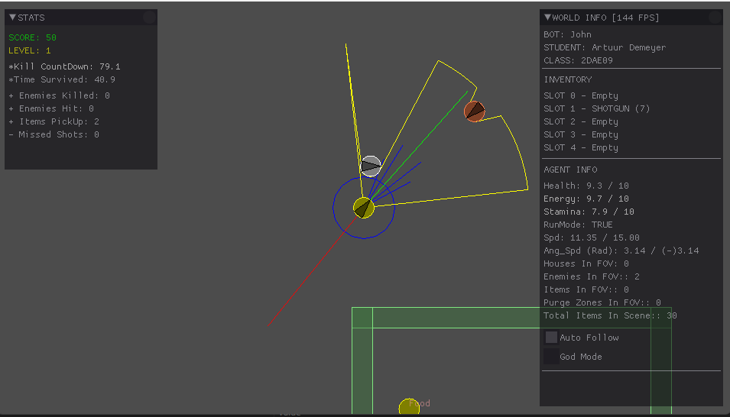
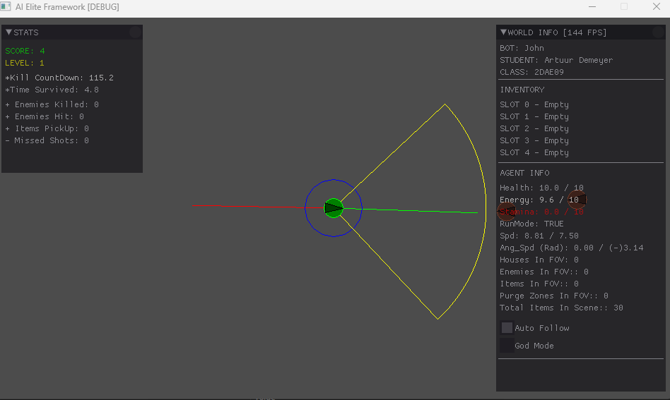
Enemy handling

Slide 4
Inventory
When the agent is exploring a house, and he meets the PickableItemInSight condition he will pick up that item.
When the agent can fully utilize its food or med kit, he will use the item and afterwards destroy it.
All this works because we have an inventory which works like a memory for items
When an enemy is in range and between a certain angle (different for shotgun and pistol) he will shoot the gun. And destroy it when empty

Slide 5
Movement - Steering
Seek behaviour which goes towards a target while facing its direction
Flee behaviour which goes away from a target while facing that target, very useful for shooting whilst running away
The wander behaviour is used to go to random spots, but in a way that we don’t change drastically every frame

Slide 6
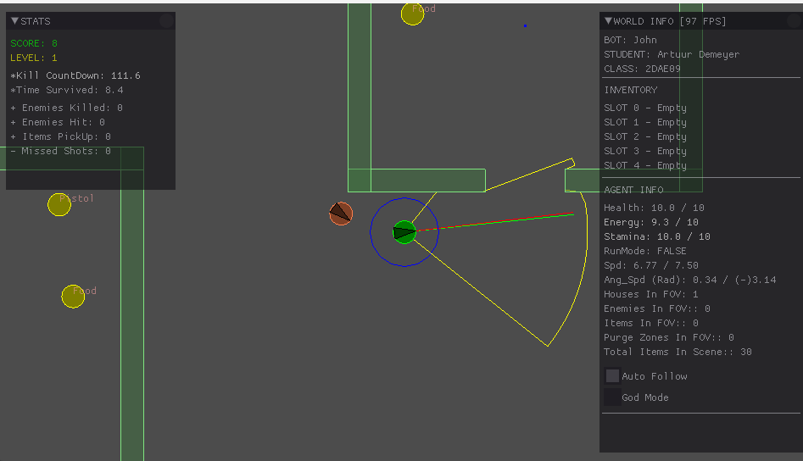
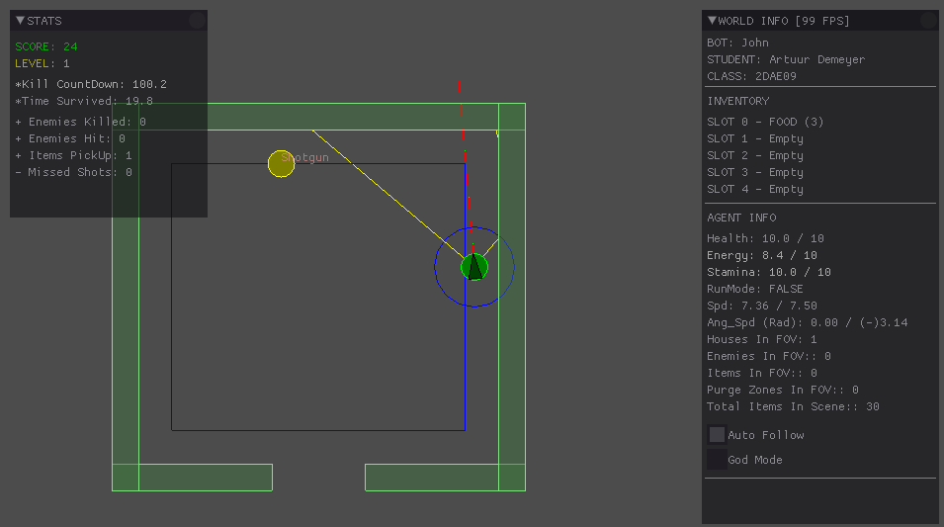
Movement - Exploration

Slide 7
High Score
359
346
262
158
173

