Slide 1
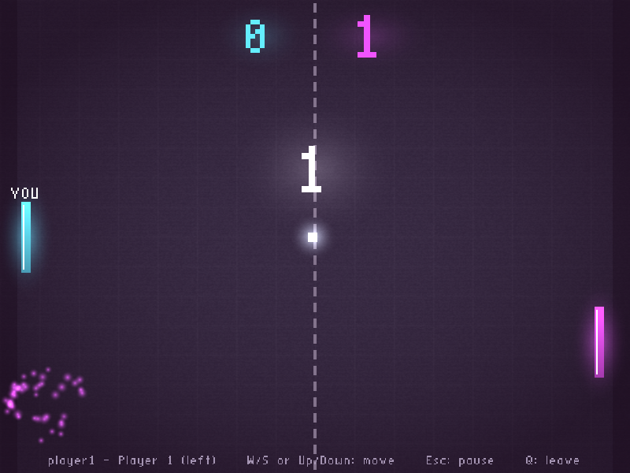

Secure DDS Pong
Team 32 · CSD3116 Team Lab
Sung Hong Chieh Jethro
2402891 · Team leader
Woh Kye Le
2401841 · Team member
Notes:
0:00-0:25 BOTH on camera.
JETHRO: Hi, we are Team 32. I'm Sung Hong Chieh Jethro, the team leader.
KYE LE: And I'm Woh Kye Le. We built Secure DDS Pong: a real-time, two-player game on Cyclone DDS, with authenticated logins and encrypted traffic.
JETHRO: In the next five minutes we'll show the game running on two laptops, then explain the security and the optimisations, and how we tested the code.

Slide 2
What we built
Laptop 1
server + player 1
Server
owns ball, paddles,
score and phases
Laptop 2
player 2
input
input
state
state
Cyclone DDS publish / subscribe
The server is authoritative: clients only send which way their paddle moves
60 Hz simulation; each player gets its own encrypted copy of the state
Two threads per program: one for DDS, one for game or rendering
Notes:
0:25-0:55 KYE LE (screen + small webcam).
Our design is an authoritative server. The clients only send one thing: which way their paddle is moving. The server runs the ball physics, scoring and match phases at 60 ticks per second, and sends each player its own encrypted copy of the game state over DDS. Because the server owns the truth, a client can't cheat the score. Each program uses two threads, so DDS traffic never blocks the game loop or the rendering.

Slide 3
Live demo on two laptops
Start the server; each laptop logs in and presses PLAY
Rally: angled bounces, speed-up, trail and spark effects
1
2
A point is scored: flash, score pop, next serve
Esc on laptop 2 pauses BOTH screens; laptop 1 resumes
3
4
Q leaves: the server frees the slot at once, then rejoin
Wrong password: the server rejects the login
5
6
Notes:
0:55-2:10 KYE LE narrates over the split-screen recording (show this slide for 3 seconds, then cut to footage).
1) Here's the server starting on laptop 1. Each player runs the client, types a password that stays hidden, and presses Play. The server log shows both logins.
2) The bounce angle depends on where the ball hits the paddle, and the ball speeds up six percent on every hit.
3) When a point is scored, both screens flash in the scorer's colour and the next serve goes to the player who lost the point.
4) If either player presses Escape, the server freezes the game for both of us. Either player can resume.
5) Pressing Q leaves the match. The server frees the slot instantly and the other player goes back to waiting. Then we rejoin from the menu.
6) Finally, with the wrong password the server rejects the login, and the server log shows the rejection.

Slide 4




Security
Client
Server
Password never sent
K = Argon2id(password); both sides prove they know K
1 username + nonce
Encrypted messages
XSalsa20-Poly1305 with a fresh key per login
2 challenge nonce
Replay + tamper proof
sequence numbers and Poly1305 MAC checks
3 proof: HMAC(K)
4 player id + HMAC(K)
No impersonation
each player's input is sealed with its own key
Notes:
2:10-3:05 JETHRO (webcam + slide).
For authentication we use a challenge-response login, so the password never crosses the network. Each user's key K is derived from their password with Argon2id, and the server stores only K. The client proves it knows K by sending an HMAC over both random nonces, and the server proves itself back the same way, so a fake server is detected too. Both sides then derive a fresh session key. Every input and game-state message is encrypted with XSalsa20-Poly1305. Sequence numbers block replays, and the MAC catches any changed byte. In the demo you saw a wrong password being rejected. And because every message is sealed with that player's own key, a forged, replayed or changed message simply fails the check and is dropped.

Slide 5
Optimisation
Baseline
Our version
33% → 0.7%
Busy-polling loop
DDS waitset: sleep until data arrives
server CPU (2 players)
20 ms sleeps inside the mutex
fixed 60 Hz tick, one short lock
27×
printf on every message
event logs + [perf] summary
fewer server instructions (callgrind)
57% → 6%
Uncapped client redraw
60 fps cap, lock-free input
of time spent locking the mutex
Notes:
3:05-3:55 KYE LE (webcam + slide; optionally show top or the [perf] log).
We profiled the lecturer's baseline and found it busy-polls DDS and sleeps for 20 milliseconds per player while holding the mutex. We replaced polling with a DDS waitset, so the network thread sleeps until data arrives, and the server now runs a fixed 60 Hz tick with one short critical section. Encryption and DDS writes happen outside the lock. Measured with two players, server CPU dropped from 33 percent to under 1 percent. Valgrind's callgrind showed 27 times fewer instructions, and time spent locking the mutex fell from 57 percent to 6 percent.

Slide 6


Testing and AI use
How we tested
AI declaration
Clean build: make, zero warnings
Correct, wrong and unknown logins
Third player gets "server full"
Leave with Q; Ctrl+C crash times out
Full matches on two laptops, with pause
AI usage(Anthropic)
Prompts:
  give us an idea on how to resturcture our code to make it more modular“
  how do I open my port for the server so another device can connect
  why is it laggy when I open 2 clients on the same devices
We reviewed and tested it ourselves
Full details in our slides and README
Notes:
3:55-4:25 JETHRO (webcam + slide).
We used AI, Claude by Anthropic, to generate much of the code. Our prompts covered building the Pong game, the menu and pause, restructuring into modules, and the visual effects. We tested it ourselves on our two laptops: a clean build with zero warnings; logging in with the right password, a wrong password and an unknown username; a third player being told the server is full; leaving with Q and killing a client with Ctrl+C, which the server drops after 3 seconds; and full matches across both laptops, including pausing on one and resuming on the other. [Add one sentence in your own words about what you reviewed or changed.] The full declaration is in our slides and README.

Slide 7
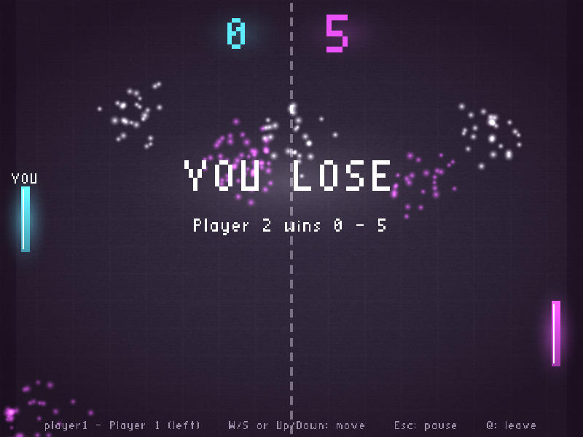



Thank you
Team 32 · Questions welcome
Real-time 2-player Pong over DDS
Authenticated and encrypted
33% → 0.7% server CPU
Notes:
4:25-4:45 BOTH on camera.
KYE LE: So that's Secure DDS Pong: real-time two-player Pong over DDS,
JETHRO: with authenticated logins, encrypted traffic, and a server that now uses under one percent of a CPU core.
BOTH: Thank you for watching!

