Slide 1
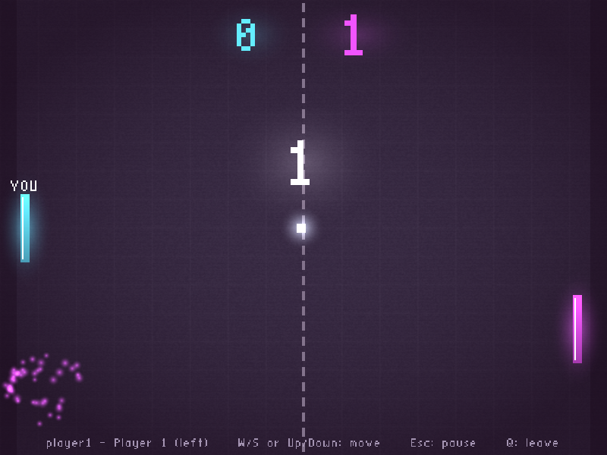
Secure DDS Pong
A real-time, distributed and secure 2-player game on Cyclone DDS
CSD3116 Low-Level Programming · Team Lab
Team 32: Sung Hong Chieh Jethro · Woh Kye Le
6 November 2026
Notes:
Introduce the team and the game: a two-player Pong built on the CSD3116 DDS baseline, with authenticated logins and encrypted traffic.

Slide 2





Agenda
01
Game design
concept, architecture, modules, threads, QoS
02
Security
challenge-response login, encrypted messages
03
Optimisation
changes from the baseline and profiler evidence
04
Testing and AI use
test results, code walkthrough, AI declaration
05
Evaluation
design trade-offs, limitations and next steps

Slide 3



Every game requirement is covered
2D animation
Required stack
Two players
OpenGL rendering at 60 fps with textures, glow and particle effects
WSL, OpenGL, GLFW and Cyclone DDS, plus libsodium for crypto
Player 1 is the left paddle, player 2 the right; a third player gets "server full"
Real-time and interactive
Distributed
Secure
60 Hz authoritative server tick, main menu and shared pause
Server and clients are separate processes talking over DDS publish/subscribe
Authenticated login plus encrypted, tamper-proof game messages

Slide 4
Build and run
1 Install once (WSL Ubuntu)
3 Run (three WSL terminals)
sudo apt install cyclonedds-dev \
cyclonedds-tools libglfw3-dev \
libgl1-mesa-dev libsodium-dev \
pkgconf make
./bin/server
./bin/client player1 # pass: pong123
./bin/client player2 # pass: pong456
2 Build
4 Play
make # or double-click build.bat
make clean # or clean.bat
Press PLAY on both clients
W/S or Up/Down move, Esc pauses, Q leaves
Add accounts: make adduser NAME=x PASS=y
Two laptops: source scripts/lan.sh <other IP>
idlc generates the DDS code; each module compiles separately; programs land in bin/

Slide 5

Who did what
Sung Hong Chieh Jethro
Woh Kye Le
2402891 · Team leader
2401841 · Team member
Contributions
Contributions
Testing
Login Behavior and Security
Two Player Communication
Gameplay
Visual Effects
Optimization of DDS loop

Slide 6
Game design
01
Concept, game flow, architecture, modules and threading

Slide 7
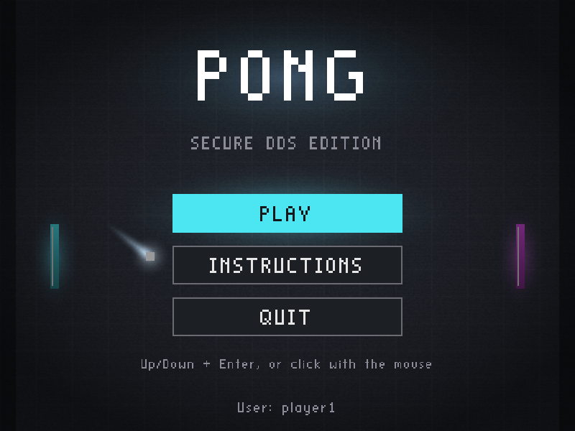
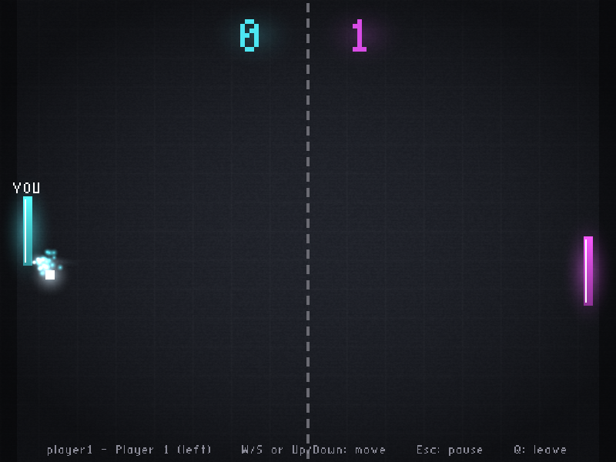
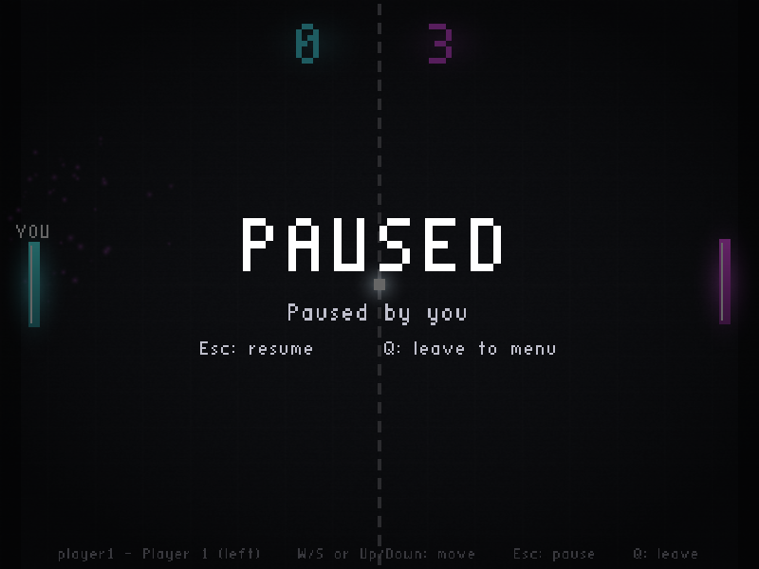
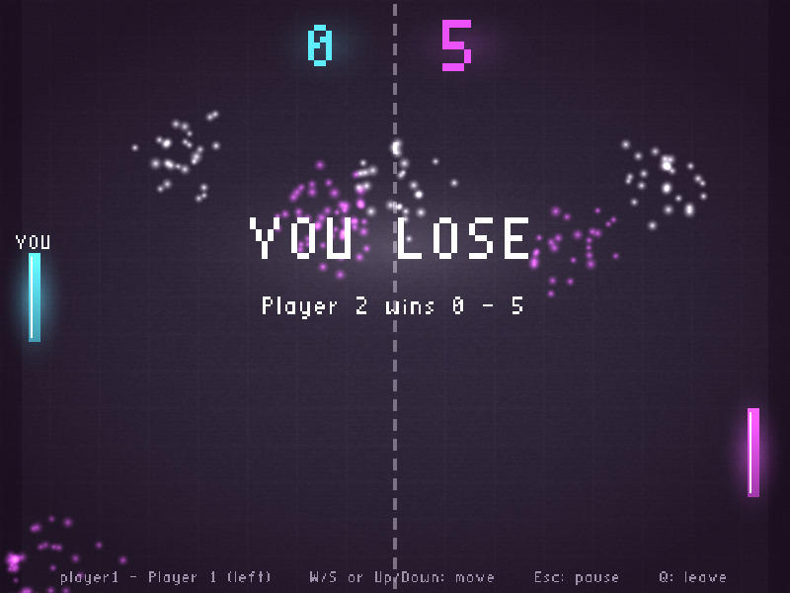
Concept and mechanics
Classic 2-player Pong: get the ball past the other paddle to score
Hit position sets the bounce angle (up to 60° at the paddle edge)
Ball starts at 330 px/s and speeds up 6% per hit, capped at 780
3-2-1 countdown before a match, 1 s before each serve
First to 5 wins; a new match starts after 4 s
Esc pauses for both players; Q leaves to the menu
Main menu
Rally with paddle-hit sparks
Shared pause
Game over

Slide 8
Game flow
CLIENT SCREENS
Main menu
PLAY
Connecting
challenge
Authenticating
accepted
In match
Q (leave)
SERVER GAME PHASES
Waiting
2 players
Countdown
timer ends
Playing
first to 5
Game over
point scored
Esc (either player)
A player leaving or timing out returns the server to Waiting from any phase
Paused
everything frozen

Slide 9
Architecture: an authoritative server
Server
owns the game state
physics, scoring, phases
login + sessions
Client 1
GLFW window
input + rendering only
Input
Input
Client 2
GLFW window
input + rendering only
GameState
GameState
Cyclone DDS publish / subscribe (UDP)
Clients only send which way their paddle moves; they cannot cheat the score or ball
The server simulates at a fixed 60 Hz and sends each player its own encrypted copy of the state
Login uses four extra DDS topics (next section); all six topics have their own QoS

Slide 10
Module structure
common/
server/
client/
protocol constants, formats, clock
main start-up, 60 Hz loop, broadcast
main window, frame loop
dds_setup participant, topics, QoS
users account file
login password prompt
secure Argon2id, HMAC, encryption
auth login handshake
shared thread-shared state
world shared state + mutex
client_net network thread
game pure Pong rules
screens menu, game, pause
server_net network thread
draw / textures OpenGL drawing
perf tick statistics
effects trail, sparks, flash
input keyboard, mouse
36 source files, largest 324 lines · game.c has no DDS, threads or globals

Slide 11
Threading: two threads per program
SERVER
Network thread
sleeps on DDS waitset
logins + decrypt input
world (mutex)
players + game
Main thread
60 Hz tick
encrypt + publish state
CLIENT
Network thread
login, send input,
decrypt state
shared (mutex + atomics)
view, input, requests
Main thread
GLFW input
60 fps rendering
Each thread holds the lock only to copy data in or out; encryption and DDS writes happen outside it

Slide 12
DDS topics and QoS
Topic | Direction | Reliability | History | Why
4 login topics (Request, Challenge, Proof, Response) | both ways | reliable | keep last 16 | a lost login message would stall the login
PongInput | client → server | reliable | keep last 1, per player | only the newest input matters, but "leave" must arrive
PongGameState | server → client | best effort | keep last 1, per player | a late frame is useless; the next arrives 16 ms later
Input and GameState are keyed on player id, so keep-last-1 holds the newest sample for each player

Slide 13
Security
02
Authenticated clients and encrypted DDS traffic

Slide 14
Login: challenge-response, both ways
Client
Server
How it works
1 JoinRequest
username, random client nonce, tag
K = Argon2id(password, salt from username); the server stores only K
The password never crosses the network
Step 3 proves the client knows K; step 4 proves the server does too
Session key = HMAC(K, both nonces, player id): fresh for every login
Unknown usernames still get a challenge, so names can't be probed
2 JoinChallenge
random server nonce
3 JoinProof
HMAC(K, transcript)
4 JoinResponse
player id + HMAC(K, transcript)

Slide 15





Protecting every game message
Encrypted
No replays
No impersonation
XSalsa20-Poly1305 on every Input and GameState payload
Strictly increasing sequence numbers; old messages are dropped
Each player has their own session key, so forged input fails
Tamper-proof
Safe storage
Hygiene
A changed byte fails the Poly1305 check and is discarded
users.txt holds Argon2id-derived keys, never passwords
Constant-time MAC compares; keys wiped from memory after use
Attack tests: replay ignored, impersonation blocked, tampered message blocked, wrong password rejected. Ubuntu's Cyclone DDS 0.10.4 has no DDS Security plugins, so this is done in the application.

Slide 16
Optimisation
03
What changed from the baseline, and the profiler evidence

Slide 17
What we optimised
Area | Baseline | Our version
Waiting for data | busy-polls dds_take in a loop | sleeps on a DDS waitset until data arrives
Server loop | sleeps 20 ms per player while holding the mutex | fixed 60 Hz tick; sleeps outside the lock
Locking | lock/unlock per player inside loops | one short critical section per tick
State messages | one Position message per player | one packed state per tick, encrypted per player
Logging | printf on every message | events only + [perf] summary every 10 s
Client drawing | uncapped redraw, mutex per square | 60 fps cap, one view copy per frame, atomic input
Timing | wall clock | monotonic clock, immune to clock jumps

Slide 18
Profiler evidence
27×
fewer CPU instructions on the server
1,058 M → 39 M over the same run (Valgrind callgrind), while also encrypting
57% → 6%
of server instructions spent locking the mutex
the baseline's busy loop spends most of its time in lock/unlock
60 ticks/s
with under 0.1 ms of work per 16.7 ms tick
from the server's built-in [perf] statistics
Same machine, same load (server + 2 connected clients). Client numbers use software OpenGL rendering; a GPU lowers them further.

Slide 19
Testing and AI use
04
How the AI-generated code was tested, explained and declared

Slide 20
How we tested the code
Test | Method | Result
Build | clean make with -Wall -Wextra | 0 warnings
Login | correct, wrong and unknown accounts | accepted / rejected
Admission | third player; same user twice | server full / retry
Attacks | replay, impersonation, tampered bytes | all blocked
Leave and crash | Q / window close; killed client | slot freed; dropped after 3 s
Pause | Esc on one client, resume from the other | both screens frozen
Full match | bot vs bot to 5 points | game over + rematch
Performance | callgrind + CPU sampling vs baseline | see profiler slide
Automated with a headless DDS test client (bots and attacks) and GUI clients driven by xdotool on a virtual display

Slide 21
Code walkthrough: three key decisions
Shared pause that survives packet loss
Short critical section
Swept paddle collision
world.c
server/main.c
game.c
n = presses - last;
last = presses;
if (n & 1)
toggle_pause();
world_lock(w);
world_tick_locked(w);
world_unlock(w);
broadcast_state();
t = (old - face)
/ (old - new);
y = old_y + dy * t;
if (miss) return;
Each input carries a running count of Esc presses, so a lost message can't lose or double a press
The lock covers only the game update; encryption and DDS writes run after unlocking
Finds where the ball crossed the paddle face, so a 780 px/s ball can't skip through
simplified from the source
simplified from the source
simplified from the source

Slide 22

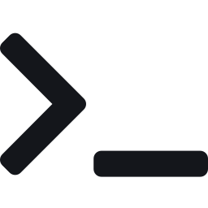
AI declaration
Tool and use
Prompt summary
Claude (Anthropic)
Fixed setup errors (missing pkg-config, en-dash in idlc command)
Tested: every feature and attack in "How we tested the code", plus our own runs on WSL
"make a 2D multiplayer game (pong)"
"build into the files folder" / "structure the project neater“
"settle structure and modularity" / "add textures"
Team review: We tested the assisted pause feature with two clients. Pressing Esc on either paused the match on both screens. We reviewed how the client sends a running count of Esc presses and how the server uses that count.

Slide 23
Evaluation
05
What our design choices cost, and what we would do next

Slide 24
Design trade-offs
Authoritative server
App-level crypto (libsodium)
Gain One source of truth: clients can't fake the ball or score
Cost Every move waits one network trip plus up to one 16.7 ms tick
Gain Works with Ubuntu's Cyclone DDS 0.10.4, which has no Security plugins
Cost DDS discovery data (topic names) still travels unencrypted
Best-effort game state
Argon2id password keys
Gain No stale frames are resent, so a hiccup never delays newer ones
Cost A dropped frame repeats the previous state for 16 ms
Gain Sniffed logins and a stolen users.txt are slow to brute-force
Cost About 0.1–0.5 s at client start-up (done once, before the window)

Slide 25
Limitations and future work
Known limitations
Next steps
DDS discovery data (topic names) is not encrypted
A recorded login could be brute-forced offline if the password is weak (Argon2id slows this)
No protection against message flooding
Two laptops need WSL mirrored networking and firewall rules
Cyclone DDS Security plugins for encrypted discovery
Client-side interpolation for smoother motion over Wi-Fi
Spectator mode and an AI opponent
Rate limiting on login attempts

Slide 26
Thank you
Team 32: Sung Hong Chieh Jethro · Woh Kye Le

