Slide 1
Bike sharing case study presentation
Bike sharing company
Done by Wojciech C.
2026
May, Q2

Slide 2
AGENDA
Business Problem
1
Data Overview
2
Data Preparation
3
Key Insight #1
4
Key Insight #2
5
Interpretation
6
Recommendations
7
Conclusion
8

Slide 3
Understand differences between casual riders and members
Goal: Increase annual memberships
Business Problem

Slide 4




Divvy trip data (multiple months)
Includes ride time, stations, user type
Processed using R
Data Overview

Slide 5
Combined multiple datasets
Created ride length variable
Extracted day of week
Removed invalid data
Data Preparation

Slide 6
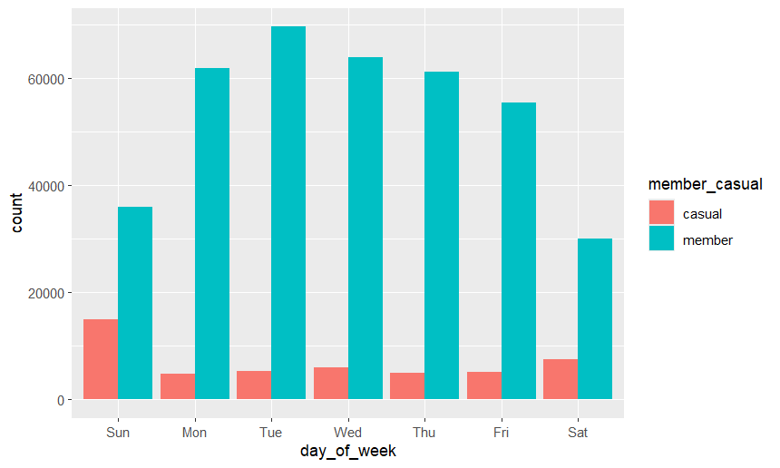
Key Insights
Weekly Patterns
Members → weekdays
Casual → weekends
Members vs Casual Usage
Members ride more frequently
Casual riders ride less often but longer
$0M
$0M
$0M
$0M
$0M

Slide 7
Timeline
Interpretation
Members = commuting behavior
Casual = leisure behavior

Slide 8
Weekend promotions for casual riders
Promote commuting benefits
Use targeted digital marketing
Recommendations:

Slide 9
Thank you!
Conclusion
Clear behavioral differences exist
Opportunity to convert casual riders
Data supports targeted marketing strategy
Contact WojciechCzarnyEmail@gmail.com

