Slide 1
Topic Modelling Bigfoot Sightings Project
Topic Modelling – Autumn 2025
Wojciech Hrycenko

Slide 2
Table of Contents
01
02
03
04
Introduction
Technicals
What I decided to work on?
What Topic Modelling Methods have been used?
Results
Conclusions
What I was able to achieve?
What can we get from such analysis?

Slide 3
01
Introduction
Can you really find ‘bigfoot’?

Slide 4
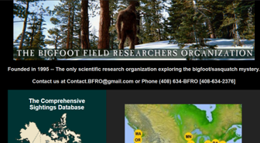
Introduction
The Bigfoot Field Researchers Organization (BFRO) is an organization aiming to uncover the truth about mysterious occurrences in the natural world.
This dataset contains various reports of bigfoot and sasquatch sightings in different parts of the world.
I decided to look for some familiarities and patterns between such sightings

Slide 5
5486
Various reports of bigfoot and sasquatch sightings

Slide 6
Introduction - Research Questions
Are there geospatial correlations between states and specific sighting types?
Can we identify latent narrative themes (e.g., visual vs. auditory encounters)?
Can we distinguish environmental contexts (e.g., roadside vs. deep wilderness)?

Slide 7
02
Technicals
The "How"

Slide 8
Data Collection & Preprocessing
Preprocessing Pipeline
bfro_reports.csv
Feature Selection
Normalization: Lowercasing, whitespace stripping.
Focused strictly on the OBSERVED column (narrative text) to maximize topic coherence and reduce noise from auxiliary columns.
Cleaning: Removal of empty rows and exact duplicates (Final count: 4,982 unique docs).
Domain-Specific Stopwords removal + standard nltk list

Slide 9
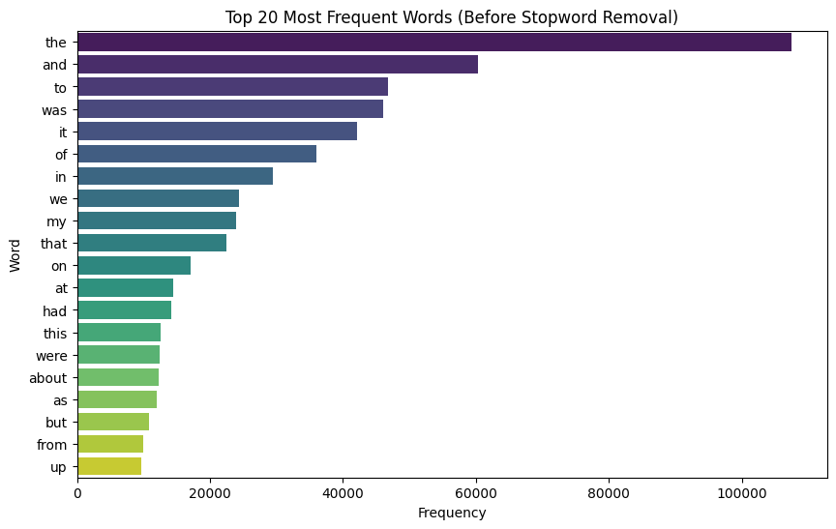
Vocabulary Analysis
Analyzed top 20 most frequent words.
Observation: High frequency of standard stopwords ("the", "and", "was") confirmed the need for strict stopword removal in the modeling phase.

Slide 10
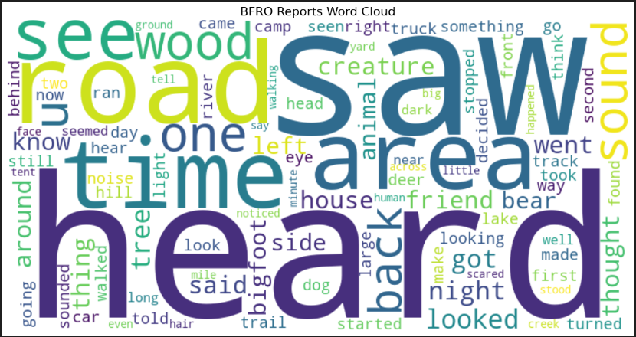
Vocabulary Analysis After Cleaning

Slide 11
Technical Pipeline
Dimensionality Reduction
Representation
c-TF-IDF & KeyBERT for keyword extraction
UMAP (Optimized for global structure)
Embeddings
Clustering
SBERT (all-MiniLM-L6-v2) for semantic understanding
HDBSCAN (Density-based clustering to handle noise)

Slide 12
Challenges
 | Narrative Noise | The "Super-Cluster"
Issue | Initial models were dominated by common storytelling verbs (went, saw, looked, time). The model clustered by writing style rather than content. | Early iterations grouped ~60% of data into one generic "Topic 0".
Solution | Engineering a domain-specific stopword list. Removed generic narrative fillers, common background terms (forest, woods) to force the model to focus on unique details. | Hyperparameter Tuning HDBSCAN: Lowered min_samples (from 7 to 2) to capture smaller, denser micro-clusters. UMAP: Increased n_neighbors (from 15 to 50) to preserve the global structure of the data. Vectorization: Aggressive max_df filtering (0.6) to remove words appearing in >60% of documents.

Slide 13
03
Results
What we can see in our data?

Slide 14
Key Findings (Topic Analysis)
Semantic Separation: The model successfully distinguished distinct types of encounters based on narrative context.
Incidents occurring while driving or near roads (keywords: road, ditch, driving).
Classic sightings in deep forests and national parks (keywords: national forest, campground, wilderness).
Encounters happening surprisingly close to homes (keywords: front yard, back yard, driveway).
Sightings associated with specific outdoor hobbies (keywords: fished, elk, horses, boulder).
Topic 1: "Residential/Farm"
Topic 0 (Dominant): "Roadside crossings"
Topic 4 (Proximity): "Residential Areas"
Topic 8: "River/Fishing"

Slide 15
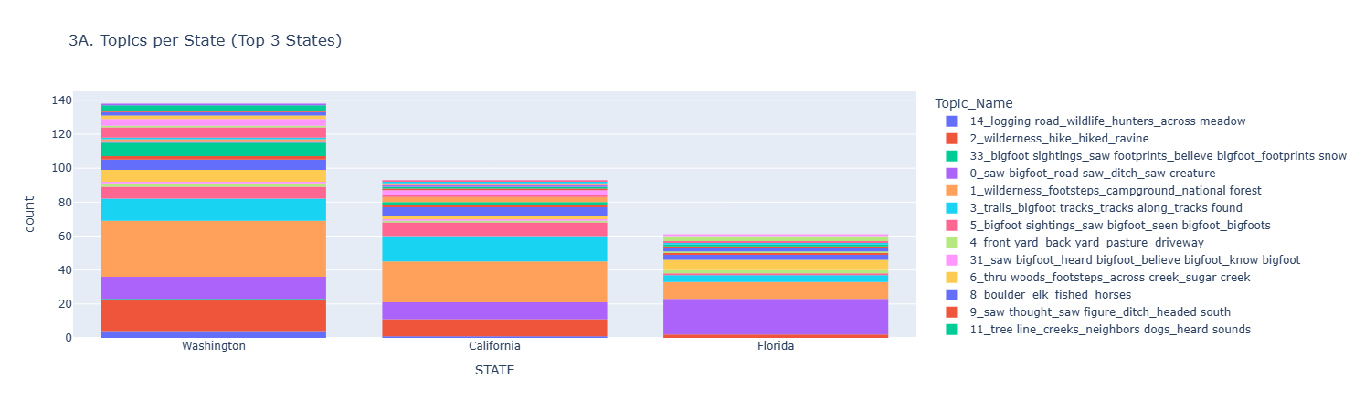
Geospatial Insights
Washington (WA) – The Wilderness Hub
WA shows a strong correlation with deep forest keywords ("national forest", „campground", „wilderness"), reflecting its dense Pacific Northwest geography.
California (CA) – The "Active Terrain"
High volume of Topic 3 („Trails & Tracks"). A bit less "camping" than in WA, "hiking/trails" and difficult terrain ("ravine", "steep hill"), reflecting the Sierra Nevada geography.
Florida (FL) – Roadside Domination
In case on Florida we can see a dominance of Roadside crossings

Slide 16
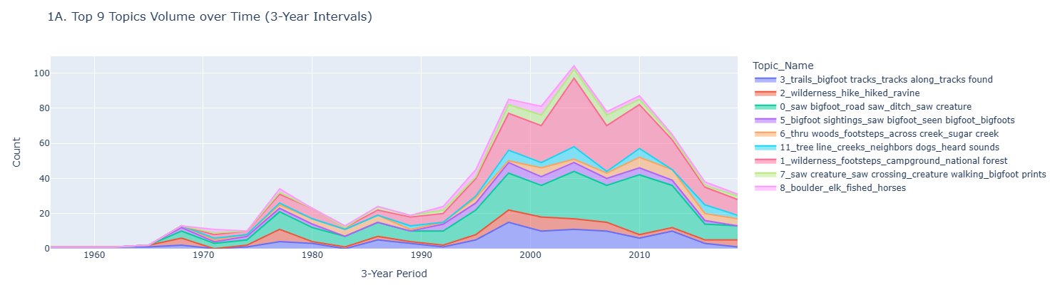
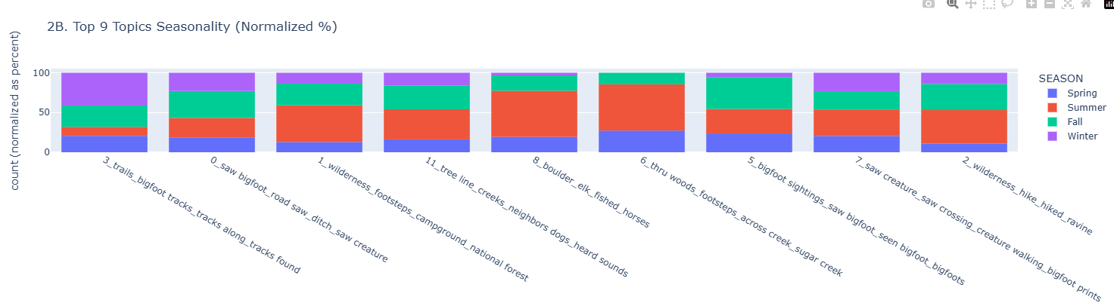
Seasonality & Timeline
Timeline
Significant peak of all observations in 2000s - Sasquatch: Legend Meets Science and Internet Effect
Seasonality
Trails related topic with winter dominance
Fishing topic mostly in summer
Generally mostly summer and spring

Slide 17
04
Conclusions
Projects’ achievements and future posibilities

Slide 18
Conclusions & Future Work
Summary
Methodological Success
Future Improvements
Successfully extracted structured topics from unstructured text.
Proved that density-based clustering (BERTopic) is effective for narrative reports even with varying lengths.
Could incorporate the ENVIRONMENT column as a guided variable or test different embedding models

Slide 19
Thanks!
Do you have any questions?
Bigfoot sasquatch is his bff!!

