Slide 1
Reproducible Research
Wojciech Misiura 410579
Tarlan Aghayev 455149

Slide 2
Aim of the project
Verify the reproducibility of the code.
Transform code from original code written in Python to R.
Ensure that the project written in R is reproducible.
Improve the results

Slide 3
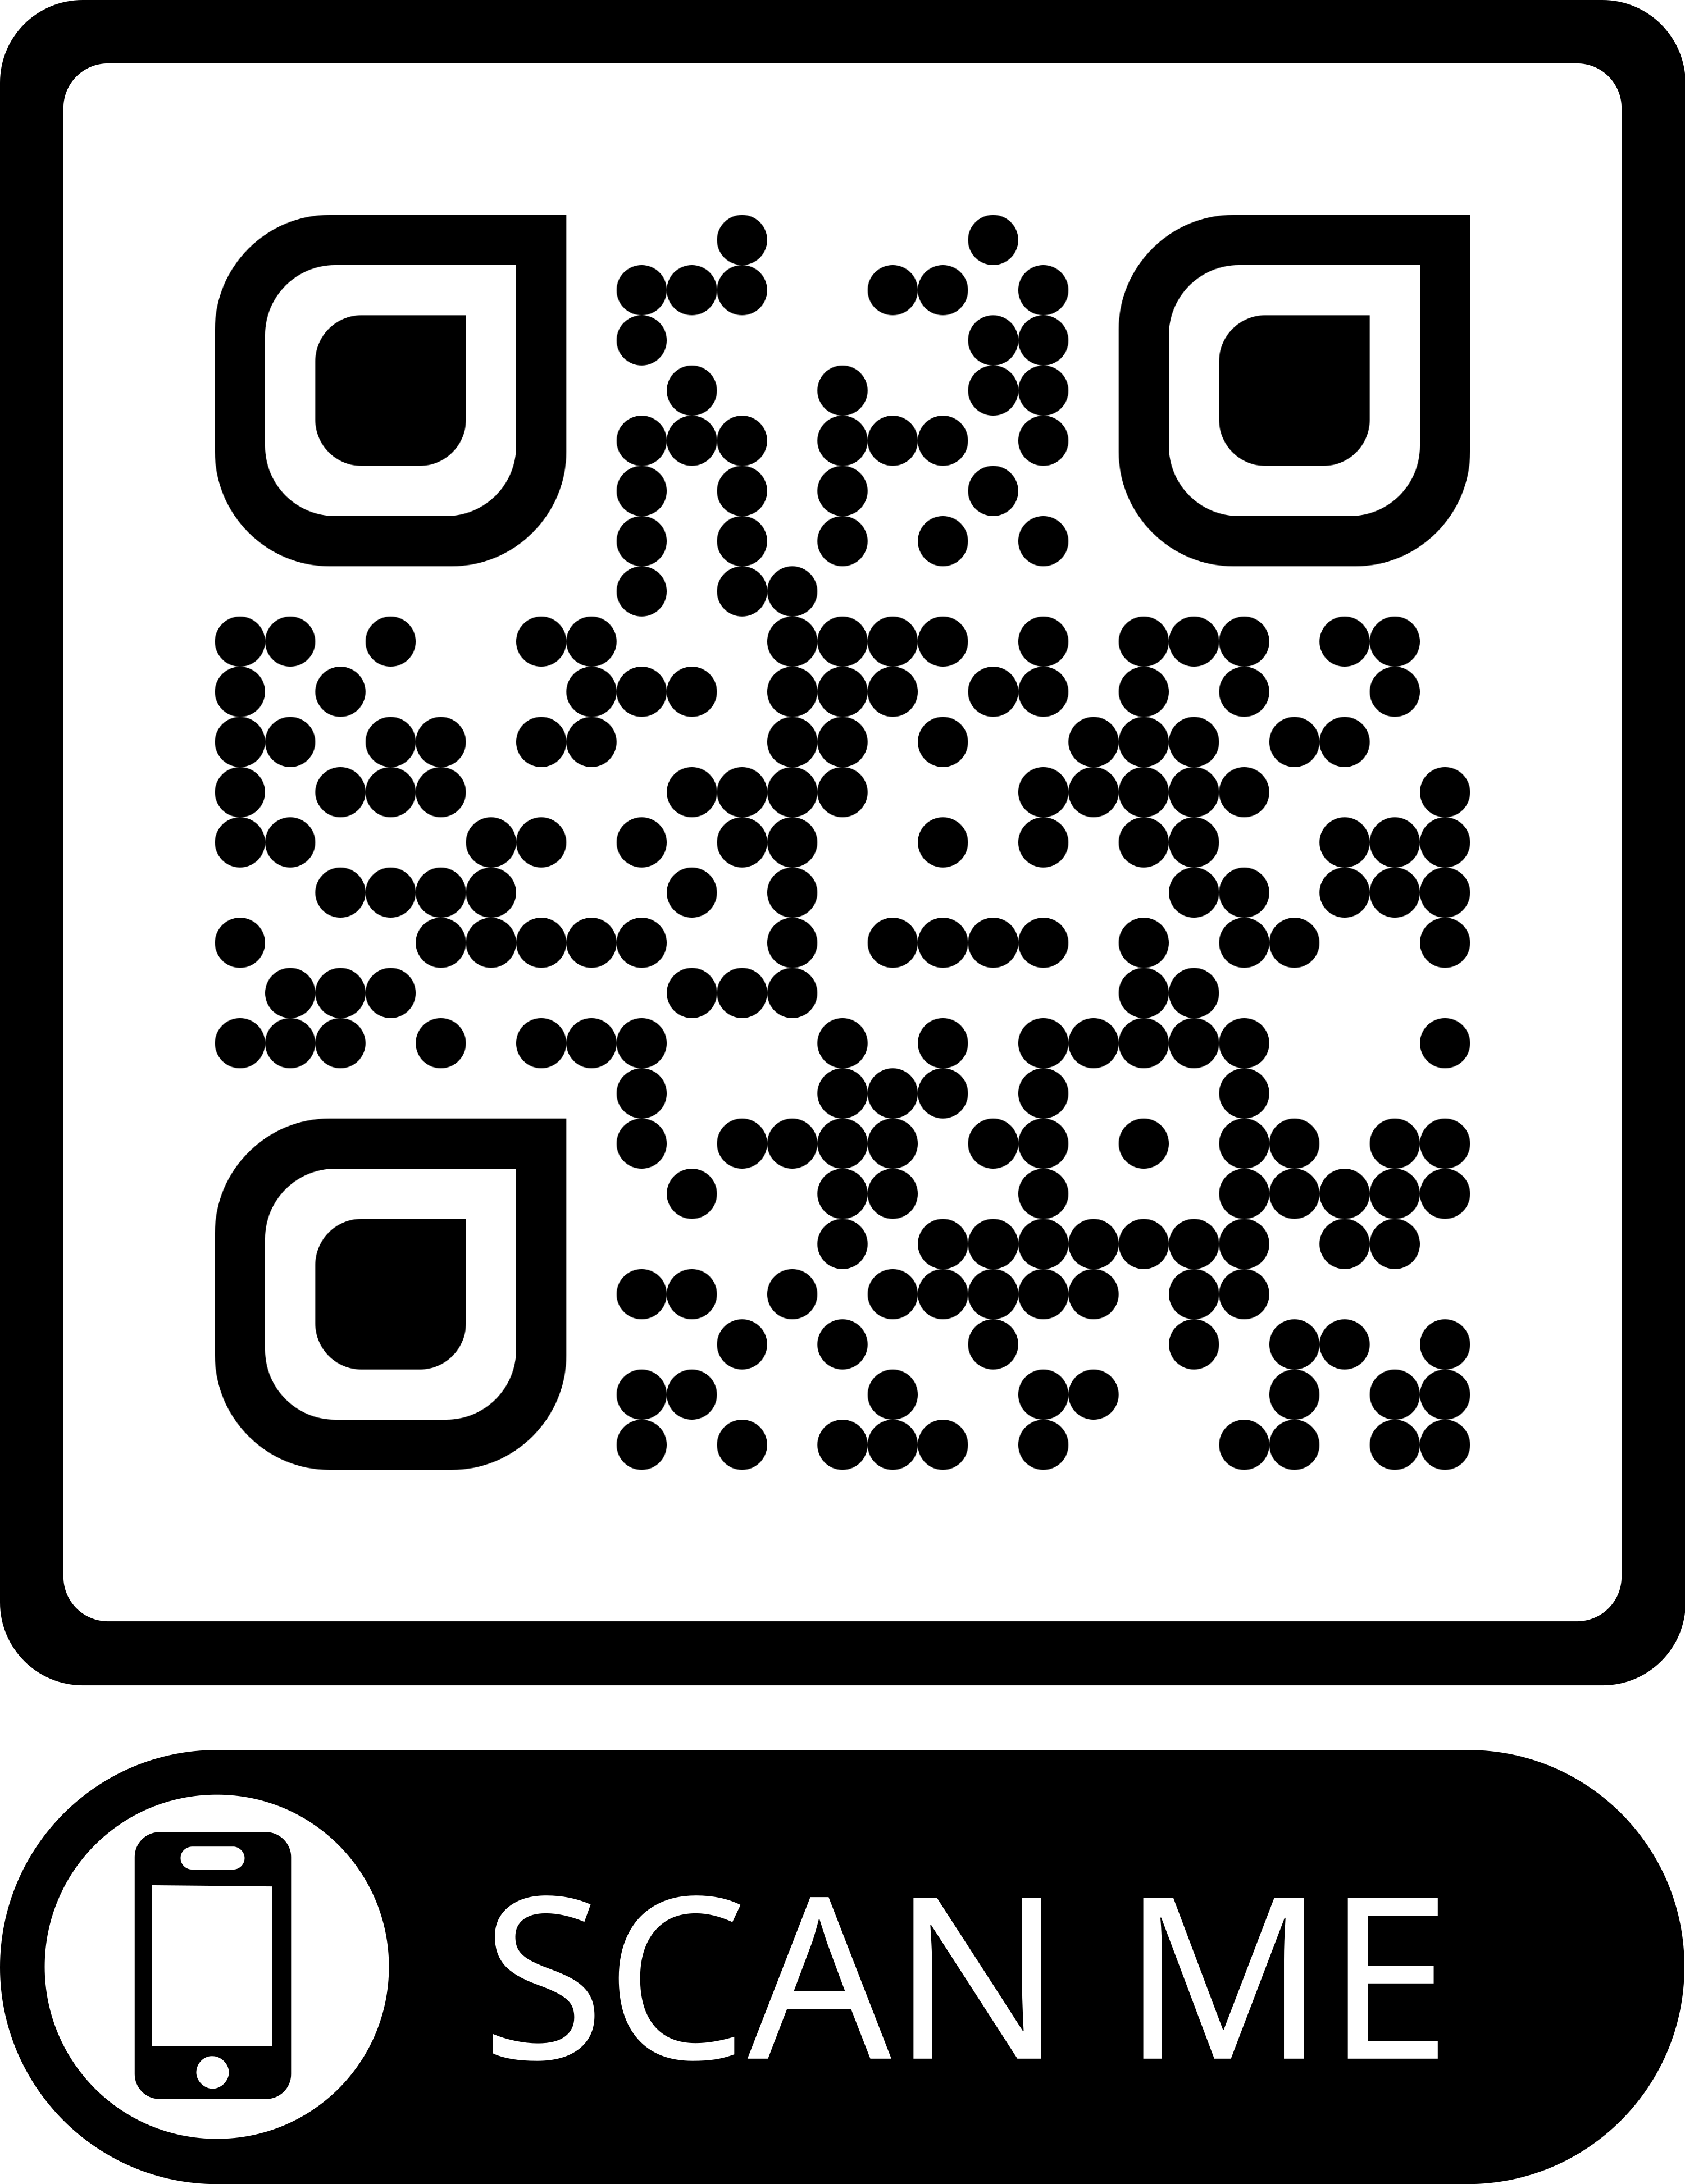
Reference project
Project was selected from kaggle.com and presented usage of Decision Tree machine learning model on dataset available on kaggle.com.
Dataset was taken from UCI website and represented only selected number of observations – around 11k out of 45k.
The core aim is to predict if the customer will subscribe or not

Slide 4


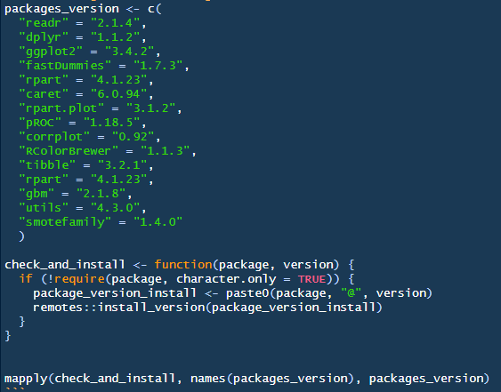
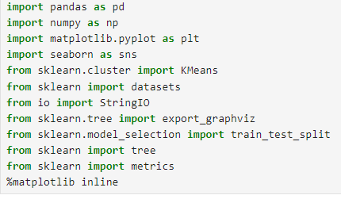
Code Transformation - Libraries
Python
R

Slide 5
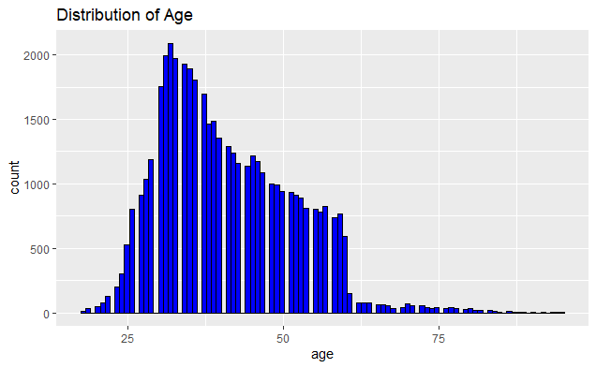
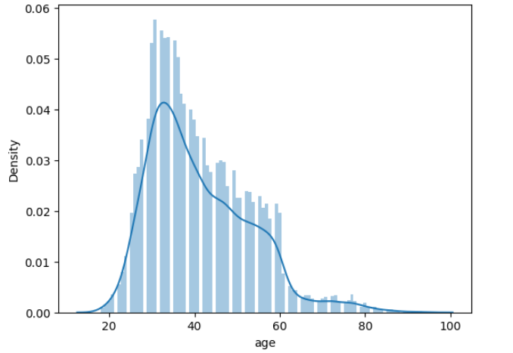
Code Transformation – Data Analysis
Python
R

Slide 6
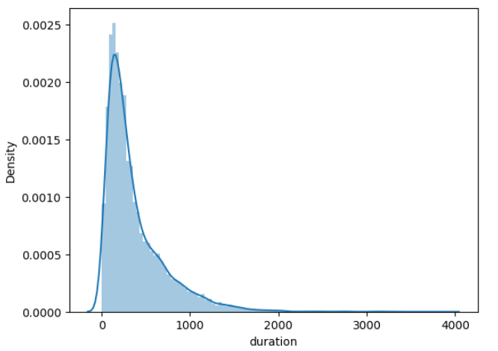
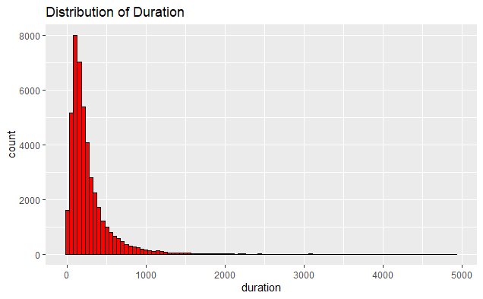
Code Transformation – Data Analysis
Python
R

Slide 7
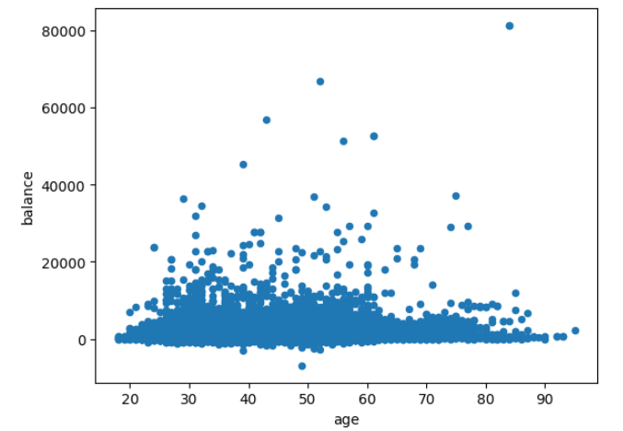
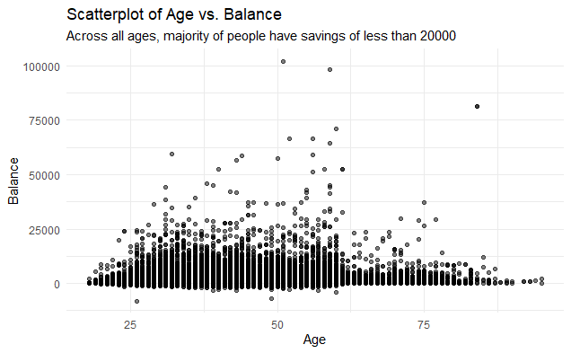
Code Transformation – Data Analysis
Python
R

Slide 8
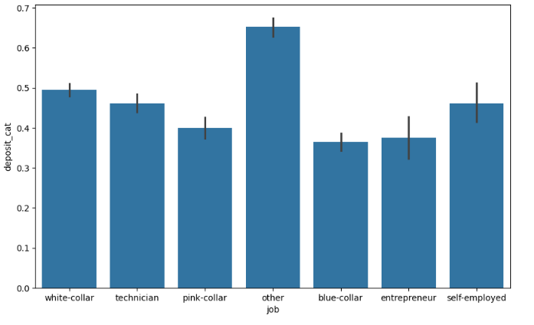
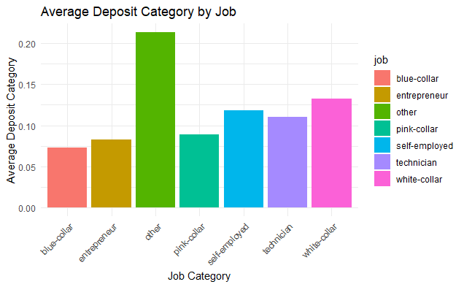
Code Transformation – Data Analysis
Python
R

Slide 9
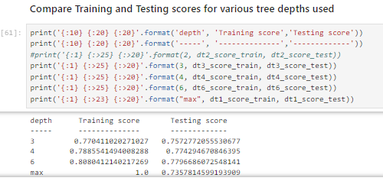
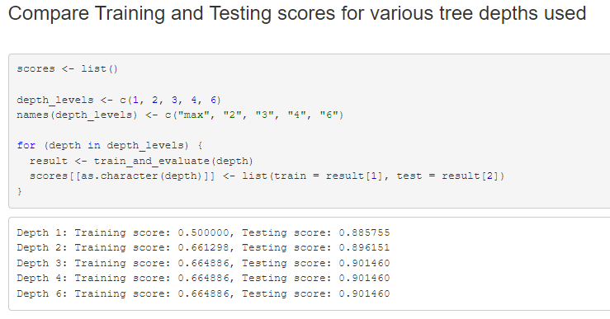
Model Results – Decision Tree Classifier
Python
R

Slide 10
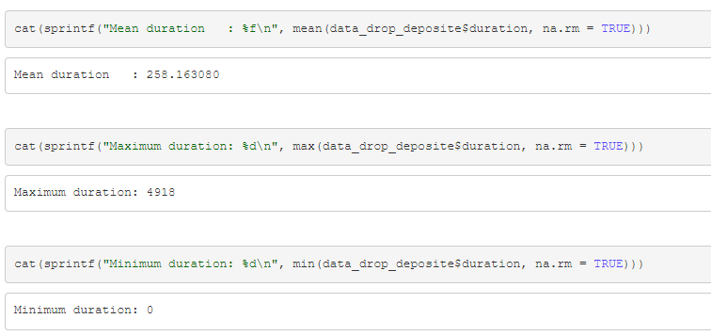
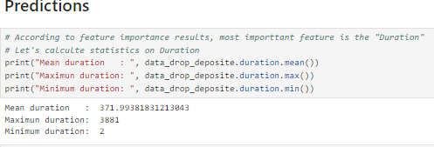
Model Results – Decision Tree Classifier
Python
R

Slide 11
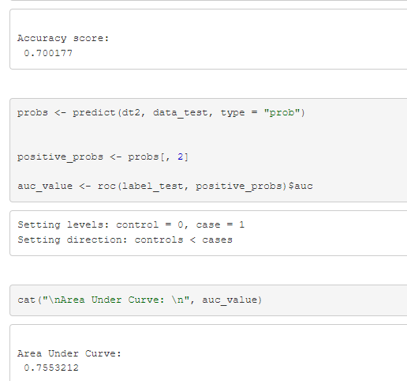
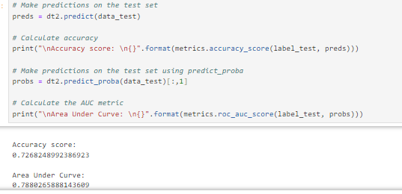
Model Results – Decision Tree Classifier
Python
R

Slide 12
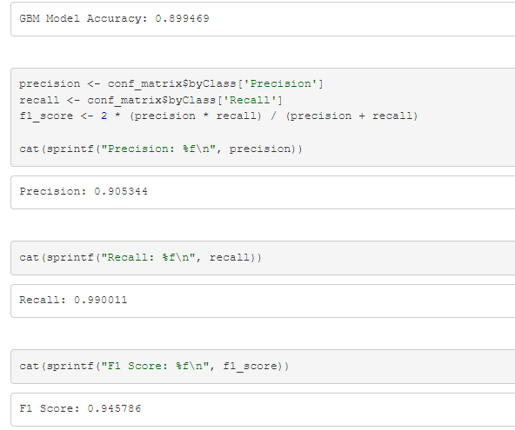
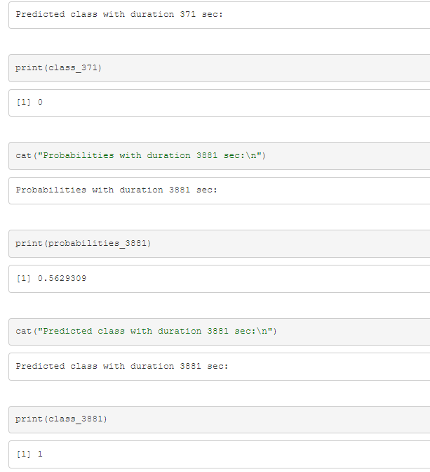
Model Results – Gradient Boosting
R

Slide 13
Project improvements
Added library verification as dependency and fixed versions of libraries
Ensured data is loaded from UCI repo (original site where dataset was uploaded) instead of Kaggle
Fixed the seed
Implemented code comments to provide code narration

Slide 14
Project improvements
Transformed project from Python to R
Trained model on complete dataset instead of 5%
Additional Exploratory Analysis
Fixed the error of balancing the test dataset. Now only train data is balanced, and test data follows the distribution of the original dataset.
Implemented Gradient Boosting machine learning model

Slide 15
Conclusion
We did manage to reproduce the project in different code languages, however we achieved different results.
Difference results from original author not fixing seed used by machine learning functions.

Slide 16
AI usage
We used following AI tools while building our project:
Chat GPT 4.0 and 4.0 omni
Microsoft Copilot for code error resolution.

Slide 17
Thank you

