Slide 1
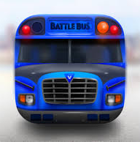
Battle Bus
Play to win discounts on your travel
Hugh Ashby-Hayter
Sarah Leach
Wojciech Nowak

Slide 2
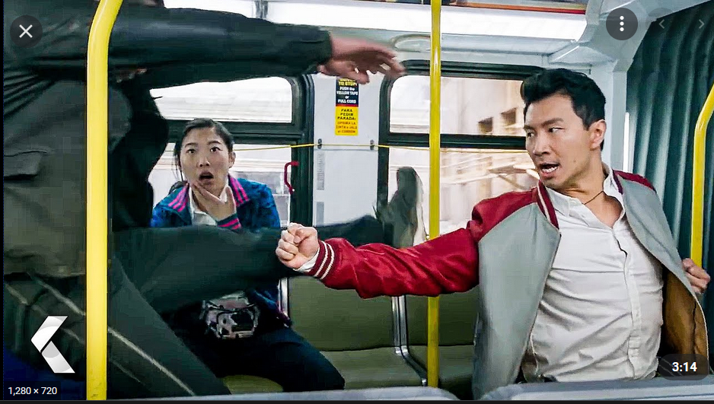
It may be a little competitive…

Slide 3
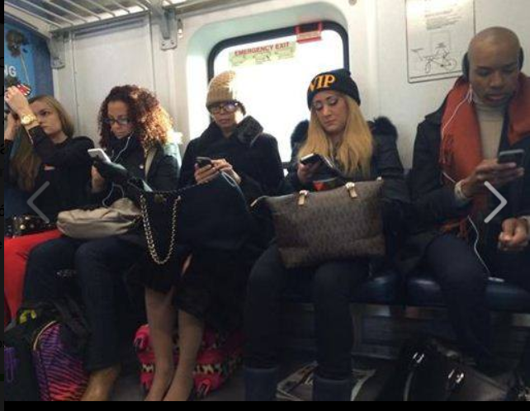
Don’t worry it will look like this

Slide 4
Aims
Provide bus passengers with entertainment via an app
Play against other passengers to earn discounts on travel
Provide multiple games to suit different passengers
Leaderboard to show user rankings
Reach higher level in game to earn bigger discounts
Encourage users to travel more frequently
User required to login so avoiding fare evasion
Track users anonymously

Slide 5

Solution
Front end user app developed using Angular
Back end service developed in C#

Slide 6
Time for a demo

Slide 7
Future Enhancements
Inform user if they do not have enough time to finish the game based on their destination
Offer option to buy another ticket to continue
Notify user when opponent is on board
Pokemon style events

Slide 8
Everything comes to an end…
THANK YOU

