Slide 1
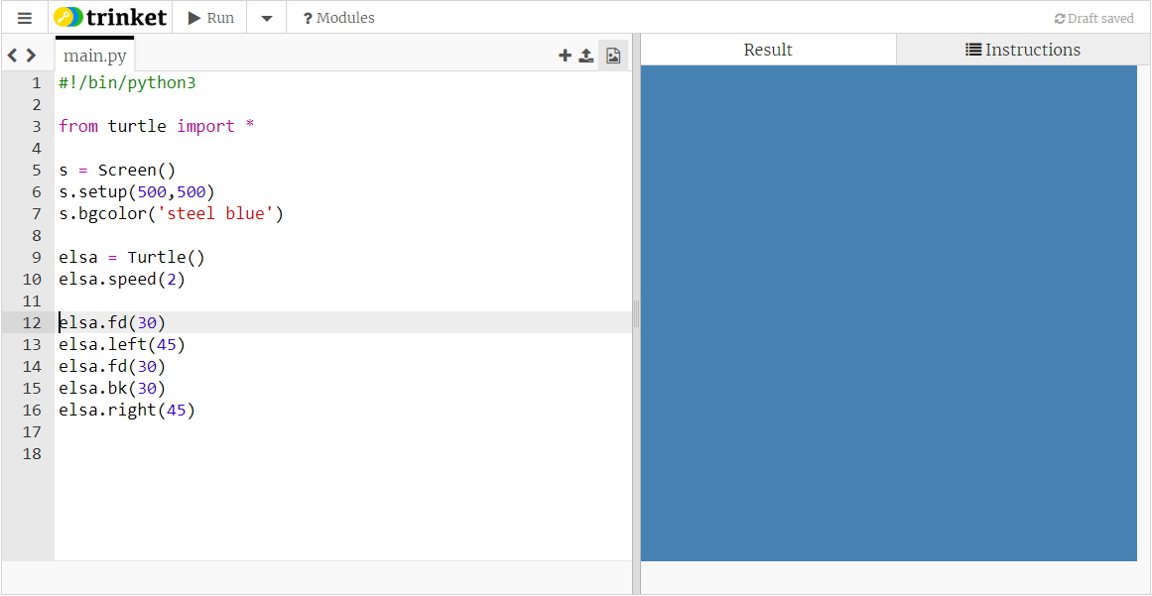
Import turtle library
Set up turtle screen
Make a turtle, give it a gentle speed
Code some forward and backward moves, and turns

Slide 2
The number 30 here will set the size for the whole snowflake. If we wanted to change the size we’d have to change it in three places...

Slide 3
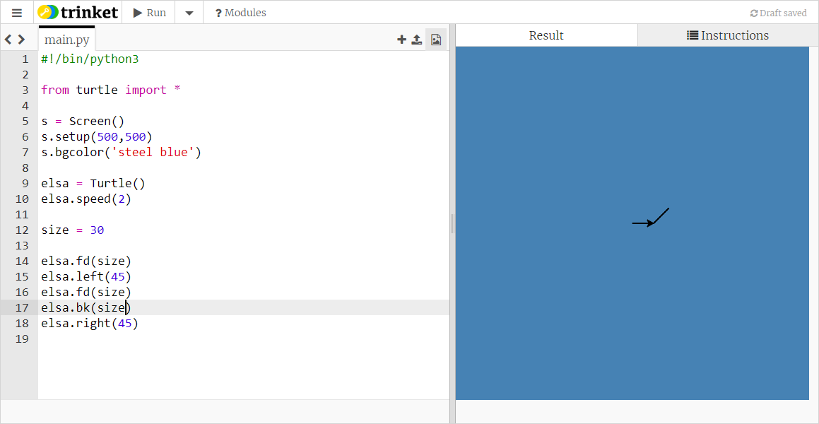
Make a variable for the size

Slide 4

Repeat these lines 3 times

Slide 5
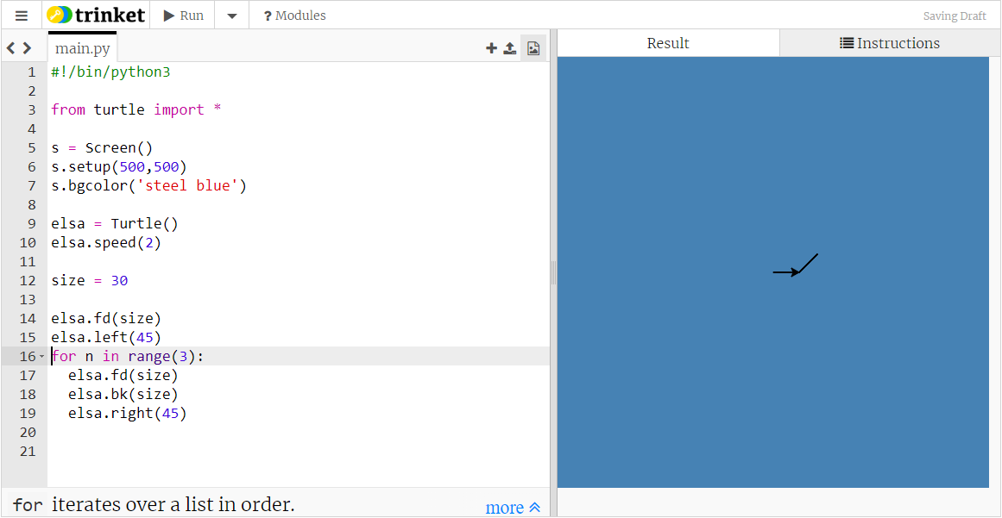

Slide 7

Want to get elsa to here pointing to the right

Slide 8
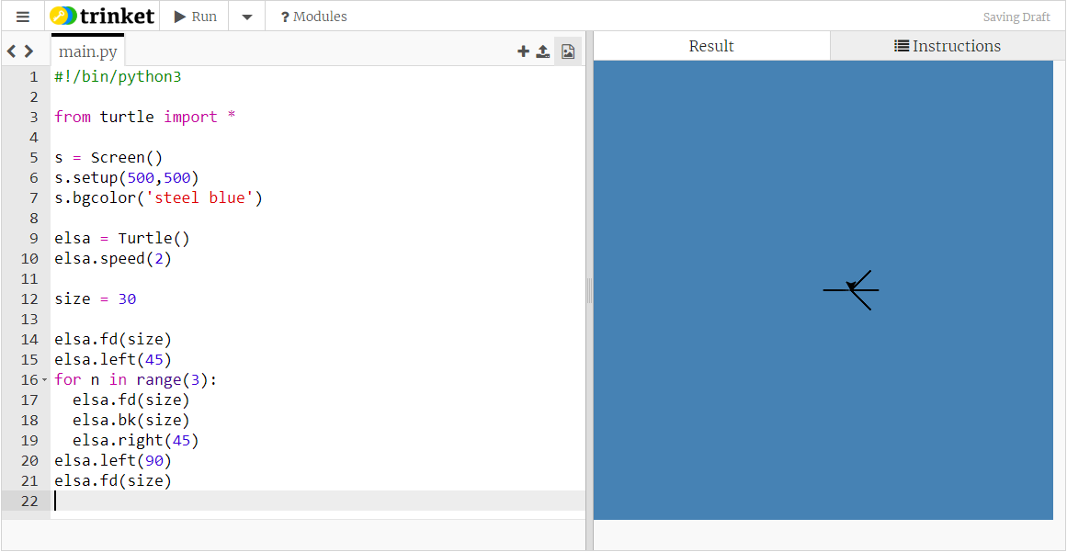

Slide 9


Slide 10

Repeat these lines 3 times

Slide 11
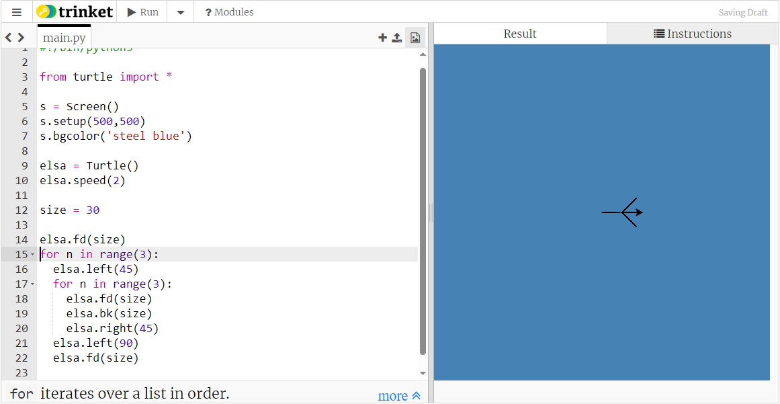

Slide 13
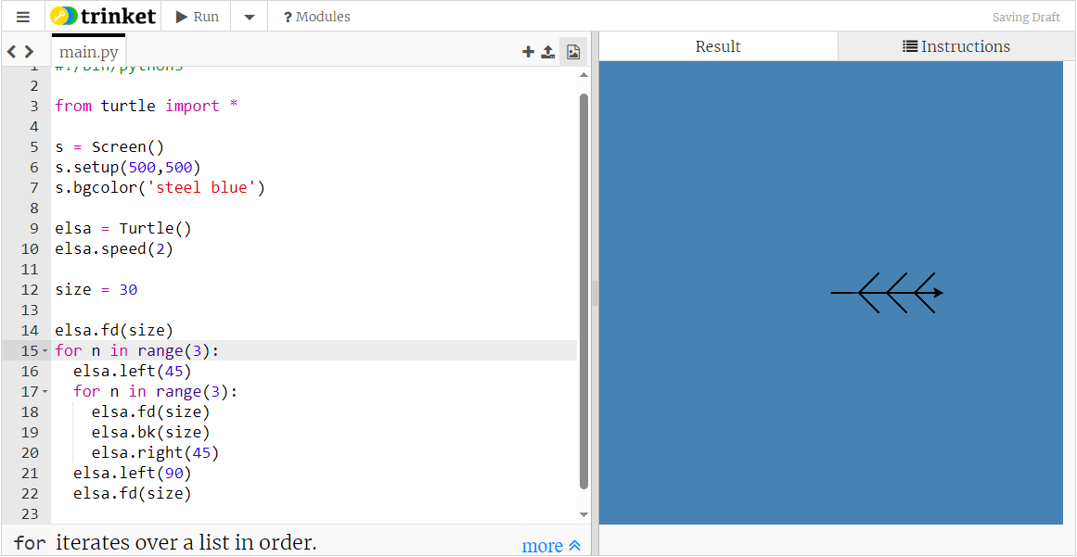

It works, but as a rule it’s better to use a different loop variable for each loop when the loops are nested

Slide 14
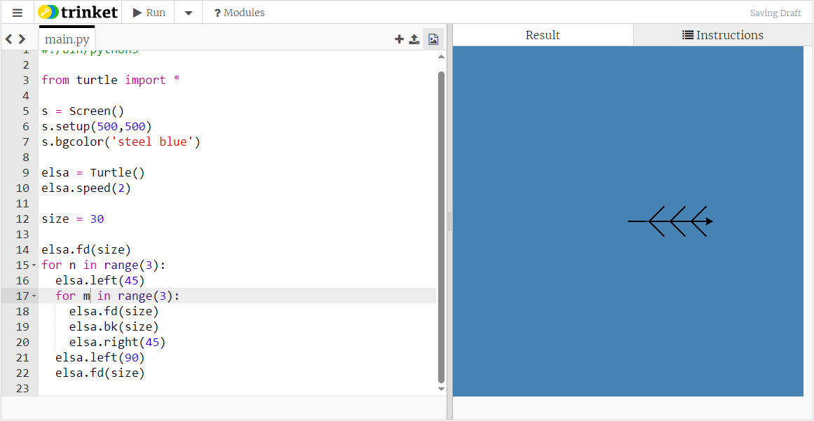
It works, but as a rule it’s better to use a different loop variable for each loop when the loops are nested

Slide 15
Want to get elsa to here pointing to the right

Slide 16
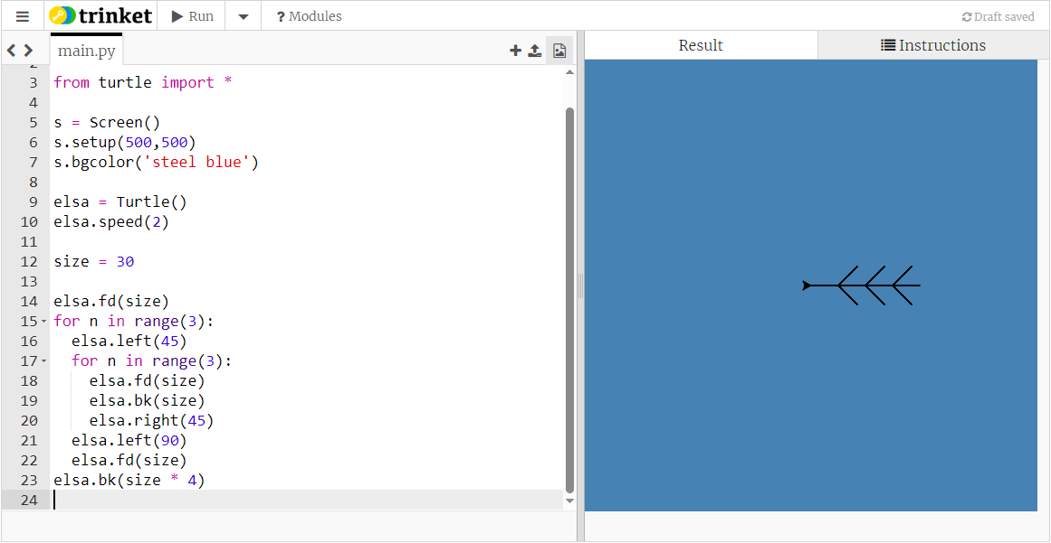
This is the code for a complete branch of the snowflake.
Put all these lines into a function

Slide 17
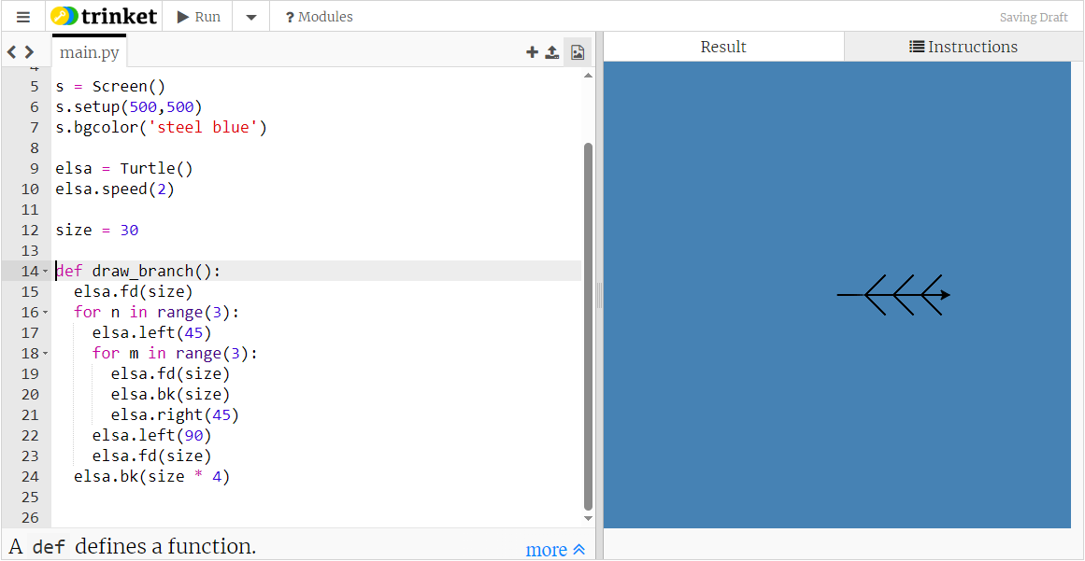
The word def
a name for the function
brackets
colon
All the code which you want to be part of the function is indented.

Slide 18

Run the code:
Nothing happens

Slide 19
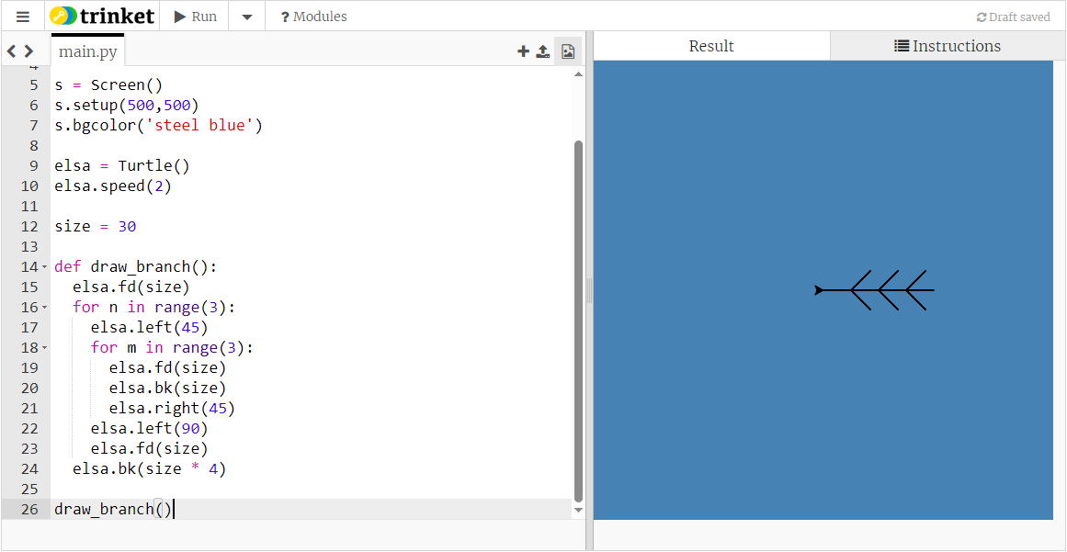
Call the function

Slide 20
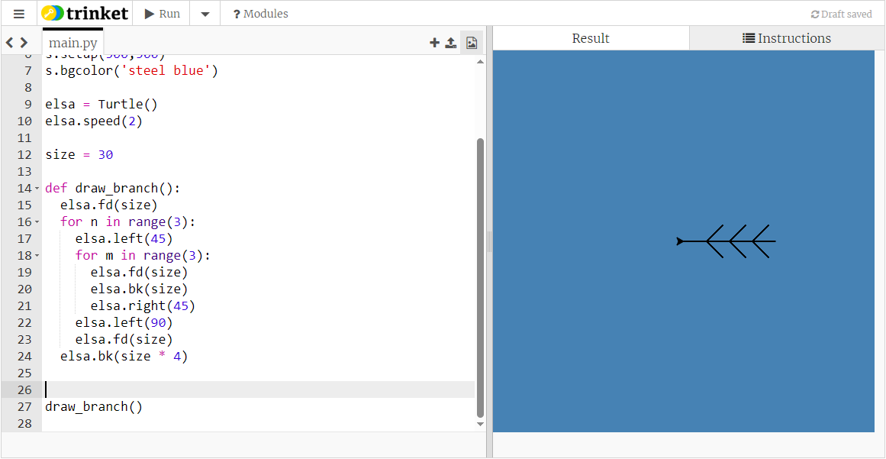
To draw the whole snowflake we need to draw six branches, so we need to repeat the function call six times

Slide 21
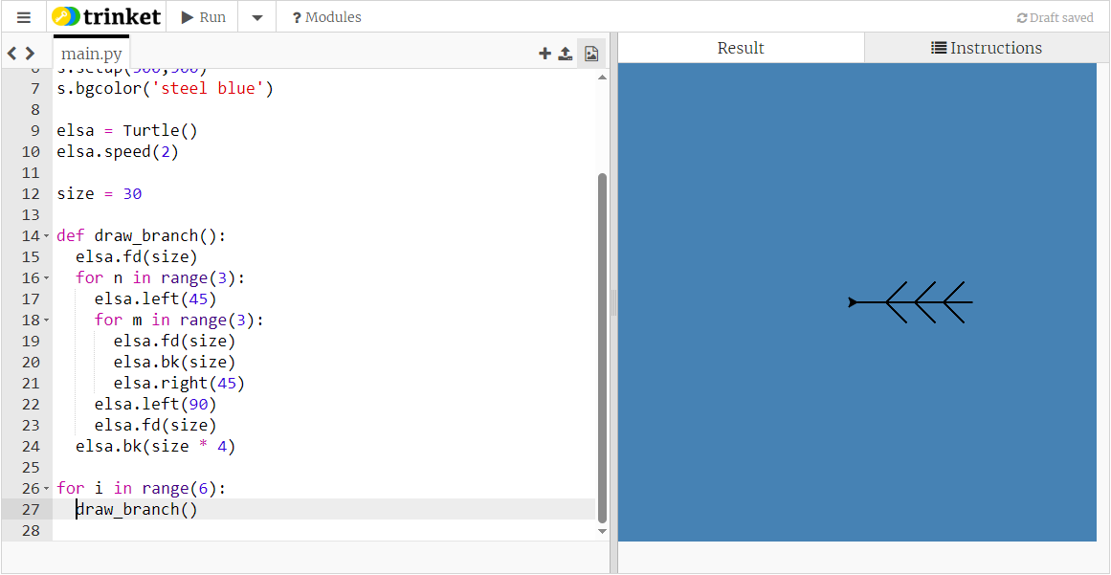
But this just draws the branch six times in the same place...

Slide 22


Slide 23


Slide 24
Now that we know how to draw a branch we don’t need to sit and wait while the turtle works its way round all the branches.
So we’ll add two lines of code to get the turtle to draw the whole snowflake in one go - one line at the top of the code and one at the bottom.

Slide 25
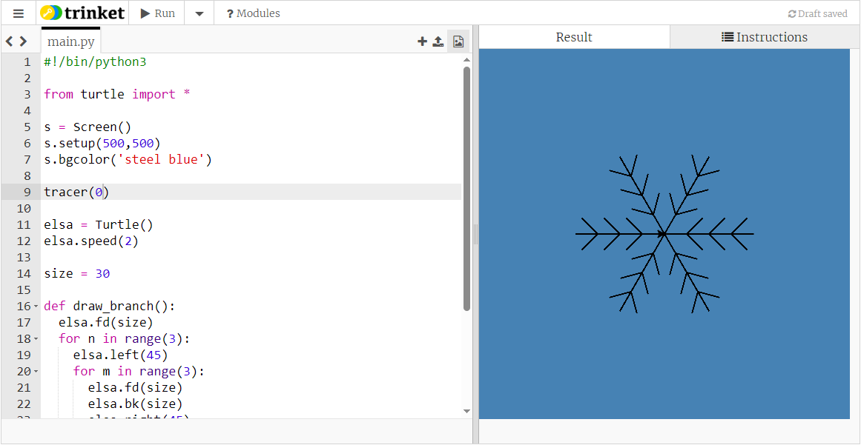

this line near the top
this line at the bottom

Slide 26
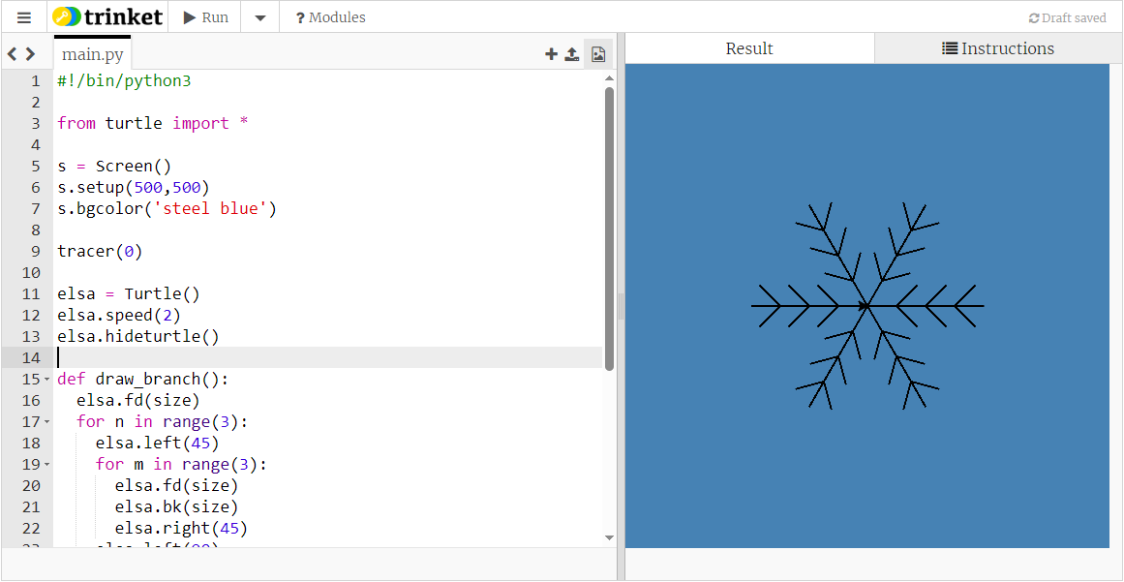
We can still see elsa at the middle of the snowflake, but we can hide her

Slide 27
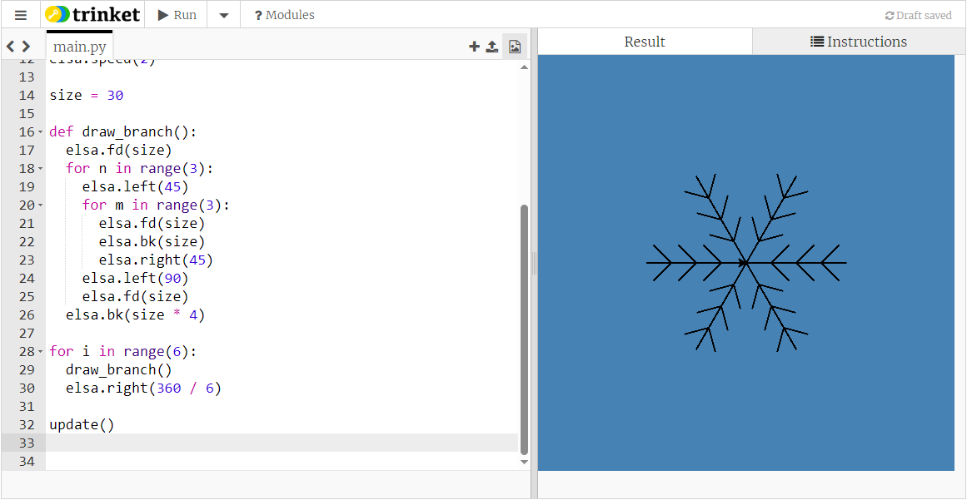
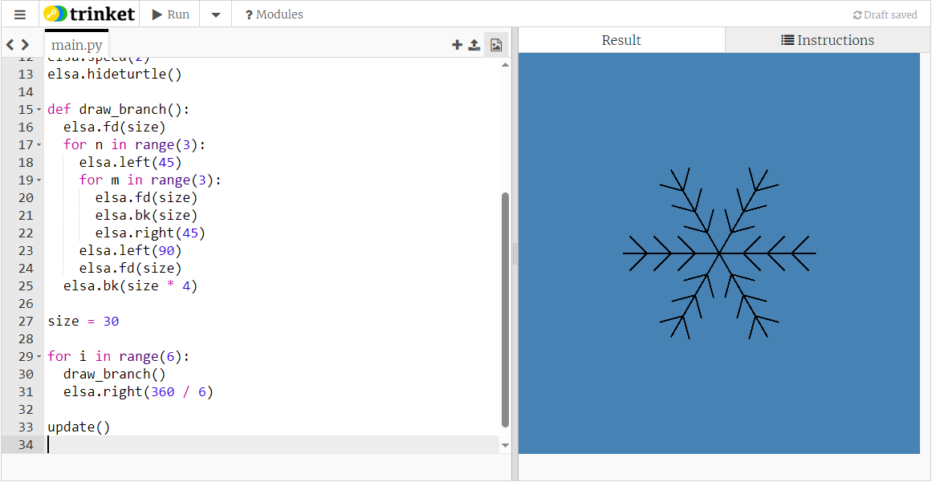
move the size line to be with the other lines which draw the snowflake
These lines of code draw a snowflake, so we will want to repeat them to get multiple snowflakes

Slide 29

How about some random variation in the size of our snowflakes?

Slide 30
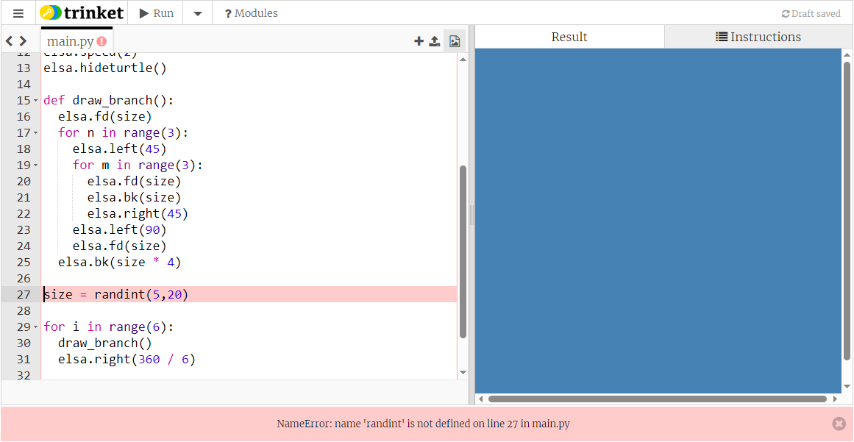
It can’t find the function randint()

Slide 31
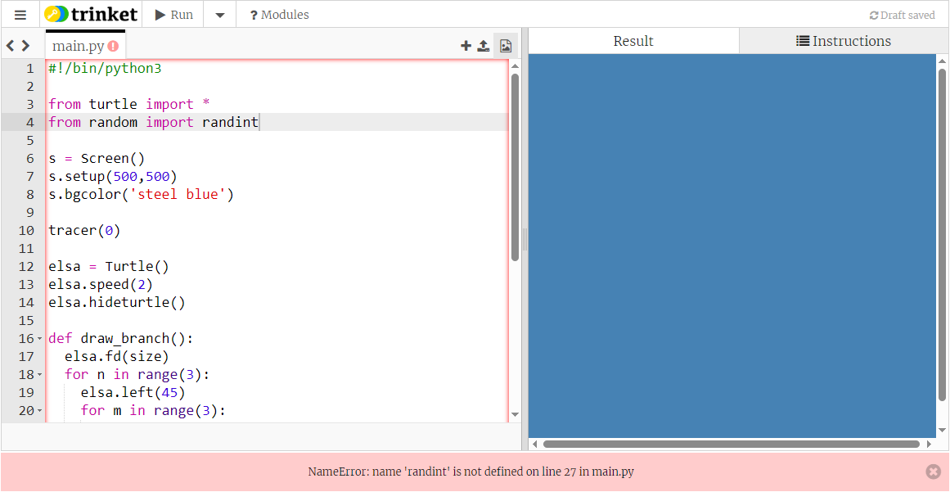
because we need to import it from the random library

Slide 32

Run the code a few times

Slide 33

Run the code a few times

Slide 34

Run the code a few times

Slide 35

elsa doesn’t always need to start pointing to the right

Slide 36
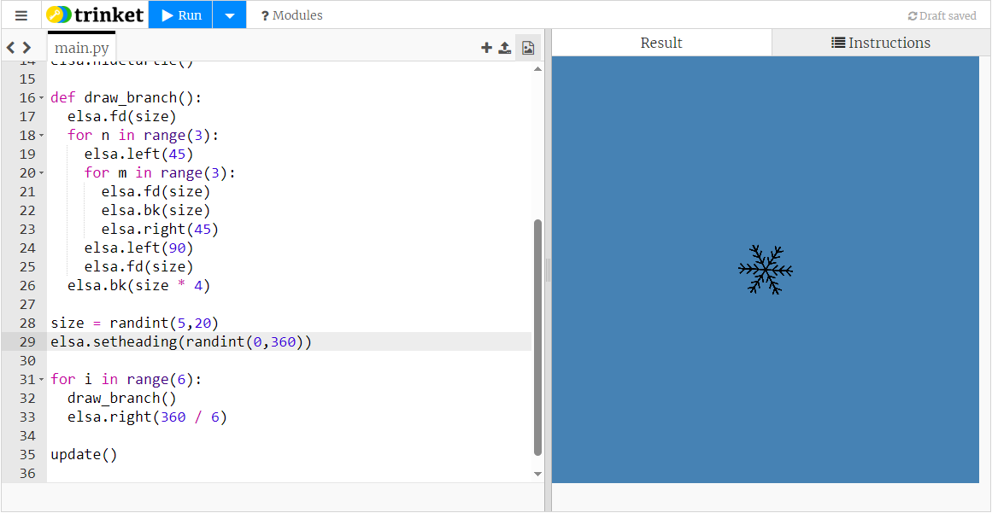

Slide 37


Slide 38
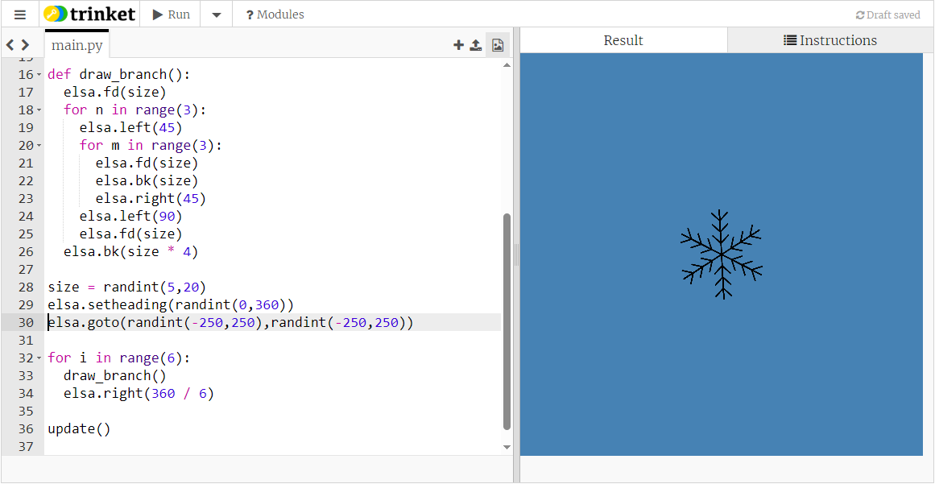
pick a random position for elsa

Slide 39


Slide 40
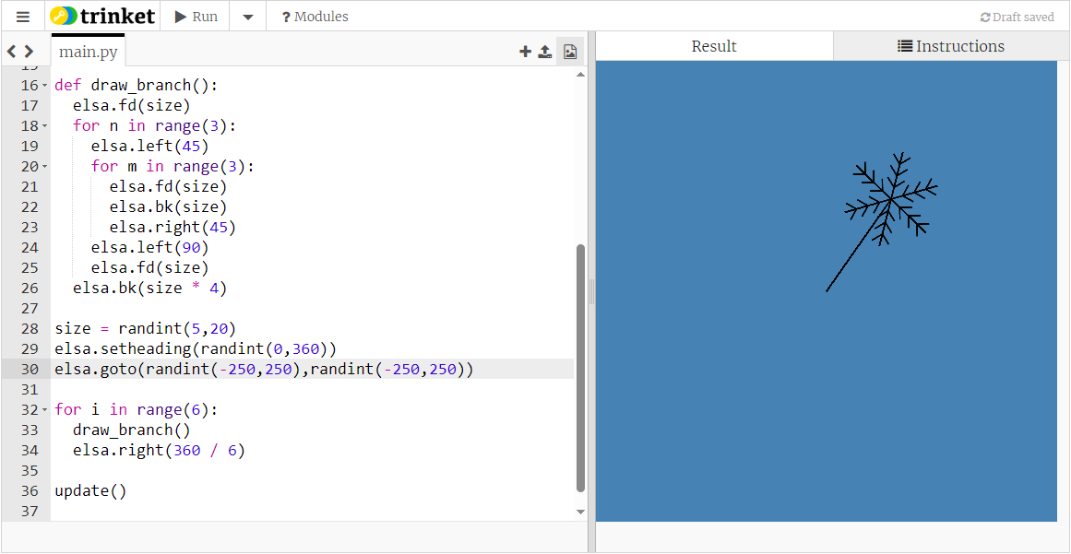
but now elsa’s drawing a line from position 0,0 to its random position

Slide 41
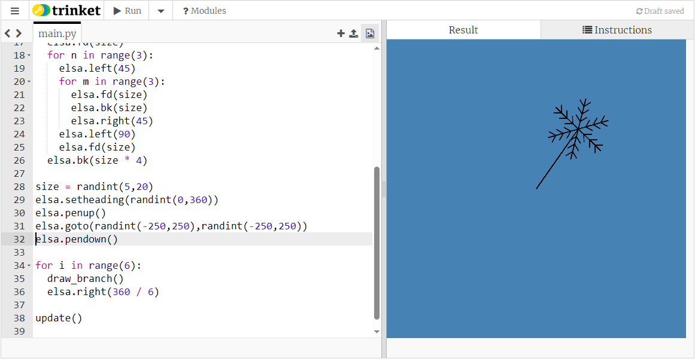
so add penup() and pendown() code

Slide 42
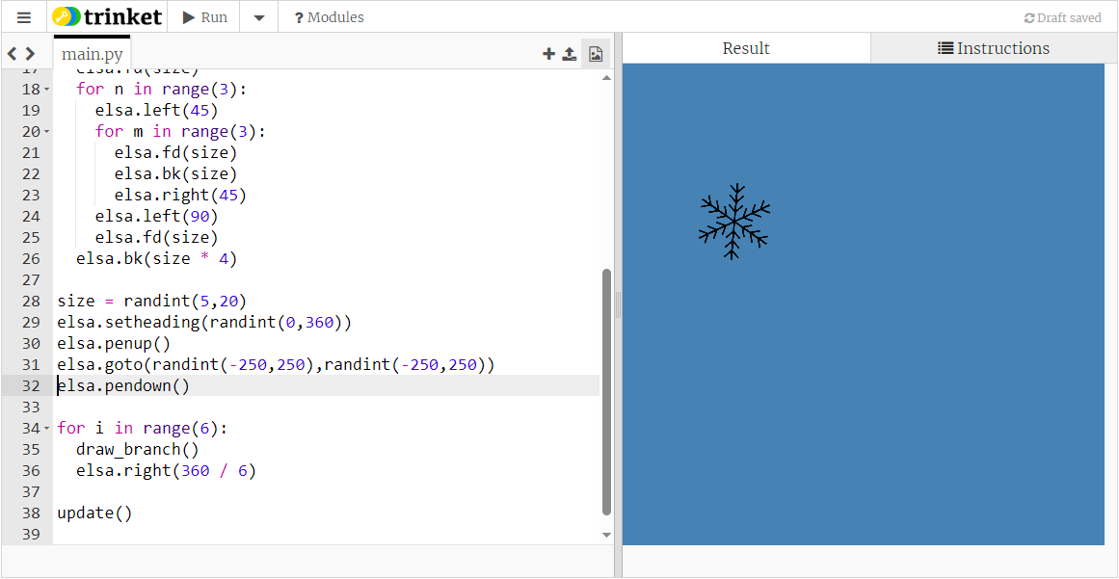

Slide 43
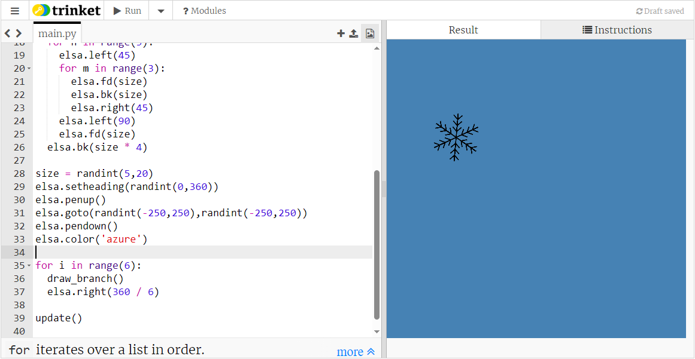
Give elsa a more snowflakey colour

Slide 44
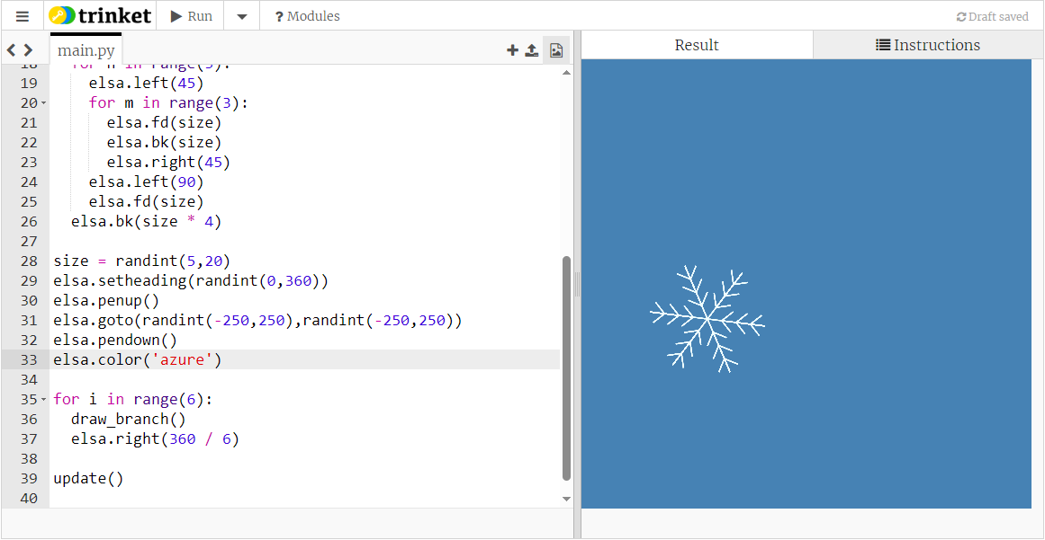

Slide 45
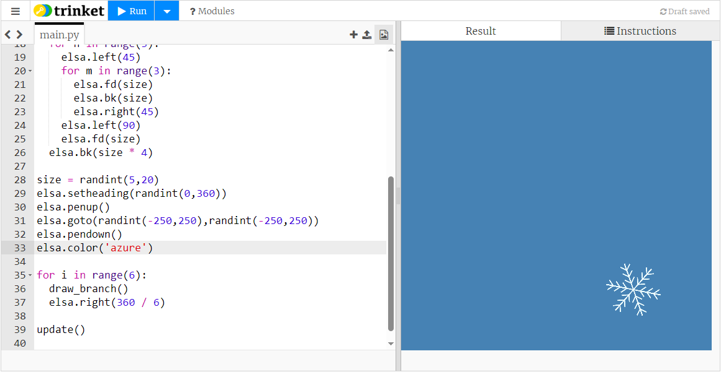
These lines of code draw a snowflake, so we will want to repeat them to get multiple snowflakes

