Slide 1
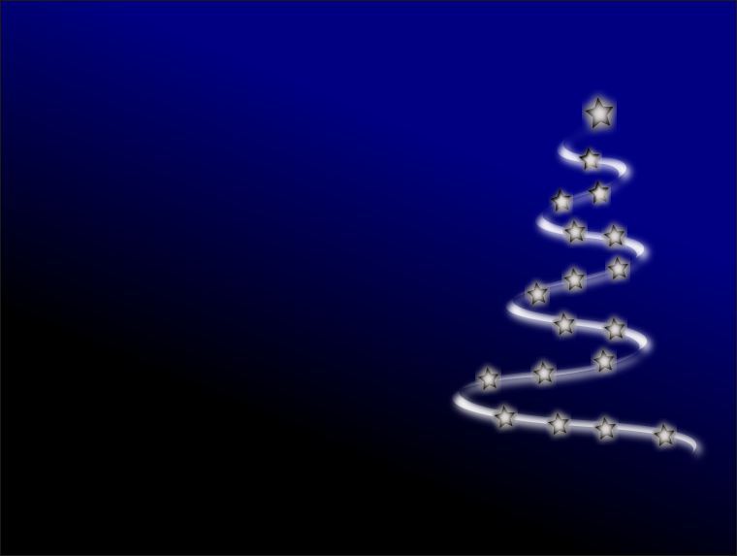
Wokingham Library Code Club
Christmas Scratch Coding Challenge 2020

Slide 2
The Challenge
Use Scratch to make an animation (up to 45 seconds long) for the festive season.
This year’s challenge will be for Code Club members doing our Scratch sessions, and not open to those who have now moved on to learning Python. We hope anyone who is now learning Python will have a go at the Python challenge this year!

Slide 3
How to get a really good score:
Do really clever coding. This will get more marks than just making nice graphics.
Here are some things to include in your code:
Lots of Movement
If/else blocks
Repeat blocks
Variables
Random Numbers
Clones
Calculations
Messages
You can use sound as well, if you like.
Try using a Scratch block you have never used before!

Slide 4
How to submit your entry:
When you have perfected your Scratch animation make sure you Share your project.
Send the link to your shared project to
Elizabeth.McDonald@wokingham.gov.uk
before 5pm on Thursday 17th December 2020.
The code club organisers will look at all the entries and decide the scores before the online Scratch session on Saturday 19th December 2020.

Slide 5
Judging and awards:
At theScratch session on Saturday 19th December 2020 all the entries will be shown to everyone, using Microsoft Teams Share Screen. You can give a short introduction to your entry if you like.
At the end we will announce the results.
We will send out certificates to the best entries, but unfortunately it won’t be possible to give any prizes this year.

Slide 6
Stuck for ideas?
We have put together a couple of Scratch starter projects with lots of sprites and backdrops which might help you with ideas. These are shown on the next couple of slides:
Decorate a Christmas tree - make lots of decorations and lights and have them move into position on the tree
Create an animated winter scene - use sprites of winter-related items and animate them - perhaps you could make falling snow!

Slide 7
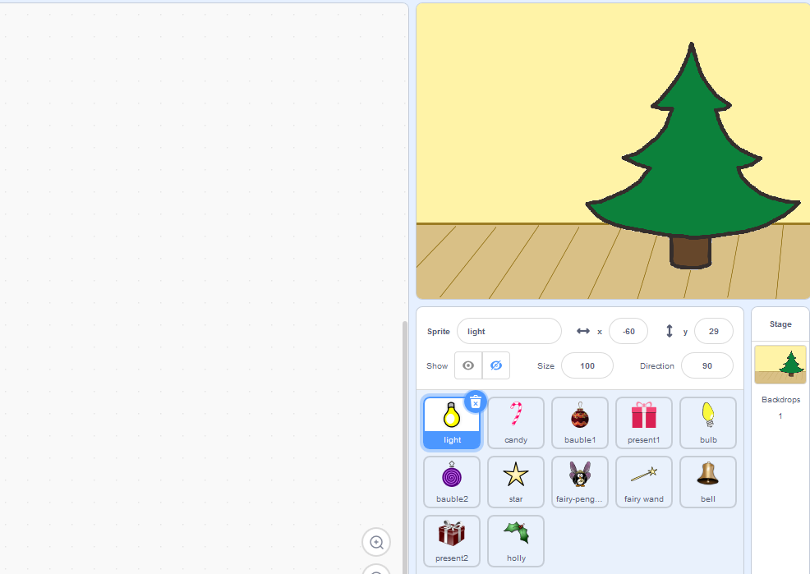
scratch.mit.edu/projects/346471686/editor/
Ideas:
decorate a Christmas tree
Go to this project page while you are logged in with your Scratch user and Remix the project to be able to work on your own version

Slide 8
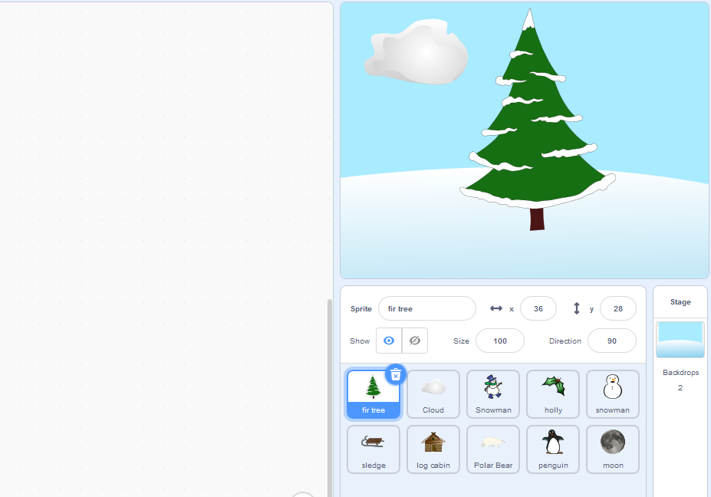
scratch.mit.edu/projects/348937468/editor/
Ideas:
animate a winter scene
Go to this project page while you are logged in with your Scratch user and Remix the project to be able to work on your own version

Slide 9
Our webpage on github:
github.com/WokLibCodeClub
Details of the Christmas Challenge are in the section called:
Christmas-Coding-Challenge-2020

