Slide 1
Amogos ඞ
(pronounced A-mog-O-S)

Slide 2
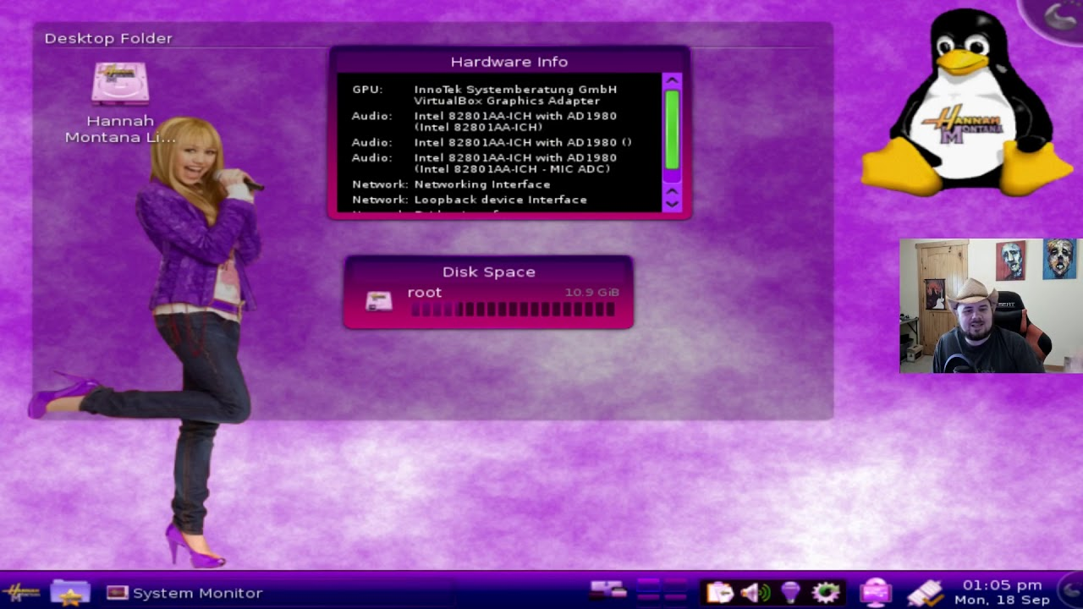
What is Amogos?
A parody OS inspired by Among Us ඞ.
This was mostly inspired by this reddit post. AmogOS is a meme OS based on the hit game Among Us, in the same vein as Hannah Montana Linux, but it's also developed and made to be a lightweight operating system. AmogOS is also less bloated than some other distros (cough cough Ubuntu). Chad AmogOS vs bloated mainstream distro, as youtuber TechHut put it.
Hannah Montana Linux

Slide 3

History
“This project was initially started as a joke in May 2021. Since then, it's been a incredible journey, meeting so many people and getting recognized by prominent individuals in the Linux space. Everything comes to an end, and as both Among Us and AmogOS have progressed far past their height, it's time we started looking forward. Who knows, maybe someday someone will be inspired by AmogOS to make a "SaulGoodmanOS" or a "FallGuys Distro". Either way, everyone who's been along for this journey will be there to have a laugh or two. The OS will still be available for download, for those in the future that discover it. The discord is also still suprisingly active, so hop in if you need support or want to chat.”
<- quote by Nooz (Lead Dev)

Slide 4

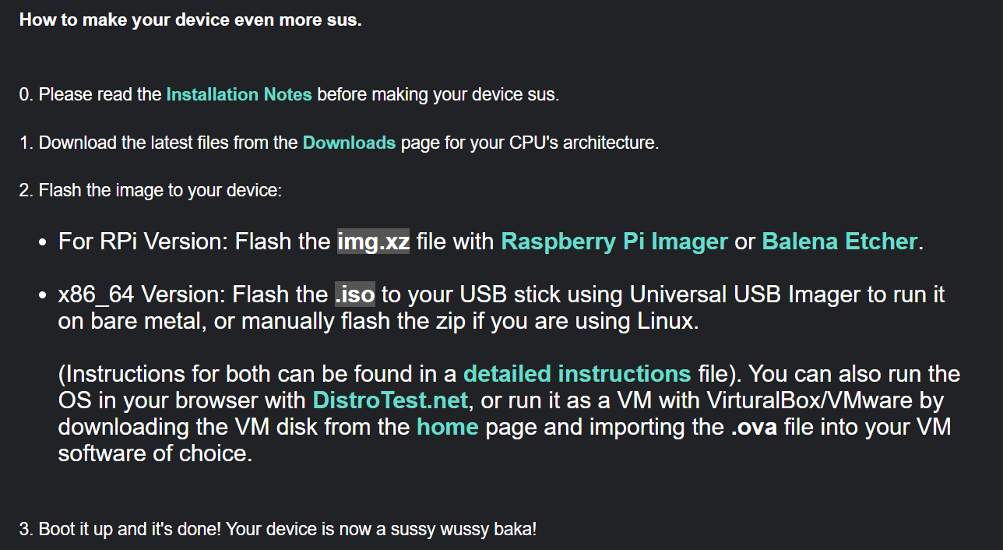
Installation

Slide 5
Features
Incredibly sussy
Custom wallpapers and start menu icon that can be found in ~/Pictures/.amogOS/. (or download them here)
Grey color palette to match Among Us tablet 😳
Custom neofetch logo
FOSS Minecraft (It's recommended you use the included "gMCPIL" launcher to launch the game)
Uses Openbox WM and LXDE, allowing you to switch to 2 desktop spaces with the scroll wheel, similar to macOS
among-sus, an open-source among us alternative playable in terminal (use "among-sus-server" to host a localhost server and among-sus to connect to a server hosted on the current device, or nc <ip on your LAN network> to join a game on your network)
Pi-Apps x86 for the x64 build
-69% compliance with the SUS specification

Slide 6
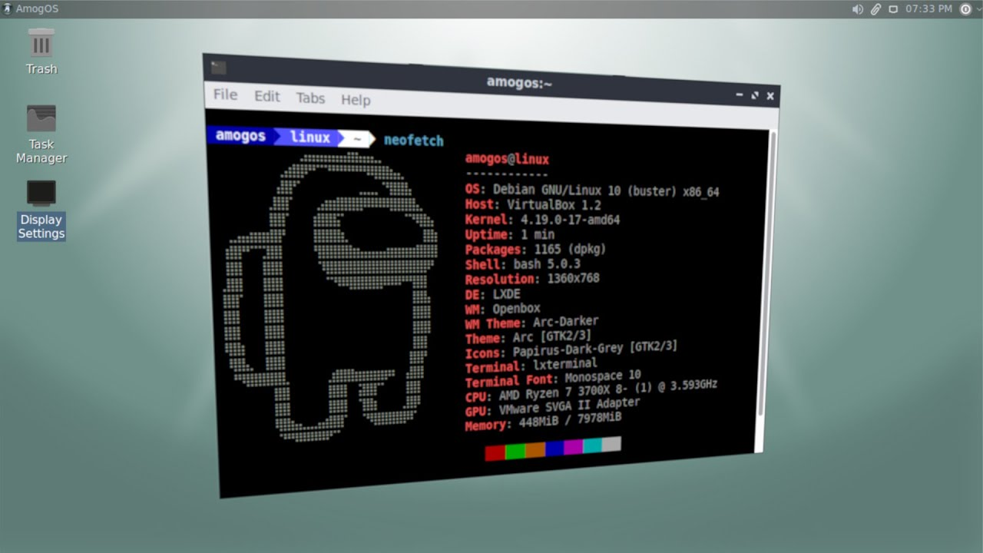
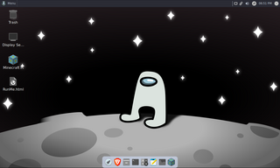
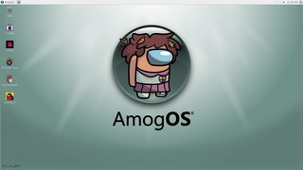
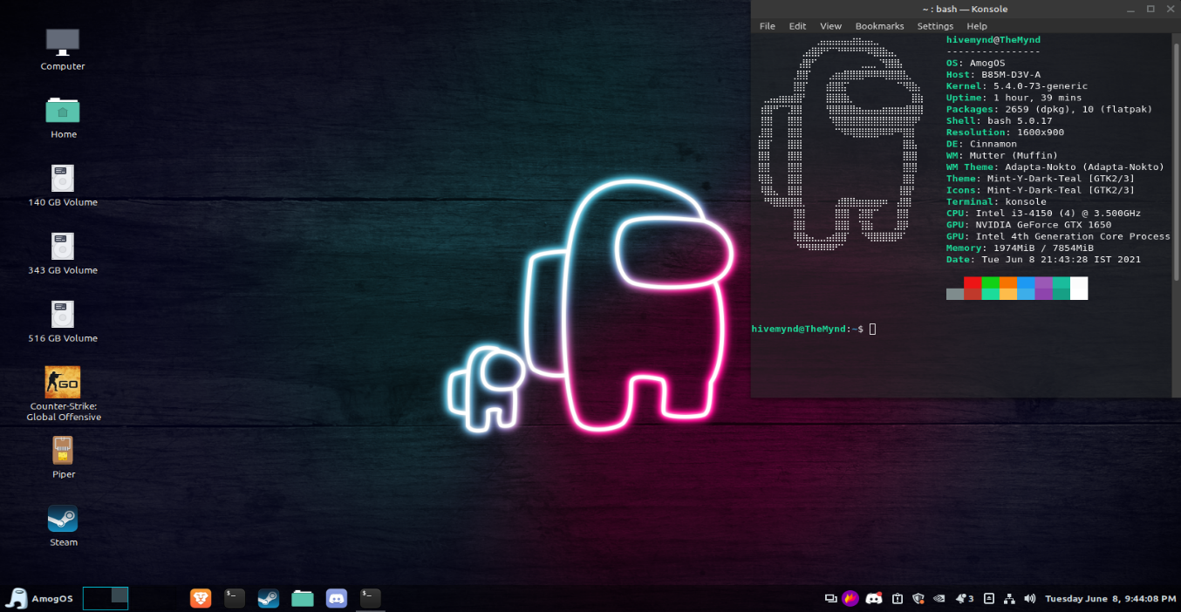

Slide 7
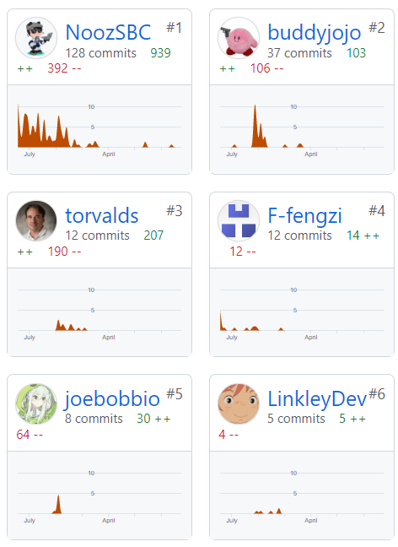
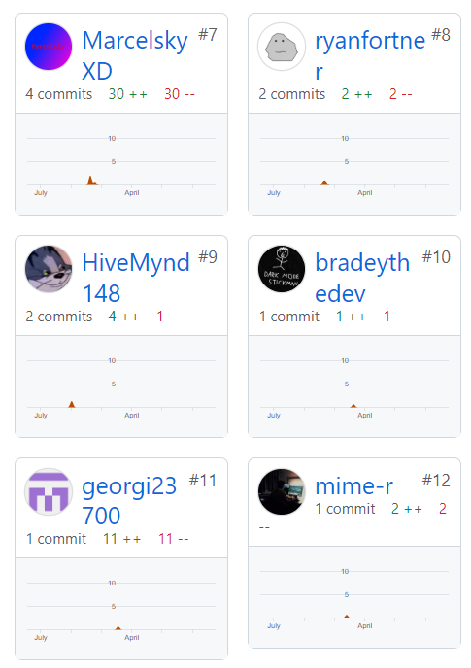
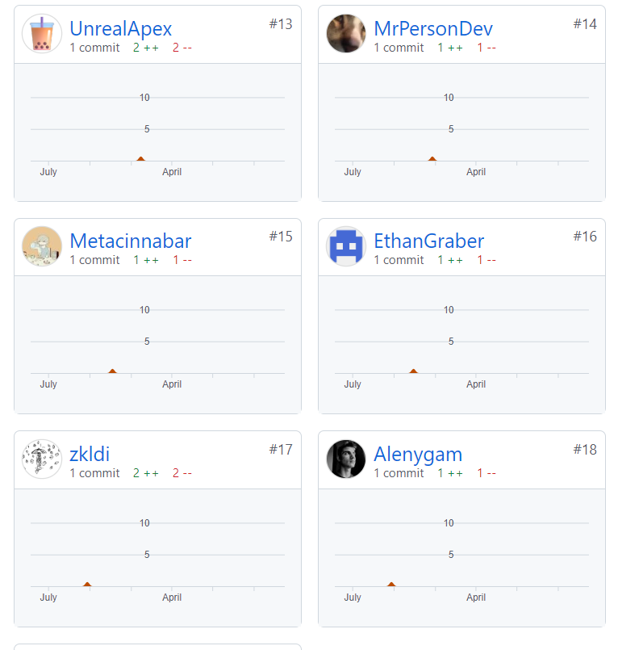
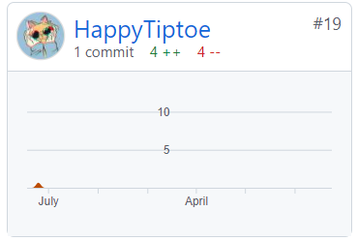
Dev NOtes
Contributors
We are not responsible for ANY KIND OF DATA LOSS or any kind of problem not relating to AmogOS, USE THIS AT YOUR OWN RISK.
AmogOS was never intended to be a replacement for mainstream distributions; it's merely a joke and a sussy OS.
For x64 users: It takes like a whole 69420 secs to load the UI from usb boot so be patient!

Slide 8

Made by Hristo Denchev

