Slide 1
The Battle of Neighborhoods
Popular Indian Restaurants in the New York City

Slide 2
Introduction: Business Problem In this project we will try to find the best Indian restaurant in the New York City with the help of foursquare data. New York City is a large and ethnically diverse metropolis. It is the largest city in the United States with a long history of international immigration. New York City accounting for over 40% of the population of New York State and a slightly lower percentage of the New York metropolitan area, home to approximately 23.6 million. Over the last decade the city has been growing faster than the region. The New York region continues to be by far the leading metropolitan gateway for legal immigrants admitted into the United States. Throughout its history, New York City has been a major point of entry for immigrants; the term "melting pot" was coined to describe densely populated immigrant neighborhoods on the Lower East Side. As many as 800 languages are spoken in New York, making it the most linguistically diverse city in the world. English remains the most widely spoken language, although there are areas in the outer boroughs in which up to 25% of people speak English as an alternate language, and/or have limited or no English language fluency. English is least spoken in neighborhoods such as Flushing, Sunset Park, and Corona. With it's diverse culture , comes diverse food items. There are many restaurants in New York City, each belonging to different categories like Chinese , Indian , French etc. So as part of this project , we will list and visualize all major parts of New York City that has great Indian restaurants.

Slide 3
Data
For this project we need the following data :
New York City data that contains list Boroughs, Neighborhoods along with their latitude and longitude. Data source : https://cocl.us/new_york_dataset Description : This data set contains the required information. And we will use this data set to explore various neighborhoods of New York city. Indian restaurants in each neighborhood of New York city. Data source : Foursquare API Description : By using this api we will get all the venues in each neighborhood. We can filter these venues to get only Indian restaurants. GeoSpace data Data source : https://data.cityofnewyork.us/City-Government/Borough-Boundaries/tqmj-j8zm Description : By using this geo space data we will get the New York Borough boundaries that will help us visualize choropleth map.

Slide 4
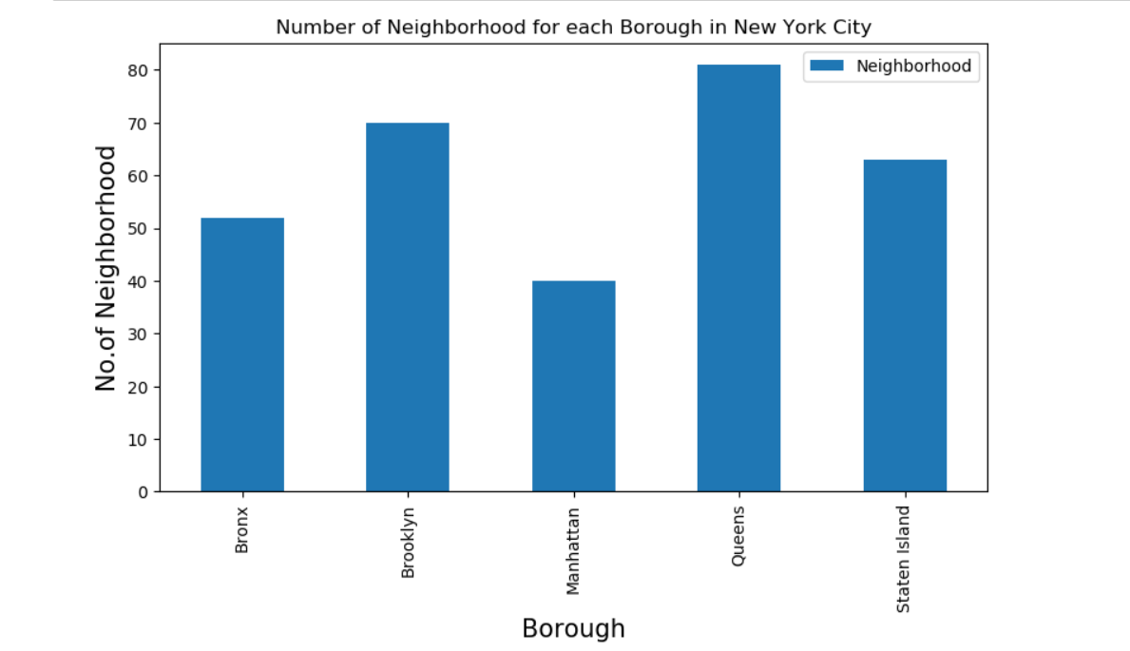
We see that Queens has highest number of neighborhoods

Slide 5
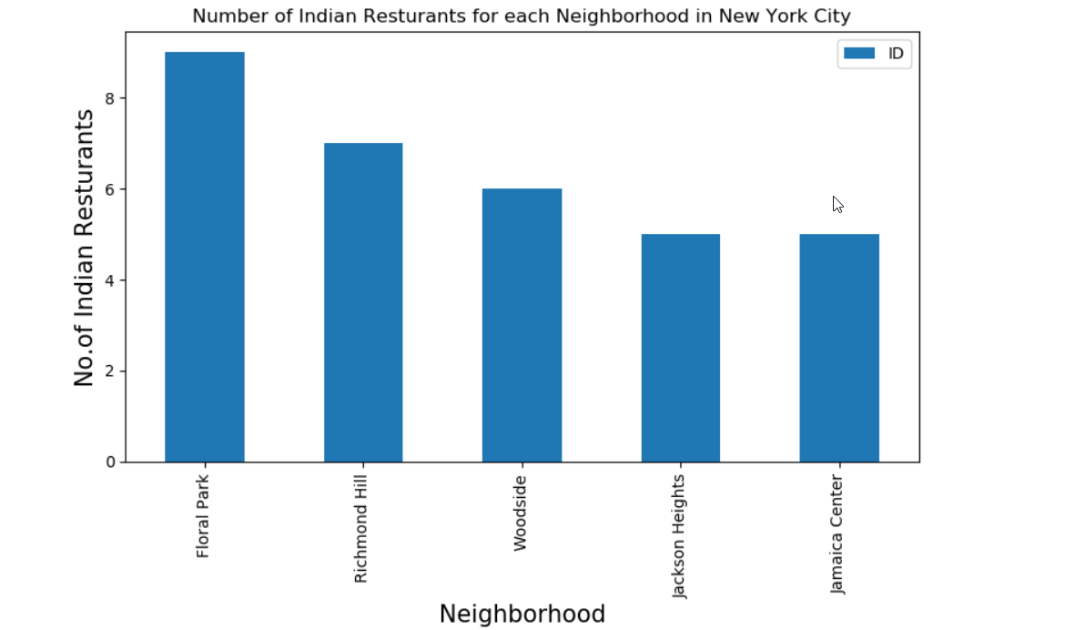
Queens has the largest number of Indian restaurants

Slide 6
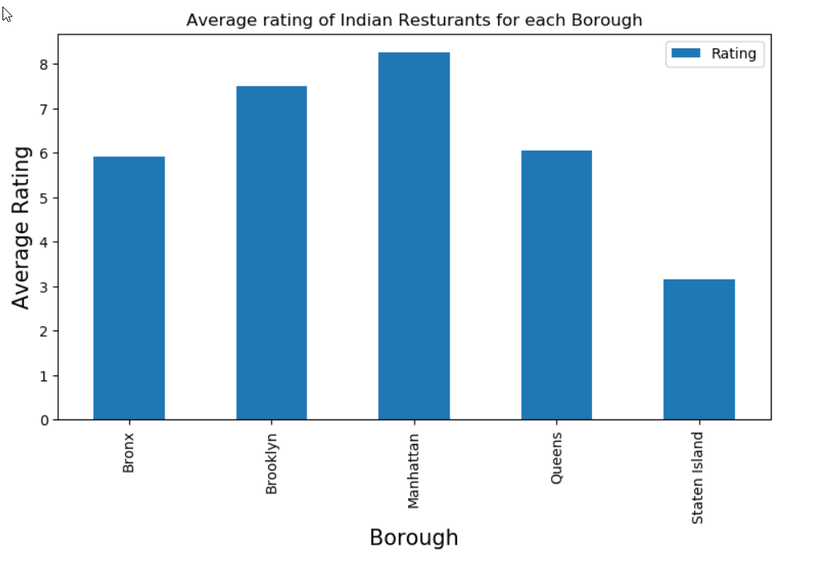
Floral Park in Queens has the highest number of Indian Resturants

Slide 7
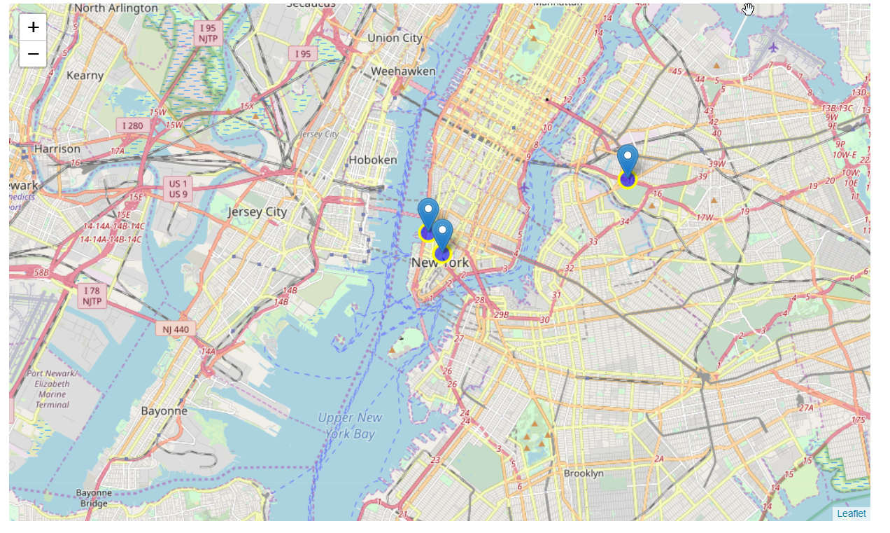
Popular Indian Restaurants in New York with highest ratings shown in map

Slide 8
Conclusion Astoria(Queens), Blissville(Queens), Civic Center(Manhattan) are some of the best neighborhoods for Indian cuisine. Manhattan have potential Indian Restaurant Market/ Staten Island ranks last in average rating of Indian Restaurants. Manhattan is the best place to stay if you prefer Indian Cuisine.

