Slide 1
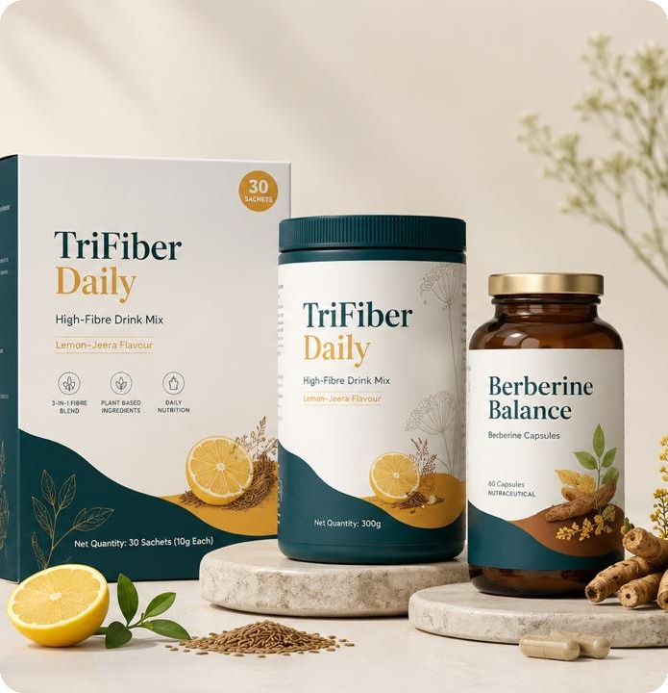
TRIFIBER HEALTH
STRICTLY CONFIDENTIAL
PRE-SEED FINANCING
Everyday Nutrition for Gut + Metabolic Health
Two products. Two daily habits. One metabolic-health platform.
TriFiber Daily
Berberine Balance
Daily multi-fiber nutrition
Botanical metabolic support
PRE-SEED FINANCING · R&D + CONSUMER VALIDATION + CLINICAL PILOT

Slide 2
COMPANY
About Us
Founder & team profiles to be added.
Clinical & Regulatory
Product & Growth
Operations & Supply
Owns formulation science, the FSSAI pathway and clinical validation design.
Owns the D2C brand, consumer experience and channel scaling.
Owns manufacturing partners, quality systems and fulfillment.
TriFiber Health is actively building its founding and advisory bench across these functions.
TRIFIBER HEALTH
2 / 10

Slide 3
THE OPPORTUNITY
The Modern Diet Has Created Two Connected Gaps
Two connected gaps. One category opportunity.
01
02
The Fiber Gap
The Metabolic Gap
Refined carbs, convenience foods and low plant diversity leave modern diets quietly under-fibered.
Consumers are newly fluent in glucose, cravings, weight and cholesterol — driven largely by the GLP-1 wave.
IRREGULARITY · POOR SATIETY · SNACKING · DISCOMFORT
POST-MEAL GLUCOSE · CRAVINGS · APPETITE · WEIGHT
Most fiber products still target occasional constipation — not everyday nutrition.
But millions aren't seeking — or don't qualify for — prescription weight-loss medication.
TRIFIBER HEALTH
3 / 10

Slide 4
WHY NOW
Four Trends Are Converging on a Large, Growing Market
KEY TRENDS
01
02
03
04
Gut Health Goes Mainstream
Fiber Is Being Rediscovered
GLP-1 Changed the Vocabulary
Strategic Buyers Are Circling
Digestive wellness is now a major global consumer category.
Prebiotics & soluble fiber join the probiotic conversation.
Consumers now think in satiety, glucose and insulin.
P&G's ~$3.8B Thorne deal (Aug 2026) signals real M&A appetite for science-led wellness.
MARKET SIZE
$25.6B
$36.2B
$71.6B
$55–57B
FIBER SUPPLEMENTS
DIGESTIVE HEALTH
WEIGHT-LOSS SUPPLEMENTS
INDIA NUTRACEUTICALS
by 2033, from $15.5B in 2025
by 2033, ~11.3% CAGR
by 2030, from $33.1B in 2024
by 2030, from $29–30B in 2024
NOTE: Adjacent category indicators, not claimed addressable revenue — built bottom-up through customer acquisition, repeat purchase and geographic expansion.
TRIFIBER HEALTH
4 / 10

Slide 5
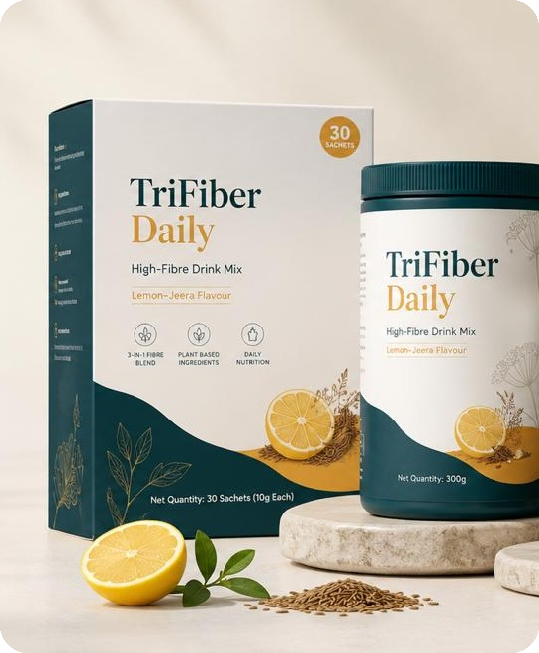

OUR SOLUTION
Two Products. One Everyday Metabolic-Health Platform.
Positioned between supplements people forget to take and prescription drugs for diagnosed conditions — evidence-led nutrition simple enough to become a habit.
TriFiber Daily
Berberine Balance
SUPPLEMENTS PEOPLE
FORGET TO TAKE
PRESCRIPTION DRUGS FOR
DIAGNOSED CONDITIONS
01
02
TRIFIBER DAILY
BERBERINE BALANCE
DAILY MULTI-FIBER DRINK
STANDARDIZED BOTANICAL SUPPLEMENT
Soluble + insoluble + prebiotic fiber in one scoop
Built to close the fiber gap — not just relieve constipation
Lemon-Jeera flavor; sachets & jar, India-first formats
Berberine HCl standardized for purity — 500 mg target
Supports healthy glucose metabolism & metabolic wellness
Responsibly positioned — never marketed as “Natural Ozempic”
Broad-entry · high frequency
Targeted · higher perceived value
TriFiber builds the customer relationship. Berberine deepens it.
TRIFIBER HEALTH
5 / 10

Slide 6
OUR MOAT
Formulas Can Be Copied. Our System Is Harder to Copy.
01
Product Experience
02
Evidence
03
Trust & Transparency
Taste, texture and tolerability engineered in — not bolted on.
Product-specific consumer & clinical data, not just ingredient literature.
Batch-level testing with QR-linked quality data.
04
Regulatory Infrastructure
05
Community
06
Disciplined Claims
Market-specific claims architecture for India, UAE, US & EU.
Owning the everyday conversation on metabolic maintenance.
“Prove more, claim less” — composition, then function, then validated outcomes.
FSSAI REGULATORY PATHWAY
→
SCHEDULE IV — BOTANICALS
→
SCHEDULE VII — PROBIOTIC STRAINS
Berberine HCl standardization and purity testing built into the TriFiber R&D protocol.
Viability testing designed to hold ≥ 10⁶ CFU/g through shelf life — not just at manufacture.
TRIFIBER HEALTH
6 / 10

Slide 7
GO-TO-MARKET
High-Frequency Consumables, Built Market by Market
Primary: Direct-to-consumer · Secondary: Marketplaces
Later: retail, pharmacy, practitioners, corporate wellness, international distributors.
TRY
→
BUILD THE HABIT
→
SUBSCRIBE
65–75%
MONTH 1
MONTH 2
MONTH 3+
TARGET GROSS MARGIN AT SCALE
Before paid acquisition & fulfillment
GLOBAL EXPANSION
01
India + UAE
02
United States
Validate product, positioning, repeat purchase & manufacturing economics.
Large D2C supplement ecosystem; structure/function claims only.
03
UK / Select Europe
04
GCC · Singapore · Australia · Canada · SE Asia
TriFiber leads; Berberine follows pending EFSA botanical review.
Market-specific registration & claims review.
NOTE: Indicative pricing — India: ₹999–1,299 · UAE: AED 89–129 · US: $24–39 per product
TRIFIBER HEALTH
7 / 10

Slide 8
ROADMAP
18 Months: From Concept to Validated Products
0–3 MO
3–6 MO
6–9 MO
9–12 MO
12–18 MO
1
2
3
4
5
Foundation
Build
Validate
Launch
Scale
Advisory board, regulatory mapping, first prototypes.
Stability testing, sensory trials, brand + D2C build.
Lock formulations, manufacturing validation, clinical pilot begins.
Controlled launch, first paying customers.
Expand India, prep UAE/US, clinical readout, next raise.
VALIDATION SPINE
Formulation
→
Analytical Validation
→
Consumer Pilot
→
Clinical Feasibility
Validation spine running throughout, parallel to the commercial timeline above.
TRIFIBER HEALTH
8 / 10

Slide 9
THE ASK
USE OF FUNDS
30% — Formulation + R&D
$750,000
Prototypes, ingredient development, stability, flavor systems.
ILLUSTRATIVE PRE-SEED RAISE
20% — Clinical + Consumer Validation
100%
Ethics/CRO, pilots, biomarker testing, consumer studies.
This round de-risks:
ALLOCATED
Product
Regulatory Pathway
15% — Regulatory + Quality
FSSAI, UAE, U.S. preparation, testing, documentation.
Consumer Demand
Retention
Unit Economics
15% — Initial Manufacturing
Pilot batches, packaging, QA, inventory.
This round covers formulation, regulatory pathway, initial manufacturing, brand build and a consumer + clinical validation pilot.
10% — Brand + Commerce
Identity, website, packaging, launch infrastructure.
Final size to be adjusted after CRO, manufacturer & regulatory quotations.
10% — Team + Operations
Scientific, product, regulatory, operating costs.
TRIFIBER HEALTH
09 / 10

Slide 10
OUR VISION
The Future of Metabolic Health Won’t Be Medication Alone.
Better food. Better habits. Better preventive nutrition. Better evidence.
TriFiber Daily — Close the fiber gap. Berberine Metabolic Balance — Support everyday metabolic health.
LARGE CATEGORY · CULTURAL TIMING · HIGH-FREQUENCY HABIT · INDIA ADVANTAGE · GLOBAL POTENTIAL
“Better Gut. Better Metabolism. Every Day.”
Built in India. Designed for the World.
TRIFIBER HEALTH
10 / 10

