Slide 1

Consent Vault Manager
A working compliance automation system for India's Digital Personal Data Protection Act, 2023
MCP server
Automated job workers
Postgres + hash-chained ledger
React dashboard
Built, tested, and verified live — grounded in the DPDP Act's actual operational obligations
github.com/WolfCreator345/Self-Project · PR #1

Slide 2




THE PROBLEM
DPDP Act 2023 doesn't forgive spreadsheets
Any organization processing Indian personal data is now a Data Fiduciary with real, deadline-driven obligations — and no forgiveness for “we meant to track that.”
Consent drift
DSR deadlines
A user revokes consent, but the processors you handed their data to never find out.
Access, correction, and erasure requests carry statutory response windows — miss one and it's a violation, not an oversight.
Breach notification
No audit trail
The Data Protection Board must be notified fast, on a defensible, provable timeline.
“Trust us, we handled it” does not hold up when a regulator asks for proof.
02

Slide 3


THE SOLUTION
Automates the operational grind of compliance —
without removing the human from the loop.
Every notification is drafted by automation and confirmed by a person before it becomes real. Every action — automated or human — lands on a ledger where none of it can be quietly rewritten.
Automated
Human-confirmed
Tamper-evident
Sweeps expiries, escalates overdue DSRs, drafts breach notices and reports on a schedule.
Nothing external is ever auto-sent — a person creates the real artifact and confirms it happened.
A SHA-256 hash chain over the audit ledger — edit history, and everything after it breaks.
03

Slide 4
THE LEGAL FOUNDATION
Every purpose rests on exactly one basis
DPDP Act §4: processing personal data must rest on the principal's consent (§6) or one of the Act's enumerated legitimate uses (§7) — never both, never neither. This system models that as a property of the Purpose itself, not the consent record.
CONSENT
LEGITIMATE USE
Requires an active, revocable ConsentArtifact — granted, tracked, and expiring on the purpose's retention schedule.
No consent required — or permitted. Processing proceeds on the statutory ground itself.
Marketing communications and promotional offers
Account creation and service delivery
Analytics and product improvement
Fraud prevention and security monitoring
ENFORCED, NOT JUST LABELED
Purpose "purpose-3" is processed under "legitimate_use" — consent cannot be recorded as its basis.
0 of 12 consent artifacts reference the legitimate-use purpose — rejected at creation, in both the mock store and the Postgres repository.
04

Slide 5

WHAT IT DOES
Four automations, running end to end
Consent lifecycle tracking
DSR SLA monitoring
Grants, revocations, and expiries flow automatically — a withdrawal cascades to every downstream processor tied to that purpose.
Every open Data Subject Rights request is watched against its statutory due date, with internal escalation reminders at T‑7d and T‑2d.
Breach notice automation
Weekly compliance reports
A high/critical breach automatically drafts a Data Protection Board notification and a countdown reminder for the notify-by deadline.
A PDF snapshot of consents, DSRs, and breaches is generated, archived, and emailed on a recurring schedule.
05

Slide 6




UNDER THE HOOD
One set of interfaces, three ways in
Mock-first design: repository interfaces were fixed before Postgres existed, so the MCP server and job workers never changed when the real backend replaced the mock.
MCP Server
Job Workers
NestJS REST API
8 tools exposed over the Model Context Protocol for AI agents and Claude Code.
BullMQ automations: expiry sweeps, DSR escalation, breach notices, weekly reports.
Session-authenticated endpoints backing the dashboard.
React Dashboard
Shared repository interfaces
ConsentRepository · DSRRepository · LedgerRepository
PostgreSQL — consents, DSRs, hash-chained ledger
Same interface, satisfied twice — an in-memory mock store for local dev and tests, a Postgres implementation for everything real.
06

Slide 7
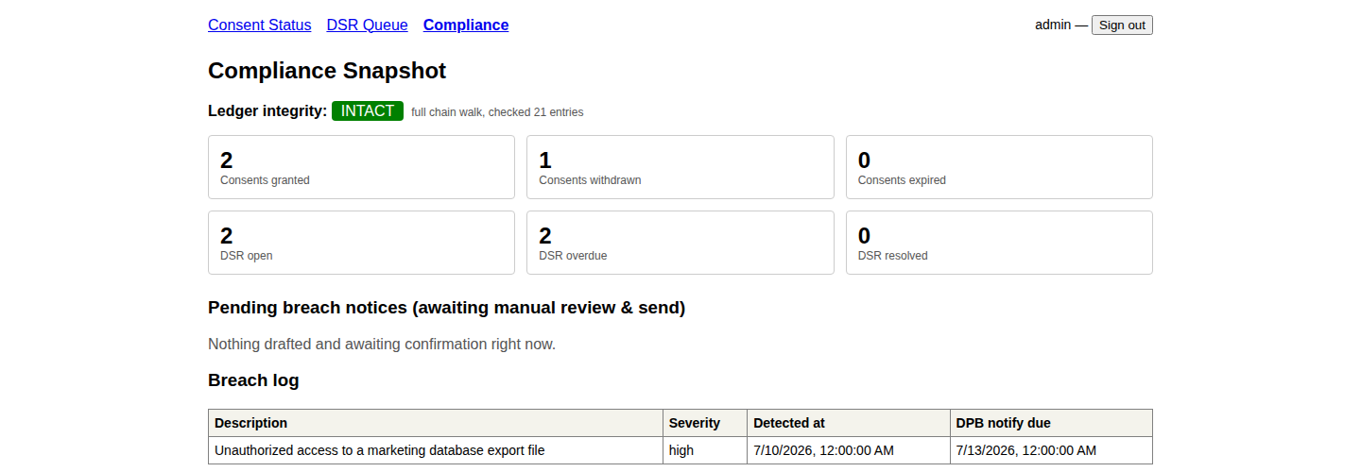
THE DIFFERENTIATOR
Every action, cryptographically chained
Each ledger entry's hash is computed over its own data plus the previous entry's hash. Edit history anywhere in the chain, and every hash after it stops matching.
Entry #1
Entry #2
Entry #3
Entry #4
4f9a1c…
8e2d70…
b31af4…
0c77e9…
SHA-256(prev + data)
SHA-256(prev + data)
SHA-256(prev + data)
SHA-256(prev + data)
Verifiable on demand
LIVE, FROM THE REAL DASHBOARD
verify_ledger_integrity walks the chain and returns INTACT — or the exact sequence number where it broke.
Fast by default, deep on request
Incremental checks re-walk only new entries from a cached checkpoint; a full re-walk is always available as a deep-verify escape hatch.
07

Slide 8


HOW AUTOMATION STAYS SAFE
Nothing external is ever sent by a machine alone
A headless worker has no Gmail or Calendar credentials, and shouldn't be handed any. So it drafts and stages — only a human, through Claude Code's live access, creates the real artifact.
1 · Detect & Draft
2 · Human Reviews & Creates
3 · Confirm & Record
A job worker notices something — an expiry, an overdue DSR, a breach — and stages a drafted email, calendar event, or report.
A person reviews the draft and creates the real Gmail draft or Calendar event through Claude Code's live connection.
The human confirms with the real draft/event id, and the ledger records exactly what happened — with that id, permanently.
Gmail's connector here only exposes create_draft — there's no send tool. The draft sits until a human sends it, a stronger gate than anything this system adds on top.
08

Slide 9
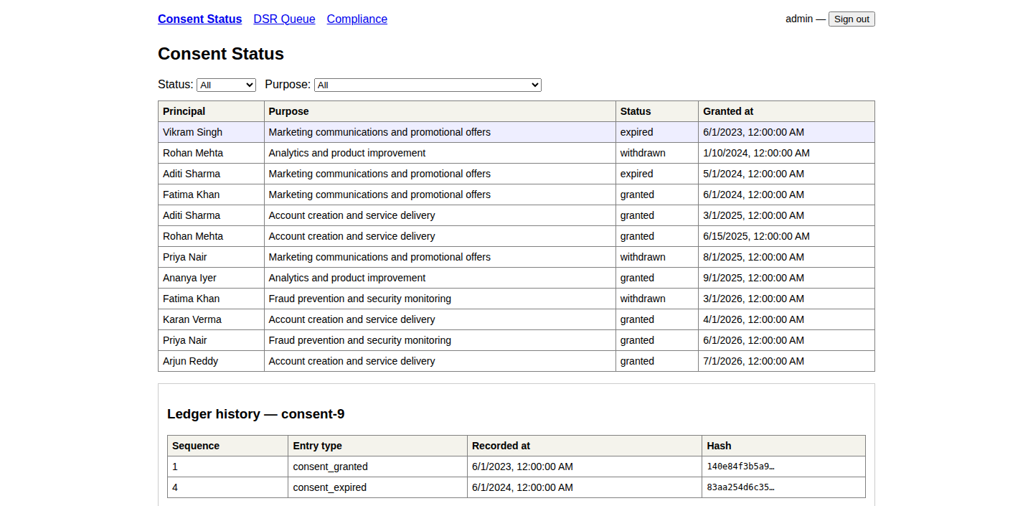
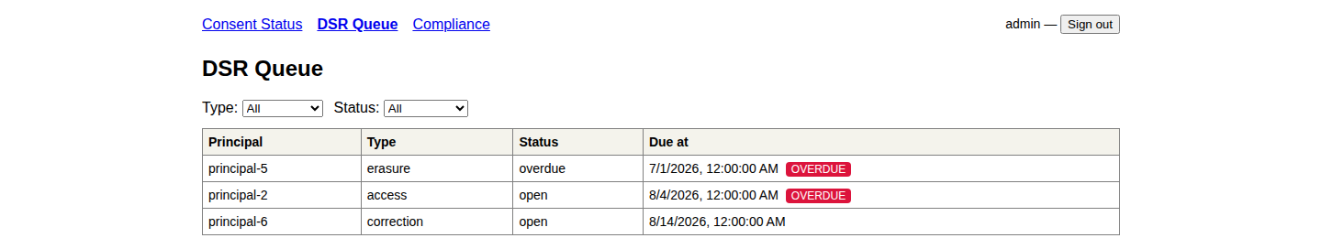
SEE IT RUNNING
A real dashboard, not a mockup
Every screenshot on this slide is a live capture from the running app — session-authenticated, backed by real Postgres data.
Compliance snapshot — ledger integrity, DSR counts, breach log
Consent status, drilled into a purpose's real ledger history
DSR queue, flagging the overdue erasure request
09

Slide 10
NOT JUST A PROTOTYPE
Built, tested, and verified against the real thing
79/79
8
8
21
automated tests passing
MCP tools
build phases shipped
ledger entries
unit + integration, 3 packages
exposed to AI agents
mock store → full automation
hash-verified intact, live
Verified live, not just typechecked: real Gmail drafts and real Calendar events were created and confirmed through Claude Code, and the audit ledger was re-verified intact after every write — across multiple full backend restarts.
Hardened after building, not just at build time: a live-questioning pass caught the lawful-basis gap on this slide's neighbor, and a seed-data date-drift bug that silently broke DSR overdue counts as real time passed — both fixed, tested, and now permanently correct by construction.
Test counts and coverage as of the latest commit on the project's pull request.
10

Slide 11

HOW IT'S BUILT
A production-shaped stack, not a toy
TypeScript
PostgreSQL + Prisma
NestJS
React 19 + Vite
End to end — domain model, servers, workers, UI.
Durable state, migrated schema, real transactions.
Session-authenticated REST API for the dashboard.
TanStack Query for live-polling dashboard views.
BullMQ + Redis
Model Context Protocol
pdfmake
bcrypt + sessions
Reliable job scheduling for every automation.
Structured tool access for AI agents.
Offline PDF generation for compliance reports.
Cookie-based auth guarding every dashboard route.
11

Slide 12


STATUS
Eight phases shipped, each verified before the next began
P0
Mock data layer
P2
Job workers
P4
Postgres backend
P6
Auth + dashboard
P1
MCP server
P3
Real notifications
P5
Hash-chain ledger
P7
Full automation
What's next
Multi-tenant + RBAC
Production hardening
Broader archival targets
One admin today — real deployments need org boundaries and roles.
Wrap mutations in transactions; move sessions off in-memory storage.
Local-disk report archival today; cloud storage once the connector's ready.
12

Slide 13
A real, working compliance system —
not a slide deck pretending to be one.
Every screenshot, every stat, and every ledger entry in this deck came from the running system.
github.com/WolfCreator345/Self-Project · PR #1
Consent Vault Manager — DPDP Act 2023 compliance automation

