Slide 1

Hash Functions, HMACs, and Digital Signatures
CSCI 172/283
Fall 2010

Slide 2




What ciphers do
Encryption ciphers
  Provide confidentiality
  Eve can’t see what Alice and Bob are saying
  Can Eve do anything?
C= Encrypt(M)
?
Alice
Bob
Eve

Slide 3



What ciphers don’t do
Suppose Eve can get between Alice and Bob
  What if Eve can manipulate the data?
Alice sent me M’
I’ll send Bob M
How can Bob tell if Alice’s message was modified?
Now for a few changes
M
M’
Alice
Bob
Eve replaces M with M’
Eve

Slide 4
Hash functions
Map a variable length message to a fixed length message
  y = h(x)
  If h is a 64-bit hash function, then y always fits in 64 bits
    0 ≤ y < 2⁶⁴
    Actual hash value may be represented with fewer bits, since 0, 1, etc. are in the output range
    Should include leading zeros
Pigeonhole principle
  If n+1 pigeons nest in n holes, at least one hole has more than one pigeon
    Maybe each hole has one pigeon, except for one that has two
    Maybe all the pigeons are in the same hole

Slide 5
Was the message modified?
Alice sends Bob {C = Encrypt(M), h(M)}
When Bob gets {C, h(M)} , he checks
  M’=Decrypt(C)
  Bob computes h(M’)
  h(M) = h(M’)?
If Eve modifies the message, it probably won’t match
If it does match, assume that it is the message Alice sent

Slide 6

What could go wrong?
Suppose h(x) maps to 1 or 0 with equal probability?
  Eve has a 50/50 chance of fooling Bob
Suppose h(x) does not map to the entire range with equal probability
Forget about the encryption for a moment
What could Eve do? Suppose:
  Eve can calculate f(h(M)) = M
  Eve knows some M’, h(M’) = h(M)
  Eve repeatedly just tries random modifications
Nice try!
We need some properties that provide security!

Slide 7
Cryptographic hash functions
When security people talk about hash functions, they mean cryptographic (or secure) hash functions
These should provide
  Collision resistance
    Difficult to find any M, M’≠ M s.t. h(M) = h(M’)
  Preimage resistance
    Given h(M), difficult to find M’ s.t. h(M’)=h(M)
  Second preimage resistance
    Given M, difficult to find M’ s.t. h(M’)=h(M), M’≠M
If a hash function h does not meet these requirements…
FAIL!

Slide 8
But what does it all mean?
If h is secure
  Easy to compute in one direction
  Very difficult to compute in the other direction
    Computationally infeasible
    i.e. your grandchildren’s grandchildren’s grandchildren will be long gone before that computation finishes
  Very difficult to find two messages that hash to the same value
Can anyone name any?

Slide 9
Secure Hash Algorithm (SHA)
NIST standards
  Mandatory in US Government
  Adopted globally
SHA (SHA-0) is no good anymore
SHA-1 has attacks and is not recommended
SHA-2 looks good for now
  What happens when there’s an attack?
  It takes years to create and analyze functions

Slide 10
SHA-3
About halfway through the process of choosing the next SHA family of hash functions
International competition
  64 submissions
  Round 1: 54
  Round 2: 14
  Round 3: ~5
  And the winner is… ?
Winner gets massive bragging rights
A lot of new design techniques
A lot of new attack techniques

Slide 11
Who can compute a hash?
A hash is a keyless algorithm
Anyone can compute h(x) if they know x
Eve could replace M with M’ and h(M) with h(M’)
  The hash matches what Bob computes, so he assumes that Alice sent him M’
How could we stop Eve from doing this?

Slide 12
HMAC
Hash-based Message Authentication Code
Keyed hash
  y = HMAC(M, k)
Provides some level of authentication
  If only and Alice and Bob know the key and the HMAC is correct, it must have come from one of them
Can make an HMAC algorithm from an unkeyed hash algorithm
Why not just make a keyed hash algorithm?
  Import/export restrictions
  Keyless algorithms are not restricted

Slide 13
How to key an unkeyed hash
We have hash function h, which processes a message in b-byte blocks
Let k be a key, |k| ≤ b
Pad k with zeros to form k’, |k’| = b
Let ipad be 00110110, repeated b times
Let opad be 01011100, repeated b times
HMAC-h is formed by
  HMAC-h(k,m) = h(k’ ⊕ opad || h(k’ ⊕ ipad || m))

Slide 14
Who sent it?
For HMACs, the key is shared
Fine for some applications
What if instead of knowing if someone who knows the key sent it, we want to know that Alice sent it?

Slide 15
Digital signatures
Use public key cryptography
  Recall that only Alice knows Alice’s private key
Alice digitally signs her message, M
  Alice computes h(M)
  Alice encrypts h(M) using her private key (signing)
  Alice sends Bob {M, Enc(h(M), A_{priv})}
Bob verifies the message was sent by Alice
  Computes y’ = h(M)
  Decrypts Enc(h(M), A_{priv}) with Alice’s public key
    y = Dec(Enc(h(M), A_{priv}), A_{pub})
  Does y’ = y?
  If yes, Alice must have sent it

Slide 16
Digital Signatures
Digital signatures provide checks for integrity and origin
Because only Alice knows her private key, it must have been her that sent it
  Non-repudiation
Suppose Alice wants to encrypt M so that Eve can’t see it Should she:
  Encrypt, then sign
  Sign, then encrypt
  Does it matter?
  Why?

Slide 17
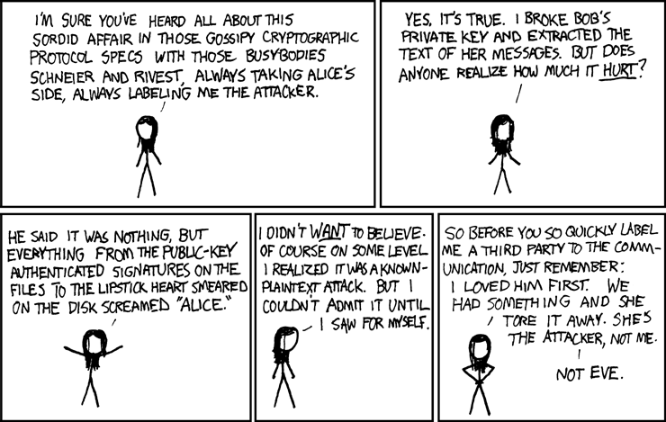
Conclusion by xkcd
http://xkcd.com/177/

