Slide 1


CyberNest
Exam Sample Presentation
Introduction
What is this?
Main problem
Objectives
Király Gellért
Macza Ádám
Kiss Richárd Bendegúz

Slide 2

What is CyberNest?
Introduction
What is this?
Main problem
Objectives
On-site IT Mentoring Program
Hands-on learning using real infrastructure
Personalized support, not self-paced online learning
Opportunities for growth from beginner to advanced levels
– A place where you can do more than just study! --
Notes:
CyberNest is an on-site IT mentoring program designed to help students acquire IT and networking skills in a hands-on manner using real infrastructure. The program is not based solely on theoretical learning; rather, it facilitates development through the use of actual systems. Participants start at their own level and can gradually progress to an advanced level.

Slide 3

A problem that the project addresses
Introduction
What is this?
Main problem
Objectives
School education often provides few opportunities for hands-on practice
Learning is often theory-focused, lacking a real-world context
There is a lack of practice using real infrastructure
Development is not always structured or mentored
Notes:
The project is based on the observation that traditional school education often fails to provide sufficient hands-on experience. Learning is frequently theory-centered and does not always relate to real-world systems. As a result, students find it harder to understand how technologies work in practice. In addition, there is often a lack of a structured development path and personal mentoring, which would aid in learning.

Slide 4

PROJECT OBJECTIVE
Introduction
What is this?
Main problem
Objectives
Hands-on IT training in a real-world environment
Personalized mentoring and ongoing support
Understanding and using real-world systems
“It’s not about knowing everything, but about daring to ask questions, make mistakes, and learn from real-world systems—because that’s where true knowledge begins.”
Notes:
The main goal of the project is for students not only to acquire theoretical knowledge but also to be able to apply it in a practical setting. Personal mentoring provides support for this, which aids the learning process. The emphasis is on understanding and using real-world systems, not merely on the superficial operation of tools.

Slide 5
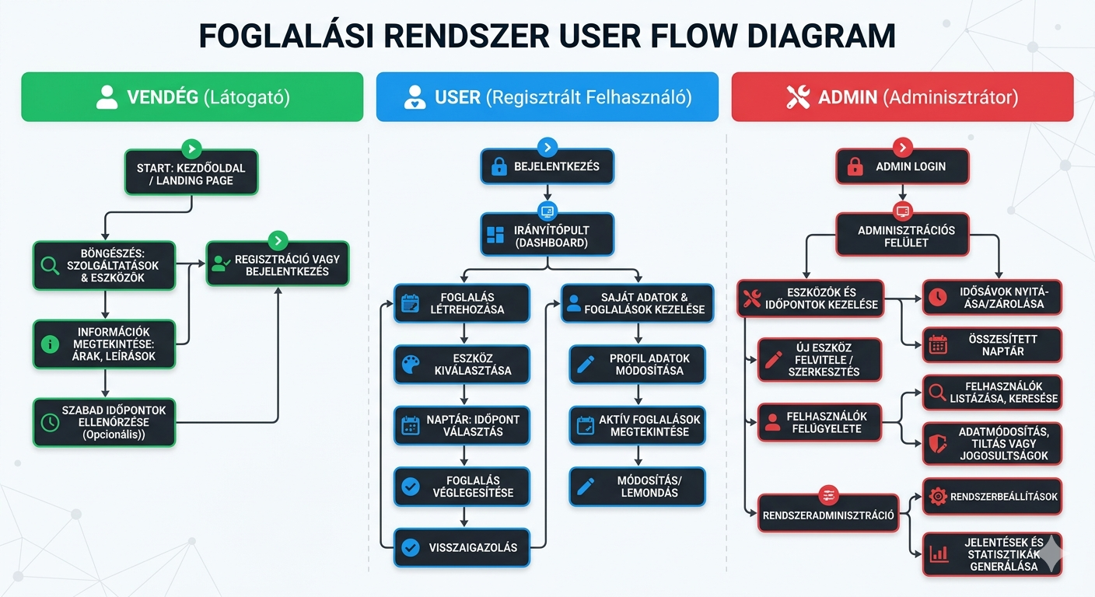
User roles
Roles
Structure
Data stream
Technologies
Guest
Browse, view information
User
Log in
Create a reservation
Manage your personal information and reservations
Admin
Manage tools and appointments
Supervise users
System administration
Notes:
The system distinguishes between three main user roles. Guest users can only view public content but do not have access to restricted features. Registered users can log in, create reservations, and manage their own data and reservations. The admin role has the highest level of permissions; they manage the equipment, schedules, and users.

Slide 6
Roles
Structure
Data stream
Technologies

Slide 7
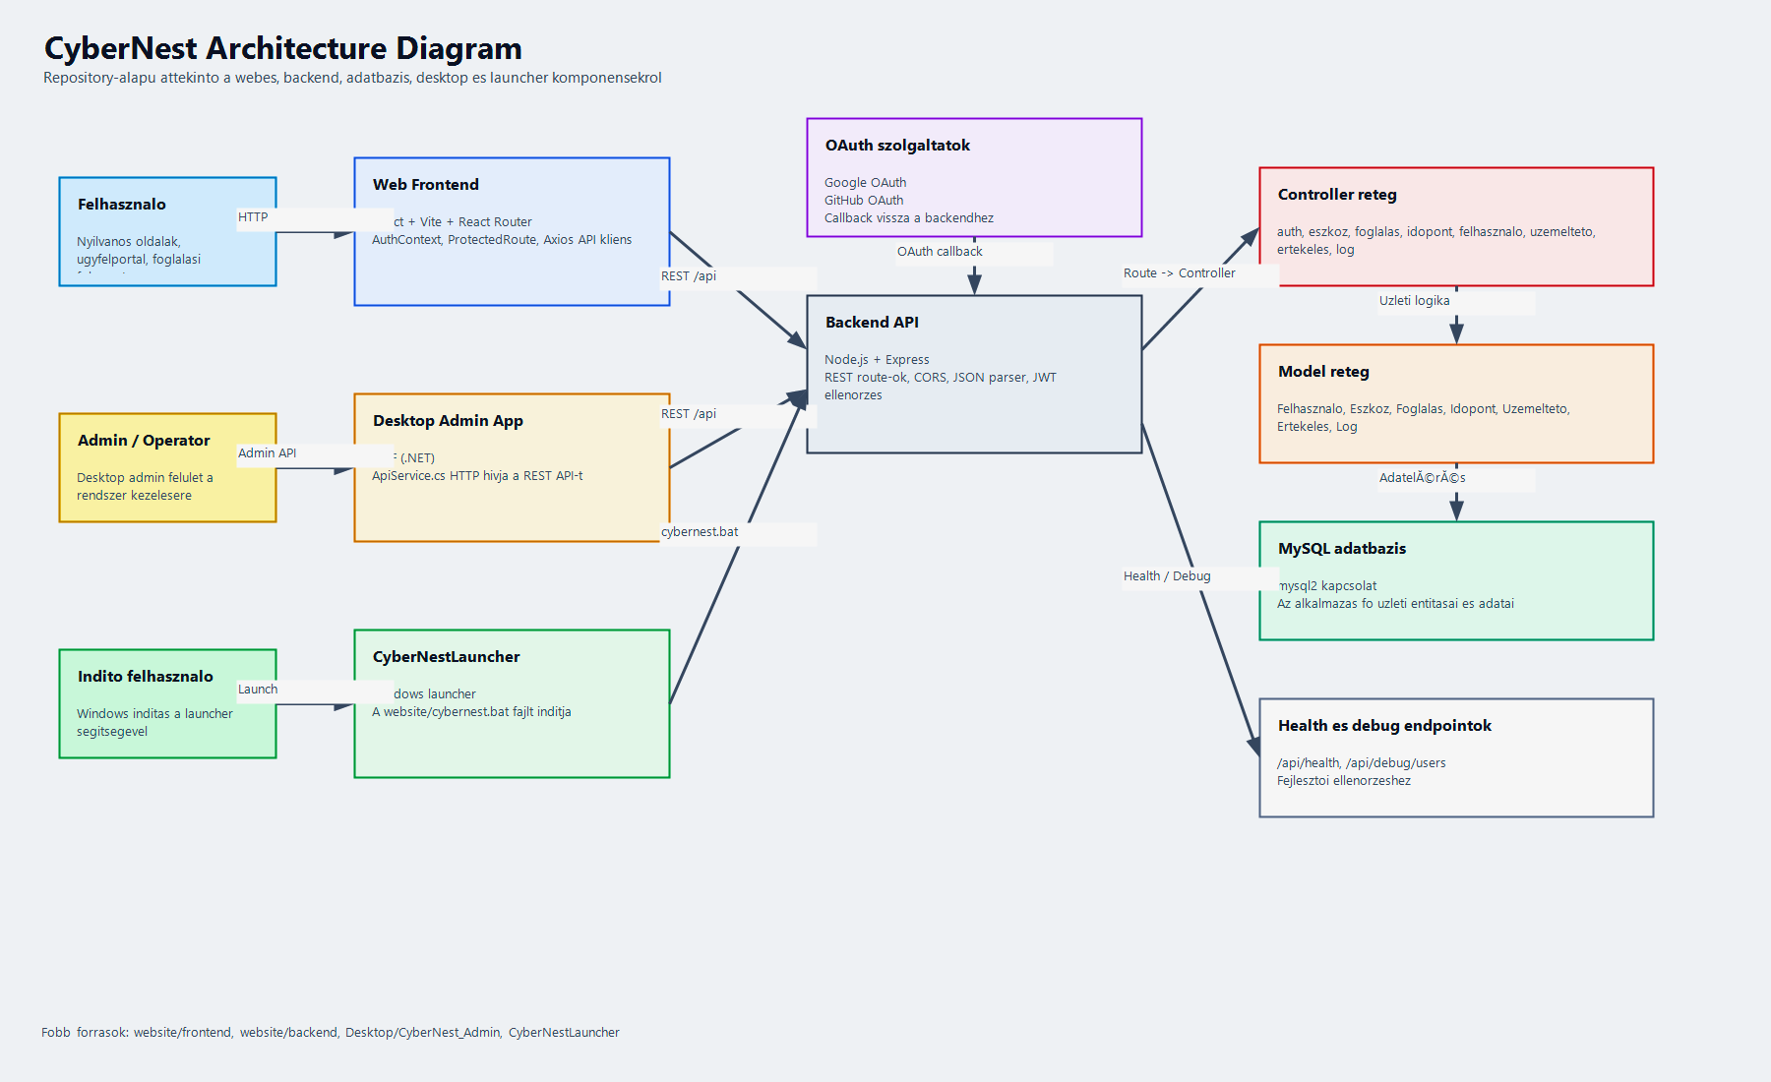
System Architecture
Roles
Structure
Data stream
Technologies
Frontend: React + ViteBackend: Node.js + Express
Database: MySQL
Authentication: JWT + OAuth
Notes:
CyberNest follows a modern, three-tier web architecture. The frontend, which handles the user interface, was implemented using React and Vite. The backend runs on Node.js and Express, where business logic is processed and API endpoints are managed.Data storage is provided by a MySQL database, which enables structured and reliable data management. Authentication in the system is handled using JWT tokens, ensuring access to protected endpoints.Additionally, an OAuth-based login option is available, enabling authentication through an external service provider, thereby enhancing the system’s security and convenience.

Slide 8
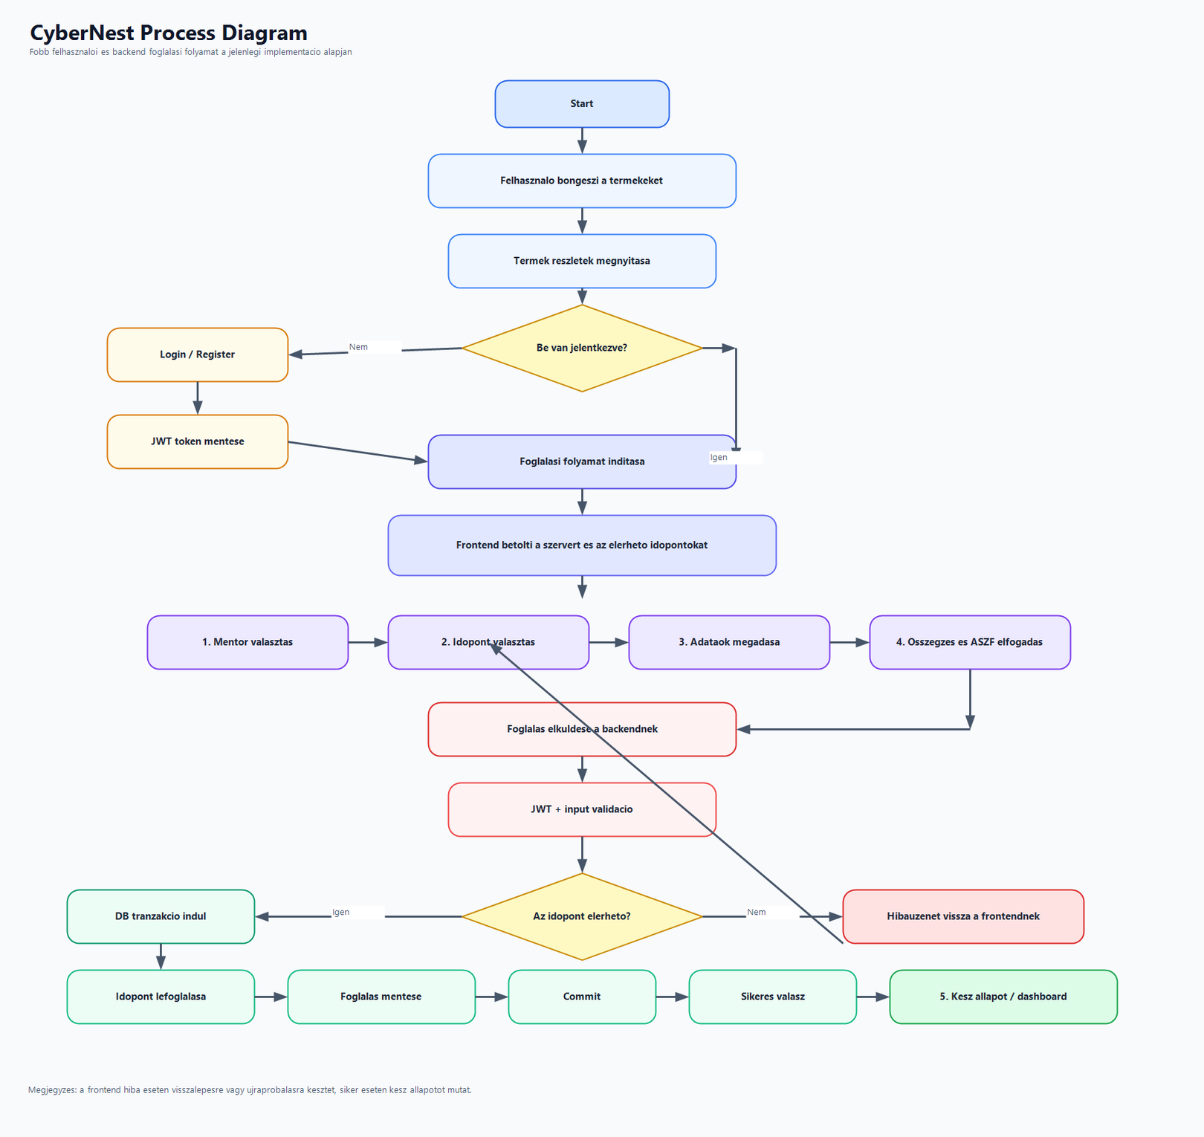
Data Stream Operation
Roles
Structure
Data stream
Technologies
User request from the frontend
The backend receives and processes the request
Performs JWT authentication if necessary
The backend executes a database operation (MySQL)
The backend returns a response in JSON format
The frontend displays the result
Notes:
Our system follows a classic client-server architecture. The user interface, or frontend, sends requests to the backend. The backend processes these requests and, if necessary, performs JWT-based authentication.The backend then executes database operations in MySQL and returns the result in JSON format to the frontend, which displays it to the user.

Slide 9
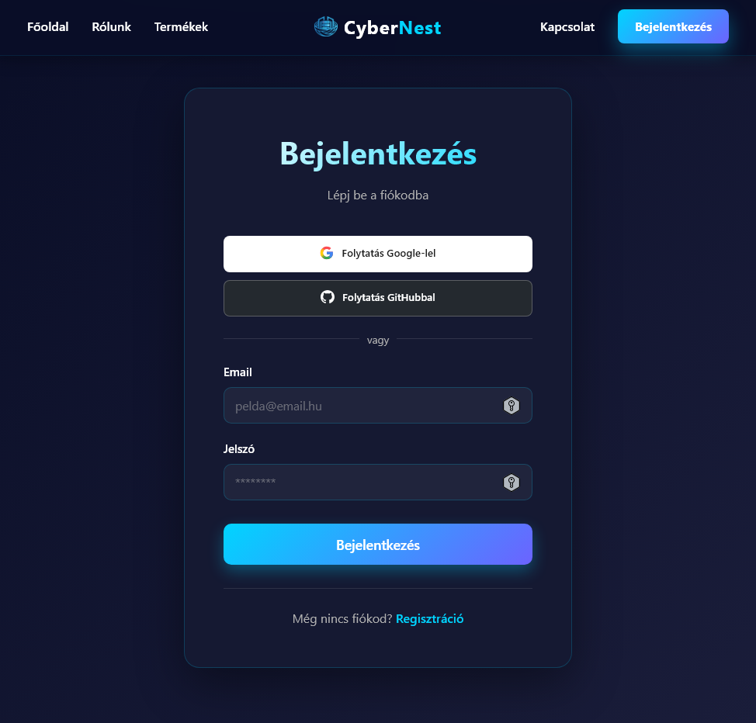
Frontend technológiák
Roles
Structure
Data stream
Technologies
•React
•React Router
•State management
•Védett route-ok
Notes:
The frontend is built on React, which enables component-based development. We used React Router to handle navigation between pages. State management is responsible for managing the application’s various states, such as user data or login status. Protected routes ensure that only logged-in users can access certain pages.

Slide 10
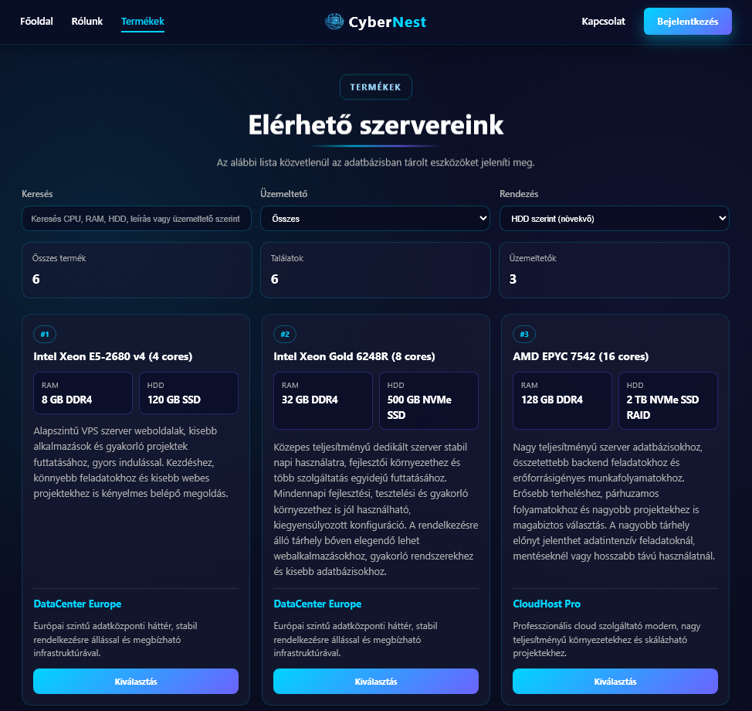

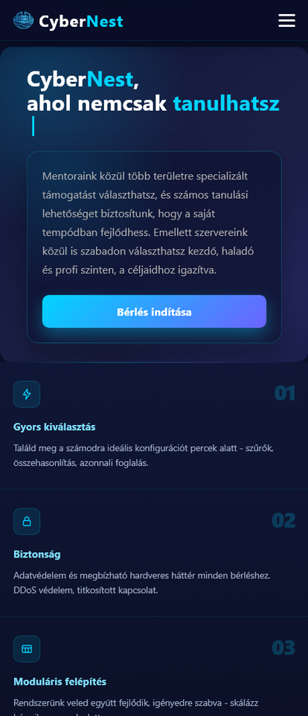
Front-end features
Features
Backend technologies
API
Database
Login / Register
Dashboard
Booking Process
Equipment List
Responsive UI
Notes:
The frontend’s main features include login and registration, which ensure user authentication. The dashboard is a control panel where users can manage their personal information and reservations.The booking process consists of several steps, where the user selects the device, the time, and then finalizes the booking. The device list displays the available devices, while the responsive interface ensures that the application works well on various devices, such as mobile phones and desktop computers.

Slide 11
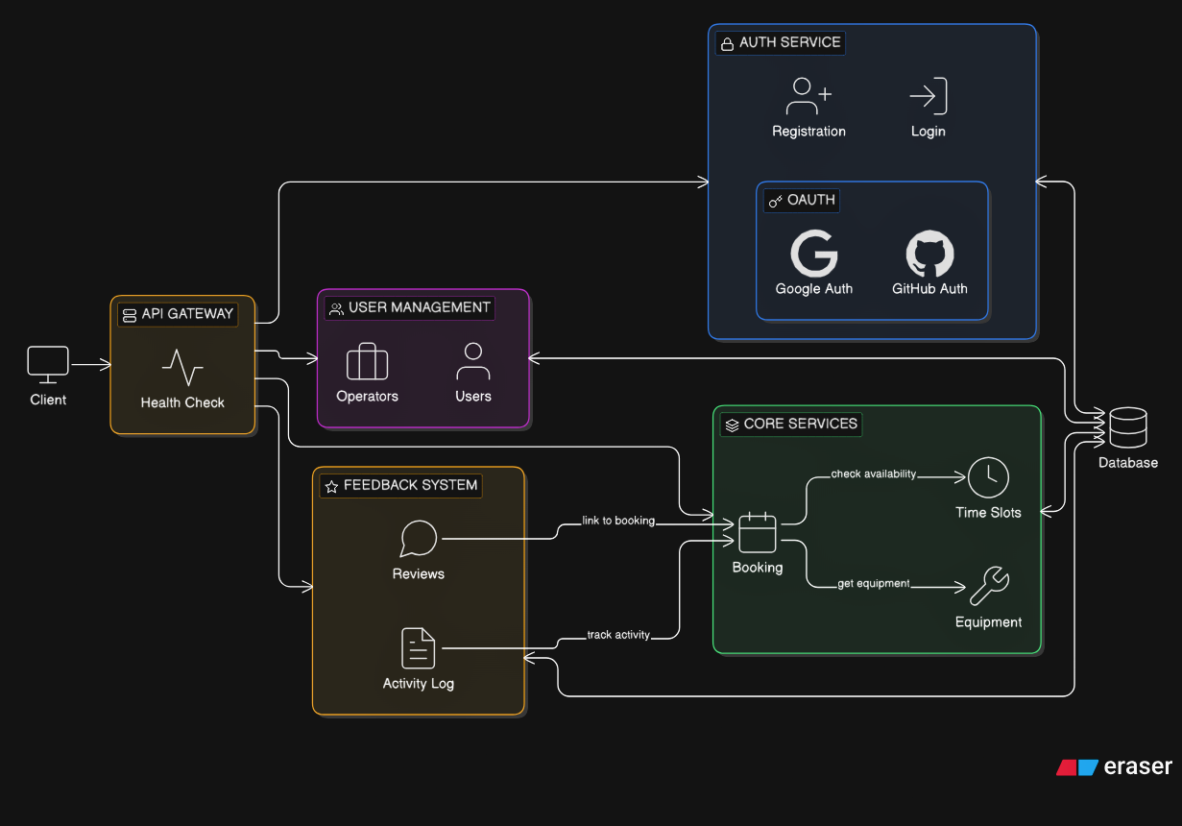
Backend technologies
Features
Backend technologies
API
Database
Node.js
Express
REST API
Middleware system
Notes:
We built the frontend using React, which enables component-based development. We implemented navigation between different pages using React Router. State management handles the application’s state, while protected routes ensure that only logged-in users can access certain pages.The dashboard is a user control panel where logged-in users can view their personal data, reservations, and the features available to them.

Slide 12
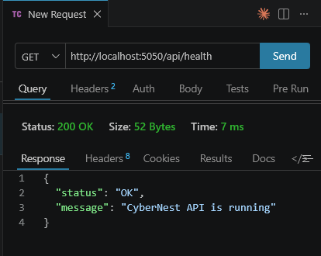
REST API Architecture
Features
Backend technologies
API
Database
Authentication endpoints
Device CRUD
Reservation management
Appointment management
Notes:
We built the frontend using React, which enables component-based development. We implemented navigation between different pages using React Router. State management handles the application’s state, while protected routes ensure that only logged-in users can access certain pages.The dashboard is a user control panel where logged-in users can view their personal data, reservations, and the features available to them.

Slide 13
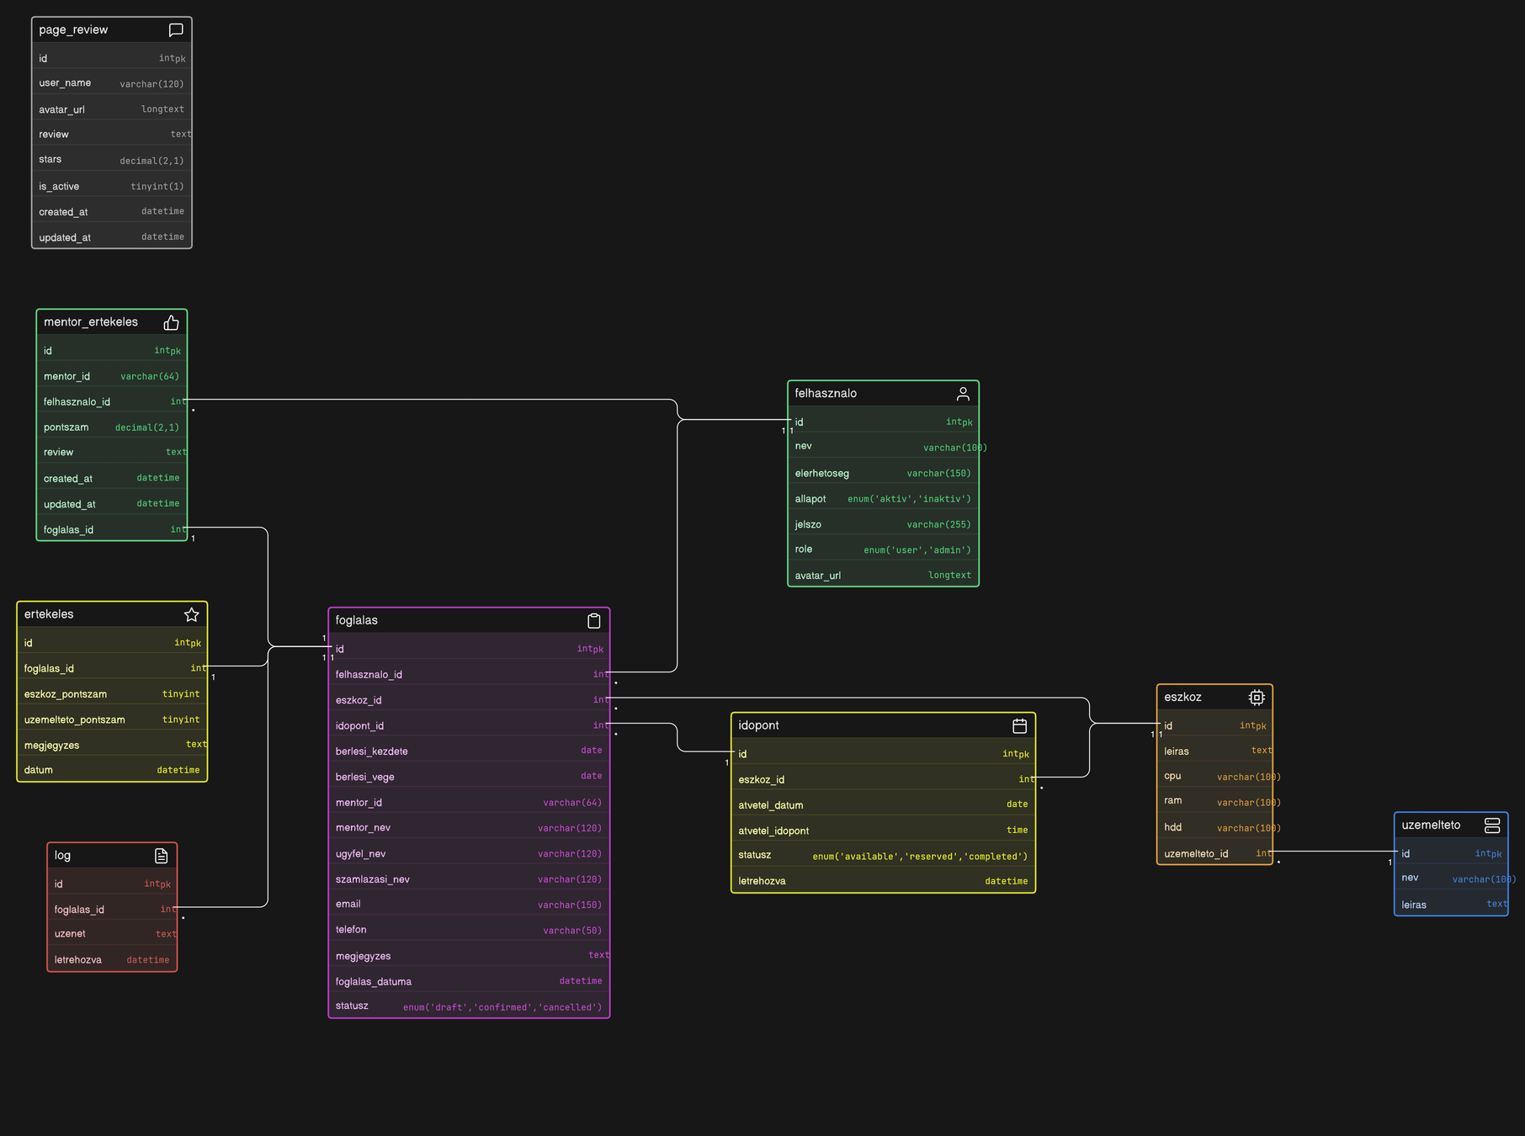
Database Structure
Features
Backend technologies
API
Database
ertekeles
eszkoz
page_review
felhasznalo
foglalas
idopont
log
mentor_ertekeles
uzemelteto
Notes:
Our database is based on a relational structure consisting of several interconnected tables. User data is managed by the `users` table, while the `equipment` and `time-slots` tables contain bookable resources and time slots.The reservation table links users to equipment and time slots. In addition, separate tables manage evaluations, such as general_evaluation and mentor_evaluation.The log table tracks the system’s operation, while the operator data supports administration.

Slide 14

Access Control
Permissions
Booking Process
Development structure
Testing and Troubleshooting
JWT token-based authentication
Admin vs. user endpointsMiddleware validation
Notes:
The system’s access control is based on JWT token authentication. After logging in, the user receives a token, which they send to the backend with every protected request.The system handles user and admin roles separately, so certain endpoints are accessible only with admin privileges. The middleware layer is responsible for verifying the token and permissions for every request before the request is forwarded to the backend logic.

Slide 15
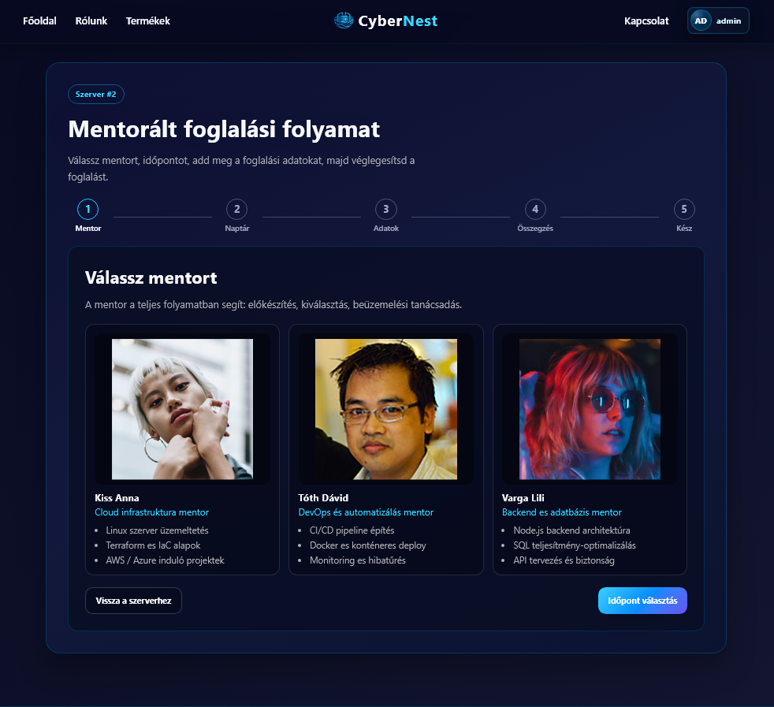
Booking Process
Permissions
Booking Process
Development structure
Testing and Troubleshooting
Select a device
Select a date
Enter your information
Confirm
Notes:
The booking process consists of several consecutive steps. First, the user selects the appropriate service, and then chooses a suitable time slot from the available options.In the next step, the user enters the necessary information, such as the booking details. Finally, the system finalizes the booking and stores it in the database, so it can be viewed and managed later.

Slide 16
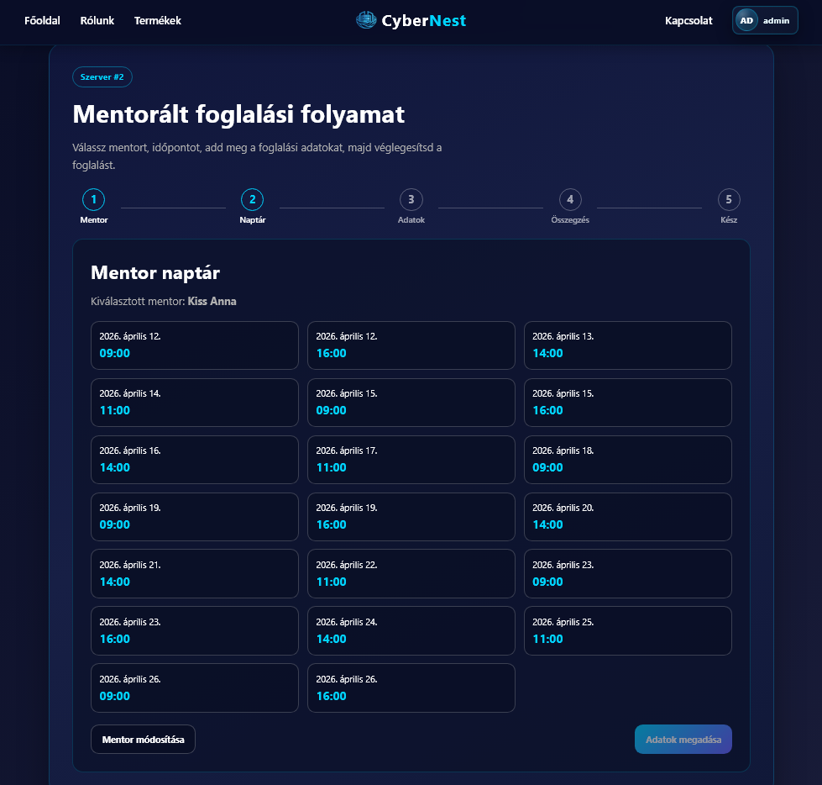
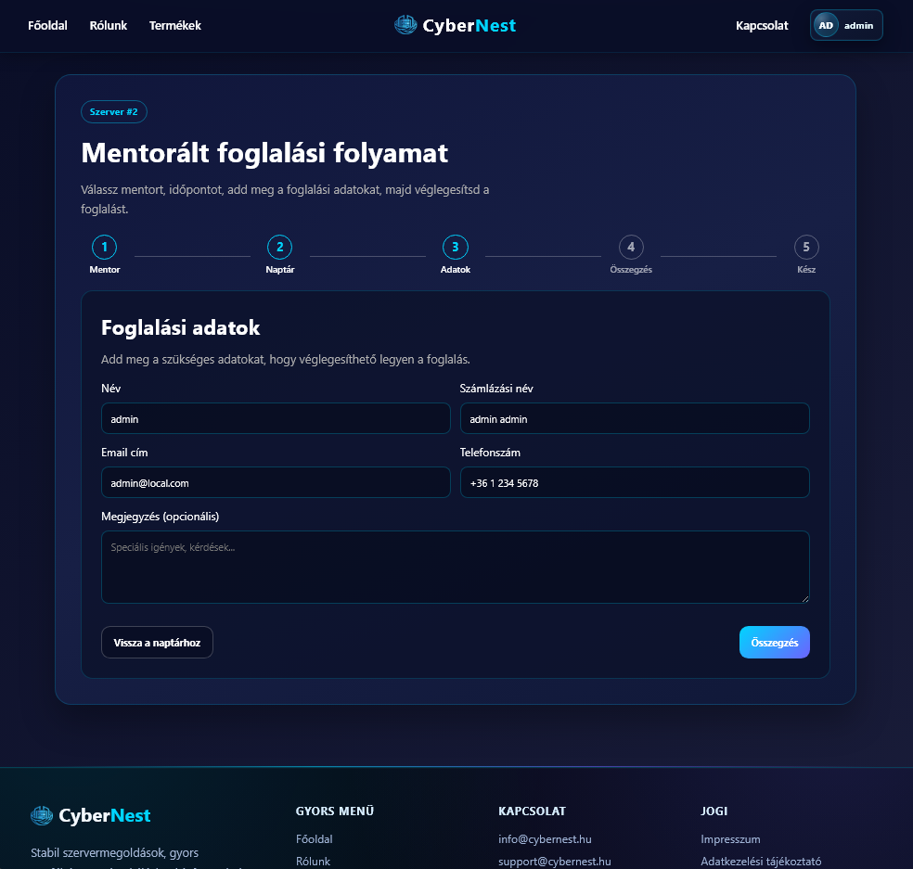
Booking Process
Permissions
Development structure
Testing and Troubleshooting
Notes:
The booking process consists of several consecutive steps. First, the user selects the appropriate service, and then chooses a suitable time slot from the available options.In the next step, the user enters the necessary information, such as the booking details. Finally, the system finalizes the booking and stores it in the database, so it can be viewed and managed later.

Slide 17
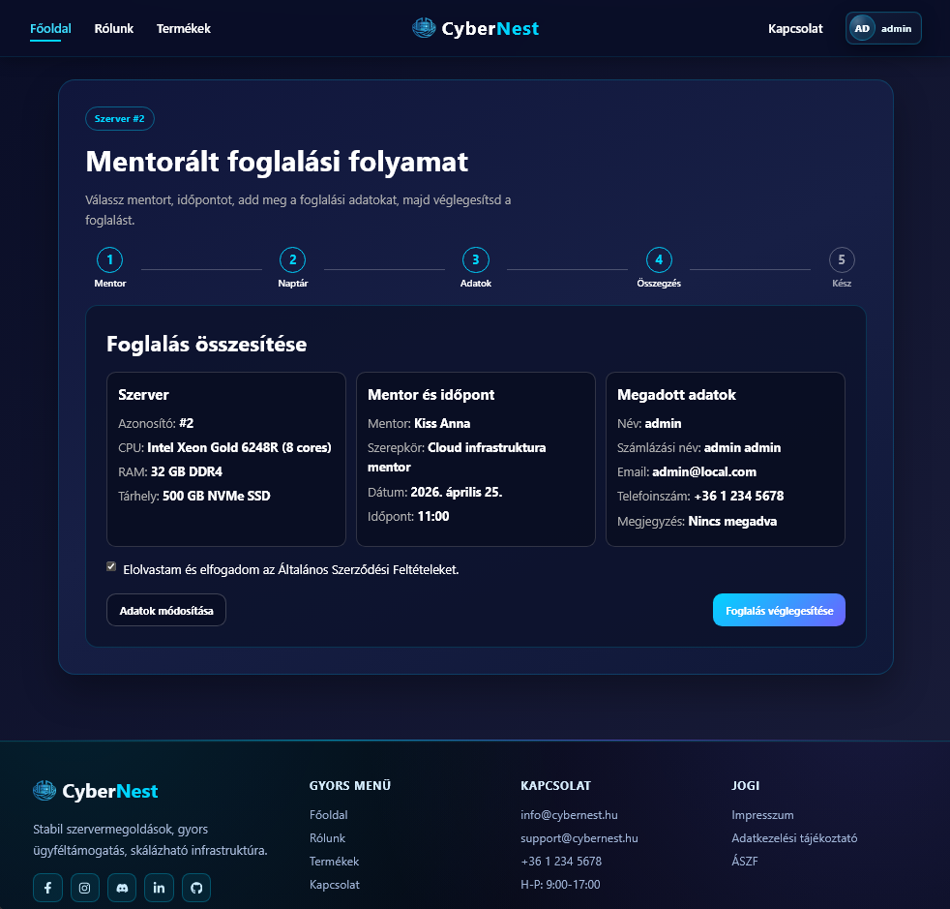
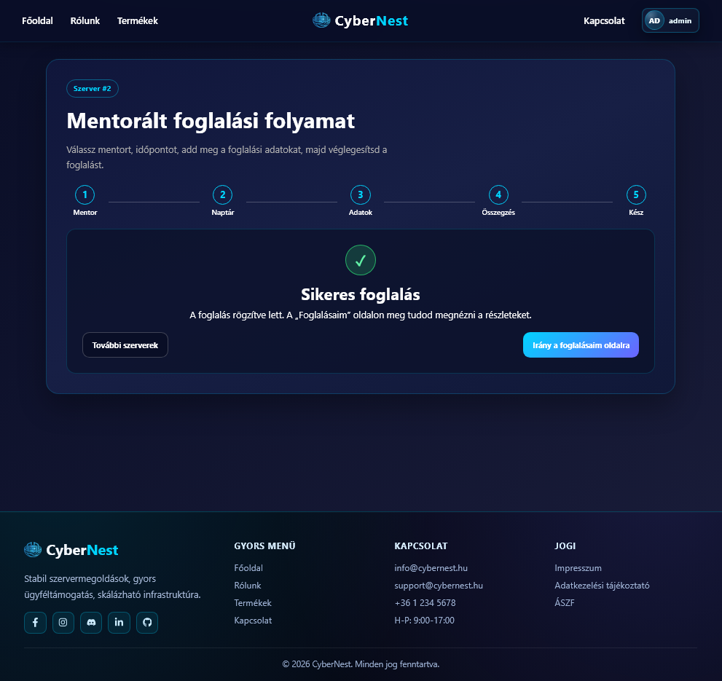
Booking Process
Permissions
Development structure
Testing and Troubleshooting
Notes:
The booking process consists of several consecutive steps. First, the user selects the appropriate service, and then chooses a suitable time slot from the available options.In the next step, the user enters the necessary information, such as the booking details. Finally, the system finalizes the booking and stores it in the database, so it can be viewed and managed later.

Slide 18
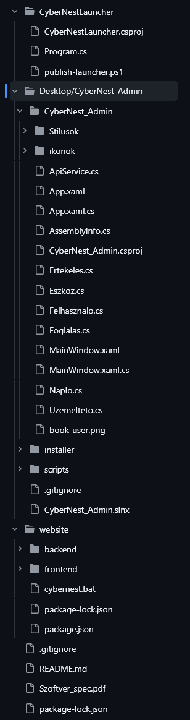
Development structure
Permissions
Booking Process
Development structure
Testing and Troubleshooting
frontend/
backend/
controllers / routes / models
Modular buildup
Notes:
The project has a modular structure. The frontend and backend are located in separate directories, and the backend is divided into controller, route, and model layers, which enhances maintainability and scalability.

Slide 19
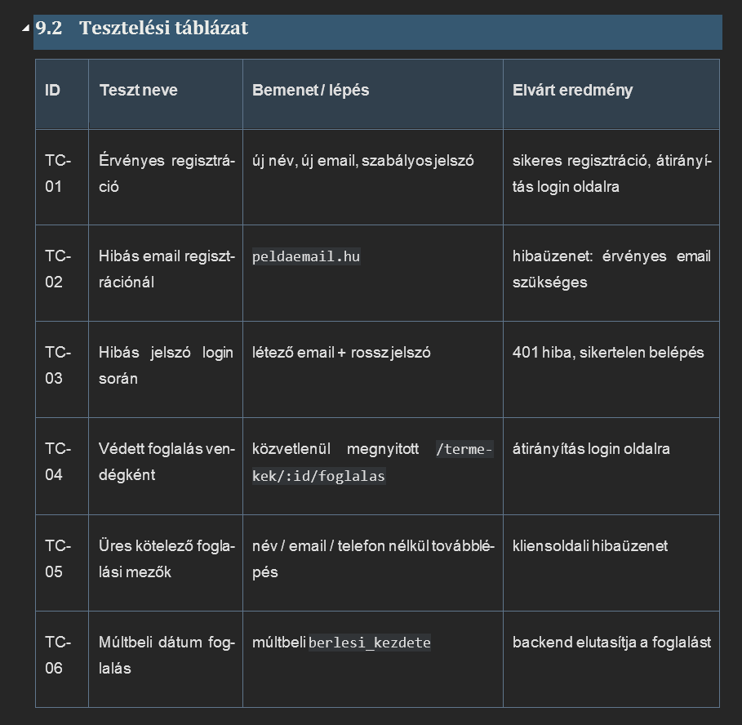
Testing and Troubleshooting
Permissions
Booking Process
Development structure
Testing and Troubleshooting
API testing (Postman)
Error codes (400/401/403/500)
frontend validation
Notes:
The project was developed as a team effort, with separate roles for front-end, back-end, and desktop development. We used GitHub for version control, which facilitated collaboration and code management.

Slide 20
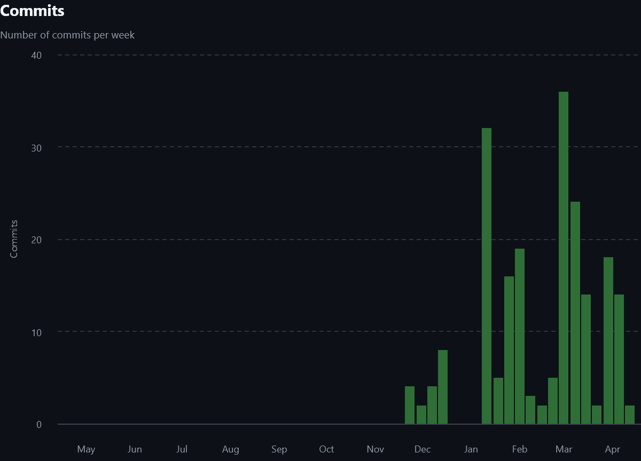

Teamwork
Teamwork
Team challenges
Afterword
Thank you!
frontend
backend
desktop
GitHub co oporation
Version control
Notes:
The project has a modular structure. The frontend and backend are located in separate directories, and the backend is divided into controller, route, and model layers, which enhances maintainability and scalability.

Slide 21

TEAM DIFFICULTIES
Teamwork
Team challenges
Afterword
Thank you!
GitHub
Schedule (at the beginning)
WPF
Discussing roles
Running the application on different platforms
Fixing compatibility issues
Notes:
At the start of the project, we set up a GitHub repository where we collaborated and managed versions. We established a schedule to ensure that all tasks were completed on time. During development, we used WPF technology to build the application. We discussed the roles so that everyone knew exactly what their tasks were. We tested the application on multiple platforms and continuously fixed any compatibility issues that arose to ensure the most stable operation possible.

Slide 22

Afterword
Teamwork
Team challenges
Afterword
Thank you!
In summary, we worked together successfully throughout the project and completed every important step, from initial planning through to implementation. We solved any problems that arose together, resulting in a functional and user-friendly application.
Notes:
In summary, we worked together successfully throughout the project and completed every important step, from initial planning through to implementation. We solved any problems that arose together, resulting in a functional and user-friendly application.

Slide 23
Thank you for your attention!
Teamwork
Team challenges
Afterword
Thank you!
Király Gellért
Macza Ádám
Kiss Richárd Bendegúz

Slide 24
References
https://stock.adobe.com/search?k=%22server+room%22
https://app.eraser.io/
https://www.zionandzion.com/how-to-fix-your-code-when-you-cant-figure-out-the-problem/
https://www.freepik.com/icon/security-lock_8631492
https://stockcake.com/i/coding-team-collaborates_1510541_1170562
Canva template Black Modern Gradient Programmer Presentation
More from: Ae Senturo by Amir

