Slide 1

Development of an LLM Agent for Processing and Qualifying Leads from a Messaging Platform with CRM Integration
Student (individual project): Madiyar Kenzhebayev, SE-2407
Supervisor: Zhanna B. Sadirmekova, PhD, Associate Professor

Slide 2
Problem and target users
Aim and objectives
Expected outcomes and scope
Problem. Leads write in free text at any hour. One manager answers and copies data into the CRM by hand, so leads wait and records are incomplete.
Aim. An LLM agent that qualifies messenger leads and writes lead cards to a CRM, with handoff to a human.
Outcomes
Working MVP (Telegram, Bitrix24)
Evaluation report
Documentation
Scope
In: Telegram, WhatsApp, Bitrix24, handoff
Out: Instagram, TikTok, own CRM
Complexity
State machine, validation, CRM tools, guardrails, evaluation
1
Collect evidence
Target users
Customers (Telegram, WhatsApp)
Sales manager
Operator (LeadUp)
Pilot: Altay Santeh Opt, Astana
2
Review literature and systems
3
Specify requirements, design
4
Implement MVP (Telegram, Bitrix24)
5
Add WhatsApp
6
Evaluate against baselines
Takeaway. clear problem, realistic scope (one pilot business, MVP first), real engineering complexity (state machine, validation, CRM tools, guardrails, evaluation).

Slide 3
Evidence of relevance
Experts consulted: 2 of 3–5 discussions held (the rest planned by 20 Oct)
Expert | Role | Company | What the discussion confirmed
Altay | Founder | Altay Santeh Opt (pilot client, Astana) | Manager overloaded: many requests, slow replies
Nikolai Salo | Founder | Salo Marketing (US home-services marketing) | The same overload at US home-services clients
Findings and their status
Finding | Status | Informs requirement
Reels ask for a keyword, photo and sizes in Direct | Verified (client content brief) | FR-04, FR-13
Manager overloaded, slow replies | Reported by Altay | FR-07, FR-08, NFR-01
The same overload at US home-services clients | Reported by Nikolai Salo | NFR-08
A faster first reply raises conversion | Assumption | Measured vs human baseline
Takeaway. verified and reported findings shape the requirements (last column); the effect on conversion stays an assumption and is tested in the evaluation.

Slide 4
Literature review
# | Source (venue) | Year | What it shows | Limitation for this project
1 | Yao et al., ReAct (ICLR) | 2023 | Reasoning interleaved with tool calls | General benchmarks, not sales chats
2 | Schick et al., Toolformer (NeurIPS) | 2023 | LMs learn to call APIs | Training-based; we use prompts
3 | Wang et al., LLM agents survey (Front. Comput. Sci.) | 2024 | Agent modules: memory, planning, action | Survey; no small-business guidance
4 | Gao et al., RAG survey (arXiv) | 2023 | Grounding reduces fabrication | Generic; we need a domain knowledge base
5 | Hudeček, Dušek (SIGDIAL) | 2023 | LLMs are weak at slot tracking | Benchmark dialogues in English
6 | Yao et al., tau-bench (arXiv) | 2024 | Judge the end state of tool use | Retail and airline domains
7 | Ji et al., Hallucination survey (ACM CSUR) | 2023 | Hallucination types and mitigations | Not specific to sales chats
8 | Zheng et al., LLM-as-a-Judge (NeurIPS D&B) | 2023 | LLM judges agree with humans | Biased; secondary scorer only
9 | Greshake et al., Prompt injection (AISec) | 2023 | Untrusted text hijacks tools | Shows attacks; defenses are ours to test
10 | Tam et al., Format restrictions (EMNLP Industry) | 2024 | Strict formats can hurt reasoning | Effect depends on model; we ablate
11 | González-Flores et al., Lead scoring (Frontiers in AI) | 2025 | ML scores B2B leads | Structured data, not chats
12 | Wu et al., Lead scoring review (SLR) | 2023 | Traditional vs predictive scoring | Review; no LLM agents
13 | Lewis et al., RAG (NeurIPS), foundational | 2020 | Retrieval grounding for NLP | Pre-dates LLM agents
18 sources: 13 scientific (12 from 2023–2025 plus one foundational) and 5 technical documents; all checked against DOI / arXiv.
Takeaway. Approaches: tool-calling agents, RAG, LLM judges. Known: slot tracking, hallucination and injection are weak. Taken into account: explicit state, KB answers, tool whitelist, human labels. Gap: lead scoring does not cover chats.

Slide 5
Existing system comparison
Criterion | HighLevel Conversation AI | Bitrix24 + AI app | Moon AI | Make / n8n + LLM | This project
Channels | WhatsApp, Instagram, SMS, chat | Telegram, WhatsApp, chat | WhatsApp, Telegram, Instagram | Any, built by hand | Telegram, WhatsApp
CRM integration | Native (same platform) | Writes Bitrix24 fields | Lead and deal (vendor claim) | Via API modules | Bitrix24 adapter + mock
Structured fields, validation | Not confirmed | Fields, validation not stated | Filled card (vendor claim) | Custom, none by default | Typed schema, validated
Human handoff | Message limits, modes | To live manager (listing) | Not confirmed | Custom | Explicit triggers
Published quality method | Not found | Not found | Not found | None | Metrics vs baselines
Control of data, prompts | Closed platform | Closed app | Closed service | Medium | Full, own server
Pricing model | Usage-based | License + message units | Subscription + tokens | Platform + API | Tokens + own server
Languages | Not confirmed | Not confirmed | RU, KZ, EN (vendor claim) | Depends on LLM | Russian first
Evidence source | Help center (official) | Marketplace listings | Product pages (vendor claims) | Author experience | Planned, measured
Why a new solution. products already automate first replies, but none reviewed publishes a quality method and most are closed; claims rest on the sources in the last row, and “not found” means not stated there.

Slide 6
Technology comparison
Decision | Alternatives considered | Chosen | Why: tied to requirements
LLM access | Hosted API · open-weight · hybrid | Hosted API behind an interface | Best Russian quality for the MVP; swappable
Orchestration | Own state machine · LangGraph · Make / n8n | Own state machine | Explicit states; testable (FR-04, FR-05)
Server platform | Python FastAPI · Node.js | Python + FastAPI | LLM and evaluation ecosystem
Data storage | PostgreSQL · MongoDB · SQLite | PostgreSQL | State, logs and knowledge base in one DB
WhatsApp access | Cloud API · aggregator · unofficial | Cloud API (official) | Official rules; unofficial libraries risk bans
CRM | Bitrix24 · amoCRM / Kommo · own CRM | Bitrix24 via adapter | LeadUp stack; own CRM is out of scope
Component interaction | Webhooks + queue · broker · synchronous | Webhooks + Redis queue | Fast reply, no lost messages (NFR-01, 02)
Conclusion on technologies. each choice is justified by a requirement (last column) and is replaceable, so the contribution stays in the agent logic and its evaluation; Telegram uses the official Bot API.

Slide 7
Requirements specification
Functional (14): Must-have shown
Non-functional (8)
ID | Requirement | Priority | Acceptance criterion
FR-01 | Telegram channel | Must | Stored, reply within NFR-01
FR-02 | WhatsApp channel | Must | Round trip with a test number
FR-03 | Dialogue state persists | Must | Resumes after service restart
FR-04 | Ask only missing fields | Must | Re-asks known field ≤5%
FR-05 | Typed lead schema | Must | 100% of stored leads pass validation
FR-06 | Lead class (HOT/WARM/COLD) | Must | Accuracy, macro-F1 vs human
FR-07 | CRM upsert via adapter | Must | One lead per chat, no duplicates
FR-08 | Handoff to a human | Must | Manager notified, agent stops
ID | Area | Priority | Acceptance criterion
NFR-01 | Latency | Must | p95 first reply ≤ 10 s
NFR-02 | Reliability | Must | No lost or duplicate messages
NFR-03 | Secrets | Must | None in the repository
NFR-04 | Privacy | Must | Evaluation data anonymized
NFR-05 | Safety | Must | Tool whitelist; 0 successful injection probes
NFR-06 | Language | Must | Russian required; Kazakh, English should
NFR-07 | Cost | Should | Cost per dialogue reported
NFR-08 | Maintainability | Should | Replaceable interfaces; ≥70% core coverage
Should: FR-09 KB answers, FR-10 config, FR-11 traces. Could: FR-12 follow-up, FR-13 photo hint. Won’t: FR-14 Instagram, TikTok.
Requirements approved by the clients. Full list: docs/06 in the repository.
Takeaway. all 14 mandatory requirements (8 functional, 6 non-functional) have a measurable criterion, so each can be verified; thresholds are calibrated after the baseline run.

Slide 8
Architecture and diagrams
1 System context
2 Use case diagram
3 Component diagram (draft)
Lead
(Telegram, WhatsApp)
Lead qualification agent
LLM API
Lead
Send message
Telegram adapter
WhatsApp adapter
Request human
Normalizer + Redis job queue
System
Qualify, extract data
Agent core
CRM
Bitrix24
State machine
LLM client
Create / update CRM lead
Manager
Take over chat
Guardrails
Handoff service
Review, correct class
Operator
Sales
manager
CRM adapter → Bitrix24 / mock
Operator
Configure rules, KB
PostgreSQL
Knowledge base
Eval harness
View metrics, traces
Description and alignment. webhook → queue → state machine with LLM and validation → CRM adapter. Traceability: FR-01/02 channel adapters; FR-03 to FR-05 state machine, LLM client, guardrails; FR-07 CRM adapter; FR-08 handoff service; scenarios = the eight use cases.

Slide 9
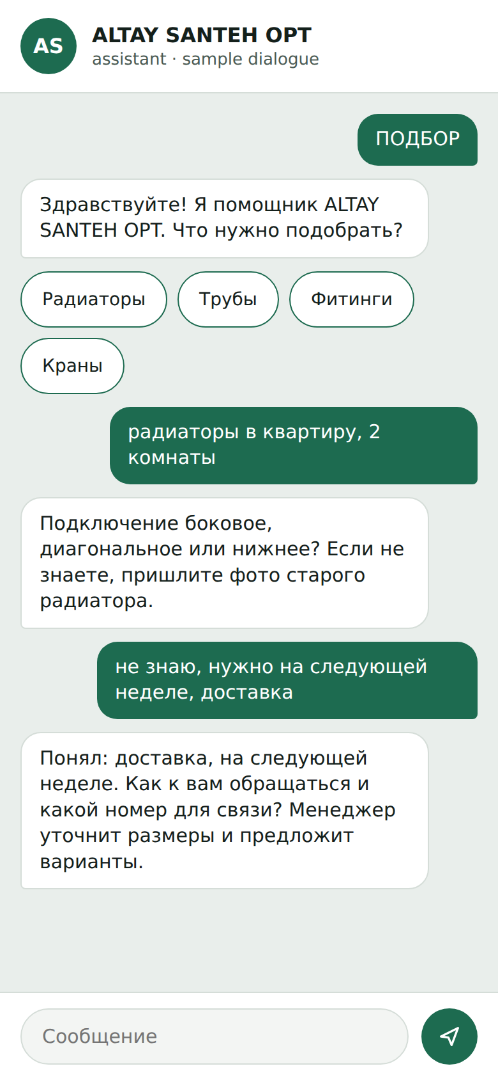
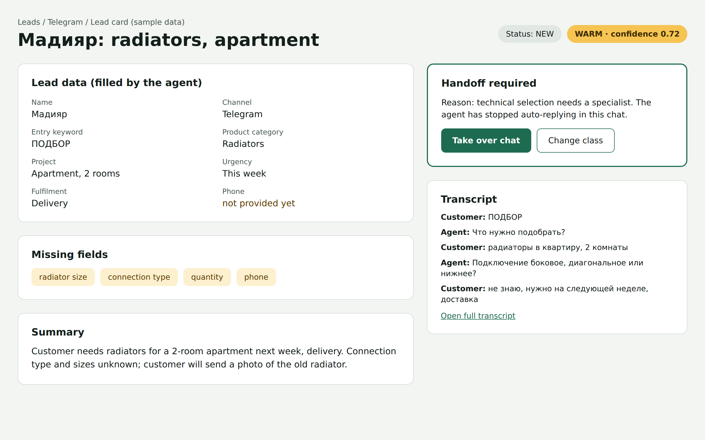
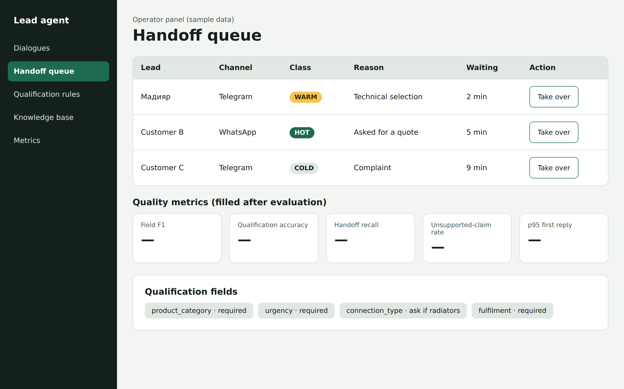
UX / prototype
2 Manager: CRM lead card
Fields, class WARM, handoff reason
3 Operator panel
Handoff queue, metrics, rules
Key scenario. A lead writes ПОДБОР; the agent asks for missing fields; a lead card with class and handoff reason appears in the CRM.
1 Customer chat
Telegram / WhatsApp
Takeaway. customers use the messenger they already have, managers work in the CRM, the operator uses a panel; external systems connect through webhooks and the REST API. Mockups use synthetic data.

Slide 10
Verification and evaluation plan
1
Test set
2
Gold labels
3
Run agent
4
Metrics
100+ dialogues: real anonymized + synthetic
Fields, class, handoff; two annotators
Same dialogues, mock CRM, 3 runs
Compare with baselines
Metric | Initial target
Field F1 vs gold labels | 0.85 or higher
Qualification accuracy | 0.80 or higher
Handoff recall | 0.90 or higher
Unsupported-claim rate | 2% or lower
Successful injection probes | 0%
p95 first-reply latency | Under 10 s
Baselines
Test plan and conditions
B1 rule-based bot, fixed questions
B2 Make / n8n, single prompt
B3 human manager
Ablations: no validation, free output
Unit, integration, end-to-end tests
Fixed prompts and model, 3 runs
Test set frozen before tuning
Targets are hypotheses, set after baseline
Takeaway. the aim is shown by metrics on labeled dialogues, compared with three baselines.

Slide 11
Project management and risks
Repository and tracker
Milestones
Risk | Mitigation | Level
Invented prices or stock | KB-only answers, handoff | High
Prompt injection | Tool whitelist, validation | High
Personal data | Anonymize, written consent | High
WhatsApp onboarding delay | Telegram first | Medium
Few real dialogues | Synthetic set, honest limits | Medium
Scope for one student | MVP first, stretch separate | Medium
GitHub: github.com/Wolfenste1n/diploma-Madiyar
YouTrack (DIP): madiyar-diploma.youtrack.cloud
24 Oct
Pre-defense 1: analysis, design, plan
18 tasks with owner, criteria, deadline
Branch and pull request per task
Tags: pre-defense-1, pre-defense-2, final
Nov
Telegram, agent core, mock CRM
Dec
WhatsApp, injection tests
Responsibilities
Student: analysis, design, code, evaluation
Supervisor: reviews key deliverables
Experts, client: interviews, data
May
Pre-defense 2: MVP, baselines
Dependencies. Bitrix24 plan with REST API, WhatsApp Business account, LLM API access.
June
Final: evaluation, documents
Takeaway. work is traceable (tasks, pull requests, tags); next steps: finish interviews by 20 Oct, Telegram skeleton, repository documents.

Slide 12
Conclusion
1
Done at this stage
2
Main findings
Problem, aim, scope and six objectives; requirements approved by the clients
Evidence from two expert discussions
13 sources reviewed; 4 existing products compared on 8 criteria
7 technology decisions justified by the requirements
Architecture, prototype mockups and evaluation plan; repository and YouTrack created
Commercial agents already qualify leads and write to a CRM
None of the reviewed products publishes a quality-measurement method; most are closed
LLM agents are weak at slot tracking, hallucination and injection: handled by explicit state, knowledge-base answers and a tool whitelist
Contribution: a measurable agent with validated schema, explicit handoff and replaceable channel, LLM and CRM
3
Limitations
4
Next steps
No code and no measured results yet
2 of 3–5 expert discussions held
Metric targets are initial hypotheses, calibrated after the baseline run
Part of the competitor data are vendor claims
By 20 Oct: finish interviews, check sources
Nov: Telegram gateway, agent core, mock CRM, Bitrix24 adapter
Dec: WhatsApp channel, injection tests
May (pre-defense 2): end-to-end MVP, baselines measured
June (final): full evaluation, documentation

Slide 13
References
Scientific sources
[10] Tam Z. R. et al. (2024). Let Me Speak Freely? A Study on the Impact of Format Restrictions on Performance of Large Language Models. EMNLP 2024 Industry Track. arXiv:2408.02442
[11] González-Flores L., Rubiano-Moreno J., Sosa-Gómez G. (2025). The relevance of lead prioritization: a B2B lead scoring model based on machine learning. Frontiers in Artificial Intelligence. doi:10.3389/frai.2025.1554325
[12] Wu M., Andreev P. et al. (2023). The state of lead scoring models and their impact on sales performance. Information Technology and Management. doi:10.1007/s10799-023-00388-w
[13] Lewis P. et al. (2020). Retrieval-Augmented Generation for Knowledge-Intensive NLP Tasks. NeurIPS 2020. arXiv:2005.11401
[1] Yao S. et al. (2023). ReAct: Synergizing Reasoning and Acting in Language Models. ICLR 2023. arXiv:2210.03629
[2] Schick T. et al. (2023). Toolformer: Language Models Can Teach Themselves to Use Tools. NeurIPS 2023. arXiv:2302.04761
[3] Wang L. et al. (2024). A Survey on Large Language Model based Autonomous Agents. Frontiers of Computer Science. arXiv:2308.11432
[4] Gao Y. et al. (2023). Retrieval-Augmented Generation for Large Language Models: A Survey. arXiv:2312.10997
[5] Hudeček V., Dušek O. (2023). Are Large Language Models All You Need for Task-Oriented Dialogue? SIGDIAL 2023, pp. 216–228. doi:10.18653/v1/2023.sigdial-1.21
[6] Yao S. et al. (2024). tau-bench: A Benchmark for Tool-Agent-User Interaction in Real-World Domains. arXiv:2406.12045
[7] Ji Z. et al. (2023). Survey of Hallucination in Natural Language Generation. ACM Computing Surveys 55(12). arXiv:2202.03629
[8] Zheng L. et al. (2023). Judging LLM-as-a-Judge with MT-Bench and Chatbot Arena. NeurIPS 2023 Datasets and Benchmarks. arXiv:2306.05685
[9] Greshake K. et al. (2023). Not What You've Signed Up For: Compromising Real-World LLM-Integrated Applications with Indirect Prompt Injection. AISec 2023. arXiv:2302.12173
Technical documentation
[14] HighLevel Support. How to set up a Conversation AI bot. help.gohighlevel.com
[15] Meta. WhatsApp Business Platform, Cloud API documentation. developers.facebook.com/docs/whatsapp/cloud-api
[16] Telegram. Bot API documentation. core.telegram.org/bots/api
[17] Bitrix24. REST API documentation. apidocs.bitrix24.com
[18] OWASP. Top 10 for Large Language Model Applications. owasp.org/www-project-top-10-for-large-language-model-applications
Identifiers: DOI where assigned, otherwise arXiv.

