Slide 1
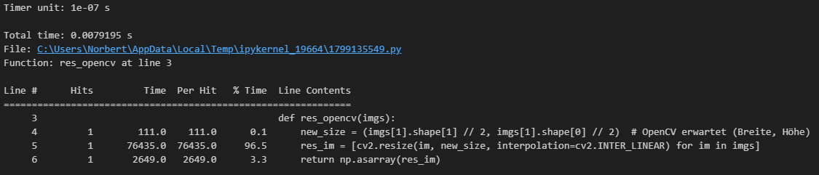
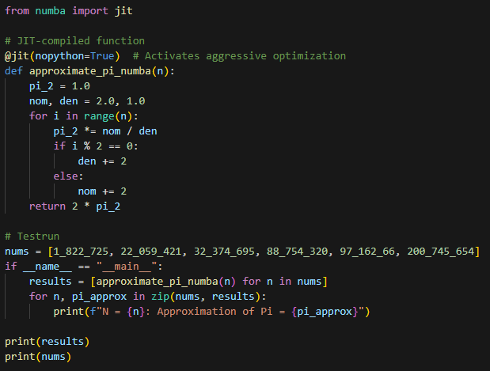
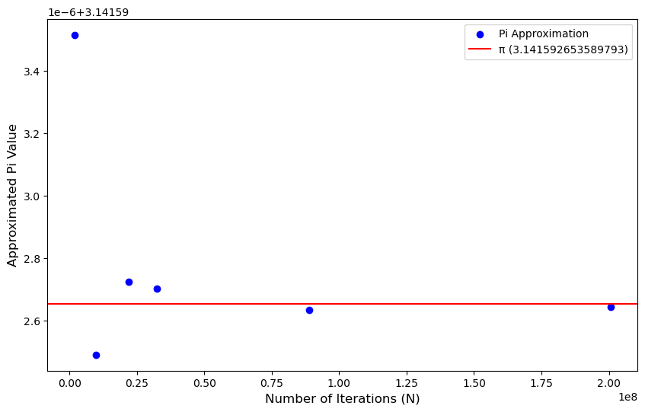
Task 1
This line has been the bottleneck. With using the opencv libary the resize function now works faster
Task 2:
I decided to use multiprocessing as it is a computation heavy function. Multiprocessing can utilize multiple CPU cores for true parallel execution. Multithreading would be limited by Python's Global Interpreter Lock (GIL), which restricts parallel execution of threads for CPU-bound tasks. The sequential call of the function for each value of N took a total of 1min25sec. By using multiprocessing, I was able to reduce this time to 54sec.
Task 3:
Task 4:
By using numba the code took only 3sec. That‘s 18 times faster than 54sec.

