Slide 1
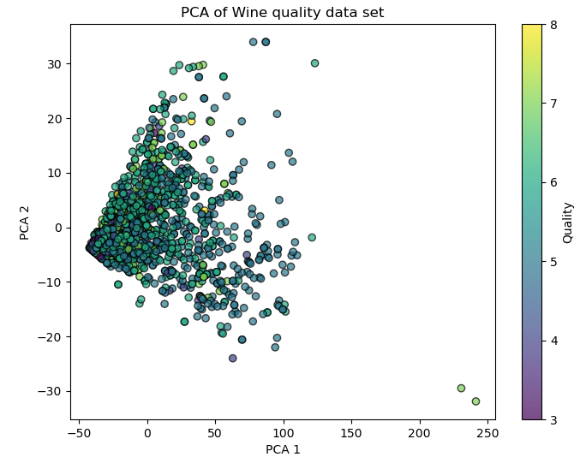
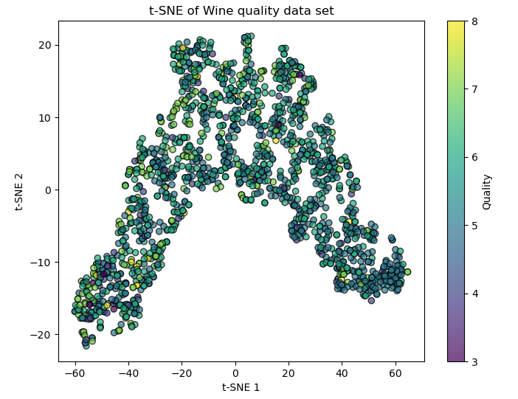
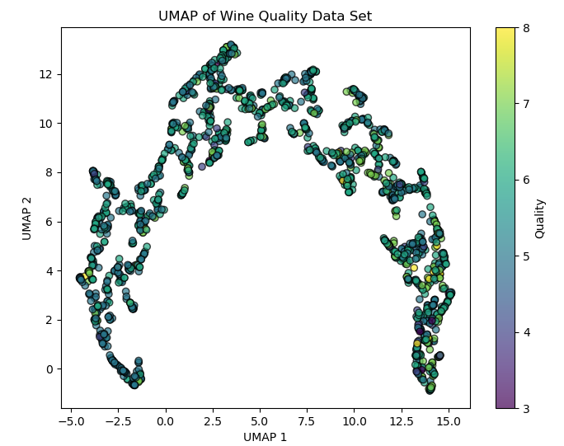
H0: The pH value has no effect on the quality of the wine.
H1: The pH value has an effect on the quality of the wine.
Test: ANOVA (Analysis of Variance) is used because we have multiple groups (quality ratings) to compare. By comparing the mean pH values for each quality rating, we can determine whether the pH value differs significantly between the quality groups.
p-value: 0.00062843887009581
Conclusion: Since the p-value is smaller than 0.05, we reject the null hypothesis. This indicates that there are significant differences in the mean pH values between the different wine quality ratings, suggesting that the pH value does have an influence on the quality of the wine.

