Slide 1
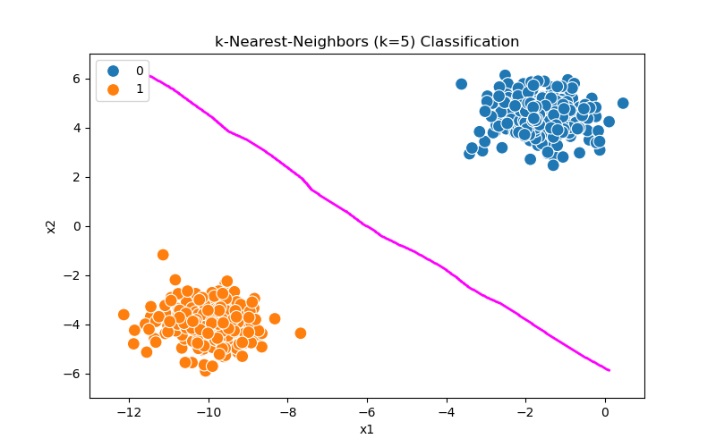
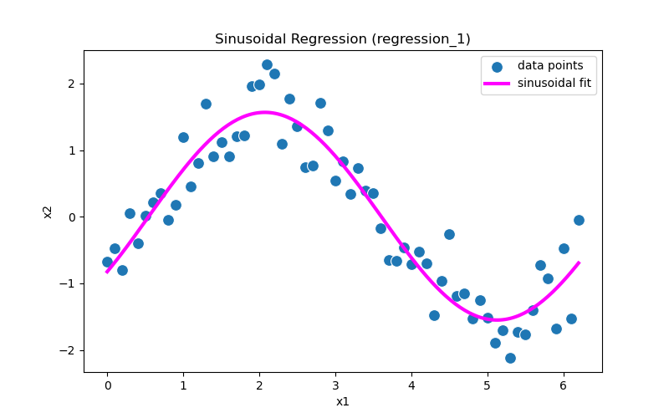
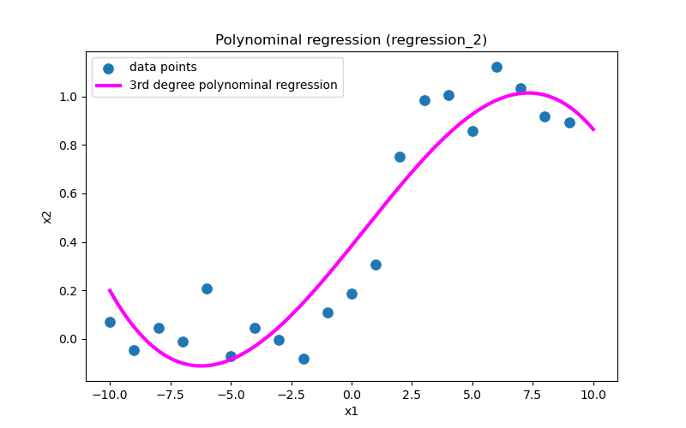
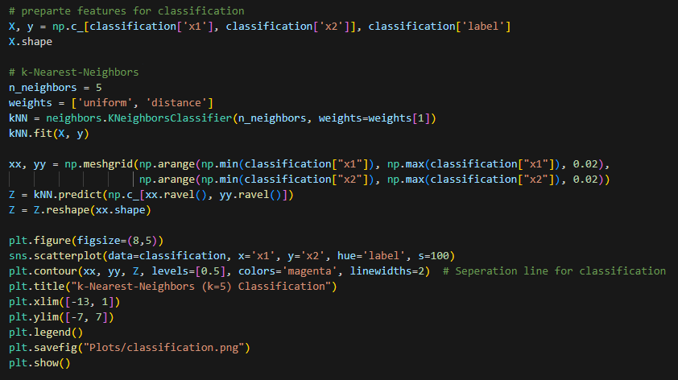
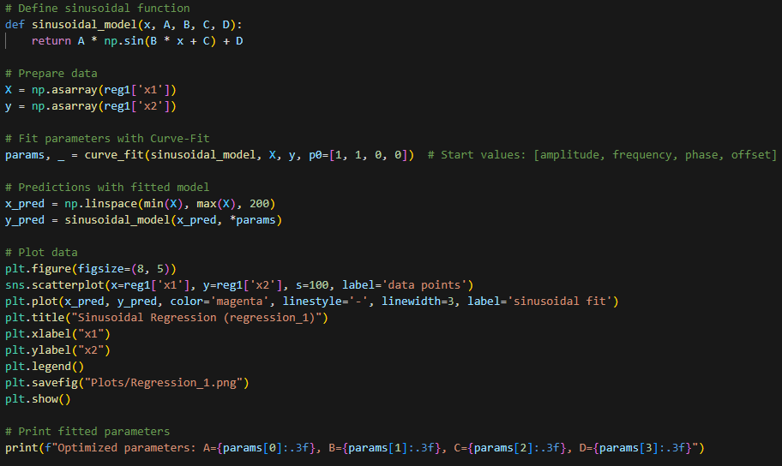
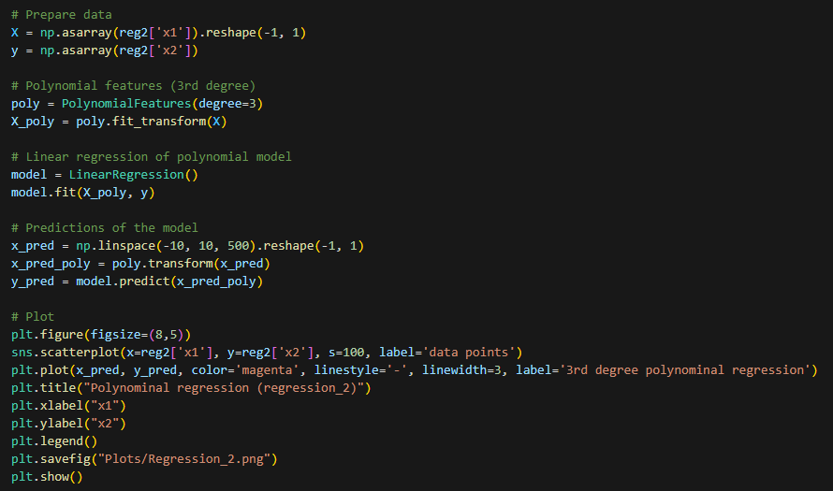
a.) It is non-noisy data with a binary classification as the output is either 0 or 1
b.) It is noisy data that follows a sinusoidal pattern
c.) The data is a non-linear noisy function (possible data source: oscillations)
a.) I chose the k-NN (with k=5) method. It creates a nearly linear decision boundary, which works good as the classes are very distinct.
b.) Because of the sinusoidal pattern of the data I chose sinusoidal regression with the general form: y=A⋅sin(B⋅x+C)+D. With A=1.559, B=1.029, C=-0.564 and D=0.007.
c.) I chose a 3rd degree polynomal regression model. It is useful to fit the non-linear relation of tha data as seen in the plot.

