Slide 1
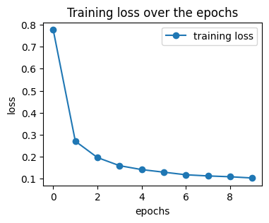
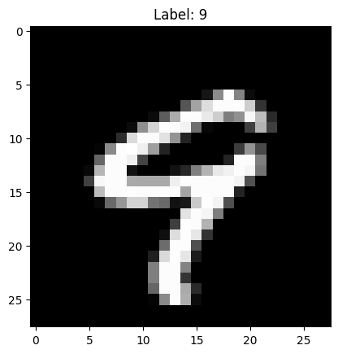
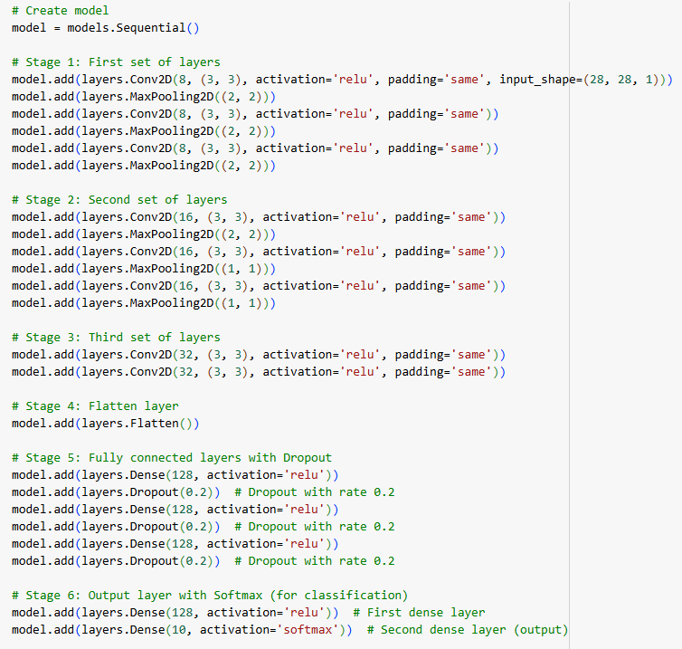
Random sample:
Screenshot of the model:
What does sparse_categorical_crossentropy mean?
Sparse categorial crossentropy is the loss function that is used at the output layers. It measures how badly the model works and outputs a number that indicates how high the error is.
What is „adam“?
Adam is the optimizer that is used to train the model. It uses the loss function to update the model parameters and reduces the error by fitting the model to the data.
What does „epoch“ mean?
1 epoch means that each example in the training dataset has been run through the model once. Several epochs are necessary to train the model, as it should gradually reduce its errors and make better predictions over the epochs
Name five activation functions:
ReLu (Rectified Linear Unit)
Linear
Leaky ReLu
Sigmoid / Logistic
Binary Step
Final test accuracy:

