Slide 1
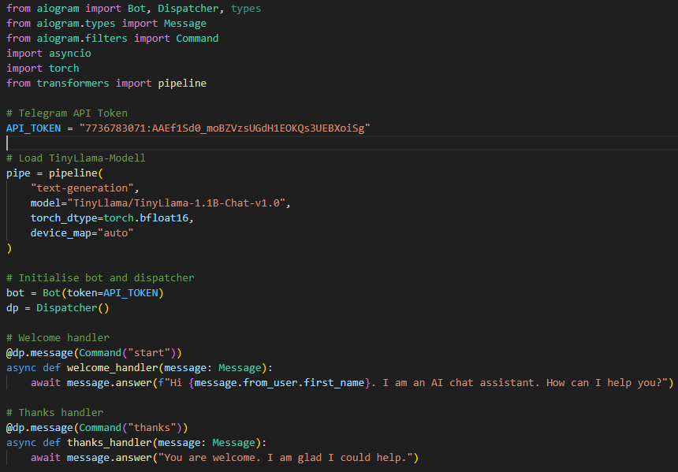
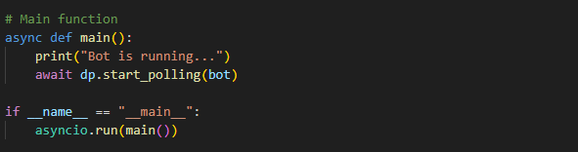
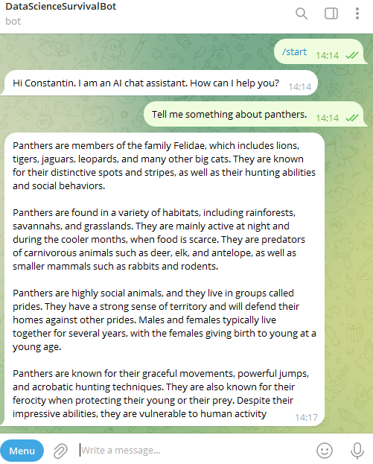
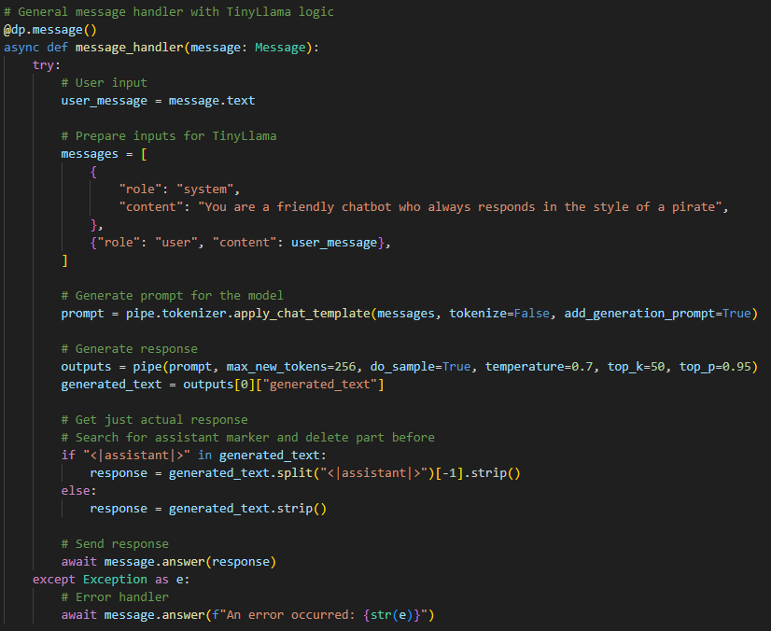
Link to Telegram Bot:
t.me/DataScienceSurvivalBot
Git repository link:
https://github.com/Wolff11912/dsss_homework9.git

