Slide 1
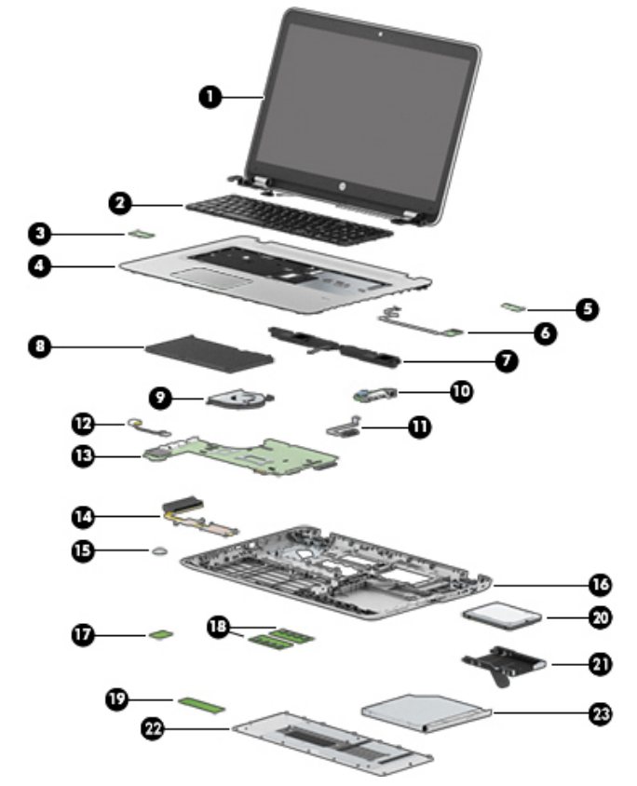
Task 1:
System: Laptop: HP ProBook 470 G4
Nr. 13: CPU: Intel Core i7-7500U processor;
GPU: NVDIA GeForce 930MX
Nr. 18: Memory: RAM: 8 GB
Nr. 19: SSD: M.2 2280 SSD (NGFF), SATA-3
Task 2:
Paper Title: CUDA and OpenCL Implementations of 3D CT
Reconstruction for Biomedical Imaging
This topic interests me because I am studying medical engineering at FAU. Furthermore, I am a working student at Siemens Healthineers AG in a CT R&D department. Therefore, the topic correlates with my work.
HP ProBook 470 G4 Notebook PC: Maintenance and Service Guide

