Slide 1
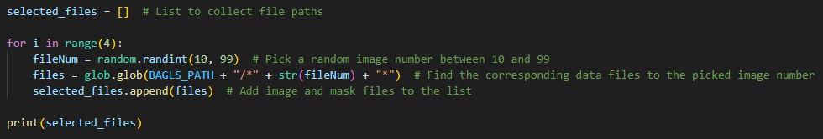
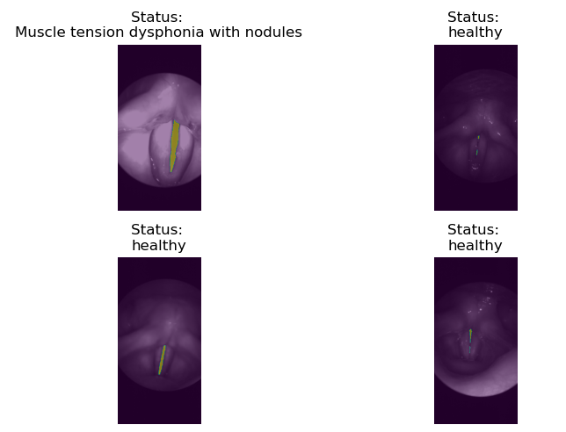
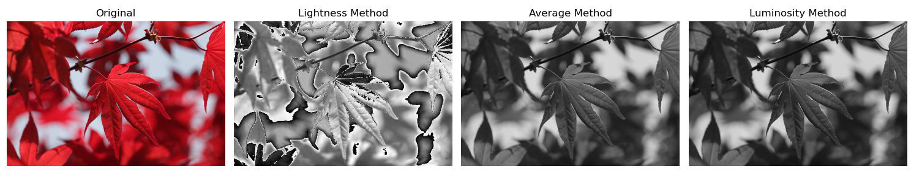
Task 1:
Task 2:
Task 4:
The luminosity method is preferred for RGB to grayscale conversion because it better reflects human perception, giving more weight to the green channel, which the human eye is most sensitive to. This method provides a more accurate and visually pleasing grayscale image
Task 3:

