Slide 1

TECHNICAL DESIGN SPECIFICATION

Slide 2

OVERVIEW
Kord is a centralized hub for communication over a digital medium, whether that's between friends, businesses, working partners, social groups, etc. Users will be able to chat and communicate in a room with an interactive board. Users will be able to draw on the board or create, manipulate, and interact with resources such as documents, videos, etc. It can be used as a space for saving important links, brainstorming, making timelines, and more.
It is a space where digital interactions have a sense of continuity and connect people to each other, rather than to the ether.
Revision History:
* 0.4 11/14/2014: Design Specification
* 0.3 10/16/2014: Functional Specification
* 0.2 10/02/2014: Proposal
* 0.1 09/15/2014: Profile
Disclaimer:
Any designs and features discussed in this document are subject to change. UI designs will evolve as we test and feature lists will change as we run into technical problems and find inspiration. Technical details will be discussed in a future document. Note that also, the two wireframe versions of the UI illustrate the different layouts and set ups we will be experimenting with.

Slide 3
TEAM MEMBERS
Julian Kuk: Project Lead
Responsible for managing the flow of the team and the distribution of tasks, with a primary focus on front-end development.
James Yanyuk: Back End Lead
Primarily focused on back-end development, and general integration of the front-end and database. Manages the application's dedicated server (currently running at http://kord.io).
Matthaus Wolff: Back-End Developer and Marketing Manager
Primarily focused on back-end development and marketing of the application.
Nam Phan: Back-End Developer
Primarily focused on database design and back-end development.
Sara da Silva: Front-End Lead and Graphic Designer
Primarily focused on front-end development and graphic design.

Slide 4
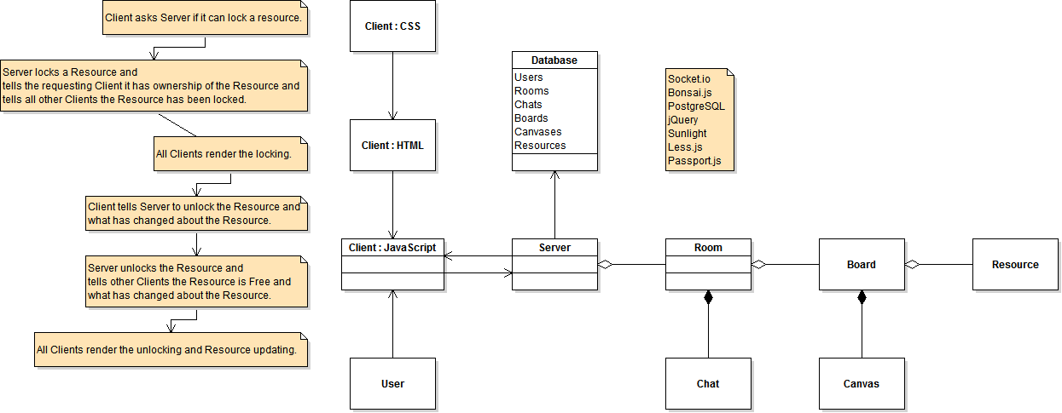
BIRD’S EYE VIEW

Slide 5
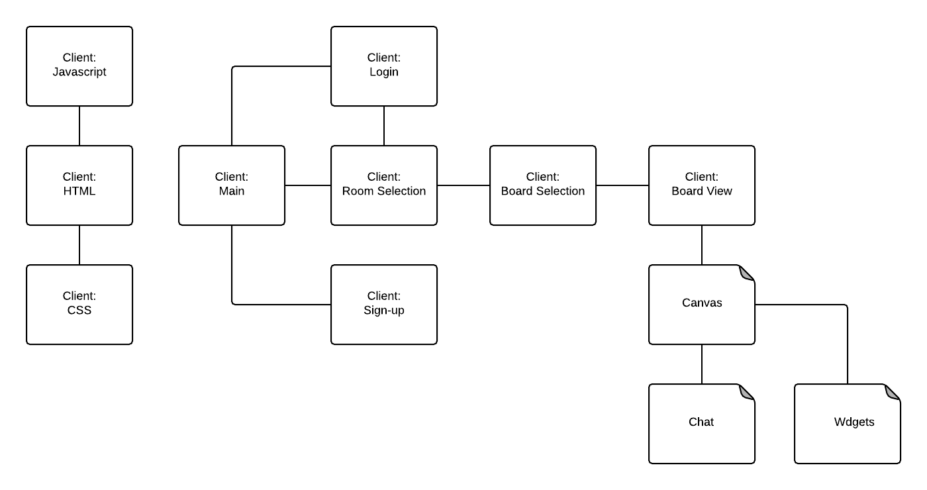
CLIENT

Slide 6
SERVER:
CONNECTION MANAMENT & USER AUTHENTICATION

Slide 7
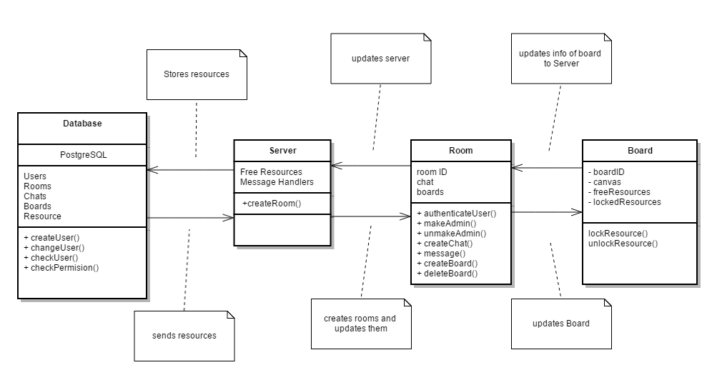
SERVER:
ROOM AND SERVER INTERACTION

Slide 8
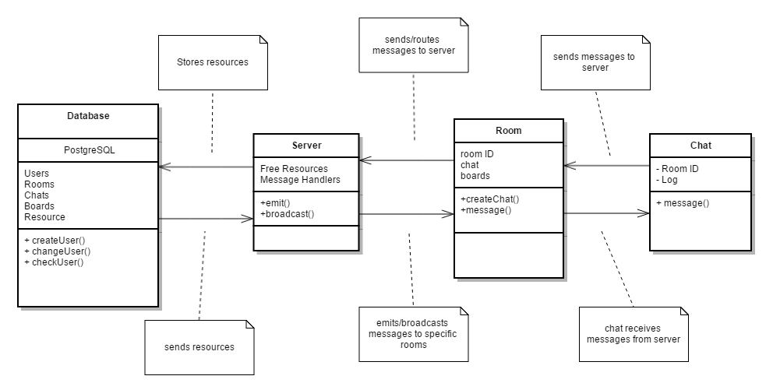
SERVER:
CHAT AND SERVER INTERACTION

Slide 9
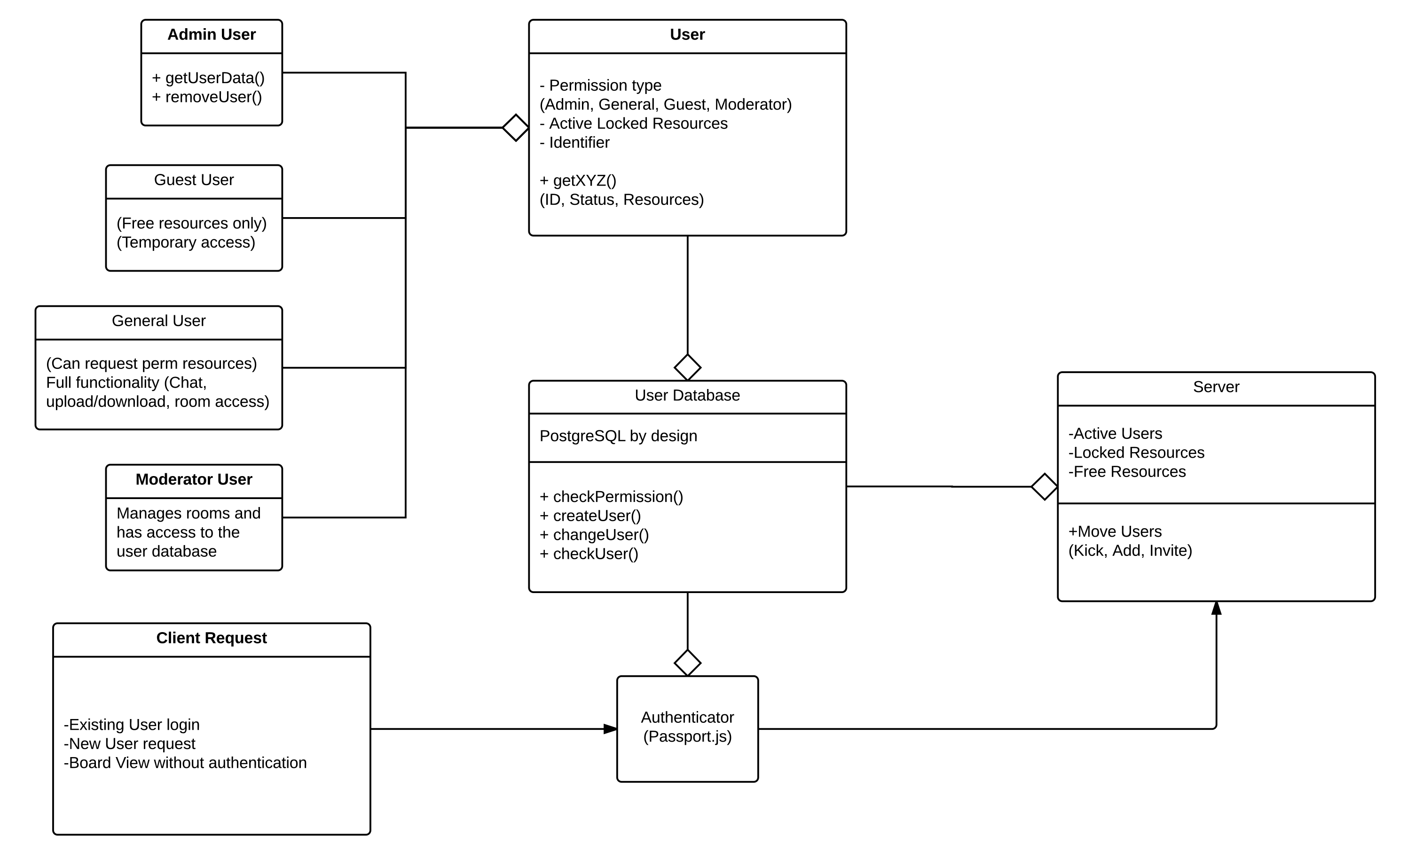
USERS DATABASE

Slide 10
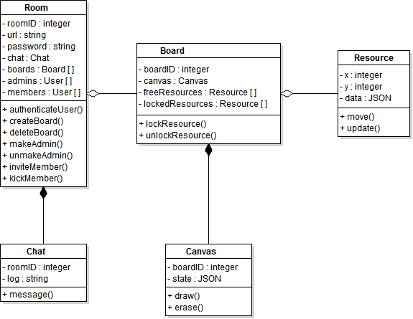
ROOMS DATABASE

Slide 11
EXTERNAL LIBRARIES
Node.js
Serverside JavaScript environment
Express
Web framework for Node.js.
EJS
Javascript template library to seamlessly integrate the Javascript and HTML of our web application.
jQuery
JavaScript library to simplify the client-side scripting of HTML.
Bootstrap
Our web application will use the tools provided by Bootstrap in order to create the front-end design of kord.io.
PostgreSQL
Database infrastructure. We chose this to handle wide-scale development with large amounts of data being handled. Very reliable and stable while being compatible with most platforms.
Socket.io
Main engine for the boards. Socket.io simplifies the usage of WebSockets while ensuring compatibility on the users end. This will be the development base for the chat system and routing between rooms.
Bonsai.js
Lightweight graphics library for drawing/animating dynamically on a board.Capable of fairly complicated development and performances while not consuming too many server resources. We prefer SVG over canvas because our app is more likely to have data overflow than it is to require complicated graphics.
Sunlight.js
Used for automatic syntax highlighting within html. Low weight and parallel resources.
Less.js
Client-side CSS pre-processor. Adds more functionality to extend maintainability and creative freedom. Less.js allows for the defining of variables and mix-ins to make full use of Nested syntax. It also has some useful Operational Functions and Mathematical operations that make it more appealing than Sass.
Passport.js
Sweet and simple Node.js authenticator. It supports persistent sessions, and has a dynamic scope. Handles large amounts of users with easy handling of success/failure and has a lightweight code base.

Slide 12
EXTERNAL LIBRARIES
Node.js
Serverside JavaScript environment
Express
Web framework for Node.js.
EJS
Javascript template library to seamlessly integrate the Javascript and HTML of our web application.
jQuery
JavaScript library to simplify the client-side scripting of HTML.
Bootstrap
Our web application will use the tools provided by Bootstrap in order to create the front-end design of kord.io.
PostgreSQL
Database infrastructure. We chose this to handle wide-scale development with large amounts of data being handled. Very reliable and stable while being compatible with most platforms.
Socket.io
Main engine for the boards. Socket.io simplifies the usage of WebSockets while ensuring compatibility on the users end. This will be the development base for the chat system and routing between rooms.
Bonsai.js
Lightweight graphics library for drawing/animating dynamically on a board. Capable of fairly complicated development and performances while not consuming too many server resources. We prefer SVG over canvas because our app is more likely to have data overflow than it is to require complicated graphics.
Sunlight.js
Used for automatic syntax highlighting within html. Low weight and parallel resources.
Less.js
Client-side CSS pre-processor. Adds more functionality to extend maintainability and creative freedom. Less.js allows for the defining of variables and mix-ins to make full use of Nested syntax. It also has some useful Operational Functions and Mathematical operations that make it more appealing than Sass.
Passport.js
Sweet and simple Node.js authenticator. It supports persistent sessions, and has a dynamic scope. Handles large amounts of users with easy handling of success/failure and has a lightweight code base.

Slide 13
