Slide 1
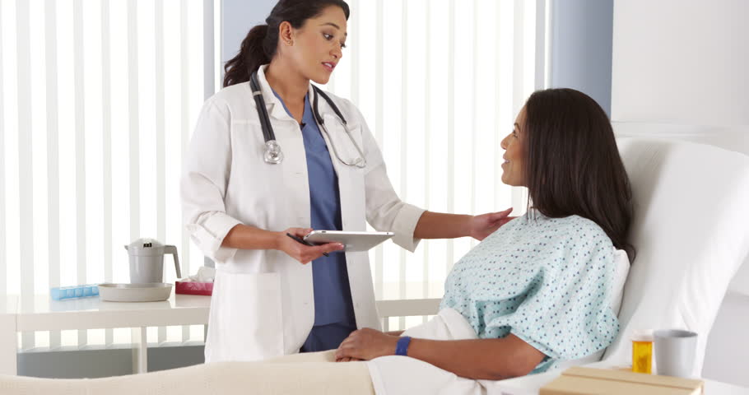
CervIcal Cancer screening
Thinkful Final Capstone
John-Alexander Hall

Slide 2
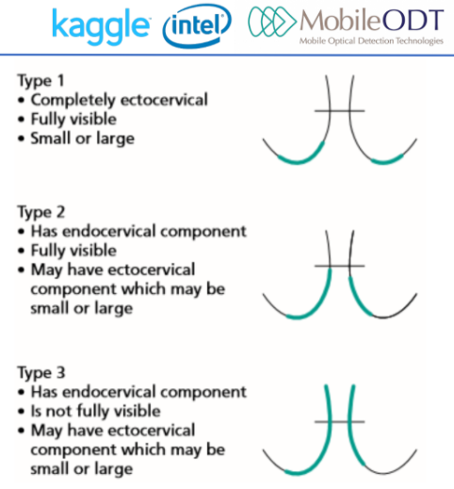
Background Information
Easily preventable in precancerous stages
Determining the type of Cervix is key
3 types of Cervixes (Type 1, Type 2, Type 3)

Slide 3
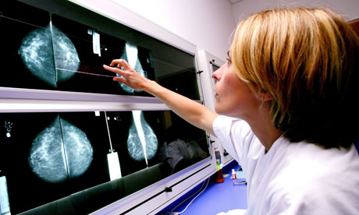
Screening Importance
Leads to potentially life-saving treatments
Type of Cervix determines the appropriate treatment
High cost of providing the wrong treatment
Help healthcare providers make better treatment decisions

Slide 4
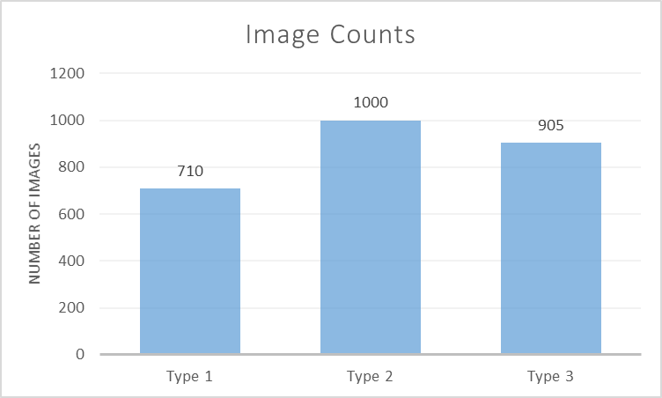
Dataset
Kaggle Dataset
Partnership with Intel and MobileODT
2615 Images, 10.9GB

Slide 5
Demo

Slide 6




Helpful Tools

Slide 7
Amazon EC2 Schematics
Setup AWS account
Configure and Launch EC2 instance
Access EC2 instance
Anaconda Setup
Configure Jupyter Notebook
Transfer Files from Local to EC2
Conduct Data Experiments
Transfer Files from EC2 to Local
Terminate EC2
Terminate Filezilla

Slide 8
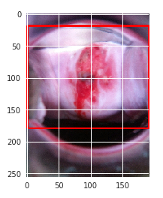
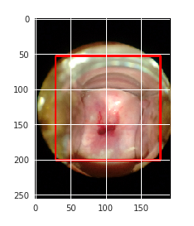
Image Segmentation
Glob python module -> used for finding file pathnames
Finding the largest rectangle when a circular frame is present
Creates CSV file with relevant resizing information
X
Y
New image dimensions
Crop dimensions

Slide 9
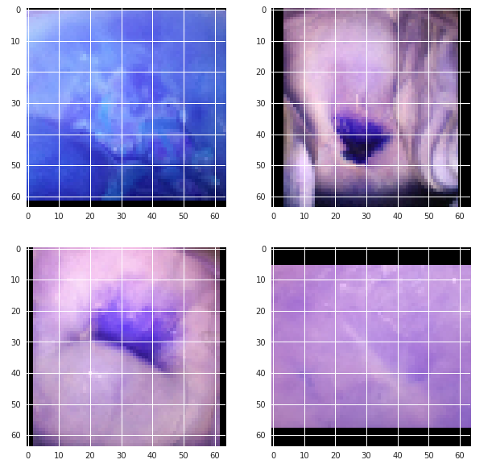
Image Resizing
Previous function does not perform cropping, simply returns crop dimensions
Append all file paths to a list -> Link to dictionary with crop info
Use image_id and type as key to ensure uniqueness
Crop with array splicing formatting
Scale cropped images to square dimensions

Slide 10
Data Preprocessing
Labels:
Converting string labels to numbers
One Hot Encoding
Type Dummy Variables
Pixels:
Reshape values to include the total size of the test and train inputs, the image dimensions and the channel
Divide all X values by 255
Ensure pixel values are between 0 and 1

Slide 11
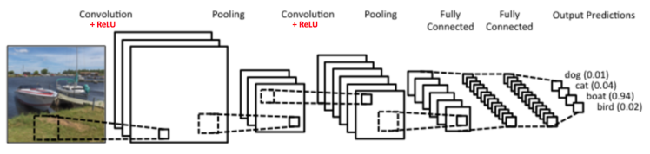
Convolutional Neural Networks
Convolution Layer
ReLU
Pooling
Fully Connected Layer

Slide 12
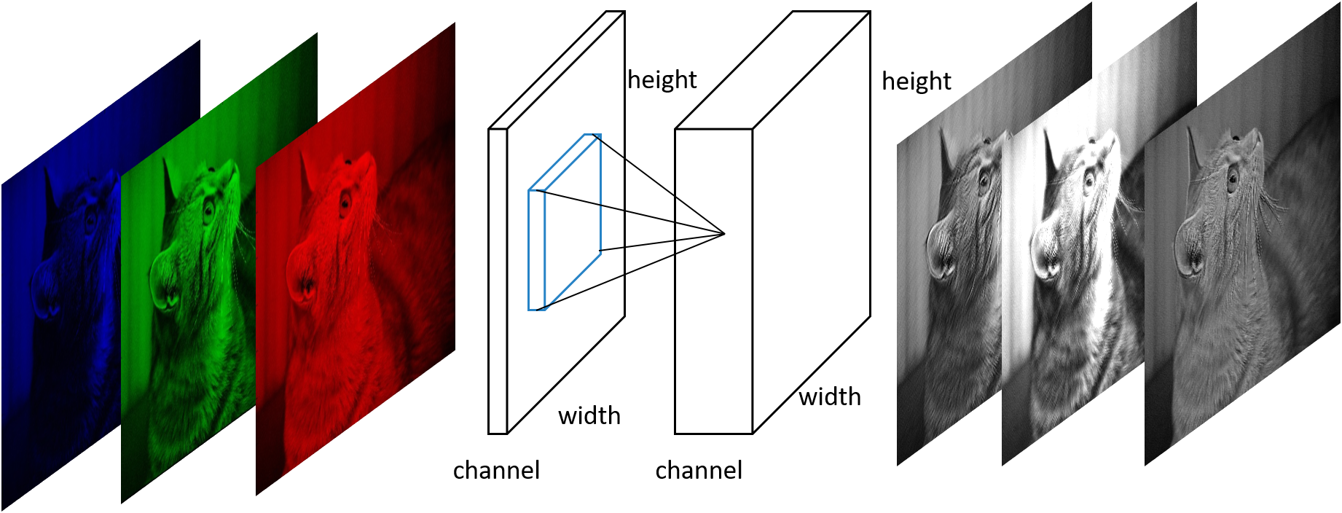
Convolution Layer
Extracts features from the input image
Learns image features using smaller squares of input data, called filters
Slide filter over the image that only sees a small part of the image at a time
Linear Process

Slide 13
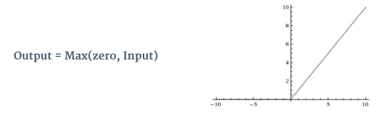
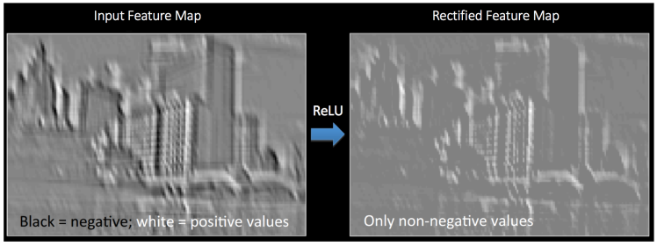
Rectified Linear Unit
Introduces non-linearity
Most real world data we want is non-linear
Replaces all negative pixel values with zero
Balances Convolution Layer
Other types you’ll see: tanh (-1, 1)

Slide 14
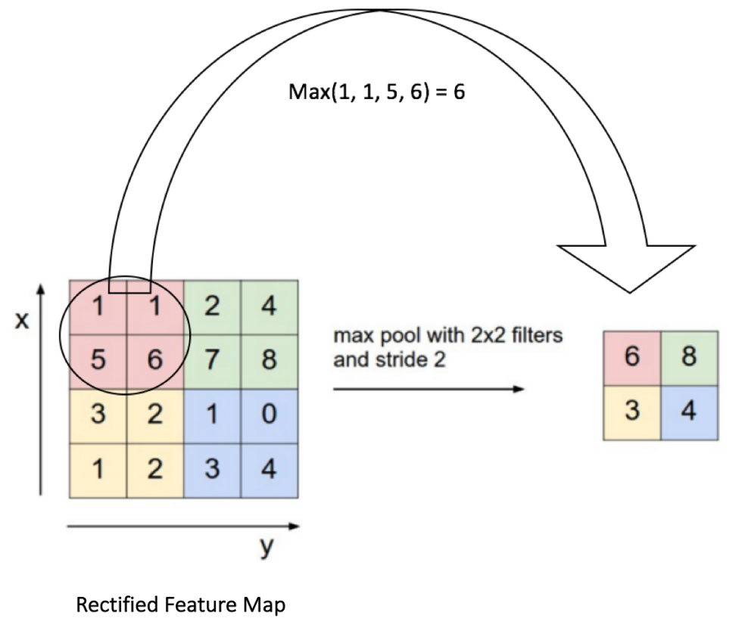
Pooling Layer
Dimensionality Reduction of feature map
Retains the most important information
Small scaled representation of the image
Max pooling is the most popular
Controls for Overfitting

Slide 15
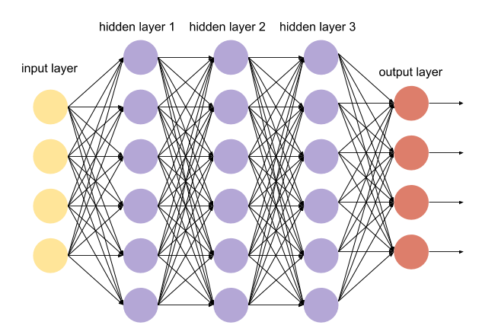
Fully Connected Layer
Traditional Multi-Layer Perceptron
Uses a Softmax function in the outer layer
Probability distribution of K different outcomes (3 cervix types)
Uses high-level features from previous layers to classify input image

Slide 16
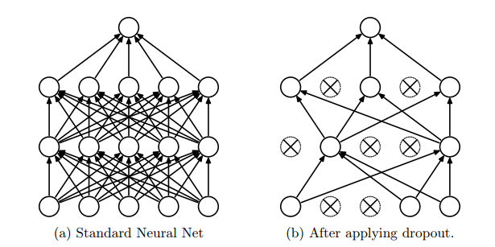
Other Layer Types
Dense
Regular Densely-connected NN layer
Dropout
Randomly drop units during training
Prevents overfitting, Increases speed
Flatten
(64, 64, 3) -> 12,288 flat pixels
Convert to 1D feature vector

Slide 17
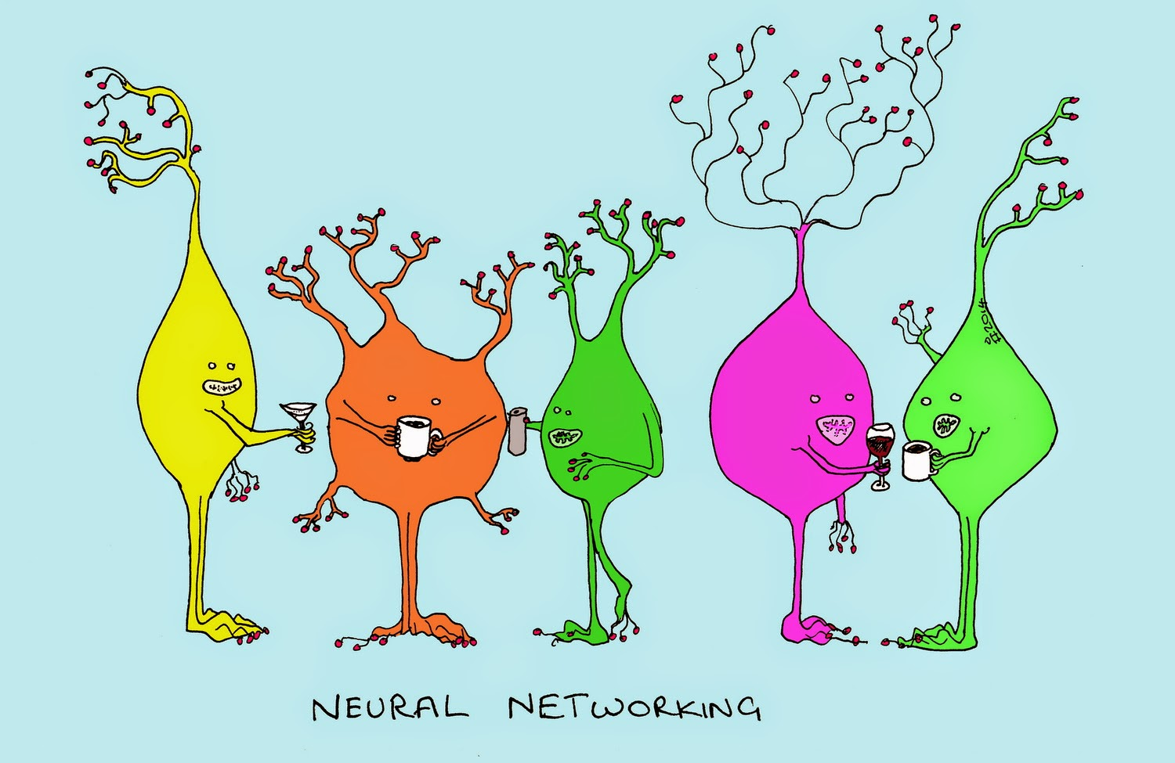
Other Layer Types (cont.)
Batch Normalization
Normalize activations of previous layer at each batch
Apply transformations that maintains mean activation close to 0 and activation std dev close to 1
Makes data more comparable across all features
ZeroPadding2D
Add rows and cols of 0 at all four sides of an image

Slide 18

Error Metric
The error metric used is multi-class logarithmic loss
Conveniently packaged as ‘categorical_crossentropy’ in Keras

Slide 19
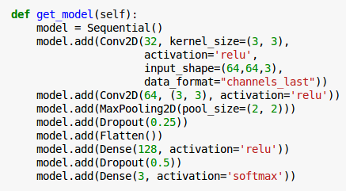
Basic CNN
Simplistic Model used to form the baseline and familiarize myself with keras process

Slide 20
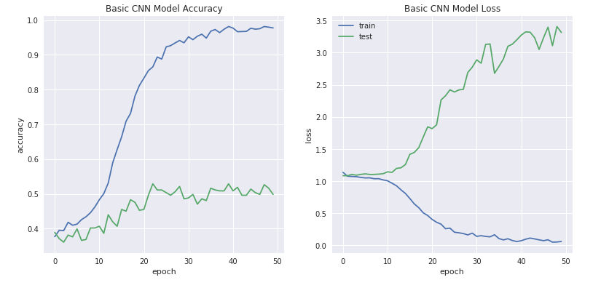
Basic CNN Results

Slide 21
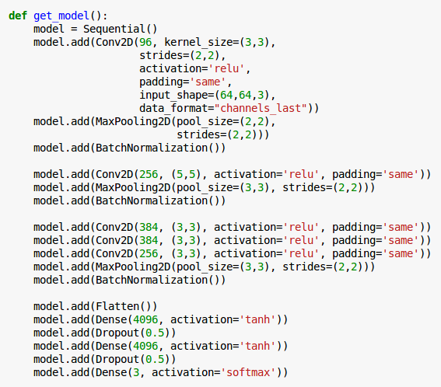
AlexNet Model
Created in 2012 by Alex Krizhevsky, Ilya Sutskever, and Geoffrey Hinton
Coming out party for CNNs in computer vision community
Relatively simple network (compared to modern architectures)
5 conv layers, 3 pooling layers and 2 dropout layers
3 fully connected layers

Slide 22
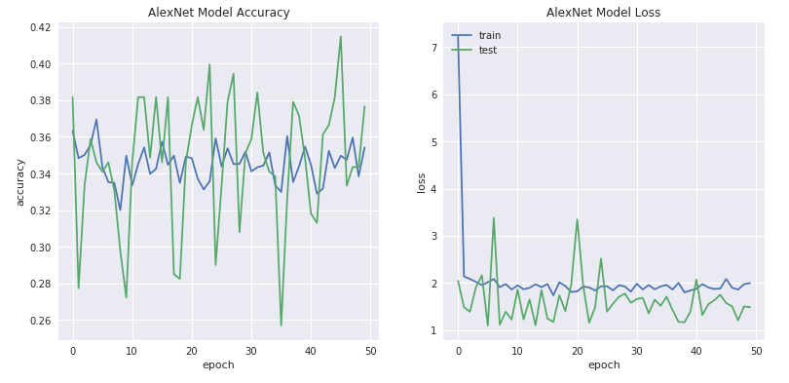
AlexNet Results

Slide 23
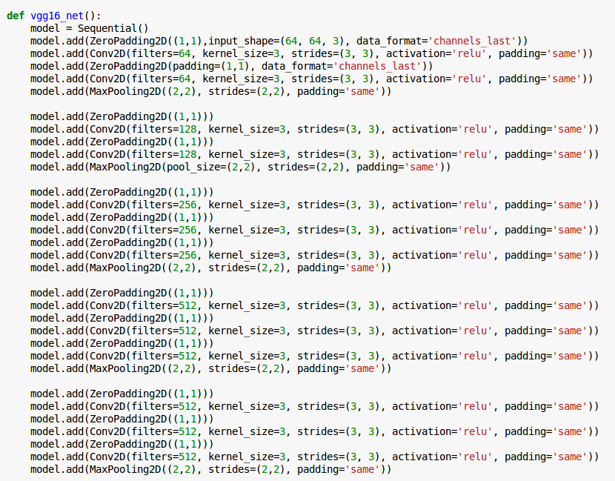
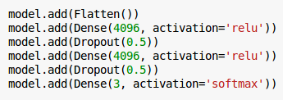
VGG-16 Net
Created in 2014 by Karen Simonyan and Andrew Zisserman
19 layer CNN
Strictly uses 3x3 filters with stride and pad of 1
2x2 MaxPooling Layers with stride 2
Simplicity and depth

Slide 24
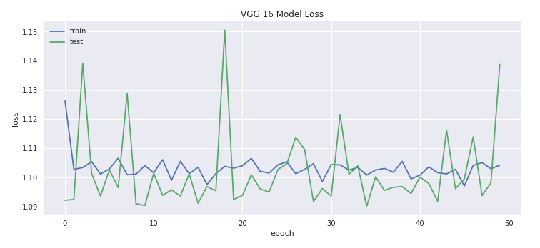
VGG-16 Net Results

Slide 25
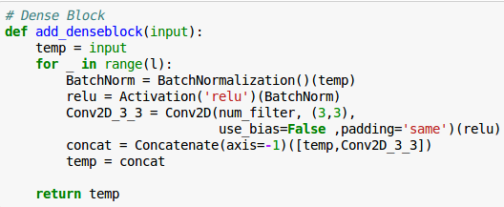
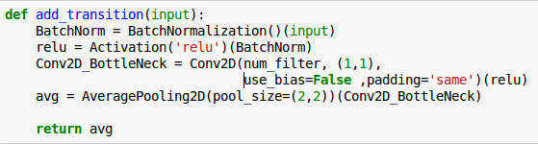
Dense Net
Connects each layer to every other layer in a feed forward fashion
Ensure maximum information flow between all layers
Requires fewer parameters
Allows for feature reuse
Uses Dense blocks

Slide 26
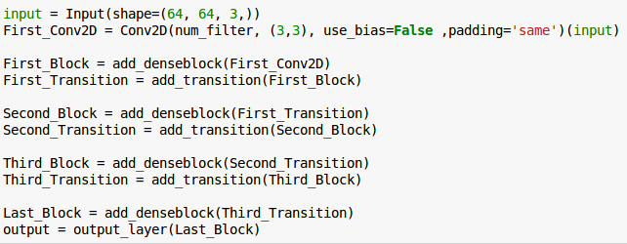
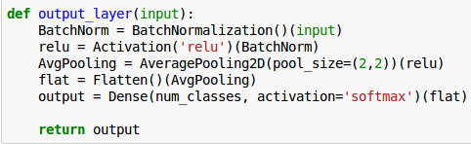
Dense Net Structure
Deviates from normal sequential formatting
on account of concatenation
Uses functions to form composition that produces the final output

Slide 27
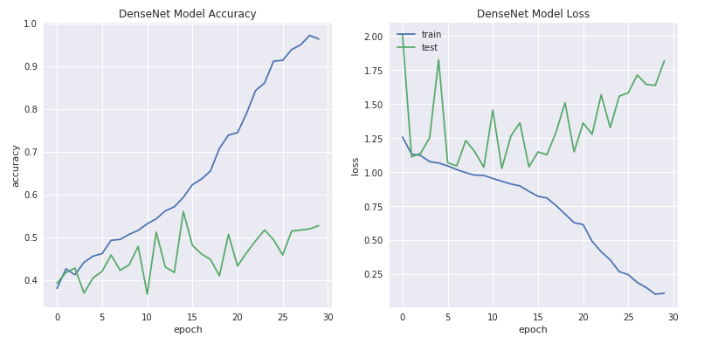
Dense Net Results

Slide 28
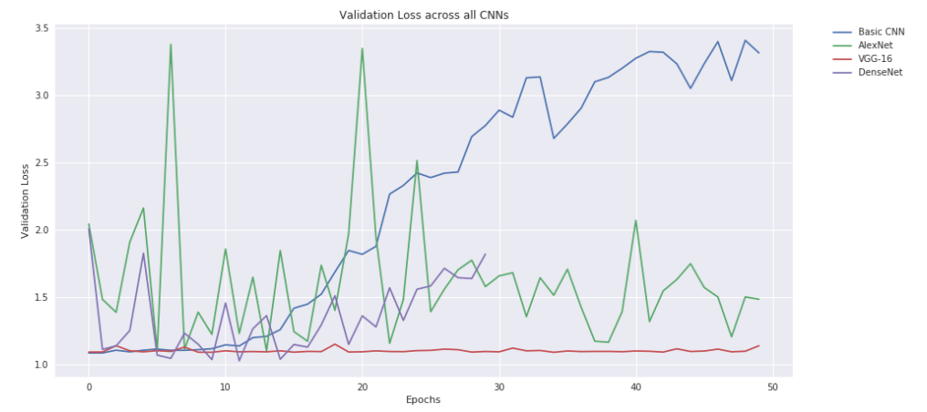
Losses Aligned
Best Results
Basic CNN | 1.08521
AlexNet | 1.09687
VGG-16 Net | 1.09002
DenseNet | 1.02712

Slide 29
Future Improvements
GPU Usage
Further EC2 authorization
Keras ImageDataGenerator Pre-Processing
Further Parameter Tuning

