Slide 1


The Mathematics behind
AI
(well, only a few first steps)
Wolfgang Waltenberger
Seminar Studienstiftung Artificial Intelligence,
Feb 12 - 14, 2020

Slide 2
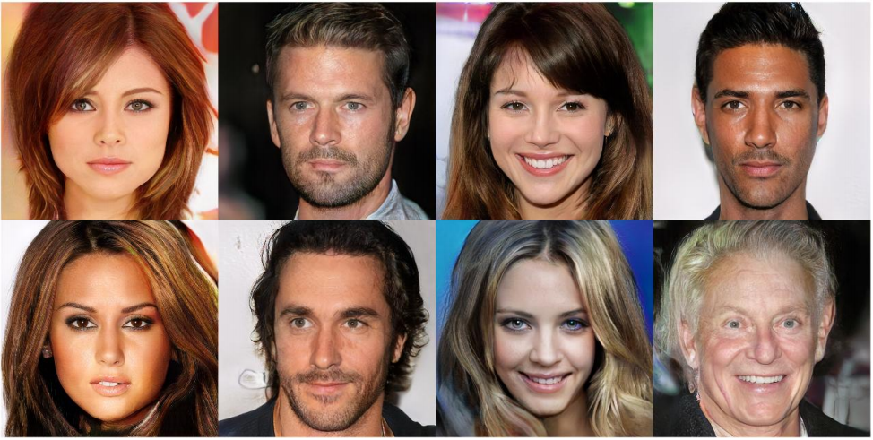
These are pictures of celebrities. Some of them have never been born.
Can you guess which?

Slide 3
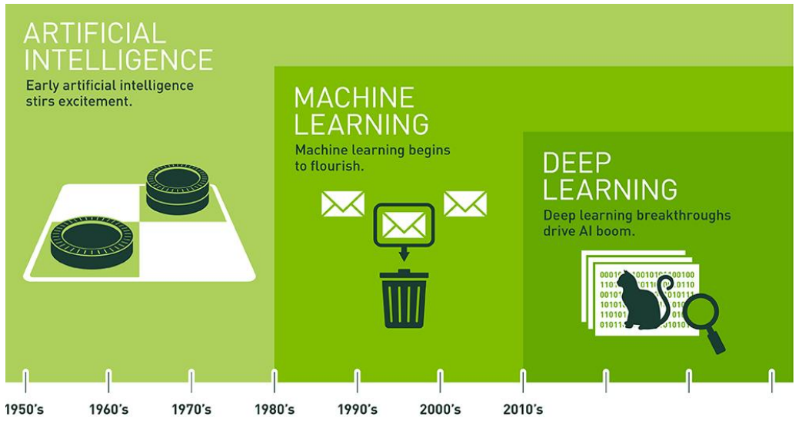
We tend to mix up terms: artificial intelligence, machine learning, (deep) neural networks.
The specialists see deep neural networks as a special case of machine learning, and machine learning as a special (though very important) case of artifical intelligence.
So: not all of artificial intelligence is about neural networks, though all the recent “hype” is about deep neural networks, and I will be talking about these.

Slide 4
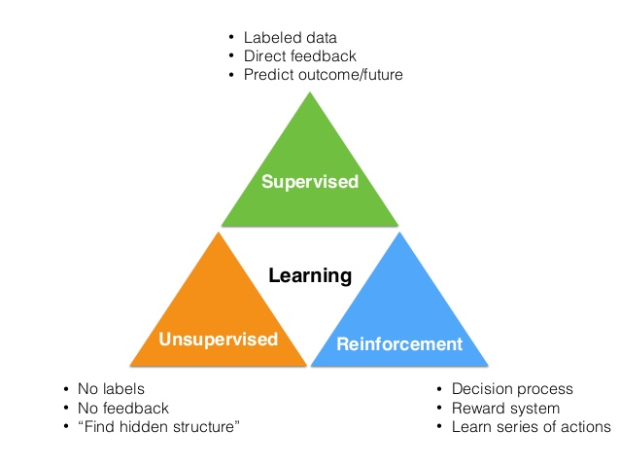
When we talk about learning, we think of three broad types of learning: supervised,
unsupervised, and reinforcement learning.
Supervised: we humans supervise=teach the machine. For example,
we show the machine many pictures of cats, and many pictures of dogs,
we tell the machine “here is a cat picture”, “here is a dog picture”,
and the machine has to learn to understand what is on the picture.
Unsupervised: the machine has to find “patterns” in the data all by itself. Example:
the machine gets all the information about how we behave, what we buy, what we look at, on amazon.at. Now it needs to finds
“stereotypes” of amazon customers.
Reinforcement: the machine has to learn to solve a task. Example: a self-driving racing car. The goal is to drive the car:
-) and not crash
-) and finish first

Slide 5
In this lecture I will try to explain how we use neural networks to solve
a supervised learning task. Neural networks, however, can also be used
to solve unsupervised and reinforcement learning tasks.
This afternoon, you will hack a bit on a simple neural network,
implemented in Facebook’s “pytorch” framework, written in python.

Slide 6
Features and Labels
In supervised learning, we have “features”, and
“labels”. “Features” are the data we have. We denote them with “x”. Examples are all pixels of an image, or data describing a person, like gender, age, height, weight, etc.
The machine will have to learn a “label”. We denote the label with “y”. If the machine should learn to tell a cat from a dog, then y is an element of the set { “cat”, “dog” }. We translate the elements to natural numbers though, for example cat=0, dog=1.
If the machine should learn to guess your age from a portrait of you, then y would be an element of all positive real numbers.

Slide 7
The function to be learned
With this vocabulary, we can already phrase our
problem mathematically. What our machine needs to find is this function:
The “label”, e.g. “cat” (0) ...
… the data (the pixels of the image, or the information about a person)
… is a function of ….

Slide 8
The function to be learned
If this function is very simple (like, say, “y=3x+2”), or if we know already know it explicitly (because we know the “laws” behind the data), then we dont use machine learning. We use (supervised) machine learning when the function is super complicated, and/or when we only have examples – pairs of x and y values – but not the function itself.
Capisci?
The “label”, e.g. “cat” (0) ...
… the data (the pixels of the image, or the information about a person)
… is a function of ….

Slide 9
How can a function be “learned”?
So the question is: how do we learn this function:
From examples alone?

Slide 10
How can a function be “learned”?
So the question really is: how do we learn this function:
from examples alone?
Here is the answer:
we start with a completely random function
we have another function that tells us how well our completely random function is solving the task.
we have an algorithm that will change our completely random function, hopefully for the better.
we repeat until we have a good function.

Slide 11
How can a function be “learned”?
So the question really is: how do we learn this function:
from examples alone?
Here is the answer:
we start with a completely random function
we have another function that tells us how well our completely random function is solving the task.
we have an algorithm that will change our completely random function, hopefully for the better.
we repeat until we have a good function.
Let’s visualize a simple problem

Slide 12
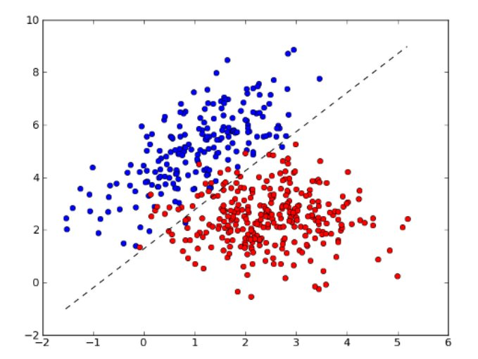
How can a function be “learned”?
x₂
x₁
The coordinates of the plot are our data. So “x” here is two-dimensional, the y-axis is the second coordinate of “x” (confusing, huh?).
The color is our label. Lets say blue is zero, red is one. The task for the machine is:
given the coordinates of the point, x=(x₁,x₂), tell me the color y of the point.

Slide 13
How can a function be “learned”?
x₂
x₁
The function that needs to be learned assigns a label (blue or red, zero or one)
to every point in this plane, agreed? But lets just visualize the “decision boundary”, that is the line where the decision of the machine changes from red to blue.
This line does not have to be straight, it can be very “crooked”.
What is the best straight line you can think of?
What is the best line you can think of?

Slide 14

Logistic regression
Let’s try to construct the “loss function” for the “straight line boundary”. The loss function should tell us, how good a solution we found. We need two ingredients:
orthogonal vectors, and dot products!
x₂
orthogonal
vector
x₁

Slide 15
Logistic regression
x₂
orthogonal
vector
x₁
If you did not fully understand the last slide, remember this: D(x) is positive the points above the line, it is negative for the points below the line. The further away, the larger the number. Ok?

Slide 16
Logistic regression
x₂
orthogonal
vector
x₁
If you did not fully understand the last slide, remember this: if D is positive the points above the line, it is negative for the points below the line. The further away, the larger the number. Ok?

Slide 17
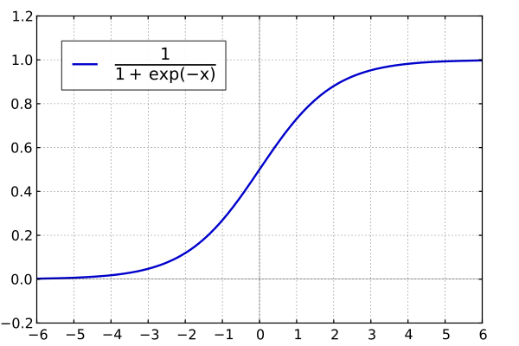
Logistic regression
Now let’s turn this into something like a “probability” that the point is blue or red. We use this function “σ”:
If we apply this to our function “D”, then for a very good solution, we get 1.0 for points that are clearly blue, 0. for points that are clearly red, 0.5 for points that are exactly in between.
Awesome, right? This function gives us a “probability”, a that the point is blue!
We use this function to predict if the point is blue!

Slide 18
Logistic regression
If we apply this to D(x) for a very good solution, we get 1.0 for points that are clearly blue, 0. for points that are clearly red, 0.5 for points that are exactly in between.
Awesome, right? This function gives us a “probability” that the point is blue!
Now if we subtract the “true” value (1.0 for blue, 0.0 for red) and take the absolute value of the difference:
then we have something that tells us how well our algorithm predicts the color of a given point, right?
The worse the prediction, the higher this number. The function is close to zero, if we predict correctly. It is close to one, if we are “maximally off”.

Slide 19
Logistic regression
Now that we have a “loss function” for one data point,
we construct one for many data points. How do we do that? We simply sum up
the “losses”. The sum tells us how well we are doing on all the data, right?
Here, we introduced the index “i”. The first data point has index i=1, the second has i=2, and so on. For every i we have a data vector and a label y_{i}
The orthogonal vector is all about the decision boundary. It has no index. You understand why?

Slide 20
Okay, if you did not understand everything perfectly, no problem. What is important, though, is that you understand that we now have a function
… that tells us, if a certain line is a good decision boundary. So now we need to find the line for which the function “L” above is as low as possible.
We need to minimize the loss function “L” as a function of

Slide 21
Okay, if you did not understand everything perfectly, no problem. What is important, though, is that you understand that we now have a function
… that tells us, if a certain line is a good decision boundary. So now we need to find the line for which the function “L” above is as low as possible.
We need to minimize the loss function “L” as a function of
So, how does one find the minimum of a function?

Slide 22
Okay, if you did not understand everything perfectly, no problem. What is important, though, is that you understand that we now have a function
… that tells us, if a certain line is a good decision boundary. So now we need to find the line for which the function “L” above is as low as possible.
We need to minimize the loss function “L” as a function of
So, how does one find the minimum of a function?
The “high school way”: You compute the derivative of the function, you set the derivative to zero.

Slide 23
Okay, if you did not understand everything perfectly, no problem. What is important, though, is that you understand that we now have a function
… that tells us, if a certain line is a good decision boundary. So now we need to find the line for which the function “L” above is as low as possible.
We need to minimize the loss function “L” as a function of
So, how does one find the minimum of a function?
The “high school way”: You compute the derivative of the function, you set the derivative to zero.
Works very well for simple functions. Won’t work for complicated functions.

Slide 24
Okay, if you did not understand everything perfectly, no problem. What is important, though, is that you understand that we now have a function
… that tells us, if a certain line is a good decision boundary. So now we need to find the line for which the function “L” above is as low as possible.
We need to minimize the loss function “L” as a function of
So, how does one find the minimum of a function?
The “physics way”: You think of “L” as a landscape. You take a ball, you let it roll down the landscape.

Slide 25
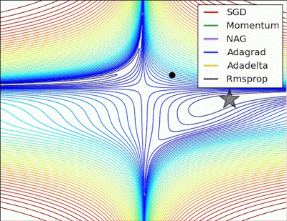
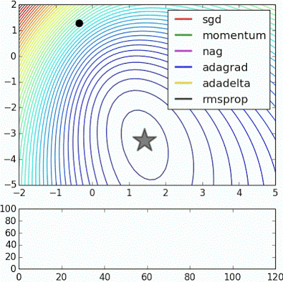
Balls rolling down
Plots taken from: http://www.denizyuret.com/2015/03/alec-radfords-animations-for.html

Slide 26
And this is what “learning” is in neural networks!
Mathematically speaking, balls rolling down in
(abstract mathematical) spaces are computed by calculating the “gradient” of the function.
The gradient is derivative of the function with respect to all parameters.
In our case, we compute the gradient, the derivative of the “loss function” L with respect to all components of
The result is a vector. It tells us, how we need to
change the components of if we want to have a
good chance at arriving at a “lower” point.

Slide 27
Learning in neural networks is exactly that –
computing the gradient of the loss with respect
to the loss function. The gradient is a vector
that points in the direction where the loss becomes lower. We then take a step in that direction!
Now we do one more trick: we think of the
as weights in a neural network!!

Slide 28
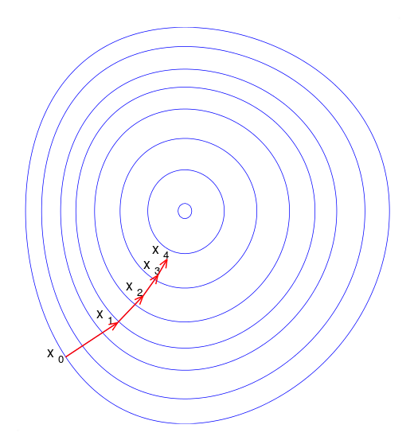
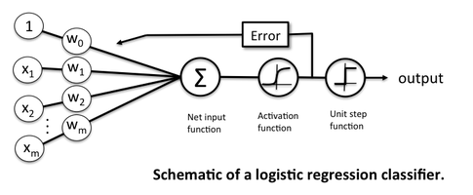
Learning := gradient descent
Training: find the weights that minimize the loss function → gradient descent!
https://sebastianraschka.com/images/faq/logisticregr-neuralnet/

Slide 29
Learning is gradient descent
Training: find the weights that minimize the loss function → gradient descent!
“Perceptron”
“Synapse”
“Neuron”

Slide 30
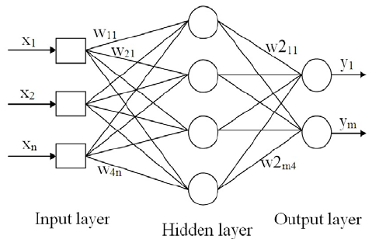
And now we can make such networks more complicated, by adding more (“hidden”) layers:

Slide 31
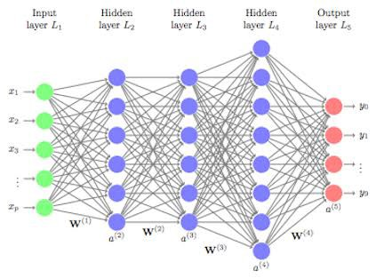
… and more (“hidden”) layers ...

Slide 32
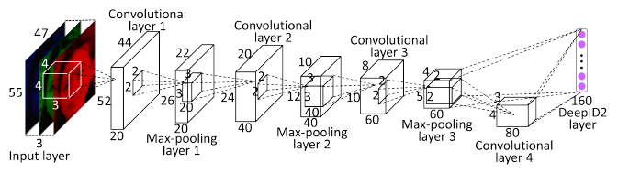
… and more complicated layers ...

Slide 33
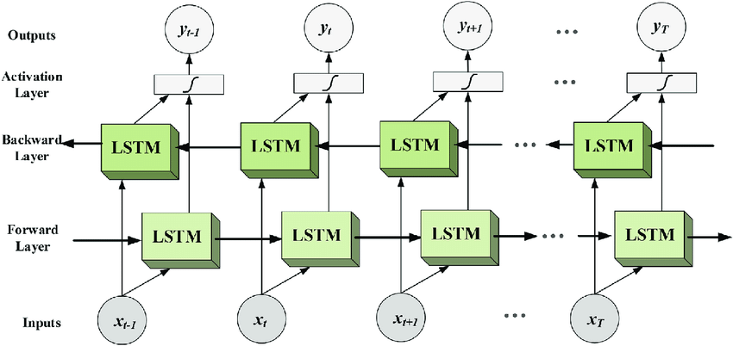
… and more complicated layers ...

Slide 34
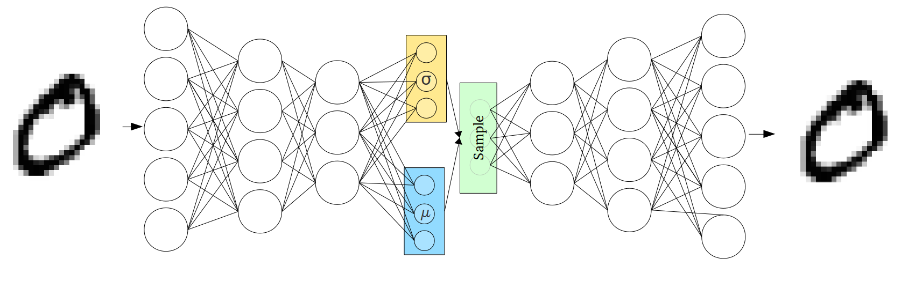
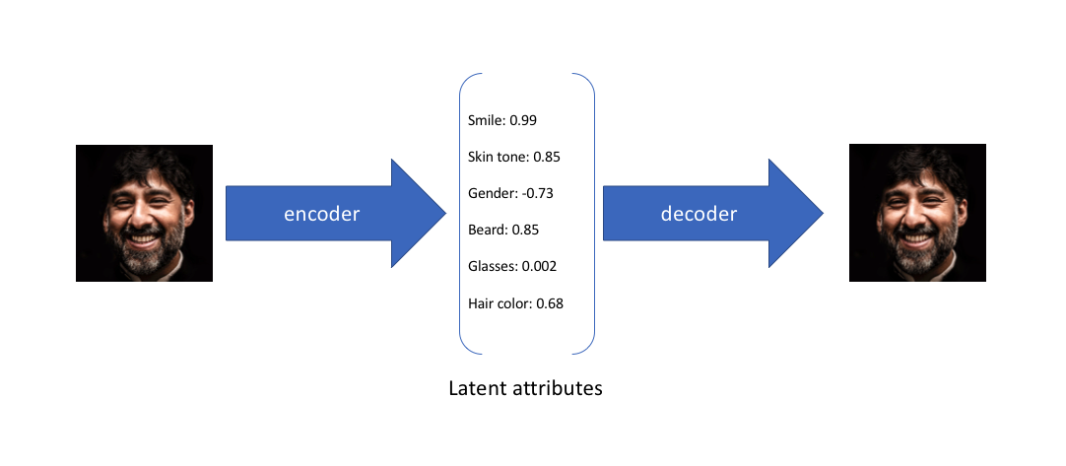
…. and networks that generate fake data by inverting the problem ….

Slide 35

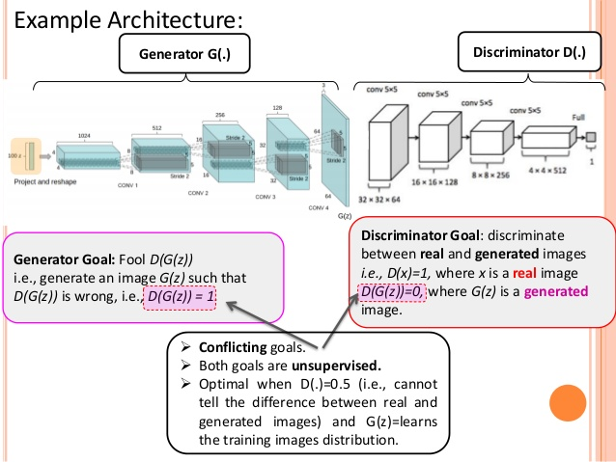


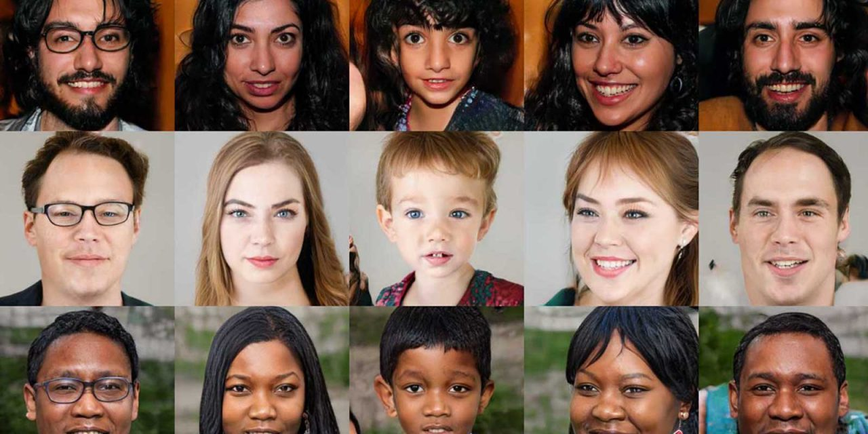
…. and networks that compete against other networks ...
https://www.slideshare.net/shyamkkhadka/unsupervised-learning-represenation-with-dcgan

Slide 36
But, to repeat, the mathematical ingredients of all these neural networks are:
– data x and labels y, and the problem is to find the best y=f(x;w). w are the parameters of the functions.
– we do this by constructing another function L that tells us how badly we are doing,
based on the true “y”.
– we find those values of w, that minimize the function L
– we do this via “gradient descent”, that is we take a step in the direction of the steepest slope, in this abstract mathematical step.
– we interpret the w’s as the weights of a neural network, that is as a measure for how easily a certain neuron fires.
– we interpret “learning” as updating weights in a neural networks. Gradient descent tells us how exactly we update the weights.
– we make our neural networks more and more complicated.

Slide 37
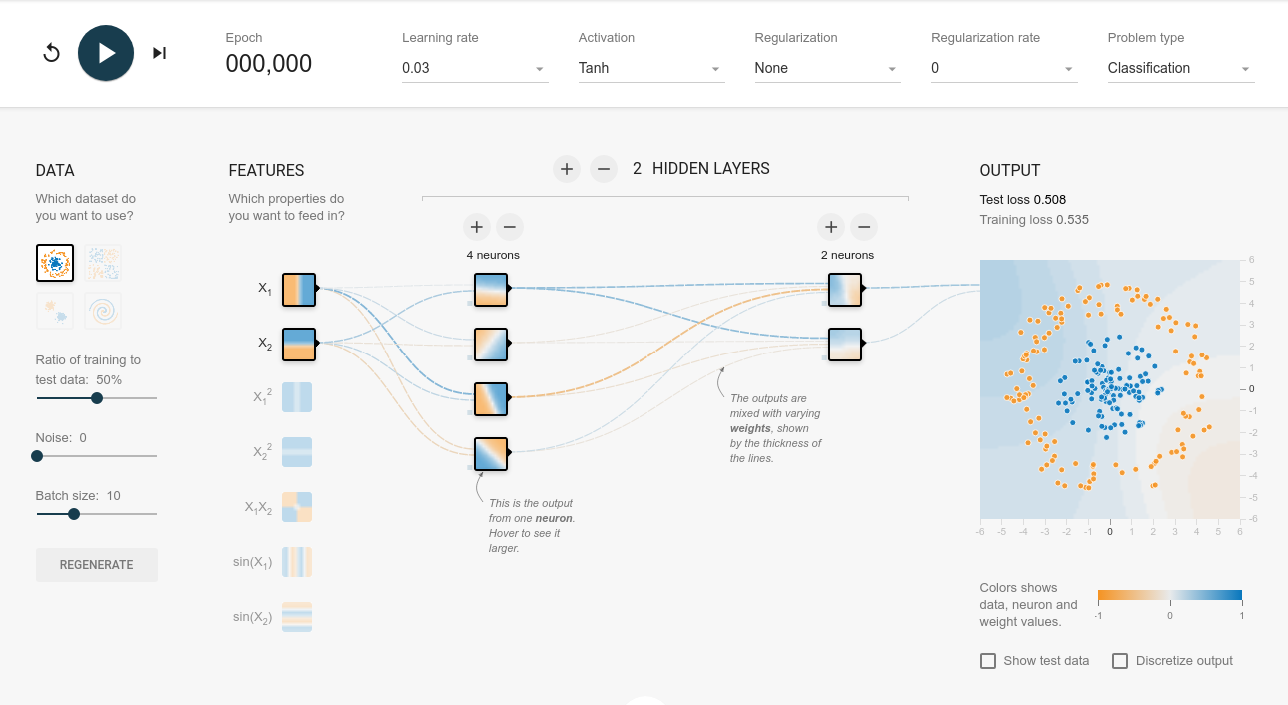
http://playground.tensorflow.org
Let’s play!

Slide 38
Google colab
https://colab.research.google.com/
If the playground is too childish for you, I prepare a very simple
pytorch example:
http://www.hephy.at/user/wwaltenberger/example.html

Slide 40
Introduction
This introductory lecture series aims at giving a very practical introduction to novel machine learning techniques.
The examples will be in pytorch and python. Please work in pairs of two. People familiar with the subject should team up with people who are new to the topic. Skeleton code will help you get started.
There will be four exercises, the last one being the “summer school challenge”. The winning team gets a certificate and a small prize.

Slide 41
In this lecture series:
mostly
this
none of
this
a bit of
this

Slide 42
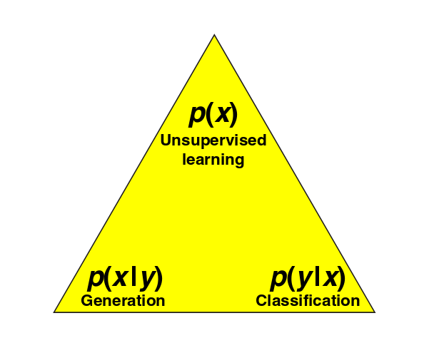
Supervised versus unsupervised
Naming convention:
x = data (a.k.a. “features” or “input”)
y = labels (a.k.a. “target” ) = regression values, classifications
Supervised:
given the data x, and a “labeled” training sample (x,y), train the label y from x → learn p(y|x)
If all possible y labels form a finite set: classification
If all possible y labels are form an infinite set: regression
Unsupervised:
Usually more difficult, more vague, than supervised.
Find structure behind data: p(x).
Generate “fake” data belonging to
category y: p(x|y).
Plot from paper (written by physicists), “why does deep and
cheap learning work so well”,
arXiv:1608.08225

Slide 43

Lesson 1
Logistic regression
and linear decision boundaries

Slide 44
Logistic regression
The (pedagogically) easiest way to understand neural networks is via “logistic regression”
Task: find straight
line that optimally
separates blue
points from red
points
x₂
x₁ and x₂ are “features”
of your data
x₁

Slide 45
Let’s construct a loss function
Now we build a function that tells us how much we are off:
The point is blue.
How wrong am I?
The point is red.
How wrong am I?
Summing up over all
points: how wrong am I?

Slide 46
Other possibilities
The loss function on the last page takes the (mean) absolute value of the element-wise difference between prediction p(x) and target y: L1 Loss.
Many other sensible choices for a loss function:
L2 Loss: (mean) squared error between prediction and target.
(Binary) Cross Entropy: the expected negative log likelihood of misclassification

Slide 47
Gradient descent: methods
We have a lot of freedom in the particular choice of the learning method.
Batch gradient descent
computes the gradient of the loss function for the entire dataset
where η is the learning rate
Stochastic gradient descent
updates the weights for each data point separately
Mini-batch gradient descent
updates the weights for small “batches” of the data

Slide 48
Gradient descent: methods
We have a lot of freedom in the particular choice of the learning method.
“Bare gradient descent”
where η is the learning rate.
Momentum
Take into account the most recent past updates, similar to a physical ball with conserved momentum
where γ is a dampening turn (0 < γ < 1)

Slide 49
Gradient descent: methods
We have a lot of freedom in the particular choice of the learning method.
RMSProp
”Root Mean Square” propagation. Learning rate weighted (“adaptive learning”) by exponentially weighted average of the squares of past gradients.
s: normalization of learning rate
β: “memory”
ε: small number to protect against “division by zero”

Slide 50
Gradient descent: methods
We have a lot of freedom in the particular choice of the learning method.
Adam
Combination of “momentum” and RMSprop. Works very well in many practical applications.
Adagrad / adadelta
Other, similar heuristics at adapting the learning rates

Slide 51
Gradient descent: methods
We have a lot of freedom in the particular choice of the learning method.
Nesterov-accelerated gradient
Like momentum, but with a “prescient” ball that looks at where the ball will roll, and corrects for an uncorrected “future” gradient
Nadam
Nesterov-accelerated Adam
Second order optimizations (Newton, natural gradients)
We can also add second order derivatives of the loss function to our updates. Interesting, also theoretically (information geometry), but often
computationally too expensive.

Slide 53

Exercise 1 – logit
Start with 01_skeleton.py, fill in the ellipses (“...”)
Goal is to find the best linear decision boundary between yellow and magenta points.
Play around with learning rate, loss function, optimizer.
Download everything from http://smodels.hephy.at/dkpi/ML.zip
All python requirements you will need are described in requirements.txt. Try ./install.sh
Which optimizer converges the fastest?

Slide 54
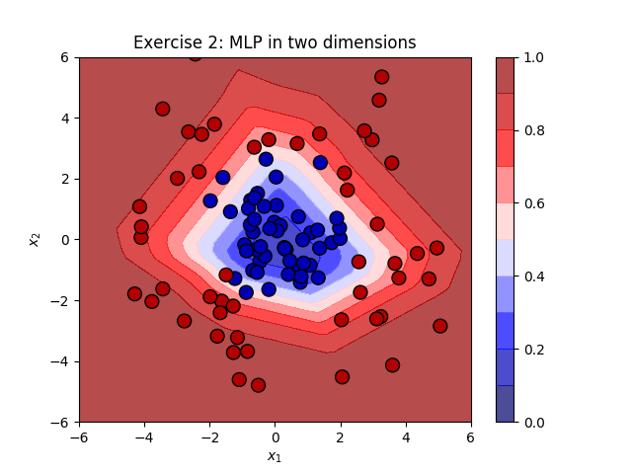
Lesson 2
Multi-layer perceptron and non-linear decision boundaries

Slide 55
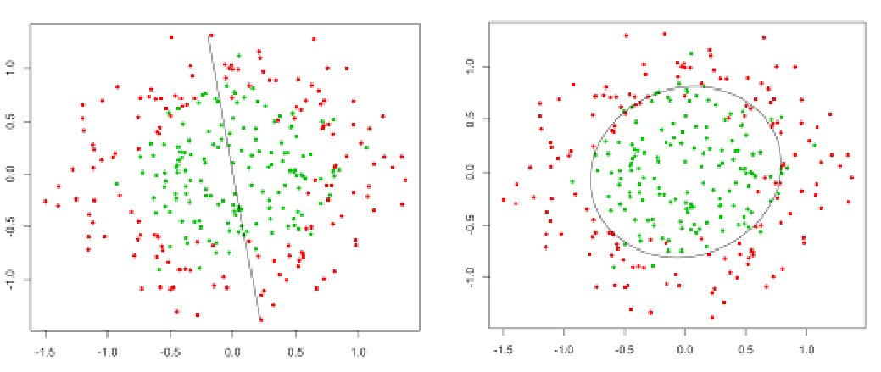
How can we go from a linear to a non-linear decision rule?
?

Slide 56
How can we go from a linear to a non-linear decision rule?
?
We introduce “hidden” layers of neurons!

Slide 57
Deep learning
How do we train a deep network?
By gradient descent + chain rule := backpropagation!
Chain rule:
where
A weight update (with simple gradient descent) is then simply
(η is the learning rate)

Slide 58
Example: backprop for MLP
Example for multi layer perceptron (MLP) for simple regression example.
Loss function: (mean) squared error (L2)
where
t is the “target” output of training data
y is the predicted output of neural network.
Network minimizes the squared error.
Chain rule:
where
A weight update is then simply

Slide 59
Example: backprop for MLP
For a logistic activation function:
Finally, for mean squared error loss function:
If o_{j} is the last layer (with a single neuron, o_{j} = y, t = target label)

Slide 60
Example: backprop for MLP
Finally, for mean squared error loss function:
If o_{j} is the output layer that contains a single neuron (o_{j} = y)
For layers other than the output layer, we can introduce a recursion:
where the index l sums over all neurons that receive input from neuron j.
Let’s put it all together:
With
For the output layer (top) and all other layers (bottom).

Slide 61
Differentiable programming
Luckily, with software frameworks like tensorflow, pytorch we do not have to perform the differentiations ourselves! All we have to do is define the network architecture, the frameworks compute the gradients.
→ automatic differentiation, differentiable programming
self.layer1 = nn.Sequential(
nn.Conv2d(1, 16, kernel_size=5, stride=1, padding=2),
nn.BatchNorm2d(16),
nn.ReLU(),
nn.MaxPool2d(kernel_size=2, stride=2))
self.rnn = nn.LSTM(hidden_size, hidden_size, 2, dropout=0.05) self.fc = nn.Linear(7*7*32, num_classes)

Slide 62
Universal approximation theorem
The “universal approximation theorem” (Cybenko, 1989, Hornik, 1991) proves, that already with a single hidden layer, we can essentially learn every continuous function (with a few mild assumptions).
So why introduce more than one hidden layer?

Slide 63
Universal approximation theorem
The “universal approximation theorem” (Cybenko, 1989, Hornik, 1991) proves, that already with a single hidden layer, we can essentially learn every continuous function (with a few mild assumptions).
So why introduce more than one hidden layer?
Because the hidden layer may have to be infeasibly large. Also, the learning might take too long, the learning sample might have to be too large, and generalization might not take place.

Slide 64
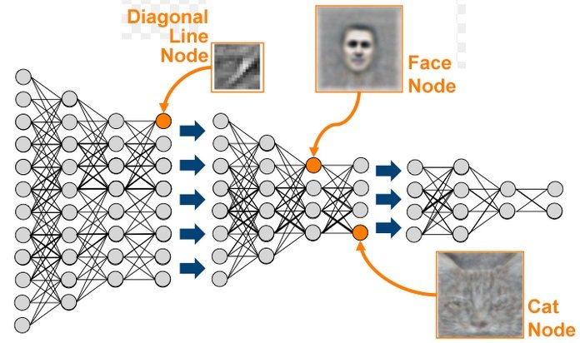
Deep learning = learning abstractions
When done right, a deep network can learn “abstract features” of the input data, and thus overcome the practical restrictions of an MLP with a single hidden layer:
increasingly abstract features

Slide 65
Deep learning = hierarchical representation learning
Because when done right, a deep network can learn “abstract features” of the input data:
A layer, evaluated for data = a “representation” of the data

Slide 66


Activation functions
We have a lot of freedom in the choice of
our activation functions
sigmoid (logistic)
tanh
pro: non-linear, differentiable, confined range [0,1]
con: zero at large values of |x| (vanishing gradient problem)
scaled version of sigmoid: tanh(x) = 2 σ(2x) - 1

Slide 67


Activation functions
We have a lot of freedom in the choice of
our activation functions
Linear
ReLU
Pro: simple, non-zero derivative
Con: constant gradient, cannot introduce non-linearity
recified linear unit
Pro: simple, computationally fast, non-linear, non-zero gradient for any large x
Con: not bound, neurons may “die”, get stuck at zero.

Slide 68


Activation functions
We have a lot of freedom in the choice of
our activation functions
Leaky ReLU
SeLU
Advantages of ReLU, plus it doesnt “die” for x < 0.
scaled exponential linear units
Used in “self-normalizing neural networks”, where the output of the neurons in each layer is distributed with zero mean and unity variance if the input is also distributed with zero mean and unity variance

Slide 69
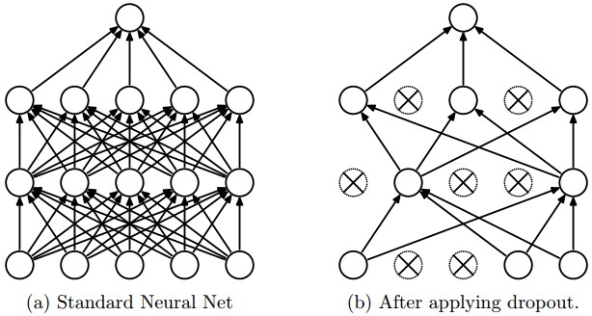
Dropout layers
During training: drop a certain fraction of the neurons, to prevent the network from “overfitting”.
During prediction: dropout is deactivated.
Usually worsens the results on the training sample, but improves the results on the validation sample.

Slide 70
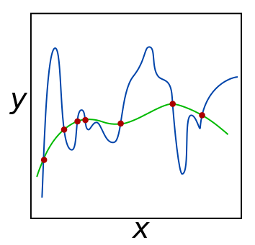
Regularization
“Occam’s razor for neural networks”:
Of two models with the same predictive power,
the “simpler” one is to be preferred.
→ Prefer networks with many weights at zero
“Punishing term” for weights in the loss function, e.g. L2 regularization:
Implemented in many of pytorch’s optimizers, lambda is often called “weight decay”.

Slide 71
Hyperparameter optimization
Finding the optimal network architecture and hyperparameters is yet another
optimization task →
hyperparameter optimization, network optimization
Many simple algorithms:
→ grid search: systematically try out many configurations
→ random search: try out configurations randomly
→ gradient based optimization: compute gradients in the space of hyperparameters
→ evolutionary algorithms
….

Slide 73
Exercise 2 – MLP
See 02_skeleton.py for skeleton code you may use for a quick start.
Goal is to find the best non-linear decision boundary between blue and red points.
Play around with learning rate, loss function,
optimizer, number of layers, number of neurons,
activation functions, dropout layers.
Which network architecture worked best for you?

Slide 74
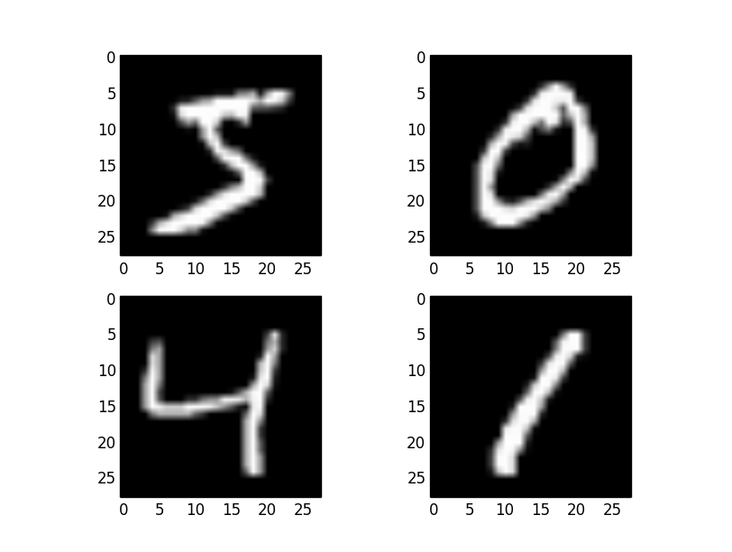
Lesson 3
Convolutional
neural
networks

Slide 75
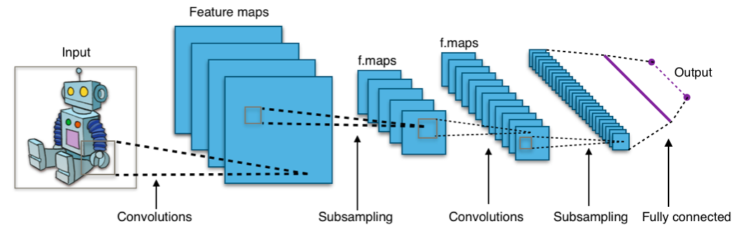
Convolutional layers
Think computer vision: we want to detect a cat,
independent of where it is in the photo: translation invariance!
Answer: convolutional layers: many several small convolution matrices (“kernels”)

Slide 76
Convolutional layers
Answer: convolutional layers: many several small convolution matrices (“kernels”) that “scan” over the input image, “sharing” the learned weights over the scan and thus detect features independent of their position

Slide 77
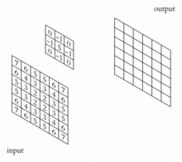
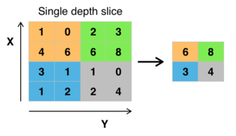
Convolutional layers
Answer: convolutional layers. Many several small convolution matrices (“kernels”) that “scan” over the input image, “sharing” the learned weights and thus detect features independent of their position
Max Pooling (subsampling)
Inspired by the “receptive field” in biology
Convolutions

Slide 78
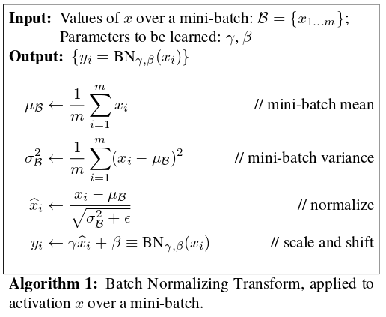
Batch normalization
It is usually a good trick to “whiten” / standardize the inputs: transform them linearly so they have zero mean and unity variance on a given data sample.
This is also true for hidden neurons → batch normalization.

Slide 79
Softmaxing
For a classification problem with K different classes (e.g. “building”, “animal”, “object”), you want the output neurons to encode a “probability” of the input belonging to class j.
(“One-hot encoding” – one neuron per class)
The K output neurons should therefore acquire values between 0 and 1, and sum up to 1.
Softmax function achieves this:
As physicists we note that this is equivalent to the Boltzmann distribution:
if y_{j} denotes the nevative energy of a quantum state j divided by k_{B}T, then p(j) is the probability of the quantum object being found in that state.

Slide 80
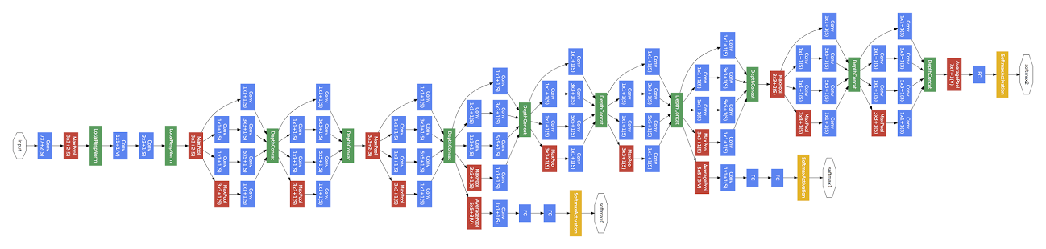
Example: google’s “Inception” network
Convolution
Pooling
Softmax
Other
9 Inception modules
Network in a network in a network...
https://storage.googleapis.com/pub-tools-public-publication-data/pdf/43022.pdf

Slide 81
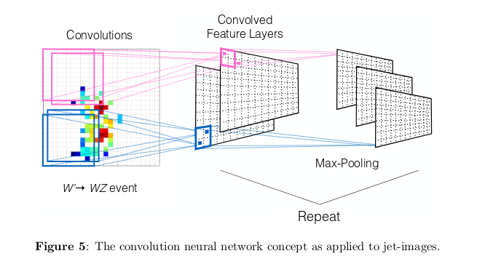
Application in particle physics: jet images
Task: learn a jet classifier
that identifies highly boosted W jets
https://arxiv.org/pdf/1511.05190.pdf

Slide 82
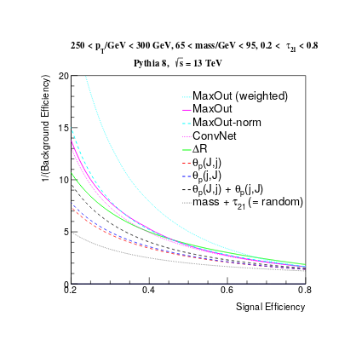
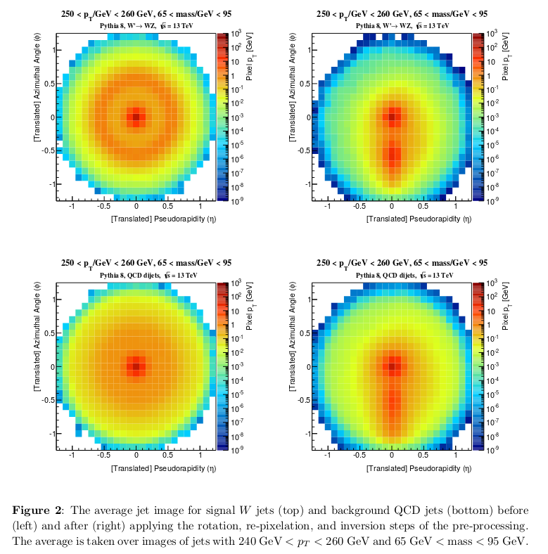
Application in particle physics: jet images
average signal
Receiver Operating
Characteristic (ROC) curves
for various choices of “hyperparameters”
average background
https://arxiv.org/pdf/1511.05190.pdf

Slide 83
Exercise 3 –
CNN
See 03_skeleton.py for skeleton code you may use for a quick start.
Run the skeleton code on the MNIST dataset of handwritten digits. It has one convolutional layer, which should already give you good results (accuracy around 98%).
Add another convolutional layer. With a little tweaking you should get the accuracy around 99%.
Play around with all hyperparameters. Can you get an accuracy above 99.25%?

Slide 84
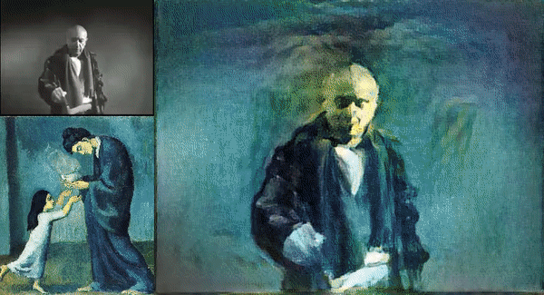
Lesson 4
Recursive and recurrent neural networks,
auto encoders
generative adversarial networks,
explanation methods

Slide 85
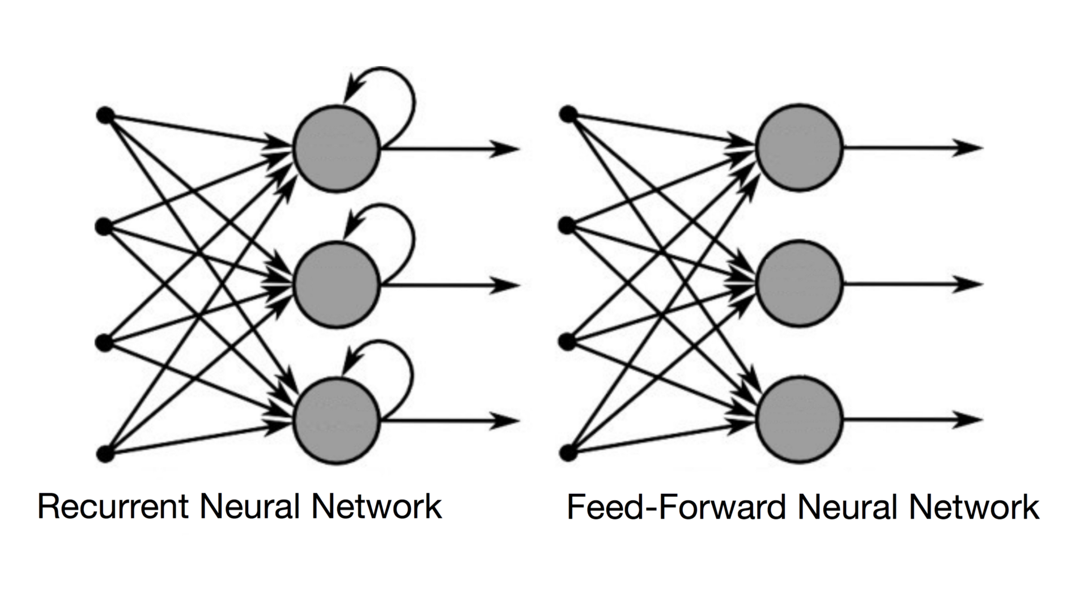
Recurrent networks
How can we apply neural networks on variable-sized time series like text or speech, where the prediction of the current input must depend on the past “events”.
By making the network “recurrent”:

Slide 86
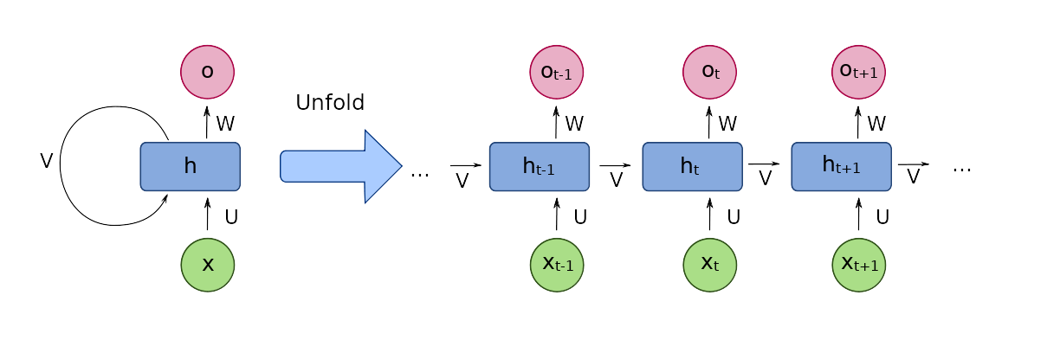
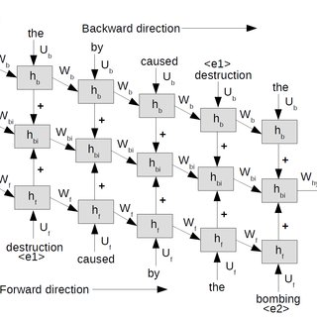
Recurrent networks
Note that one can always “unfold” recurrent networks to turn them into (complicated) feed-forward networks with fixed record lengths:

Slide 87
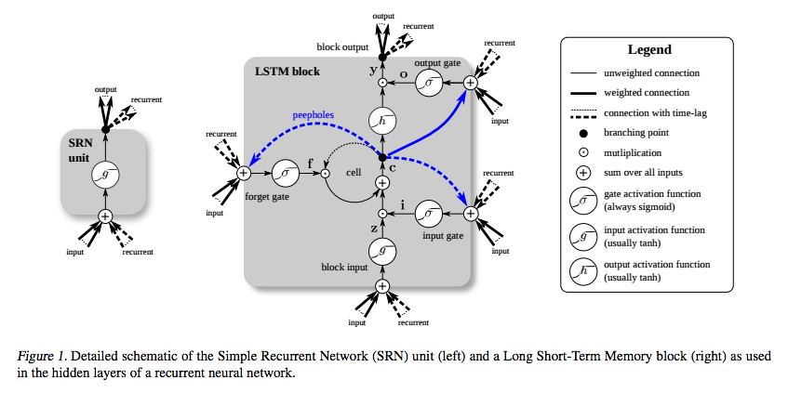
Recurrent networks
These types of networks had the problem, that the gradient quickly vanished when “propagated back through time”. The Long Short Term Memory (LSTM) solved that.

Slide 88
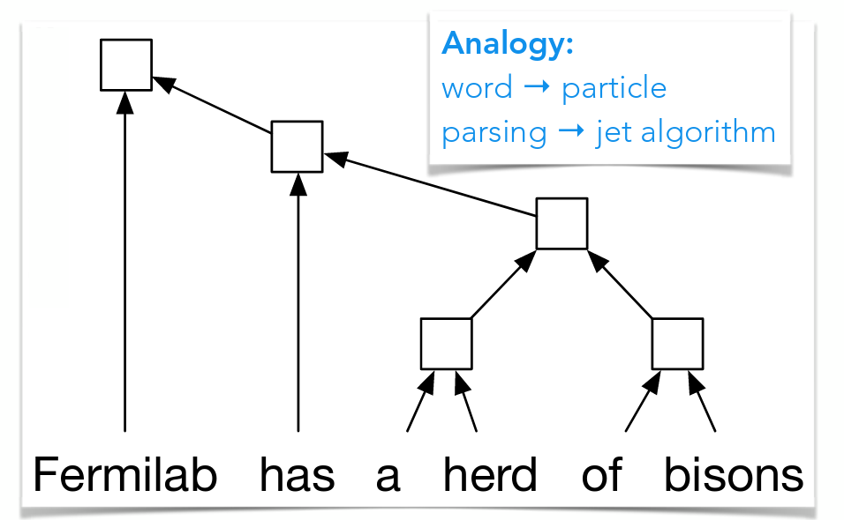
Application (of a similar class of algorithms) in particle physics: jet classification
QCD-aware recursive neural networks for jet physics. (Recurrent = special version of recursive)
See also talk at DS@HEP 2017 workshop
https://arxiv.org/pdf/1702.00748.pdf

Slide 89
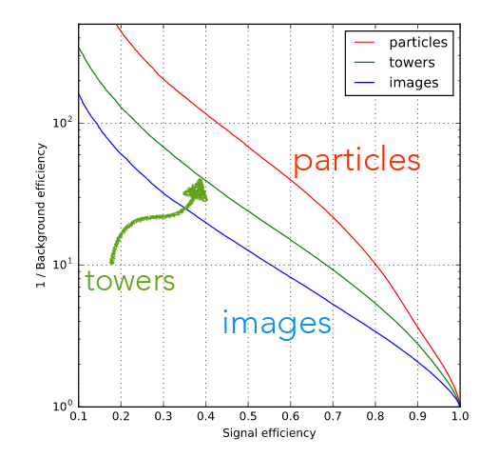
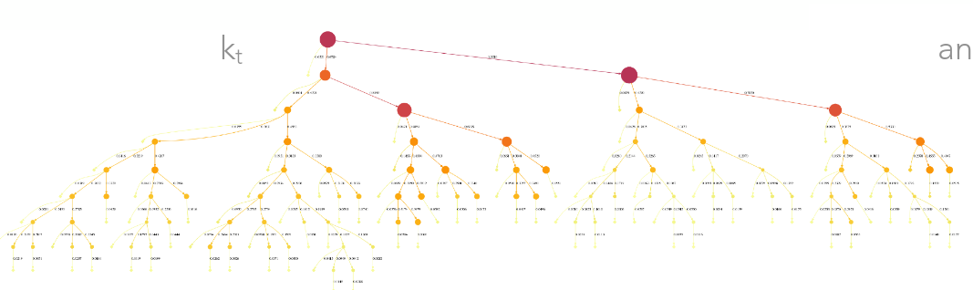
Application (of a similar class of algorithms) in particle physics: jet classification
“QCD-aware recursive neural networks for jet physics”
“better”
Visualisation of k_{t} jet algorithm.
“particles”: recursive network
“images”: convolutional network
ROC curve of W jet tagging example, comparison with jet images algorithm
See also talk at DS@HEP 2017 workshop
https://arxiv.org/pdf/1702.00748.pdf

Slide 90
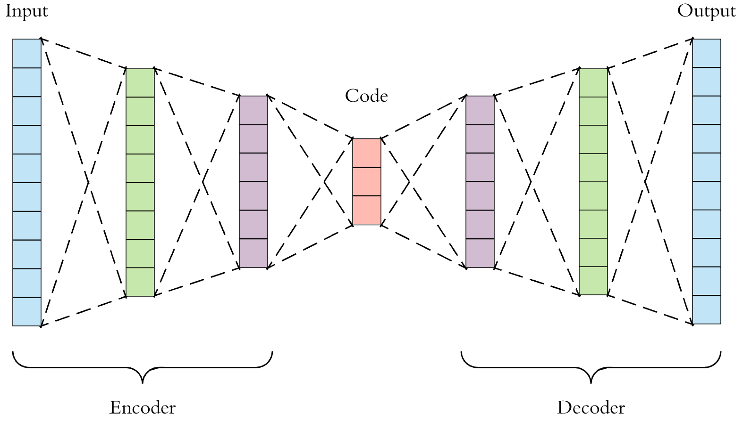
Autoencoders – a.k.a. “understanding is compression”
Consider the following network architecture:
z
x
x’
With a loss function:

Slide 91
Autoencoders – a.k.a. “understanding is compression”
Consider the following network architecture:
z
x
x’
With a loss function:
The network learns to reproduce its own input!
z becomes a lower-dimensional representation (a “code”) of a higher-dimensional x
Applications: Lossy compression, denoising data. With another trick (by imposing constraints on z): generative model (variational autoencoder)

Slide 92
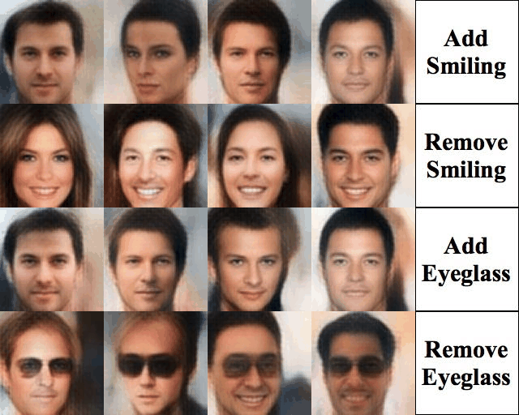
Example: Variational Autoencoder applied to “CelebA” dataset
Taken from: https://houxianxu.github.io/assets/project/dfcvae

Slide 93
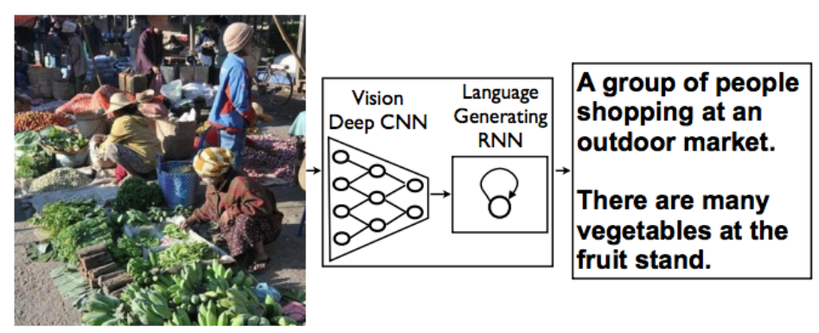
Example: Combination of CNN (encoder) and LSTM (decoder)
http://cvlab.postech.ac.kr/~bhhan/class/cse703r_2016s/csed703r_lecture11.pdf

Slide 94
Adversarial setups
Networks can be set up to compete against each other in an adversarial setup: generative adversarial networks (GANs)
One machine is set up as a generator, it learns
to generate fake data, e.g. images that resemble Picasso paintings.
Another machine learns to discriminate the real Picassos from fakes.

Slide 95
https://www.slideshare.net/shyamkkhadka/unsupervised-learning-represenation-with-dcgan

Slide 96
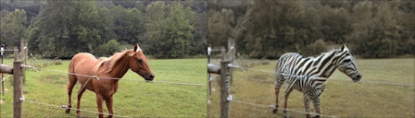
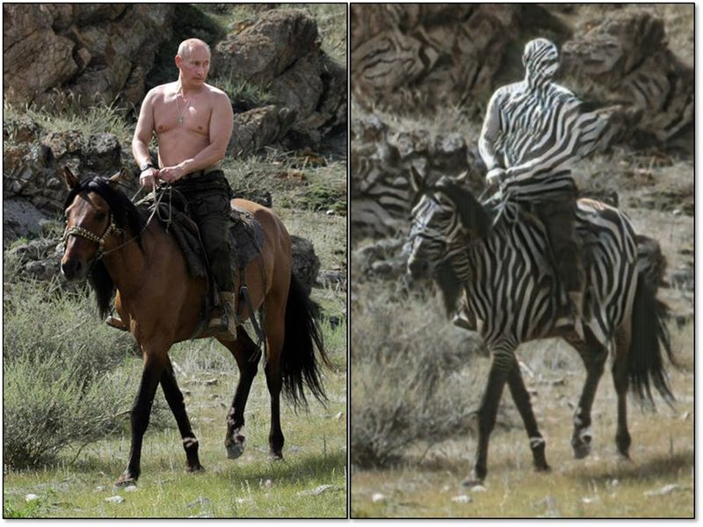
Example: the “CycleGAN”, a type of a conditional GAN, changing the condition horse → zebra
A “failure case”
https://github.com/junyanz/CycleGAN

Slide 97
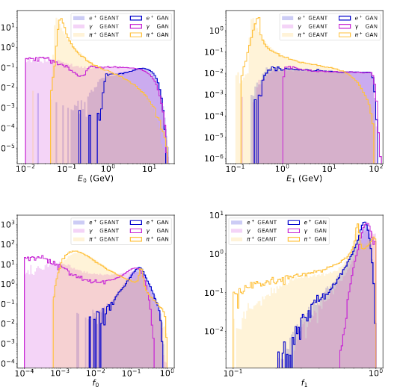
Application in Particle Physics:
Fast simulation of ATLAS calorimetry (CALO GAN)
Comparison of shower shape variables, Calo GAN versus full Geant 4 simulation
See also: talk in ACAT 2017
https://arxiv.org/pdf/1705.02355.pdf

Slide 98
Explanation methods
What is the machine learning? How can we “debug” deep networks?
There are several methods on the market.
Simple class of algorithms for convolutional networks: which pixels of a picture most contributed to a prediction? Which pixels were in contradiction to prediction? “Sensitivity analysis”, or (for pictures) heatmaps (based on “input gradient” df/dx_{i}).

Slide 99
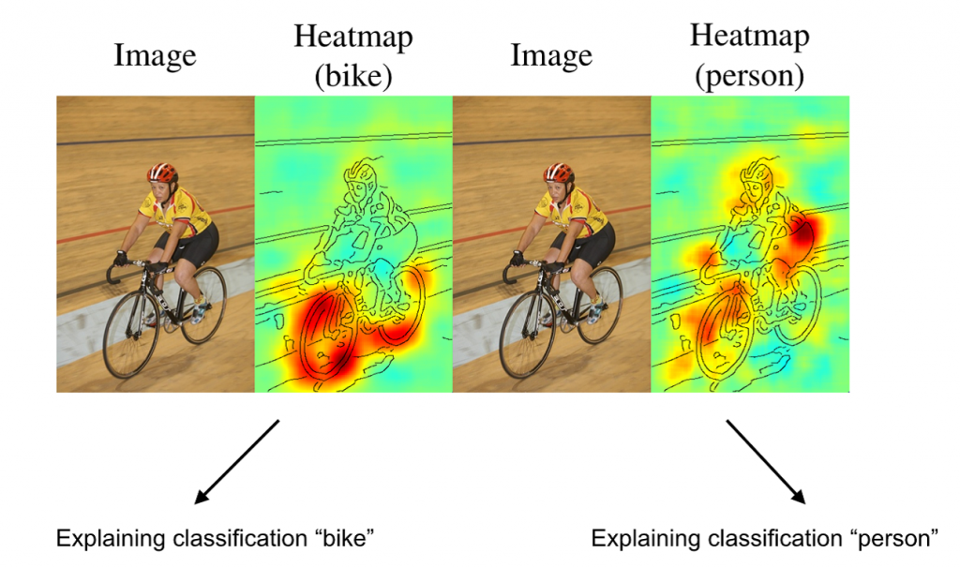
Explanation methods
What is the machine learning? How can we “debug” deep networks? Heatmaps:
https://arxiv.org/pdf/1512.00172.pdf

Slide 100
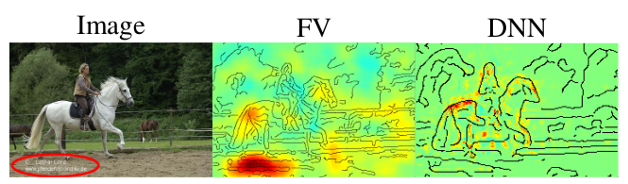
Explanation methods
What is the machine learning? How can we “debug” deep networks? Heatmaps may sometimes help discover learned “artifacts”.
The networks learns to exploit undesirable correlations.
Machine learned to identify horses by the imprint.
https://arxiv.org/pdf/1512.00172.pdf

Slide 101
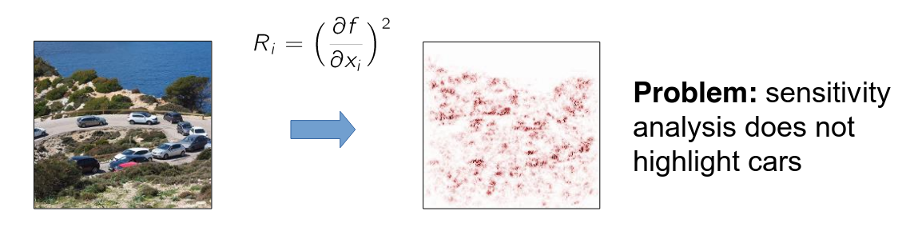
Explanation methods
But sensitivity analyses fail at grasping “the bigger picture”.
What makes the picture below a road with cars?
See e.g. http://heatmapping.org, http://heatmapping.org/slides/2018_CVPR_1.pdf

Slide 102

Explanation methods
An entire industry of explanation methods has emerged in only 3 years!!
Very hard to keep up and identify the algorithms that are interesting for us.
See e.g. http://heatmapping.org, http://heatmapping.org/slides/2018_CVPR_1.pdf

Slide 103
Workshop challenge

Slide 104
Backup

Slide 105
Recommended literature
Coursera course by Andrew Ng
Deep learning, book by Ian Goodfellow et al.
see also http://www.deeplearningbook.org/
Tensorflow tutorials
Pytorch tutorials
Deep learning course at univie by Philipp Grohs

