Slide 1


Machine Learning for Particle Physics –
A Gentle, Hands-On Introduction
Wolfgang Waltenberger
The 28th Vietnam School of Physics,
July 25 – August 5, 2022

Slide 2
Introduction
This introductory lecture series aims at giving a very practical introduction to novel machine learning techniques.
The examples will be in pytorch and python. Please work in groups of two or three. People familiar with the subject should team up with people who are new to the topic. Skeleton code will help you get started.
There will be four exercises, the last one being the “challenge” with data from a dark matter experiment.
The winning team gets a small prize.

Slide 3
Syllabus
Introduction
Lesson 1: Logistic Regression
Exercise 1
Lesson 2: Multi-Layer Perceptron
Exercise 2
Lesson 3: Convolutional Neural Networks
Exercise 3
Lesson 4: Generative Models
Lesson 5: Beyond
recurrent/recursive neural networks, explanation methods, uncertainty of network
Challenge: learn discriminator for dark matter direct detection experiment

Slide 4
Introduction
in which we mostly concern ourselves with naming conventions and problem statements

Slide 5
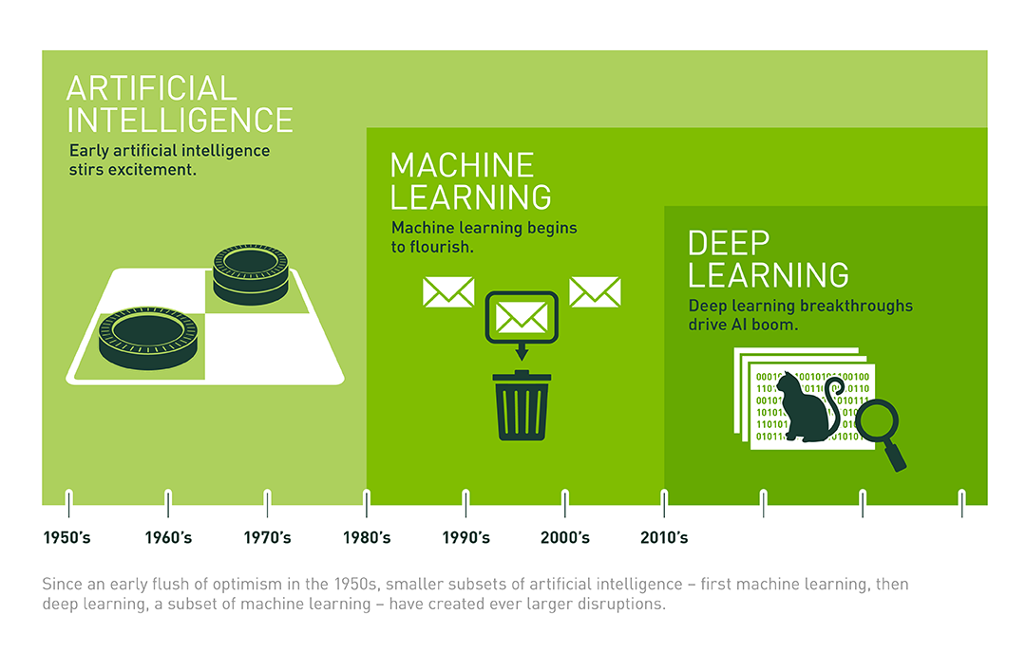
this course will be an introduction to the rightmost box – deep learning

Slide 6
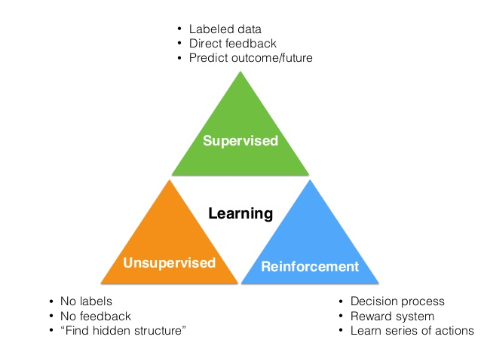

Slide 7
In this lecture series:
mostly
this
none of
this
a bit of
this

Slide 8
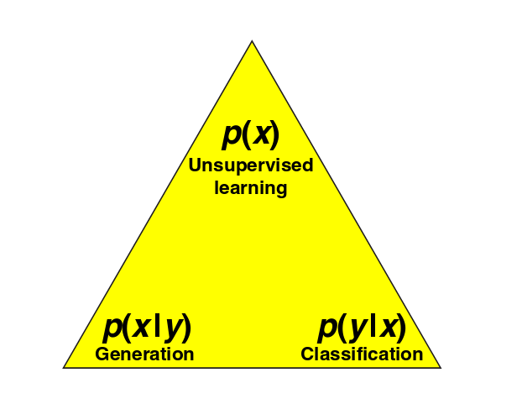
Supervised versus unsupervised
Naming convention:
x := data (a.k.a. “features”, “observables”, or “input”)
y := labels (a.k.a. “target” ) = regression values, classifications
Supervised:
given the data x, and a “labeled” training sample (x,y), train the label y from x → learn “probability” of y, given x: p(y|x)
If all possible y labels form a finite set: “classification”
If all possible y labels are form an (uncountably) infinite set:
“regression”
both: “discriminative models”
Unsupervised:
Usually more difficult, more vague, than supervised.
Find structure behind data: p(x).
Generate “fake” data belonging to
category y: p(x|y): “generative model”
Plot from paper (written by physicists), “why does deep and cheap learning work so well”, arXiv:1608.08225

Slide 9
Machine learning versus statistics
No clear boundary between machine learning / neural networks and statistics
Rough distinction:
statistics deals with well-motivated low-dimensional models, is concerned with inference of the parameters of the models. Often probabilistic, “frequentist” interpretation of estimates
machine learning, especially deep learning, is more concerned with learning “representations” and generalizing from data, not so much about probabilistic interpretability. Neural networks are high-dimensional heuristic models, less well-motivated.

Slide 10
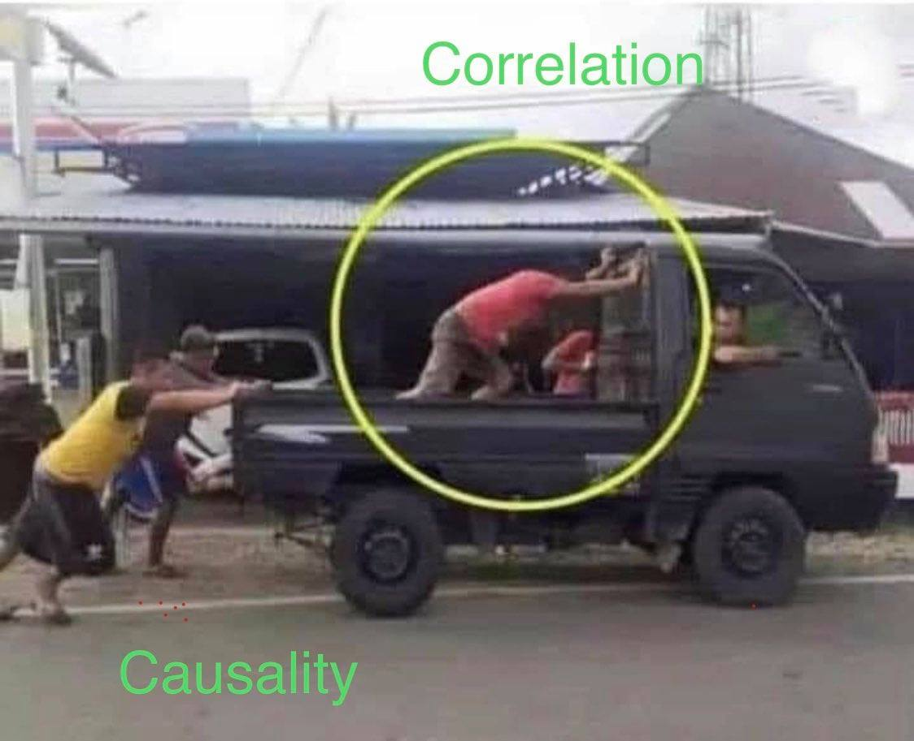

Slide 11
Deep learning versus other methods
Not all of machine learning is based on neural networks!
Other (“shallow”) methods are e.g.: boosted decision trees, support vector machines, Bayes statistics, and many more
This course will however be an introduction to neural networks and deep learning.
(we can of course discuss when to use neural networks, when not to use neural networks, when to combine methods)

Slide 12
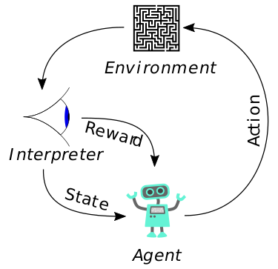
Reinforcement learning
There is an agent that can perform a series of actions in an environment.
After each action a ϵ A, the agent is in a state s ϵ S.
The outcome of the action is subject to reward or penalty.
The goal is to learn a policy p: S → A, that maps states to actions, maximizing reward.
(“Given the state s, which action should I perform?”)

Slide 13

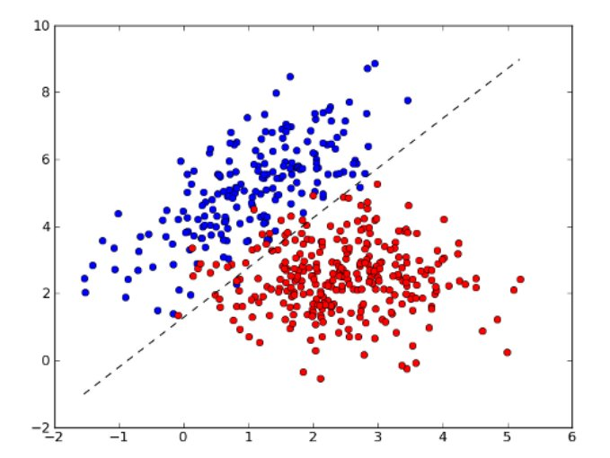
Lesson 1
Logistic regression
and linear decision boundaries

Slide 14
Logistic regression
The (pedagogically) easiest way to understand neural networks is via “logistic regression”
Task: find straight
line that optimally
separates blue
points from red
points
x₂
x₁ and x₂ are “features”
of your data
x₁

Slide 15

Logistic regression
x₂
orthogonal
vector
x₁

Slide 16
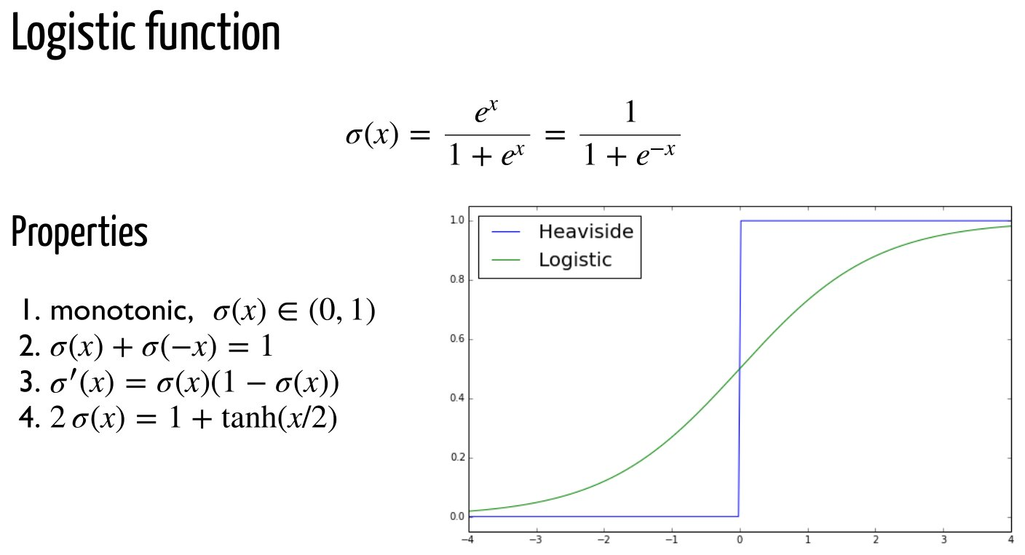
Logistic regression
But can take on any value between -∞ and +∞.
Lets map (-∞,∞) to [0,1]. Makes the handling easier. And it makes it look like a probability. One possible mapping:
σ(x) = 1 means “clearly blue”, σ(x) = 0 means “clearly red”
As physicists we take note that this looks a lot like the Fermi function

Slide 17

Let’s construct a “loss” function
Now we build a function that tells us how much we are off:
The point is blue.
How correct is my prediction?
The point is red.
How “right” am I?
Summing up over all
points: how wrong am I?

Slide 18

Other possibilities
The loss function on the last page takes the (mean) absolute value of the element-wise difference between prediction p(x) and target y: L1 Loss.
Let’s turn the labels yi ϵ { red, blue } into numbers: yi ϵ { red=0, blue=1 }.
The “prediction” for label yi
Many other sensible choices for a loss function:
L2 Loss: (mean) squared error between prediction and target.
(Binary) Cross Entropy: the expected negative log likelihood of misclassification
(*) note that I dropped a factor of 1/N in all losses, as they do not really matter

Slide 19
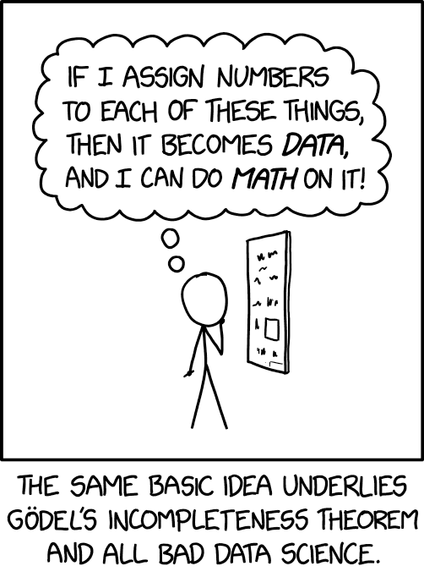
“Let’s turn the labels yi ϵ { red, blue } into numbers: yi ϵ { red=0, blue=1 }.”

Slide 20
Loss function
The loss function goes by many names:
energy function
objective function
reward function
They all mean the same thing (up to the difference in sign: a loss is a negative reward)

Slide 21
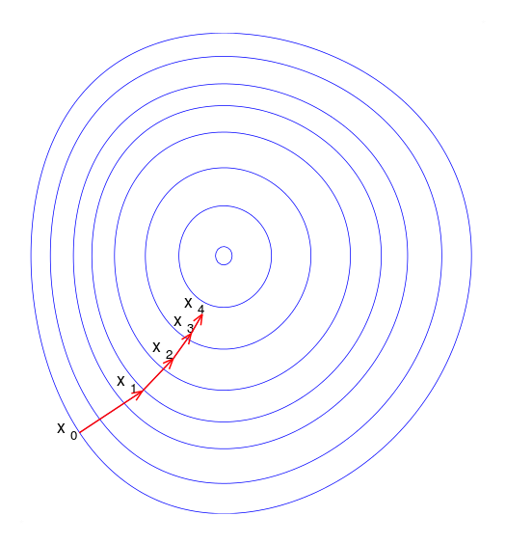
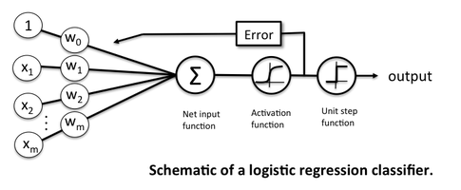
Learning := gradient descent
Training: find the weights that minimize the loss function → gradient descent!
https://sebastianraschka.com/images/faq/logisticregr-neuralnet/

Slide 22
Learning := gradient descent
Training: find the weights that minimize the loss function → gradient descent!
“Perceptron”
“Synapse”
“Neuron”

Slide 23
Gradient descent: methods
We have a lot of freedom in the particular choice of the learning method.
Batch gradient descent
computes the gradient of the loss function for the entire dataset
where η is the learning rate
Stochastic gradient descent
updates the weights for each data point separately
Mini-batch gradient descent
updates the weights for small “batches” of the data

Slide 24
Gradient descent: methods
We have a lot of freedom in the particular choice of the learning method.
“Bare gradient descent”
where η is the learning rate.
Momentum
Take into account the most recent past updates, similar to a physical ball with conserved momentum
where γ is a dampening turn (0 < γ < 1)

Slide 25
Gradient descent: methods
We have a lot of freedom in the particular choice of the learning method.
RMSProp
”Root Mean Square” propagation. Learning rate weighted (“adaptive learning”) by exponentially weighted average of the squares of past gradients.
s: normalization of learning rate
β: “memory”
ε: small number to protect against “division by zero”

Slide 26
Gradient descent: methods
We have a lot of freedom in the particular choice of the learning method.
Adam
Combination of “momentum” and RMSprop. Works very well in many practical applications.
Adagrad / adadelta
Other, similar heuristics at adapting the learning rates

Slide 27
Gradient descent: methods
We have a lot of freedom in the particular choice of the learning method.
Nesterov-accelerated gradient
Like momentum, but with a “prescient” ball that looks at where the ball will roll, and corrects for an uncorrected “future” gradient
Nadam
Nesterov-accelerated Adam
Second order optimizations (Newton, natural gradients)
We can also add second order derivatives of the loss function to our updates. Interesting, also theoretically (information geometry), but often
computationally too expensive.

Slide 28
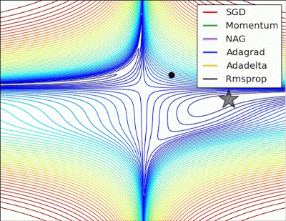
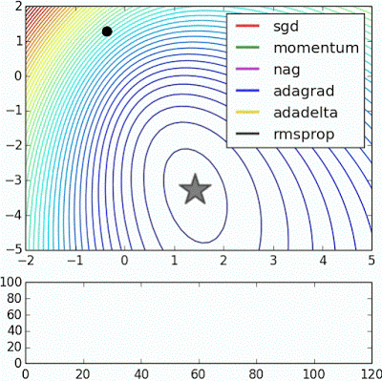
Gradient descent: methods
Plots taken from: http://www.denizyuret.com/2015/03/alec-radfords-animations-for.html

Slide 30

Exercise 1 – logit
Go to https://github.com/WolfgangWaltenberger/vietnam2022
See explanations on that webpage
Start with 01_logistic.ipynb, fill in the ellipses (“...”)
Goal is to find the best linear decision boundary between yellow and magenta points.
Play around with learning rate, loss function, optimizer.
Which optimizer converges the fastest?

Slide 31
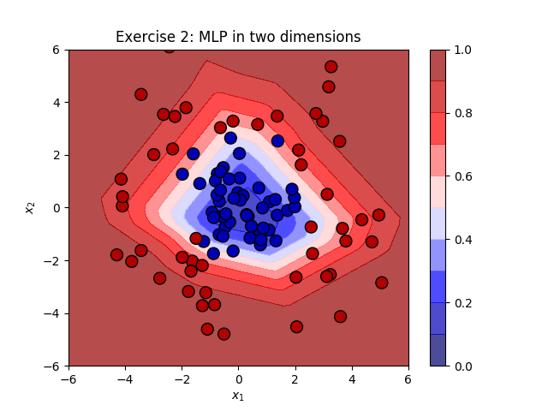
Lesson 2
Multi-layer perceptron and non-linear decision boundaries

Slide 32
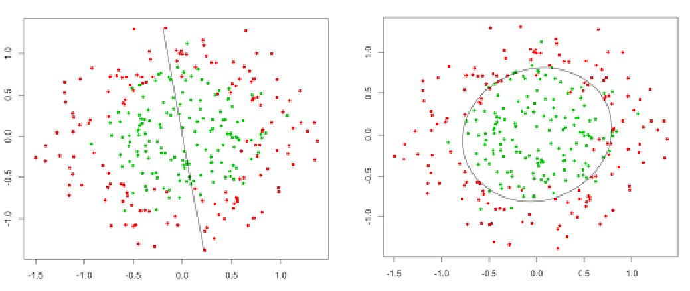
How can we go from a linear to a non-linear decision rule?
?

Slide 33
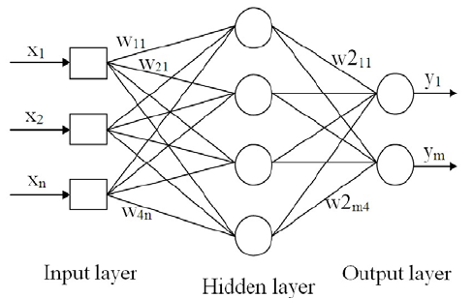
How can we go from a linear to a non-linear decision rule?
?
We introduce “hidden” layers of neurons!

Slide 34
How can we go from a linear to a non-linear decision rule?
?
Can simultaneously regress / classify multiple targets
We introduce “hidden” layers of neurons!

Slide 35
Deep learning
How do we train a deep network?
By gradient descent + chain rule := backpropagation!
Chain rule:
where
A weight update (with simple gradient descent) is then simply
(η is the learning rate)

Slide 36

Example: backprop for MLP
Example for multi layer perceptron (MLP) for simple regression example.
Loss function: sum of squared errors (L2)
where (changed naming convention!)
t is the “target” output of training data
y is the predicted output of neural network.
Network minimizes the squared error.
Chain rule:
where
A weight update is then simply

Slide 37
Example: backprop for MLP
For a logistic activation function:
Finally, for mean squared error loss function:
If o_{j} is the last layer (with a single neuron, o_{j} = y, t = target label)

Slide 38
Example: backprop for MLP
Finally, for mean squared error loss function:
If o_{j} is the output layer that contains a single neuron (o_{j} = y)
For layers other than the output layer, we can introduce a recursion:
where the index l sums over all neurons that receive input from neuron j.
Let’s put it all together:
With
For the output layer (top) and all other layers (bottom).

Slide 39
Differentiable programming
Luckily, with software frameworks like tensorflow, pytorch we do not have to compute the derivatives ourselves! All we have to do is define the network architecture, the frameworks compute the gradients.
→ automatic differentiation, differentiable programming
self.layer1 = nn.Sequential(
nn.Conv2d(1, 16, kernel_size=5, stride=1, padding=2),
nn.BatchNorm2d(16),
nn.ReLU(),
nn.MaxPool2d(kernel_size=2, stride=2))
self.rnn = nn.LSTM(hidden_size, hidden_size, 2, dropout=0.05) self.fc = nn.Linear(7*7*32, num_classes)

Slide 40
Universal approximation theorem
The “universal approximation theorem” (Cybenko, 1989, Hornik, 1991) proves, that – under a few mild assumptions -- already with a single hidden layer, we can essentially learn every continuous function.
So why introduce more than one hidden layer?

Slide 41
Universal approximation theorem
The “universal approximation theorem” (Cybenko, 1989, Hornik, 1991) proves, that already with a single hidden layer, we can essentially learn every continuous function (with a few mild assumptions).
So why introduce more than one hidden layer?
”Practicalities”: the single hidden layer may have to be infeasibly large. The learning might take too long, the learning sample might have to be too large, and generalization will not take place.

Slide 42
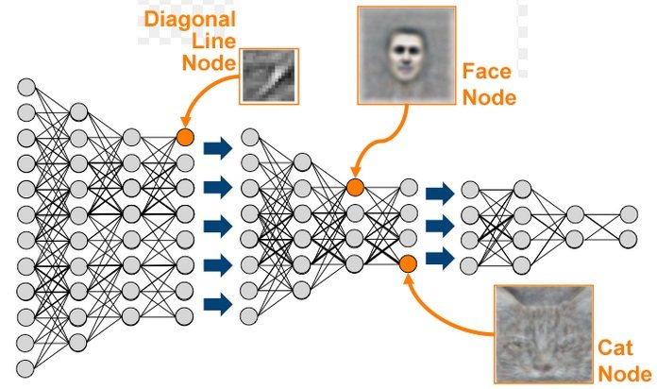
Deep learning = learning abstractions
When done right, a deep network can learn “abstract features” of the input data, and thus overcome the practical restrictions of an MLP with a single hidden layer:
increasingly abstract features

Slide 43
Deep learning = hierarchical representation learning
Because when done right, a deep network can learn “abstract features” of the input data:
A layer, evaluated for data = a “representation” of the data

Slide 44


Activation functions
We have a lot of freedom in the choice of
our activation functions
sigmoid (logistic)
tanh
pro: non-linear, differentiable, confined range [0,1]
con: zero at large values of |x| (vanishing gradient problem)
scaled version of sigmoid: tanh(x) = 2 σ(2x) - 1

Slide 45


Activation functions
We have a lot of freedom in the choice of
our activation functions
Linear
ReLU
Pro: simple, non-zero derivative
Con: constant gradient, cannot introduce non-linearity
recified linear unit
Pro: simple, computationally fast, non-linear, non-zero gradient for any large x
Con: not bound, neurons may “die”, get stuck at zero.

Slide 46


Activation functions
We have a lot of freedom in the choice of
our activation functions
Leaky ReLU
SeLU
Advantages of ReLU, plus it doesnt “die” for x < 0.
scaled exponential linear units
Used in “self-normalizing neural networks”, where the output of the neurons in each layer is distributed with zero mean and unit variance if the input is also distributed with zero mean and unity variance

Slide 47
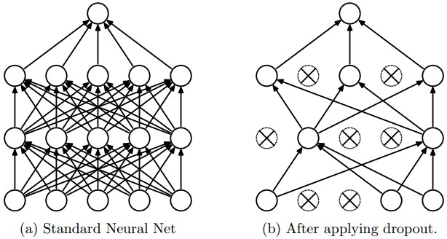
Dropout layers
During training: drop a certain fraction of the neurons, to prevent the network from “overfitting”.
During prediction: dropout is deactivated.
Usually worsens the results on the training sample, but improves the results on the validation sample.

Slide 48
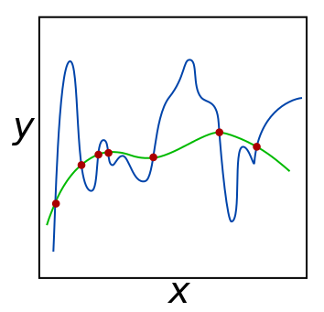
Regularization
“Occam’s razor for neural networks”:
Of two models with the same predictive power,
the “simpler” one is to be preferred.
→ Prefer networks with many weights of zero
“Penalty term” for weights in the loss function, e.g. L2 regularization:
Implemented in many of pytorch’s optimizers, lambda is often called “weight decay”.

Slide 49
Hyperparameter optimization
Finding the optimal network architecture and hyperparameters is yet another optimization task →
hyperparameter optimization, network optimization
Many simple algorithms:
→ grid search: systematically try out many configurations
→ random search: try out configurations randomly
→ gradient based optimization: compute gradients in the space of hyperparameters
→ evolutionary algorithms
….

Slide 51
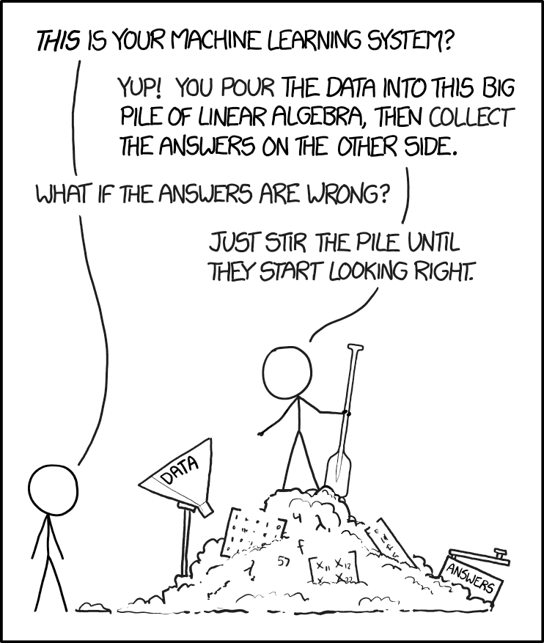

Slide 52
Exercise 2 – MLP
See 02_mlp.ipynb for skeleton code you may use for a quick start.
Goal is to find the best non-linear decision boundary between blue and red points.
Play around with learning rate, loss function,
optimizer, number of layers, number of neurons,
activation functions, dropout layers.
Which network architecture worked best for you?

Slide 53
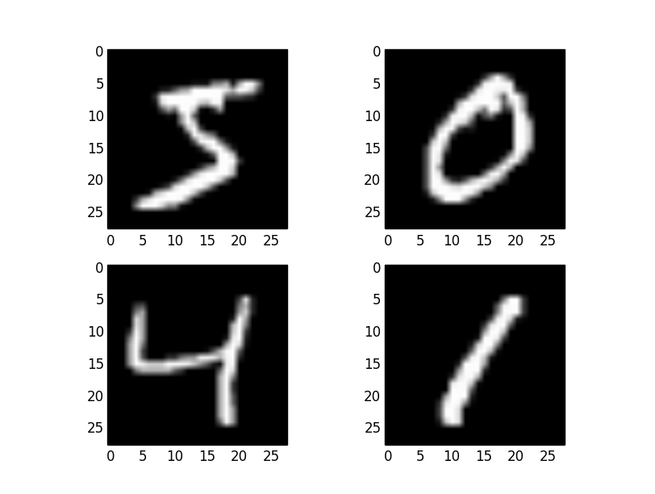
Lesson 3
Convolutional
neural
networks

Slide 54
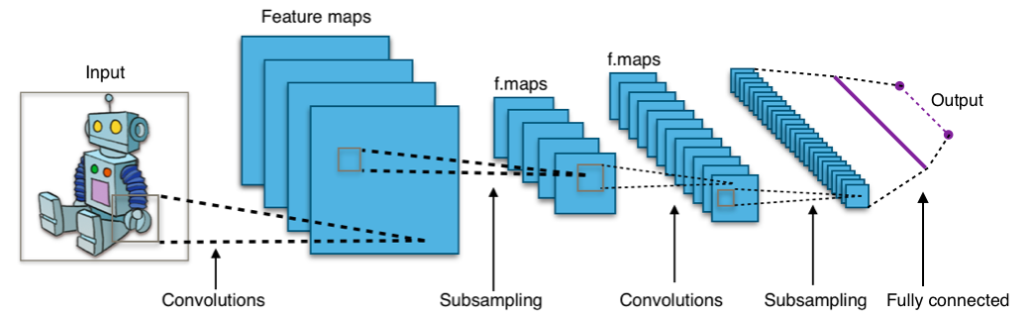
Convolutional layers
Think computer vision: we want to detect a cat,
independently of where it is in the photo: translation invariance!
Answer: convolutional layers: many several small convolution matrices (“kernels”)

Slide 55
Convolutional layers
Answer: convolutional layers: many several small convolution matrices (“kernels”) that “scan” over the input image, “sharing” the learned weights over the scan and thus detect features independent of their position

Slide 56
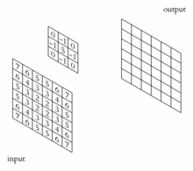
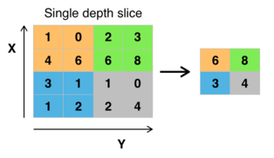
Convolutional layers
Answer: convolutional layers. Many several small convolution matrices (“kernels”) that “scan” over the input image, “sharing” the learned weights and thus detect features independent of their position
Max Pooling (subsampling)
Inspired by the “receptive field” in biology
Convolutions

Slide 57
Side remark on convolutions
Convolutional networks owe their success to exploiting the translational equivariance.
(equi-/invariance → symmetries → group theories is something we have some familiarity with from gauge theories)
Can symmetries be exploited more systematically in neural networks?
https://zenodo.org/record/6459381
https://arxiv.org/abs/2101.03164
https://arxiv.org/abs/2110.02905
http://proceedings.mlr.press/v76/ensign17a/ensign17a.pdf

Slide 58
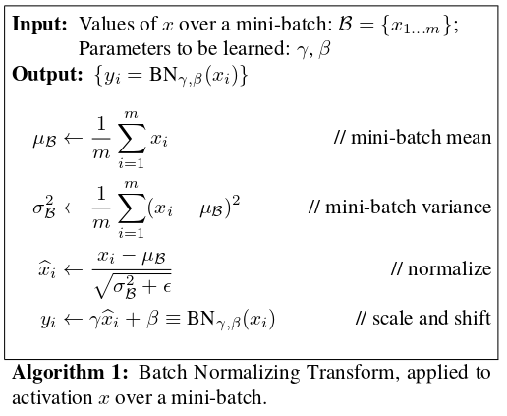
Batch normalization
It is usually a good trick to “standardize” the inputs: afine transformation so they have zero mean and unit variance on a given data sample.
This is also true for hidden neurons → batch normalization.
dead
neuron
alive, “dynamic”
dead
neuron

Slide 59
Softmaxing
For a classification problem with K different classes (e.g. “building”, “animal”, “object”), you want the output neurons to encode a “probability” of the input belonging to class j.
(“One-hot encoding” – one neuron per class)
The K output neurons should therefore acquire values between 0 and 1, and sum up to 1.
Softmax function achieves this:
As physicists we note that this is equivalent to the Boltzmann distribution:
if y_{j} denotes the nevative energy of a quantum state j divided by k_{B}T, then p(j) is the probability of the quantum object being found in that state.

Slide 60
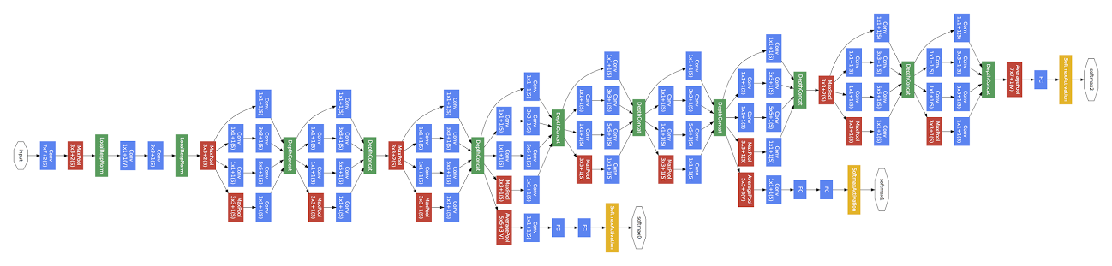
Example: google’s “Inception” network
Convolution
Pooling
Softmax
Other
9 Inception modules
Network in a network in a network...
https://storage.googleapis.com/pub-tools-public-publication-data/pdf/43022.pdf

Slide 61
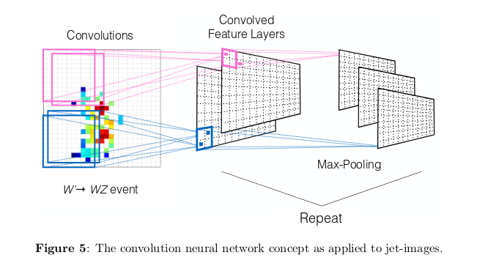
Application in particle physics: jet images
Task: learn a jet classifier
that identifies highly boosted W jets
https://arxiv.org/pdf/1511.05190.pdf

Slide 62
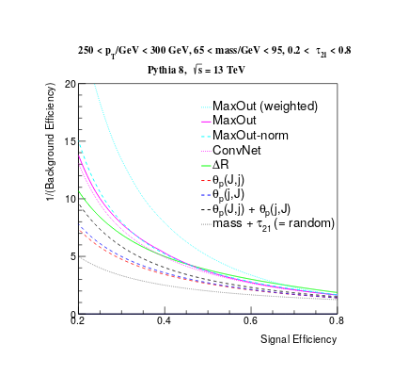
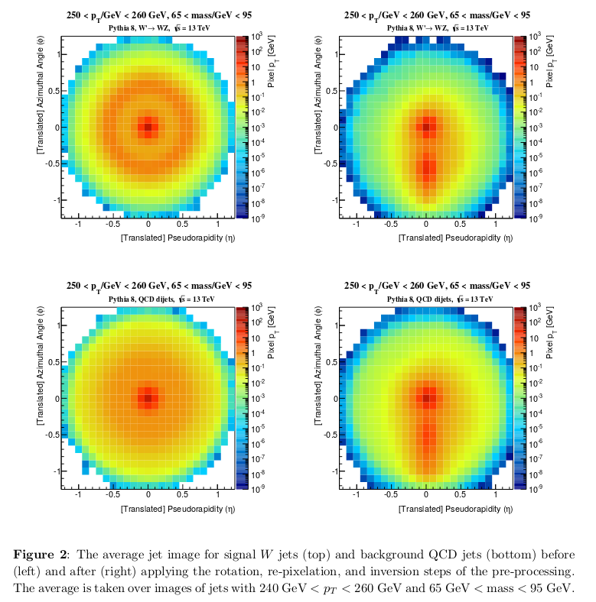
Application in particle physics: jet images
average signal
Receiver Operating
Characteristic (ROC) curves
for various choices of “hyperparameters”
average background
https://arxiv.org/pdf/1511.05190.pdf

Slide 63
Exercise 3 –
CNN
See 03_cnn.ipynb for skeleton code you may use for a quick start.
Run the skeleton code on the MNIST dataset of handwritten digits. It has one convolutional layer, which should already give you good results (accuracy around 98%).
Add another convolutional layer. With a little tweaking you should get the accuracy around 99%.
Play around with all hyperparameters. Can you get an accuracy above 99.25%?

Slide 64
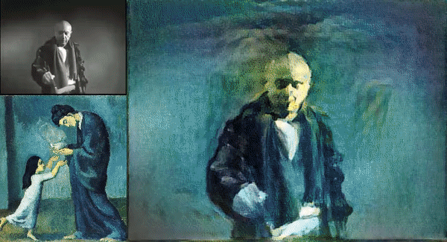
Lesson 4
Generative models

Slide 65
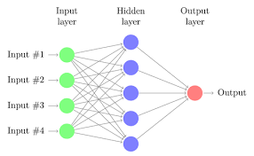
Architectures we defined so far implemented classifiers and regressors: Discriminative models!
Loosely speaking, they compute [aspects of]: p(y|x)
Can we somehow turn the information flow around, from the output to the input, to synthesize input, computing p(x|y)?
Yes!

Slide 66
Option #1: adversarial setups
Networks can be set up to compete against each other in an adversarial setup: generative adversarial networks (GANs)
One machine is set up as a generator, it learns
to generate fake data, e.g. images that resemble Picasso paintings.
Another machine learns to discriminate the real Picassos from fakes.

Slide 67

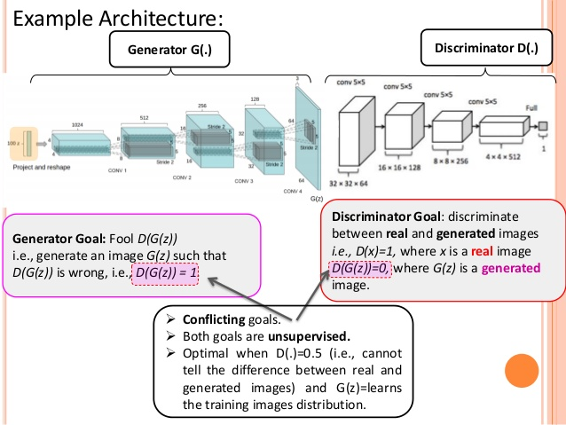


https://www.slideshare.net/shyamkkhadka/unsupervised-learning-represenation-with-dcgan

Slide 68

Example: the “CycleGAN”, a type of a conditional GAN, changing the condition horse → zebra
https://github.com/junyanz/CycleGAN

Slide 69
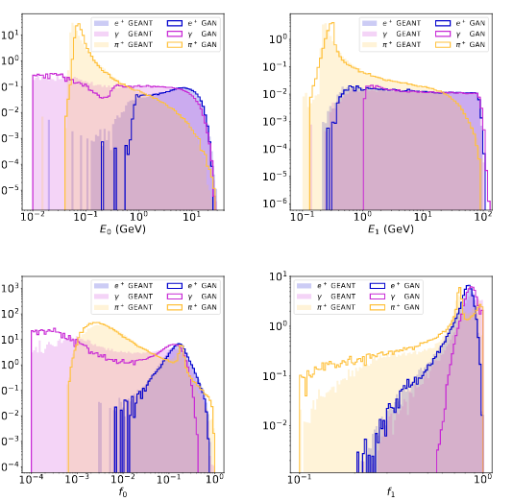
Application in Particle Physics:
Fast simulation of ATLAS calorimetry (CALO GAN)
Comparison of shower shape variables, Calo GAN versus full Geant 4 simulation
See also: talk in ACAT 2017
https://arxiv.org/pdf/1705.02355.pdf

Slide 70
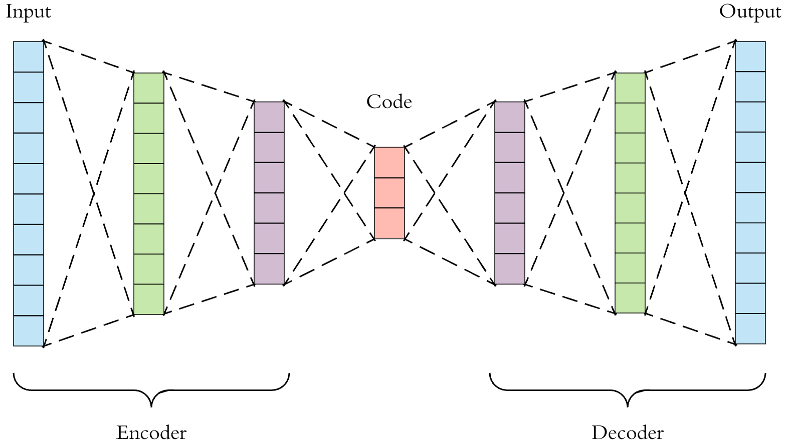
Option #2: Autoencoders – a.k.a. “understanding is compression”
Consider the following network architecture:
z
x
x’
With a loss function:

Slide 71
Autoencoders – a.k.a. “understanding is compression”
Consider the following network architecture:
z
x
x’
With a loss function:
The network learns to reproduce its own input!
z becomes a lower-dimensional representation (a “code”) of a higher-dimensional x
Applications: Lossy compression, denoising data. But cannot yet produce fake, synthetic data. Why? Because the stochastic noise
is not yet part of the model!

Slide 72
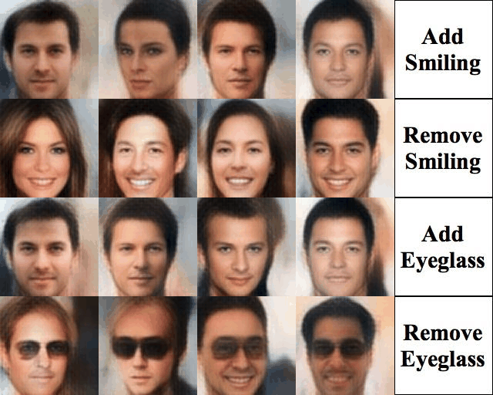
Example: Conditional Variational Autoencoder applied to “CelebA” dataset
Taken from: https://houxianxu.github.io/assets/project/dfcvae

Slide 73
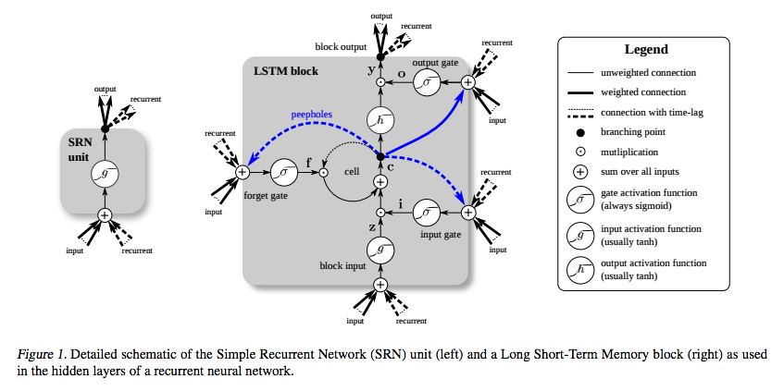
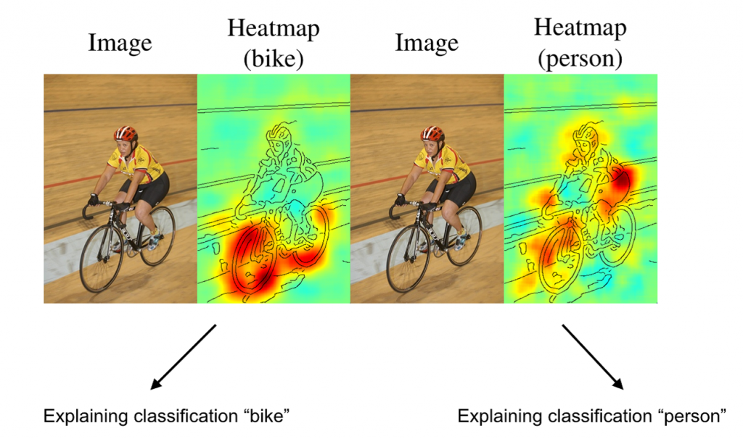
Lesson 5
Recursive and recurrent neural networks
explanation methods
Bayes networks and errors

Slide 74
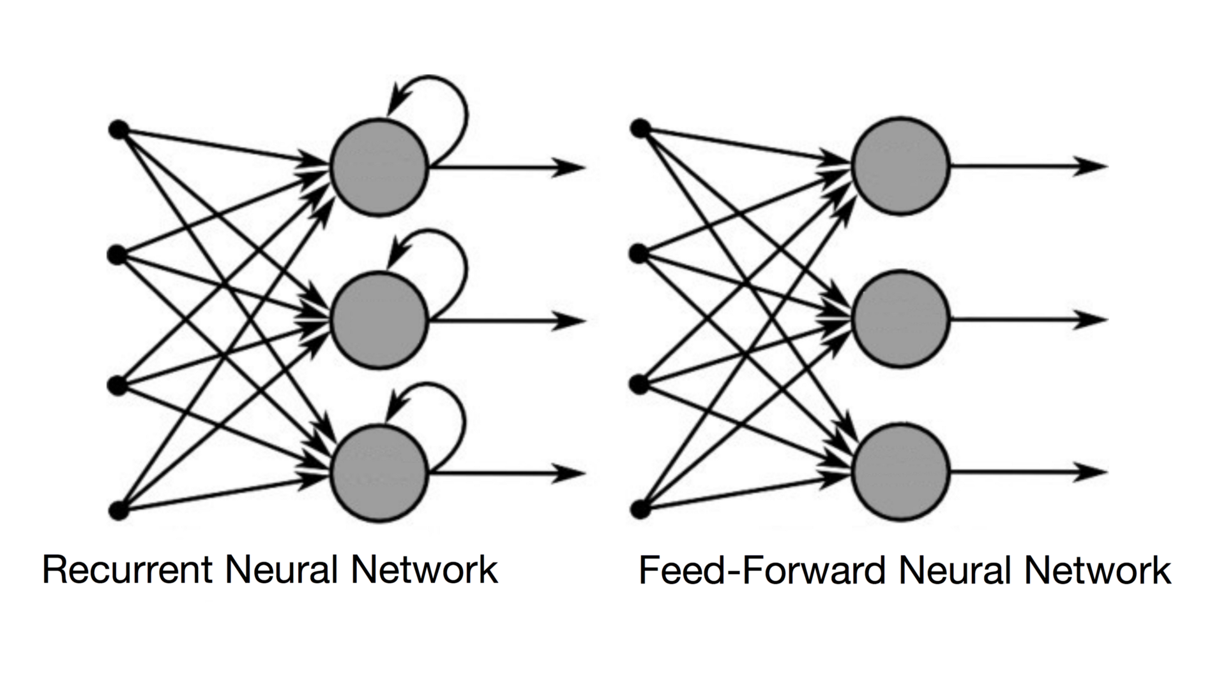
Recurrent networks
How can we apply neural networks on variable-sized time series like text or speech, where the prediction of the current input must depend on the past “events”?
By making the network “recurrent”:

Slide 75
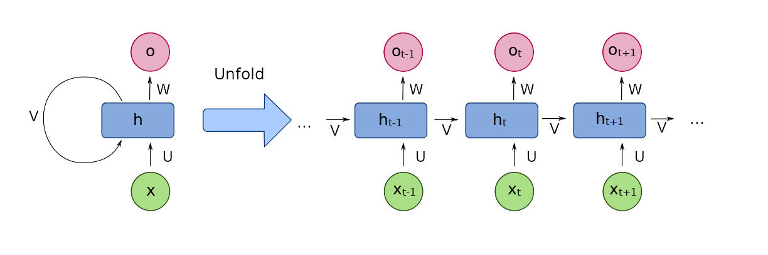
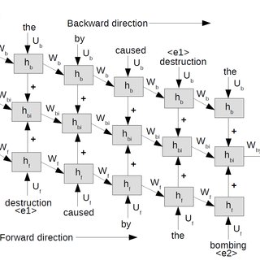
Recurrent networks
Note that one can always “unfold” recurrent networks to turn them into (complicated) feed-forward networks with fixed record lengths:

Slide 76
Recurrent networks
These types of networks had the problem, that the gradient quickly vanished when “propagated back through time”. The Long Short Term Memory (LSTM) solved that.

Slide 77
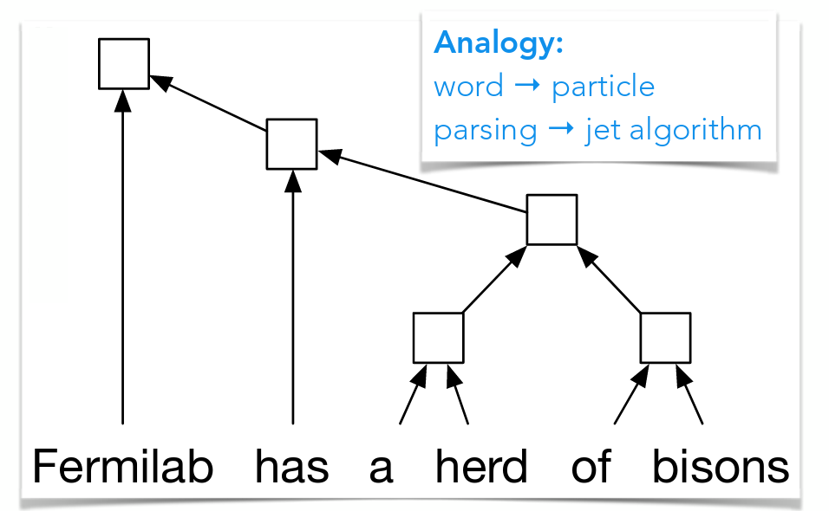
Application (of a similar class of algorithms) in particle physics: jet classification
QCD-aware recursive neural networks for jet physics. (Recurrent = special version of recursive)
See also talk at DS@HEP 2017 workshop
https://arxiv.org/pdf/1702.00748.pdf

Slide 78
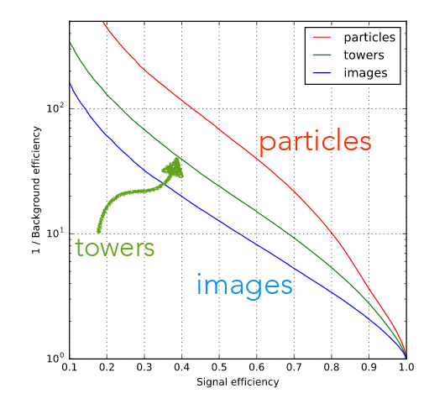
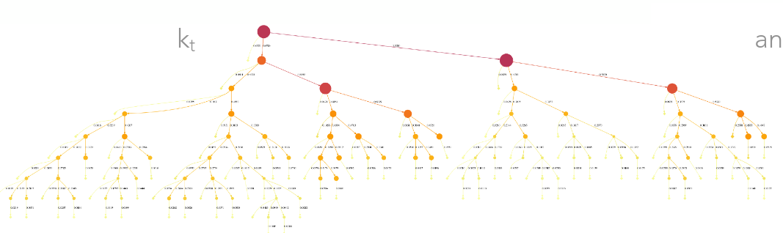
Application (of a similar class of algorithms) in particle physics: jet classification
“QCD-aware recursive neural networks for jet physics”
“better”
Visualisation of k_{t} jet algorithm.
“particles”: recursive network
“images”: convolutional network
ROC curve of W jet tagging example, comparison with jet images algorithm
See also talk at DS@HEP 2017 workshop
https://arxiv.org/pdf/1702.00748.pdf

Slide 79
Explanation methods
What is the machine learning? How can we “debug” deep networks?
There are several methods on the market.
Simple class of algorithms for convolutional networks: which pixels of a picture most contributed to a prediction? Which pixels were in contradiction to prediction? “Sensitivity analysis”, or (for pictures) heatmaps (based on “input gradient” df/dx_{i}).

Slide 80
Explanation methods
What is the machine learning? How can we “debug” deep networks? Heatmaps:
https://arxiv.org/pdf/1512.00172.pdf

Slide 81
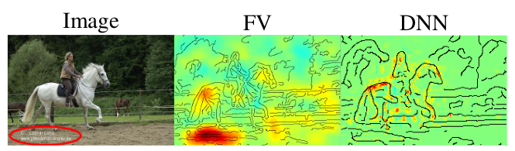
Explanation methods
What is the machine learning? How can we “debug” deep networks? Heatmaps may sometimes help discover learned “artifacts”.
The networks learns to exploit undesirable correlations.
Machine learned to identify horses by the imprint.
https://arxiv.org/pdf/1512.00172.pdf

Slide 82
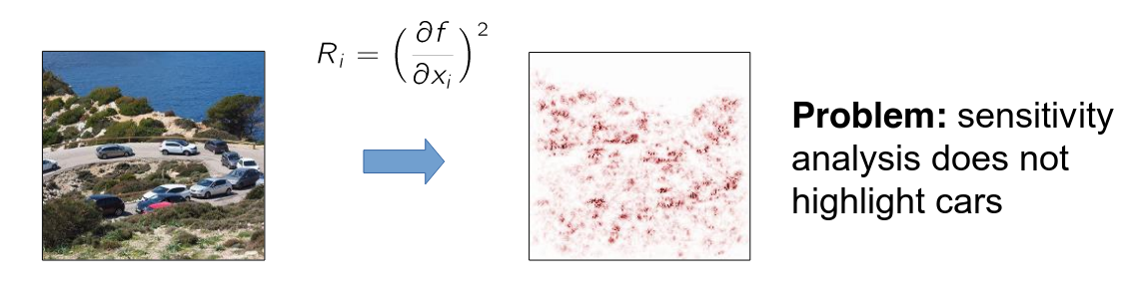
Explanation methods
But sensitivity analyses fail at grasping “the bigger picture”.
What makes the picture below a road with cars?
See e.g. http://heatmapping.org, http://heatmapping.org/slides/2018_CVPR_1.pdf

Slide 83
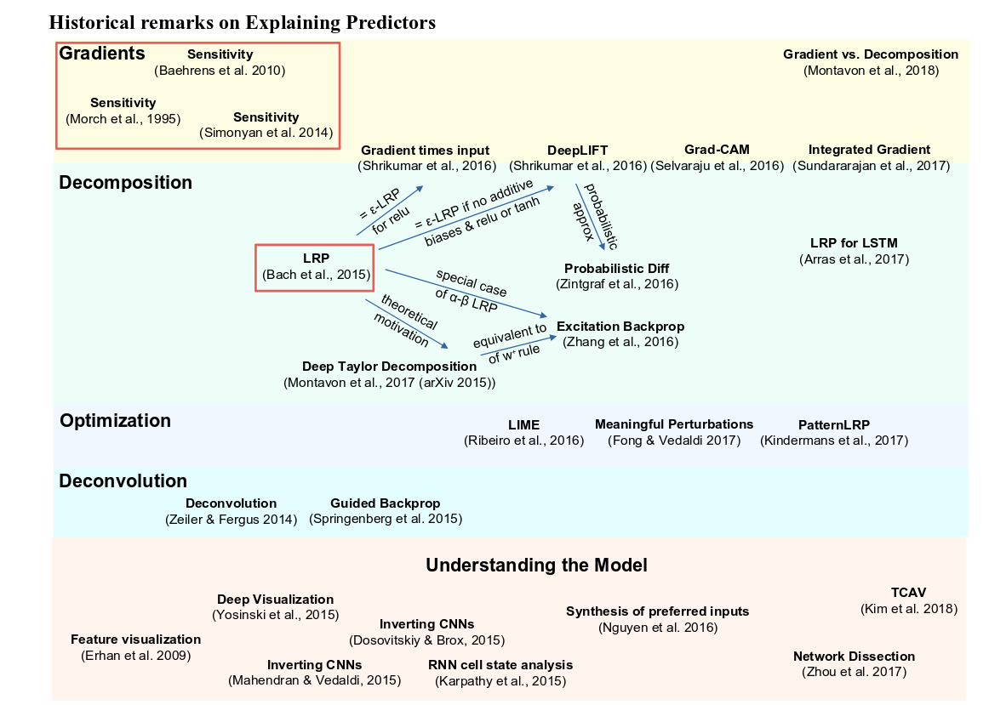
Explanation methods
An entire industry of explanation methods has emerged in only 3 years!!
Very hard to keep up and identify the algorithms that are interesting for us.
See e.g. http://heatmapping.org, http://heatmapping.org/slides/2018_CVPR_1.pdf

Slide 84
Bayesian Neural Networks and Monte Carlo dropout

Slide 85
Uncertainties: ML jargon / physics jargon
Aleatoric uncertainty: (“alea” in latin is “dice”)
All uncertainties related to the input data, e.g. sensor noise. In particle physics we often have a good understanding of these.
Epistemic uncertainty: (epistemic = “related to knowledge”)
Uncertainties on the network weights, i.e. uncertainties that are introduced with the network – and the fact that it is trained only with finite data.
How can we estimate epistemic uncertainties?

Slide 86

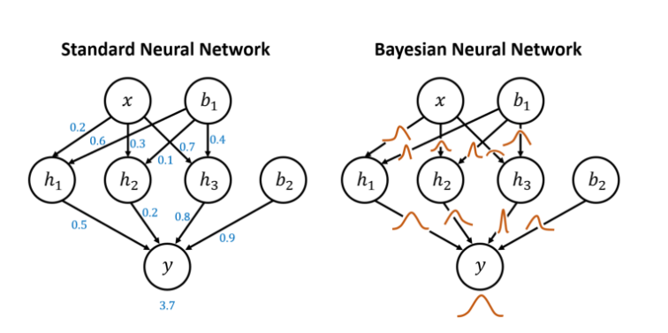
Tool #5: Bayesian neural networks and error estimation
For estimating epistemic errors, the errors inherent in the learned network, not the inputs, Bayesian statistics comes in handy:
p(data | theory parameter of model ) ↔ p( theory parameter | data )
Frequentist probability
Bayesian, subjective probability
Idea: replace weights with distributions of weights, p(w | data )
Pro: probability distributions for labels
Con: makes the networks a lot more complicated
https://davidstutz.de/a-short-introduction-to-bayesian-neural-networks/

Slide 87
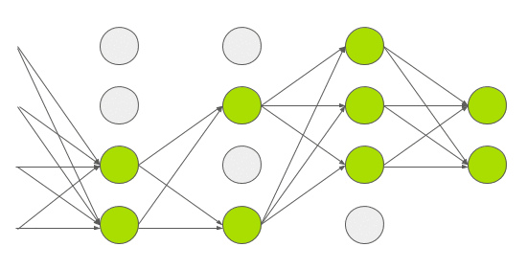
Tool #5: Bayesian neural networks and error estimation
Error estimation, the easy way: dropout!!
arXiv:1506.02142 showed that randomly applying dropout in the prediction (as opposed to dropout in training) is an approximator for the epistemic error of the prediction.
Ensembling: predict several times with dropout applied to get an estimate of the epistemic error of the network.
https://arxiv.org/abs/1506.02142

Slide 88
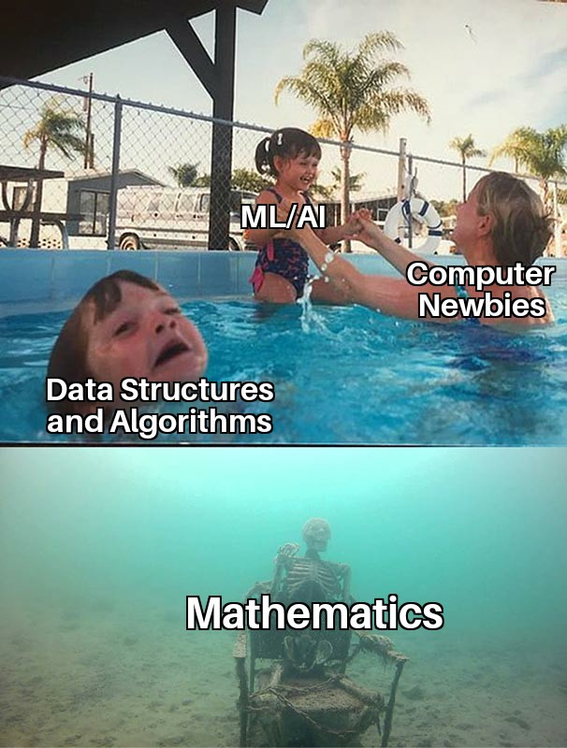

Slide 89
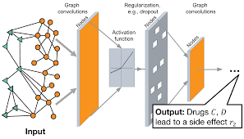
graph neural networks

Slide 90
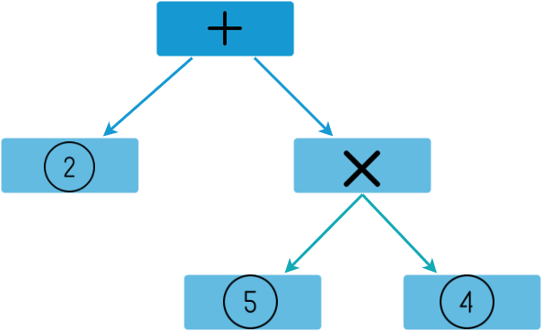
Mathematical expressions are graphs (trees), too!
2 + 5 * 4

Slide 91


AI Feynman
Symbolic regression – learning closed form equations from data!
example learn special relativity from trajectories of relativistic particles
https://www.science.org/doi/10.1126/sciadv.aay2631
https://arxiv.org/abs/2006.10782

Slide 92
challenge!

Slide 93
Backup

Slide 94
Recommended literature
Coursera course by Andrew Ng
Deep learning, book by Ian Goodfellow et al.
see also http://www.deeplearningbook.org/
Tensorflow tutorials
Pytorch tutorials
Deep learning course at univie by Philipp Grohs

