Slide 1



Summer school challenge –
classify CRESST pulse shapes
Wolfgang Waltenberger

Slide 2
Wait – CRESST?
What is CRESST?

Slide 3
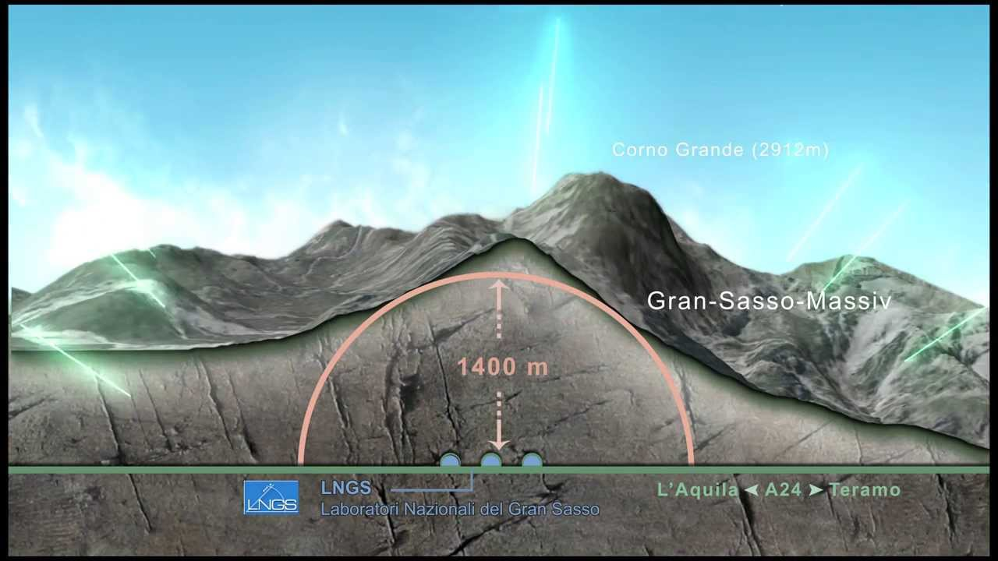
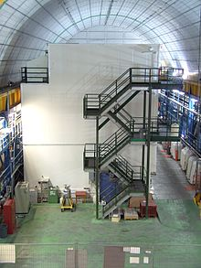
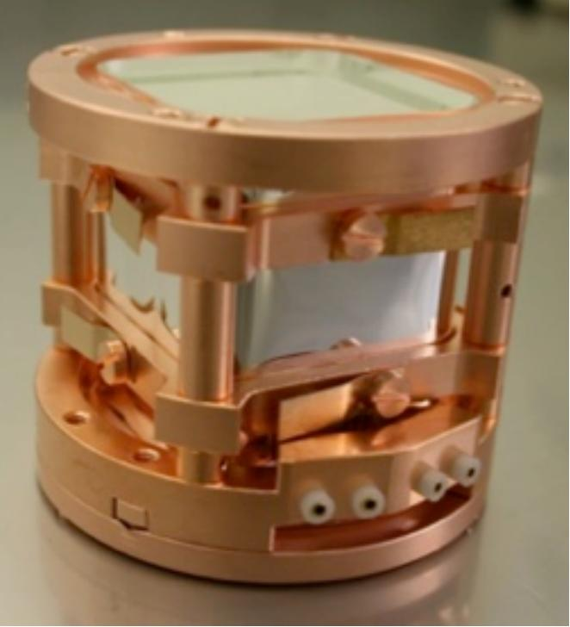
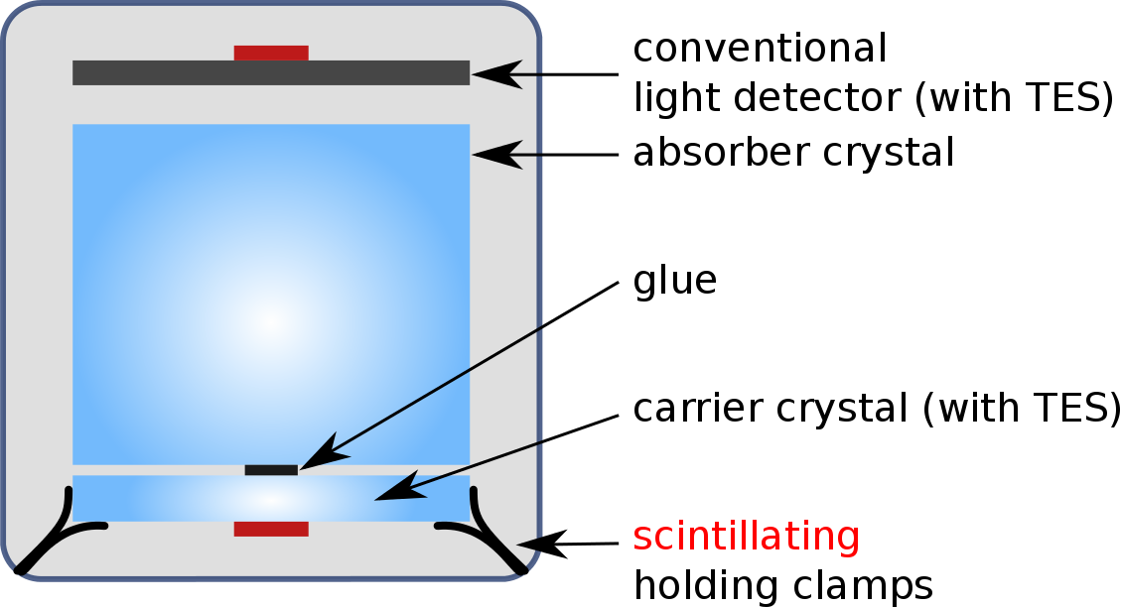
CRESST –
Cryogenic Rare Event Search with Superconducting Thermometers
Direct detection dark matter experiment
beneath Gran Sasso in italy

Slide 4
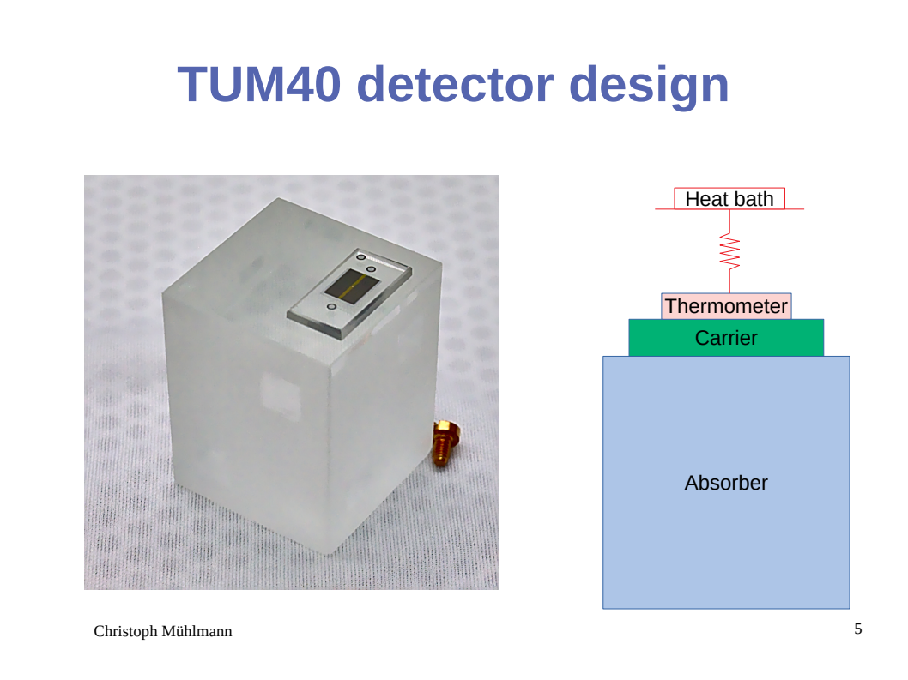

Slide 5
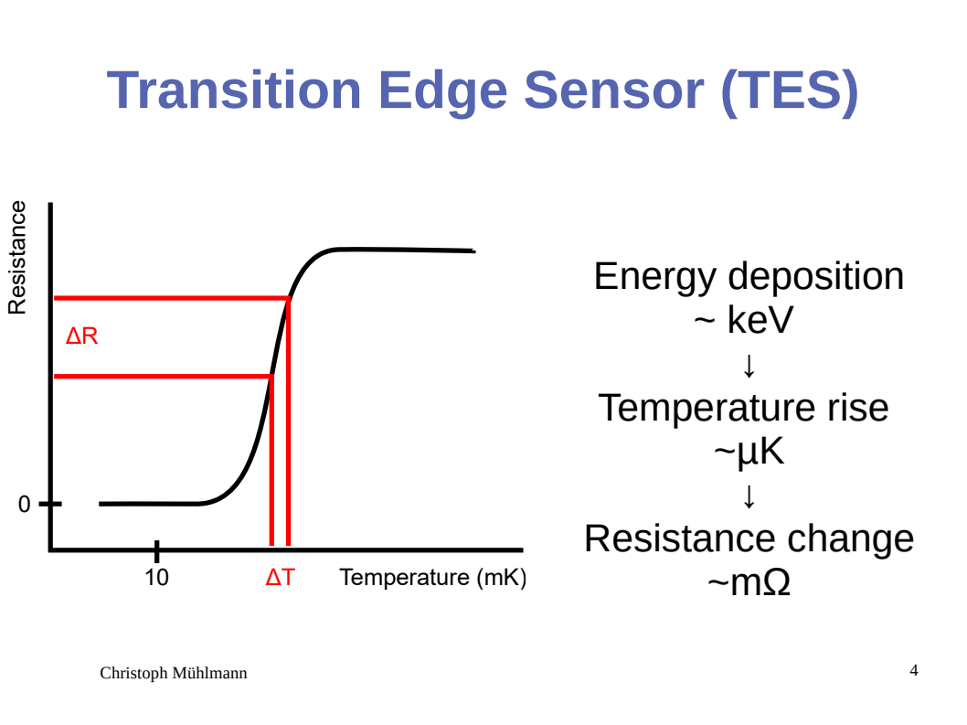

Slide 6
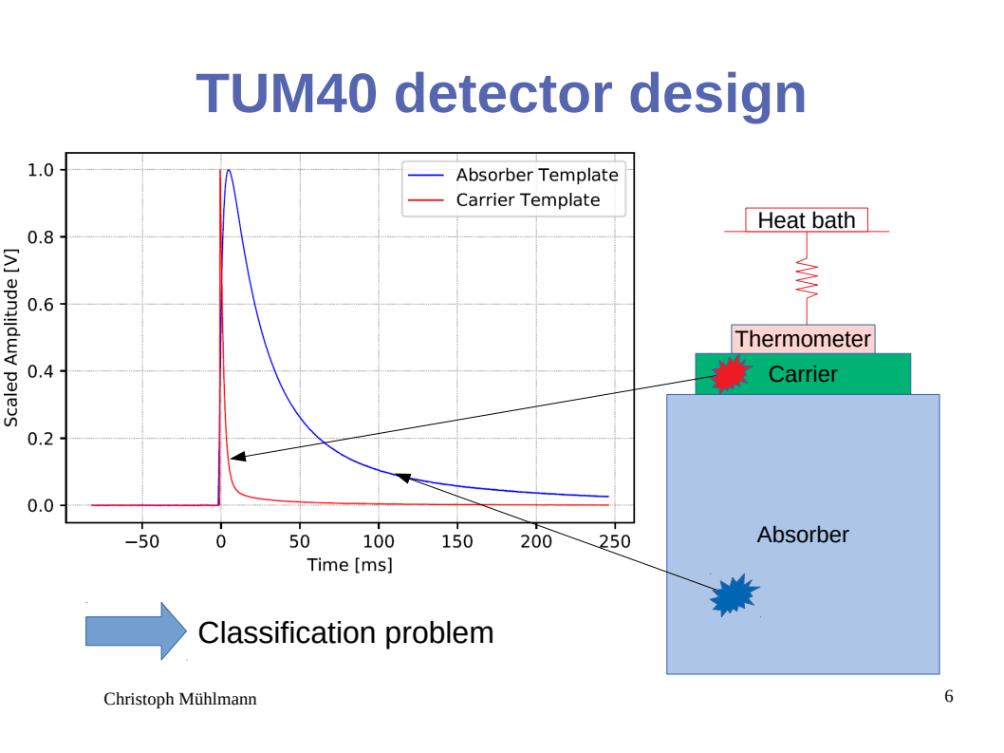

Slide 7

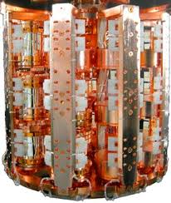
You are given a training sample of 10,000 pulse shapes, around 5,000 of which are absorber events, the others are carrier events. And a similar validation sample.
Many thanks to the HEPHY CRESST team for providing the data!
The skeleton.ipynb in the “challenge” folder is code that runs but exhibits sub-optimal performance (around 80% accuracy). Get the data from http://smodels.hephy.at/dkpi/CRESST.zip or via ./fetch_data.sh or from me (USB stick).
Improve the algorithm. Work in pairs of two. Be creative. Everything
based on pytorch and neural networks that I can reproduce (see below) is allowed. You are allowed to train on any machine.
Whoever has the lowest misclassification rate (on a third undisclosed holdout data sample!) by thursday, sept 20, 20:59, wins the workshop challenge!
In case of a tie, the smaller network wins (Occam’s razor).
Send code and the trained weights (e.g. skeleton.ckpt) to me:
wolfgang.waltenberger@gmail.com
Multiple submissions (<= 3) are allowed. The best submission counts.
The winners will be announced by Andi in the wrap-up session.

