Slide 1

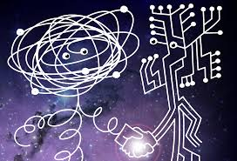

Machine Learning in Particle Physics (I) – Introduction
Wolfgang Waltenberger
ÖAW and Uni Wien
ESI Winter School, Vienna,
Feb 10 - 20, 2020

Slide 2

Disclaimer
Gregor, Lisa and I are all (mostly) LHC physicists. Within these lectures we will thus keep a strong focus on the context of the LHC.
You may find all my material for this winterschool at
https://github.com/WolfgangWaltenberger/winterschool
We will use google’s colab for the tutorial
On the github page given above of the repo you will find a link to our google colab instance

Slide 3
Syllabus
For today and tomorrow, we aim to put our focus on
generative models
decorrelating variables
outlier detection
uncertainties
Wednesday | Thursday
9:00 Introductory Lecture, Detailling our Use Cases and Problems | 9:00 Generative Models and Outlier Detection (I)
11:00 Uncertainties, Decorrelating Variables | 11:00 Generative Models and Outlier Detection (II)
14:00 Tutorial, Uncertainties & Decorrelating Variables | 14:00 Tutorial, Generative Models and Outlier Detection

Slide 4
Particle Physics and Machine Learning – Lecture I:
Use Cases, Needs, and Challenges

Slide 5
Theory

Slide 6
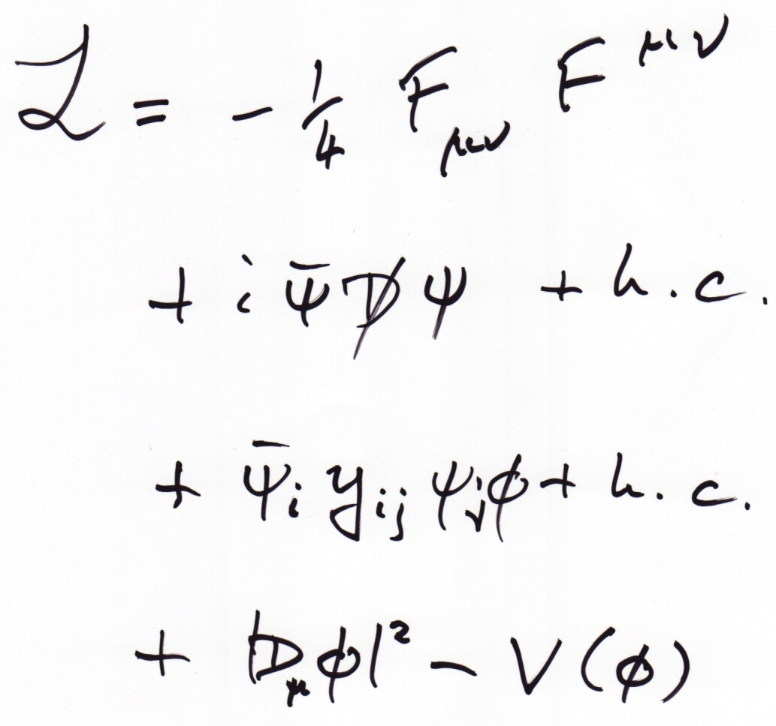
Machine Learning in Theoretical High Energy Physics

Slide 7
Machine learning in Theoretical Particle Physics
Obviously theoretical particle physics is all about performing many complex (e.g. quantum field theoretical) calculations. It is thus very natural that machine learning applications arose recently. Let me mention a few subjectively selected works:
a supervised fully-connected network that interpolates between quantum field theoretical calculations to speed up the process
A generative model to create simulations of quark-gluon plasmas
Unsupervised learning techniques to identify “classes” of string theories that possibly contain the particle content of the Standard Model

Slide 8
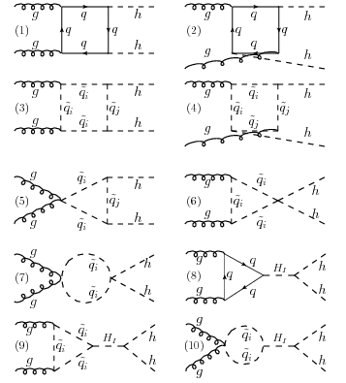
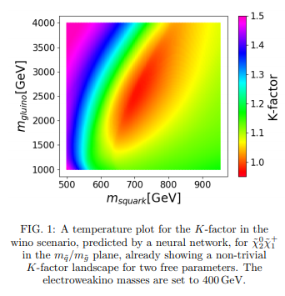

“Deep Cross Sections”
Problem: LHC theorists have to compute a very large number of quantum field theoretical processes for many similar e.g.
supersymmetric theories – a complicated, tedious, and
repetitive task.
Solution: use a neural network to interpolate
between the solutions that you computed “manually”.
https:/arxiv.org/pdf/1810.08312.pdf

Slide 9
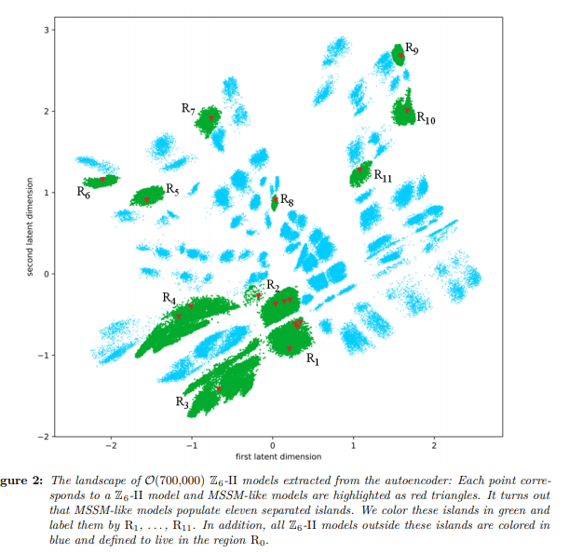

“Clustering string theories”
Problem: the landscape of string theories is vast, and only some pockets of it produce a particle spectrum that contains the known Standard Model particles. How to identify these pockets?
Solution: use e.g. an autoencoder to learn low-dimensional representations of string theories.
Use a clustering algorithm in latent space
to find similar types of string theories that
contain the Standard model particle
content (or something similar)
https://arxiv.org/pdf/1811.05993.pdf

Slide 10
LHC

Slide 11
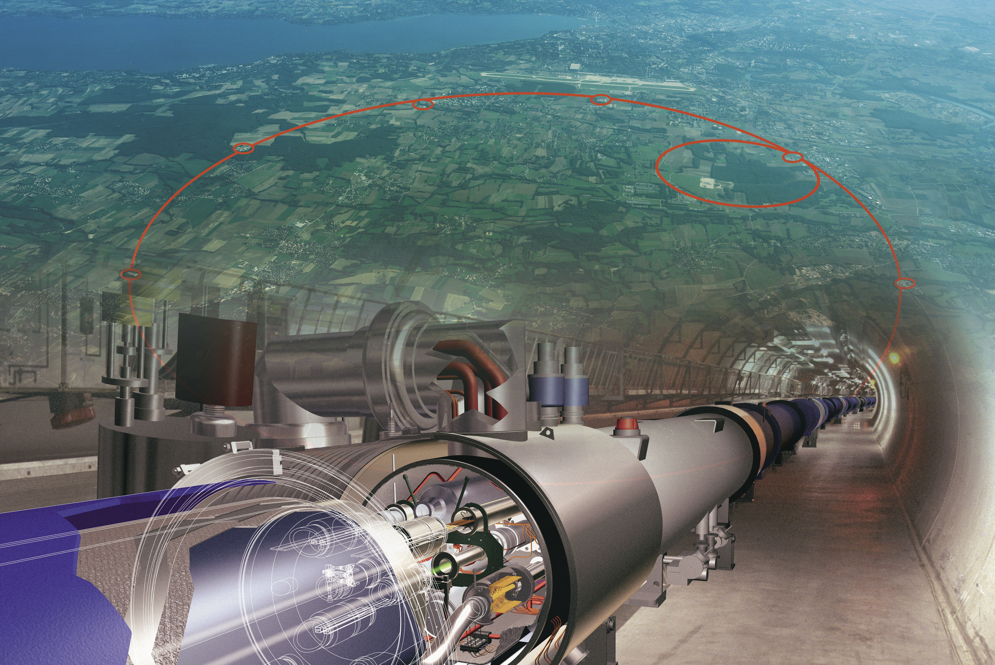
Machine Learning and the Large Hadron Collider

Slide 12
The Large Hadron Collider
Proton-proton (and lead-lead) collider, 30 km circumference, currently operating at 13 TeV center-of-mass energy. 4 large experiments + a few smaller experiments, 2 general purpose experiments: ATLAS and CMS.

Slide 13
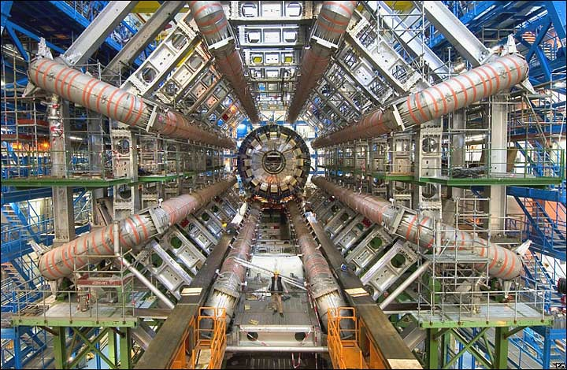
ATLAS – A Toroidal Large ApparatuS
Lorentz factor γ of our protons when they collide is ~ 7000

Slide 14
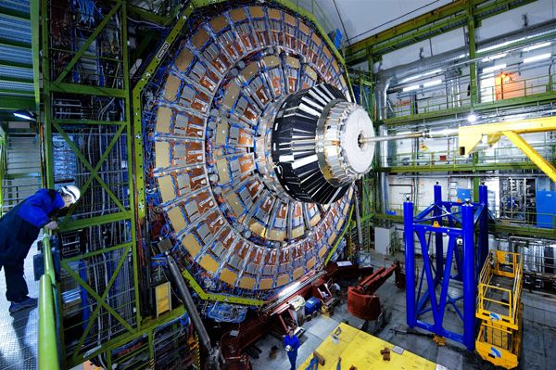
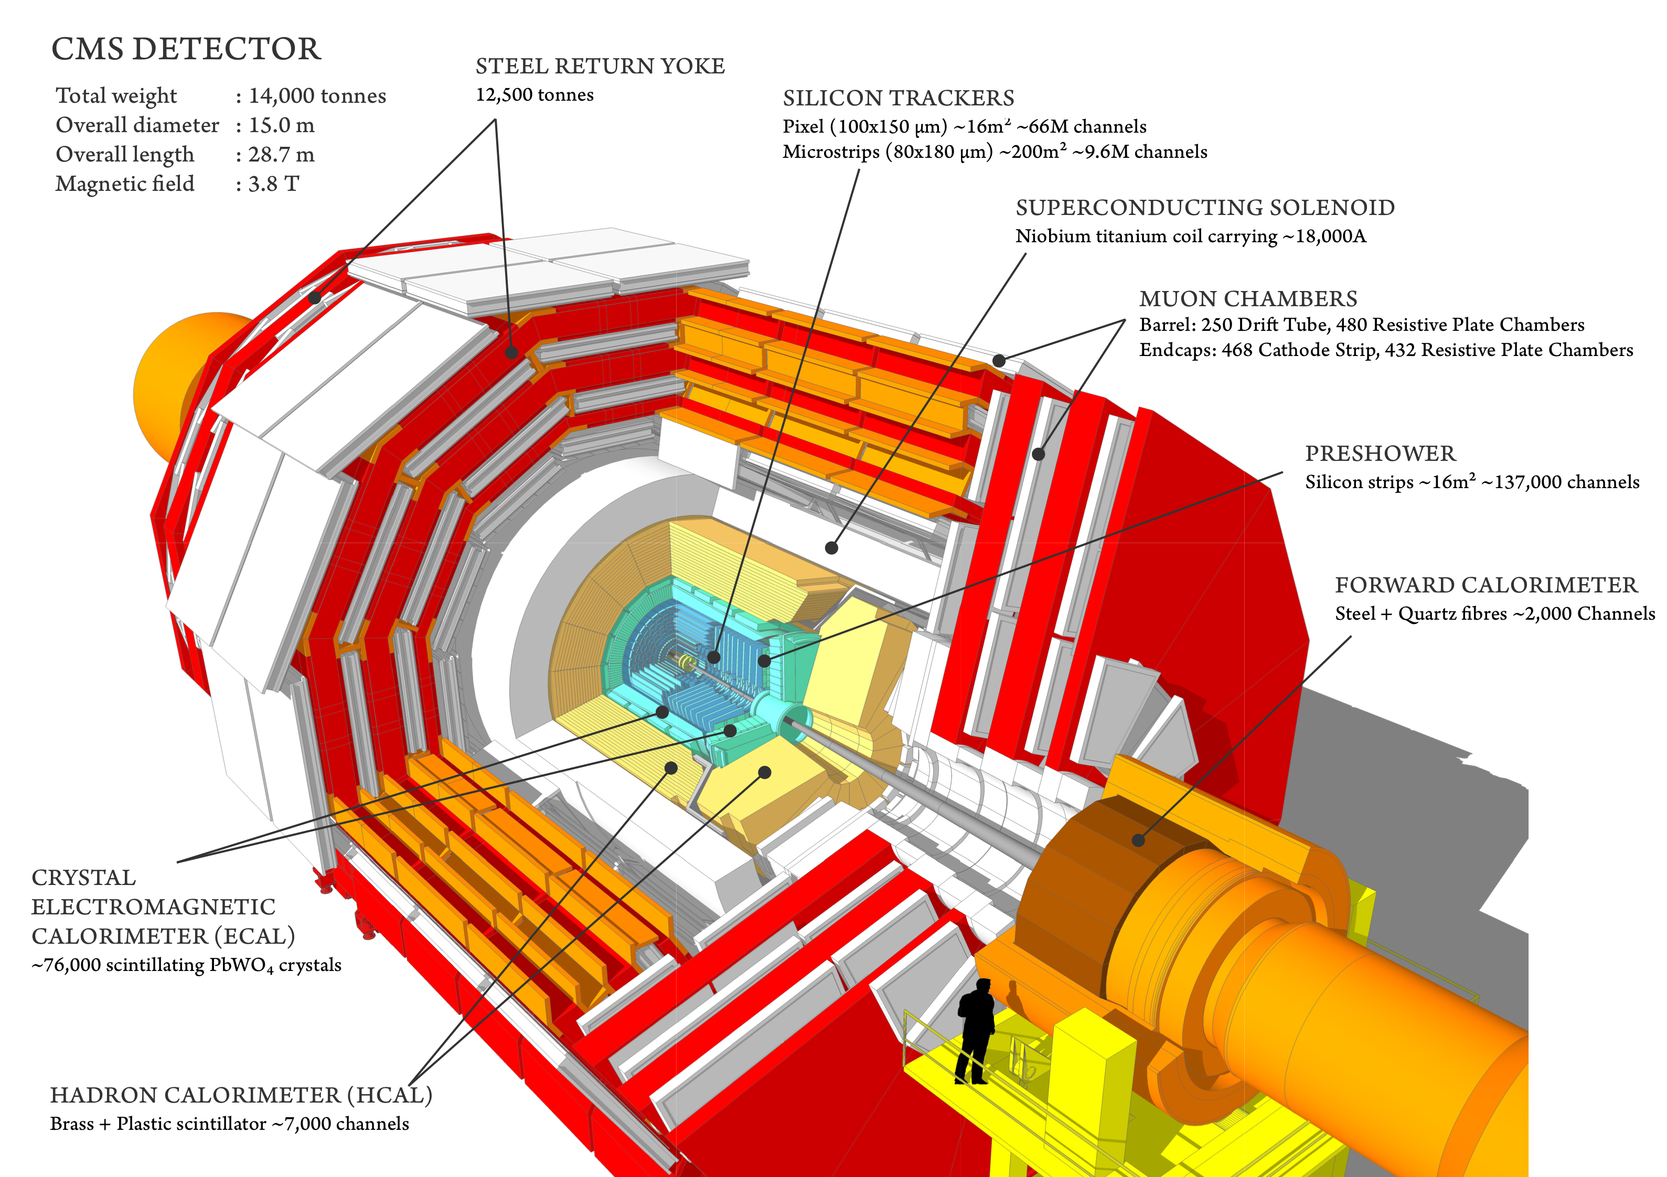
CMS – Compact Muon Solenoid
Taking 40 million images of proton-proton collisions every second.

Slide 15
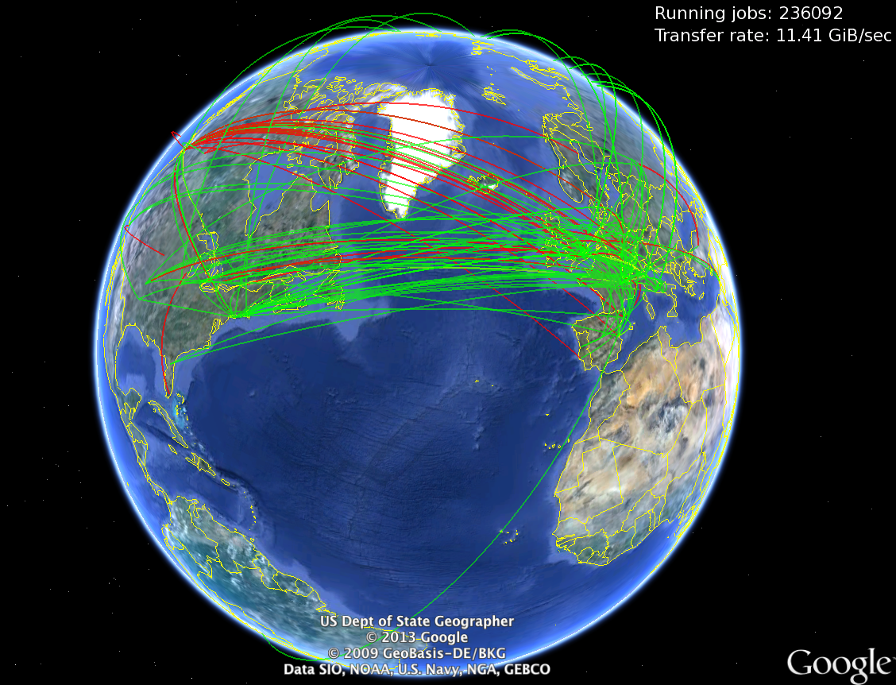
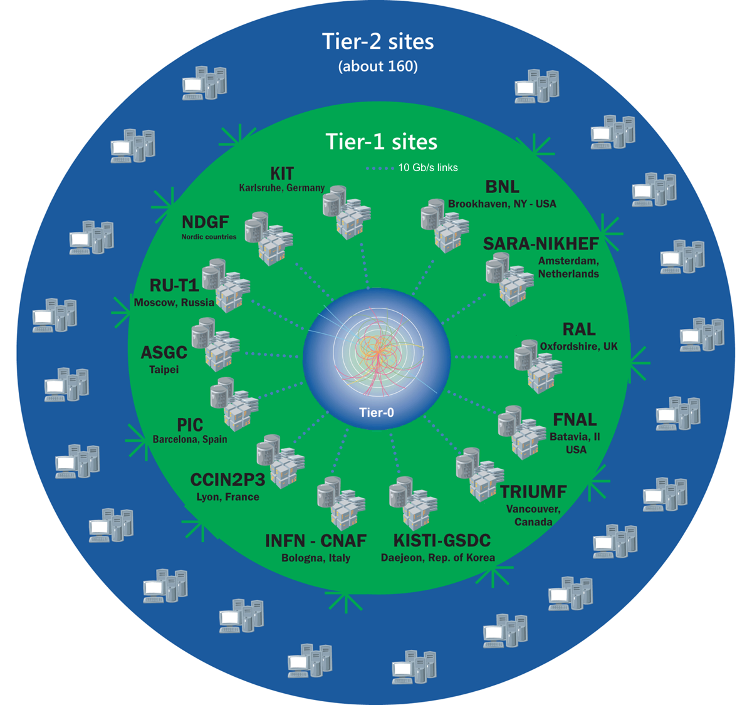
The world-wide LHC Computing Grid
The data that survive our (multi-tiered) trigger systems, get distributed via the World-wide LHC Computing Grid (WLCG)
We are currently at ~ 1 Exabyte (=10¹⁸ bytes) of storage and ~ 1 Million CPU cores.
https://wlcg-public.web.cern.ch/

Slide 16
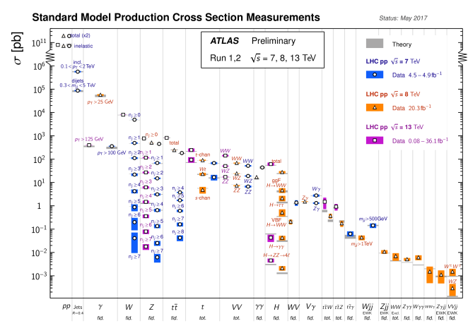
Searching for the needle in the haystack
“cross section”: measure of frequency of occurence
Off the chart: expected physics beyond the known Standard Model
5 orders of magnitude left out!
Not really interesting
More interesting
Physics processes
Very interesting

Slide 17
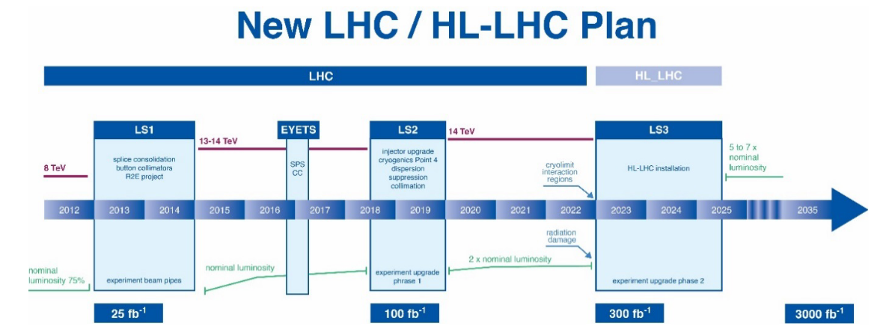
Prepare for the Future
And we start preparing for ~ 10 x more data!
soon: ~ 3 times more data
long term future: ~ 30 more data
data now
(in funny units)

Slide 18

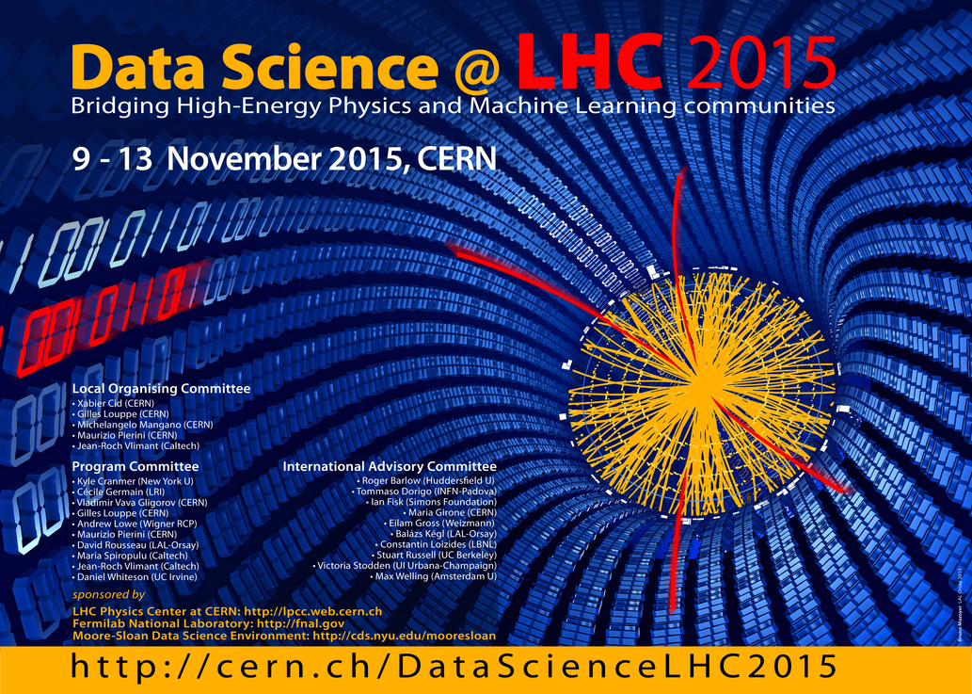
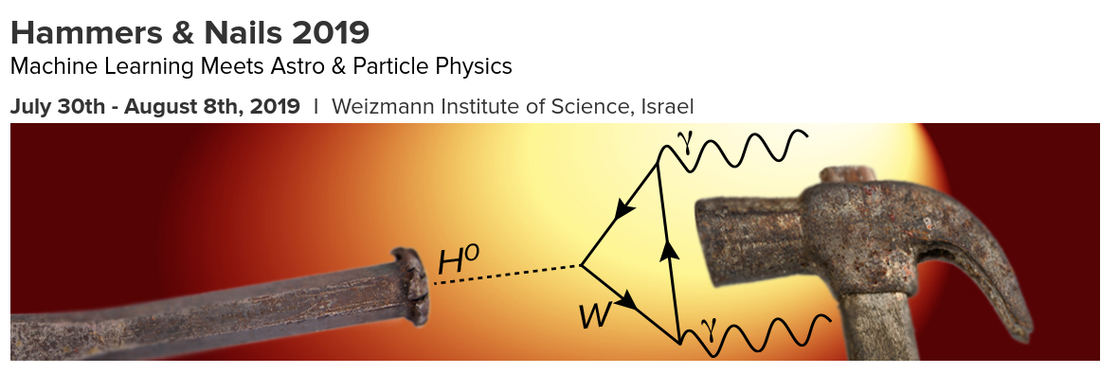
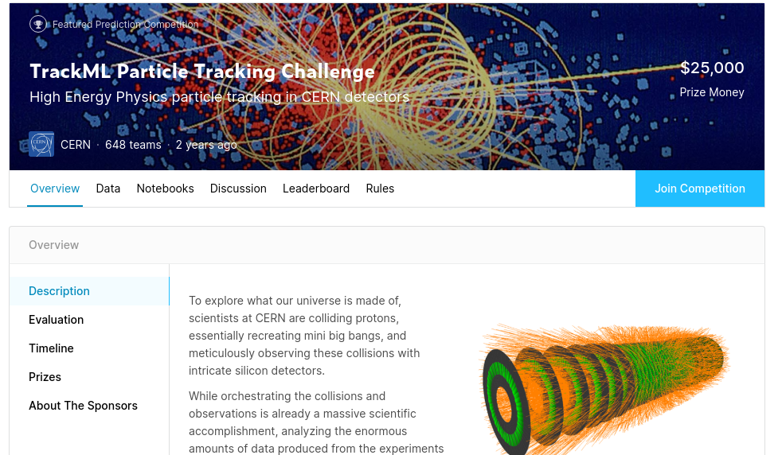



That is to say:
We need all the machine intelligence we can get!

Slide 19
Hardware

Slide 20
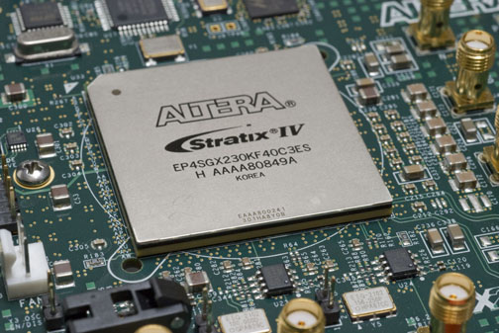
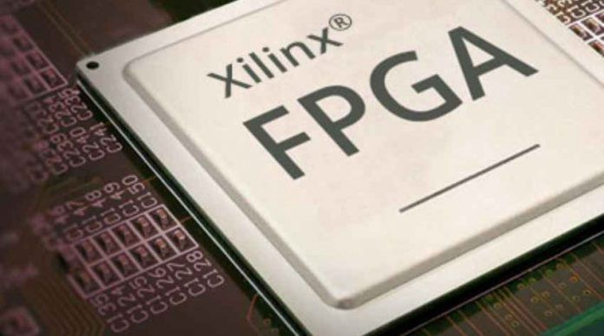
Non-standard Hardware platforms
Our community is also constantly exploring hardware platforms other than CPUs and GPUs.
E.g. our “hardware triggers” use lots of FPGAs – Field Programmable Gate Arrays
(FPGAs are something like ASICs, only reprogrammable)

Slide 21

Neural Networks on FPGAs
Our “hardware triggers” use lots of FPGAs – Field Programmable Gate Arrays
There was no solution on the market to quickly upload neuronal networks
(for prediction only, without gradients) to the FPGAs, so members of our community developed software for this task: HLS4ML, High-Level Synthesis for Machine Learning
https://github.com/hls-fpga-machine-learning/hls4ml

Slide 22
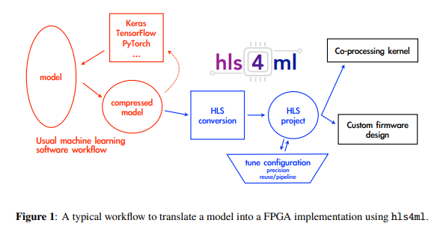
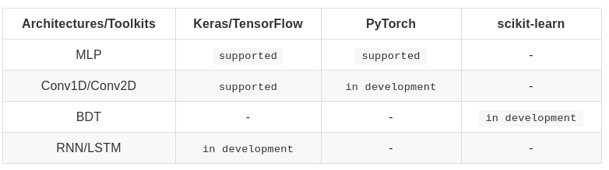
“Fast inference of deep neural networks in FPGAs for particle physics”
Currently only the simpler network architectures are
supported, but this is changing
https://arxiv.org/abs/1804.06913
https://github.com/hls-fpga-machine-learning/hls4ml

Slide 23
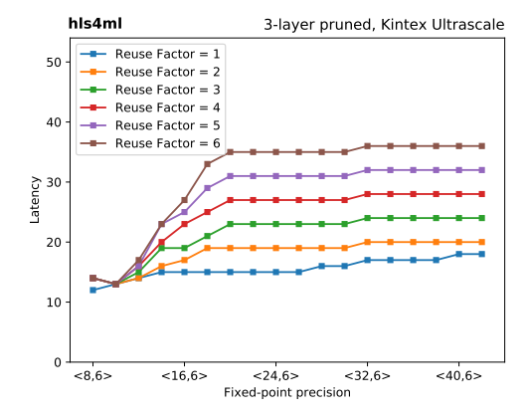
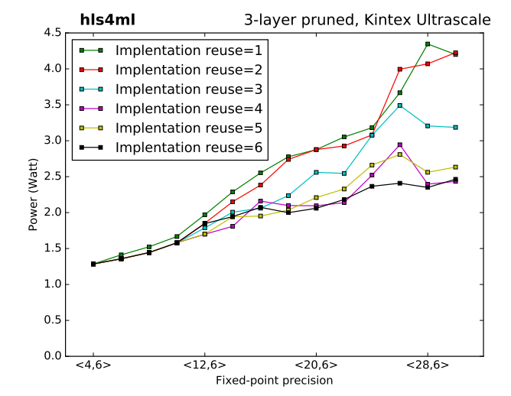
“Fast inference of deep neural networks in FPGAs for particle physics”
Number of clock cycles: O(100 ns) for a prediction of 3-layer network! Ultra-low latency neural network predictions!
O(1) Watt, not O(100) Watts like GPUs!
https://arxiv.org/abs/1804.06913
https://github.com/hls-fpga-machine-learning/hls4ml

Slide 24
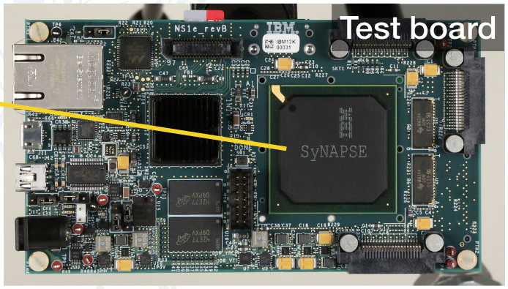
Neuromorphic Hardware
Neuromorphic Chips: experimental, post-von-Neumann architecture, loosely modeled after human brain (analog, spiking signals as opposed to “weights” in ANNs).
“True North” architecture: experimental program conducted by DARPA and IBM
Power consumption: tens of Milliwatts!

Slide 25
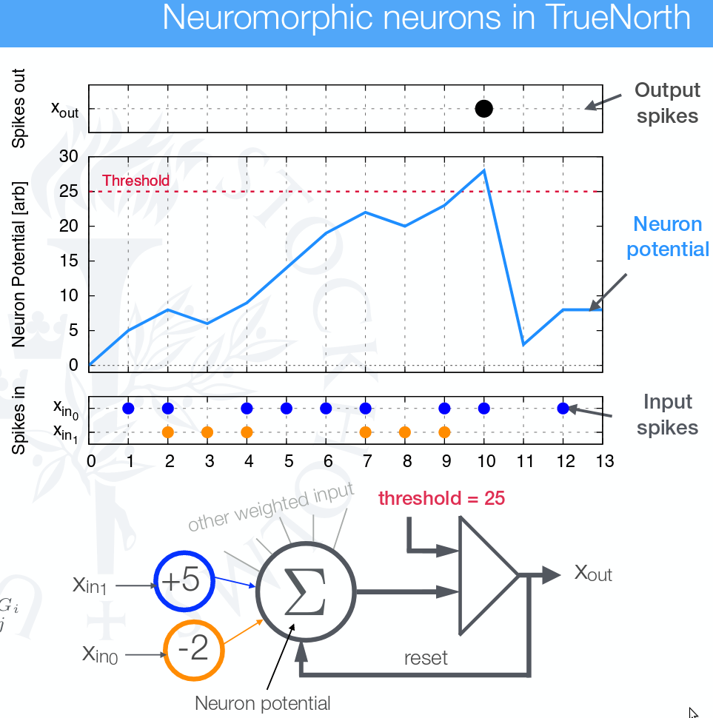
Neuromorphic Hardware
Rebecca Carney, CTD2017 Talk

Slide 26
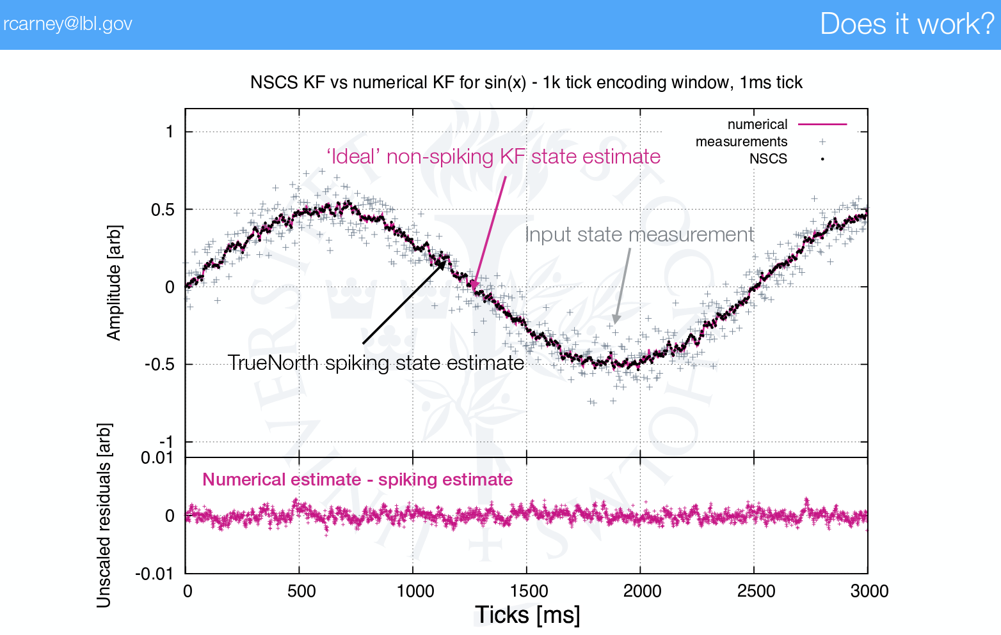
Neuromorphic Hardware
Rebecca Carney, CTD2017 Talk

Slide 27
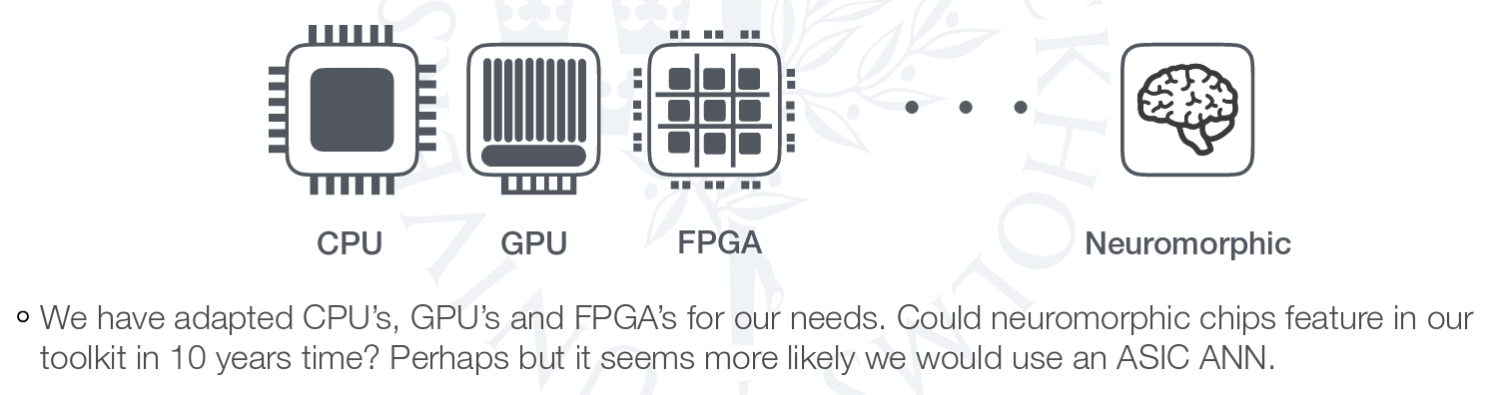
Neuromorphic Hardware
Rebecca Carney, CTD2017 Talk

Slide 28
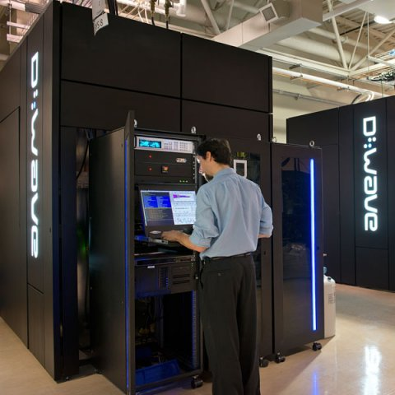
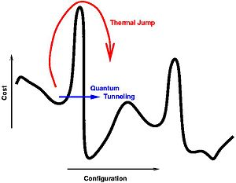
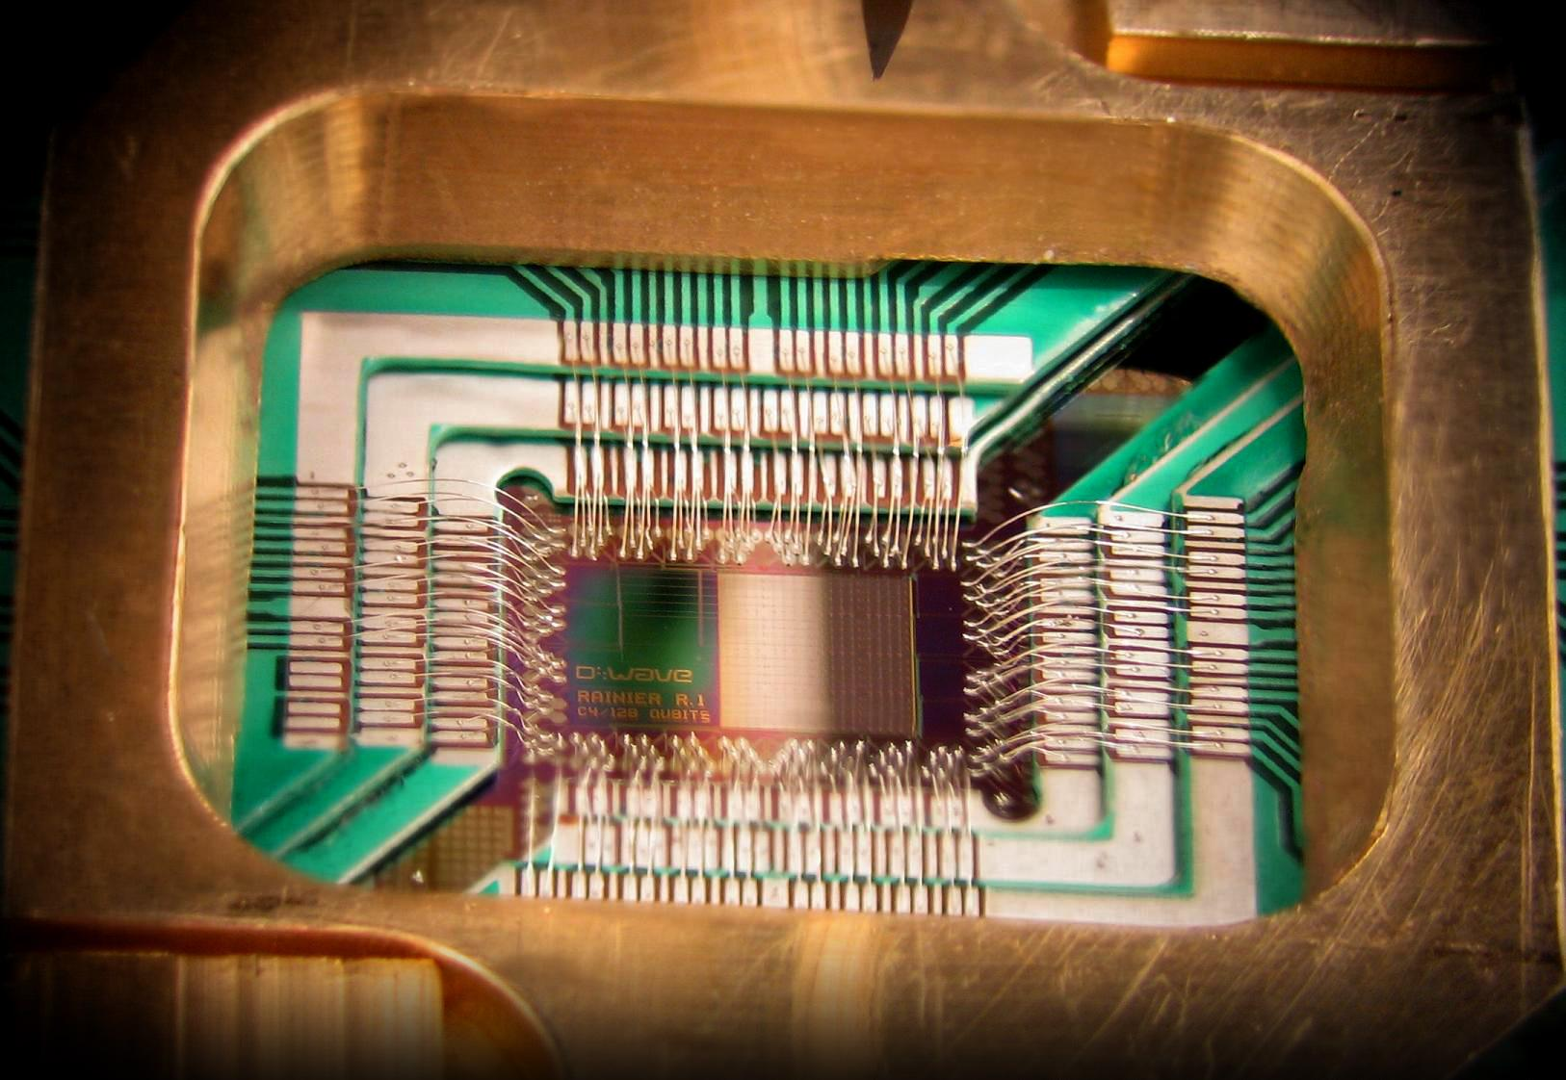
Adiabatic Quantum Computing
(“Quantum Annealers”) for
LHC Physics
Idea: map one of our optimization problems (“track finding”, a pattern recognition problem) to a Hamiltonian that can be simulated on a D-Wave quantum annealer.
Let quantum mechanics find the
global minimum of your loss function.
https://arxiv.org/abs/1902.08324
Heather Gray, ACAT 2019

Slide 29
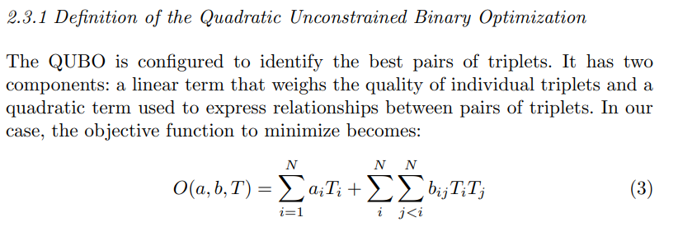
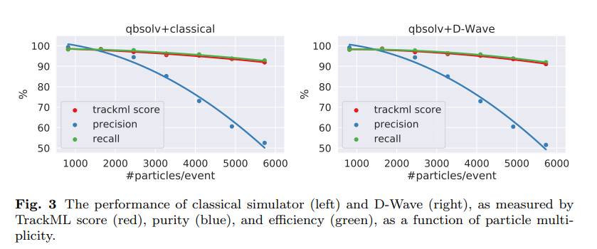
Adiabatic Quantum Computing
(“Quantum Annealers”) for
LHC Physics
https://arxiv.org/abs/1902.08324
Heather Gray, ACAT 2019

Slide 30
Machine Learning Applications @ LHC

Slide 31
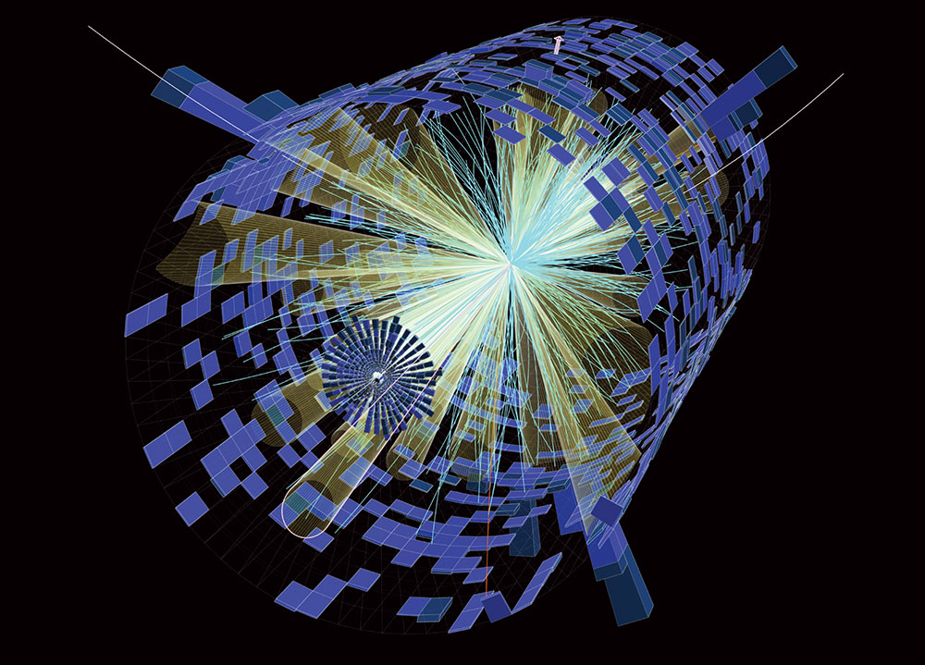
LHC’s Data Structures
Most of the times, we can think of an “event” as our fundamental data structure
An event is one “image” of a proton-proton collision
Our detectors are “layered” and use heterogeneous technologies. One event is thus the combination of many different types of detectors.
We have a gazillion such events, both “real”, measured events, and simulated events, so we can compare e.g. the measured events with certain hypothetical physics scenarios.

Slide 32
LHC’s Data Structures
We have a gazillion such events, both “real”, measured events, and simulated events, so we can compare e.g. the measured events with events from certain hypothetical physics scenarios.
We usually can treat an event to be statistically independent from any other event,
which very often makes parallelization a very easy task for us – there is usually no need for cross-talk between threads, processes, nodes.

Slide 33
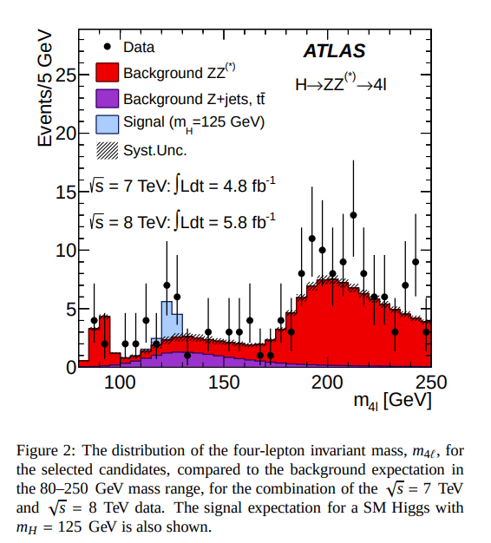
LHC’s Data Structures
Our final “physics results” are typically then given as a statement on a large statistics of “events”.
One of the “money plots” in the 2012 Higgs discovery paper by ATLAS.
The black dots show the number of events in that bin
The blue area
Indicates the excess in number of events due to
a Higgs particle,
as predicted by
theory
https://arxiv.org/pdf/1207.7214.pdf

Slide 34
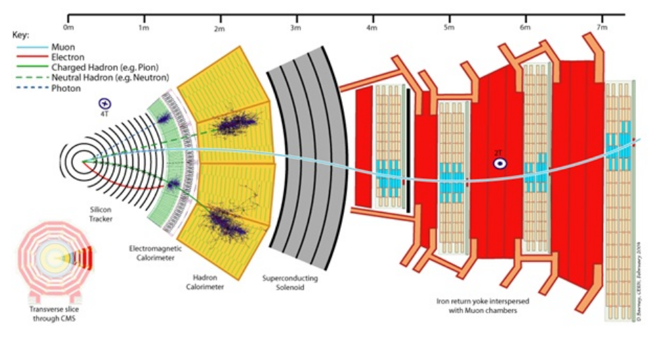
LHC’s Data Structures
We think of an event as being composed of “physics objects”:

Slide 35
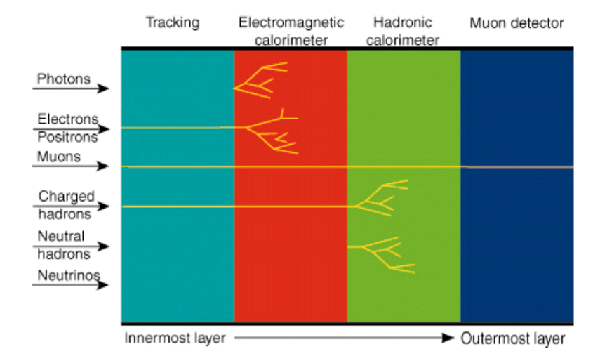
LHC’s Data Structures
We think of an event as being composed of “physics objects”:

Slide 36
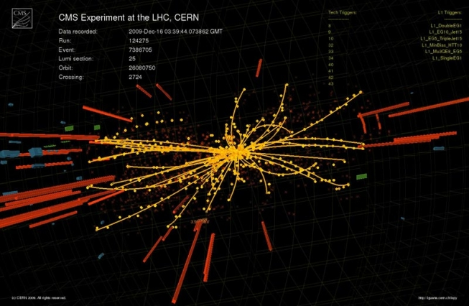
LHC’s Data Structures
In every layer, and for every physics object we have a few machine learning problems.
Innermost layer: reconstruction of charged tracks in our silicon “tracker”:
Problem: given the interactions (“hits”) of the charged particles with the silicon detectors, reconstruct (find and fit) the particle tracks. Pattern recognition as well as regression problem!

Slide 37
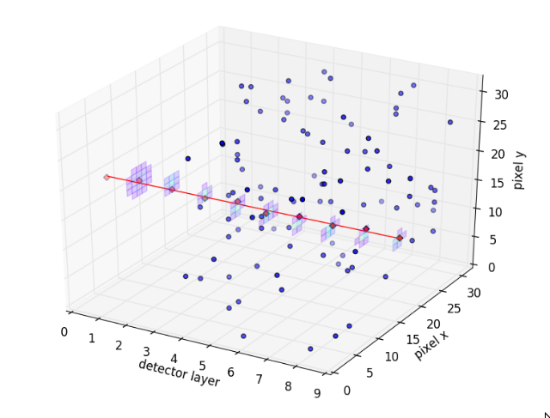
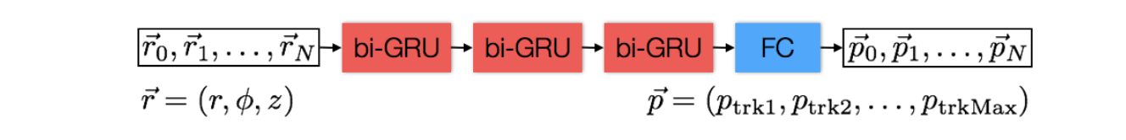
LHC’s ML Challenges
In every layer, and for every physics object we have a few machine learning problems.
Innermost layer: reconstruction of charged tracks in our silicon “tracker”:
In the past, we have used more “classical” statistical
methods, such as (combinatorial) Kalman filter,
EM algorithms, Gaussian mixture models to solve
the task.
Now also trying e.g. recurrent neural networks,
interpret the track as “something similar to a time series”
Deep Learning for Physical Sciences, NIPS 2017

Slide 38
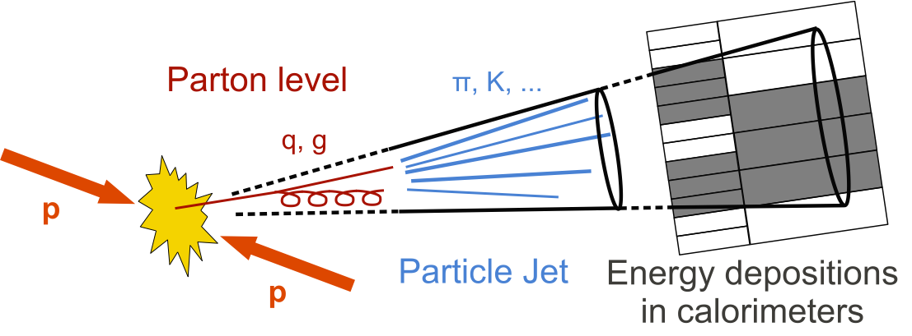
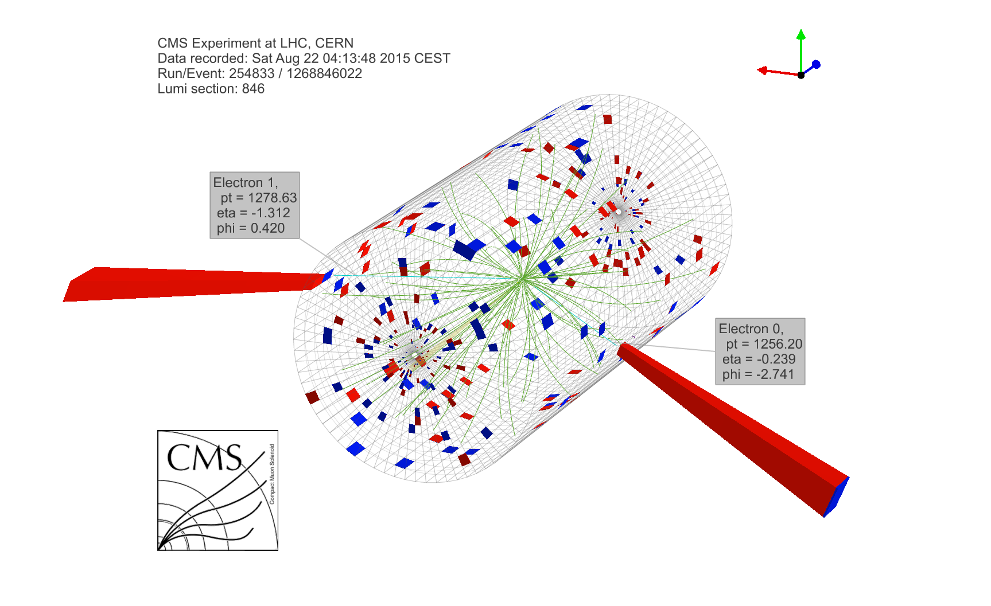
LHC’s ML Challenges
In every layer, and for every physics object we have a few machine learning problems.
Calorimeters: identification of particle “jets” (spray of particle that we see whenever quarks get produced – confinement) – and their origins
Task: learn a jet classifier
that identifies highly boosted “W” jets
In the past: many different types of physics-driven clustering algorithms for finding the jets,
simple multi-variate
Algorithms for identifying the physics process behind the jet

Slide 39
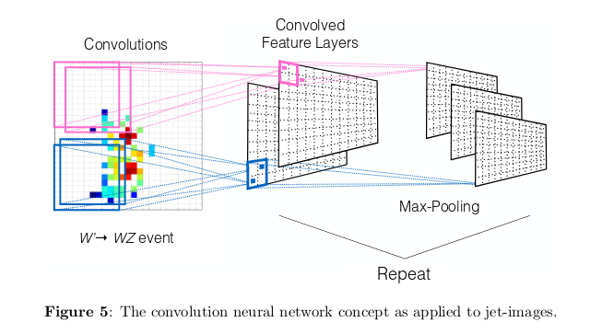
LHC’s ML Challenges
In every layer, and for every physics object we have a few machine learning problems.
Calorimeters: identification of origin of particle “jets” (spray of particle that we see whenever quarks get produced – confinement)
Task: learn a jet classifier
that identifies highly boosted “W” jets
In this paper: treat our calorimeters like an image, apply convolutional neural networks, learn difference between jets originating from gluons and quarks (“QCD”), from W bosons,
or from hypothetical new particles
https://arxiv.org/pdf/1511.05190.pdf

Slide 40
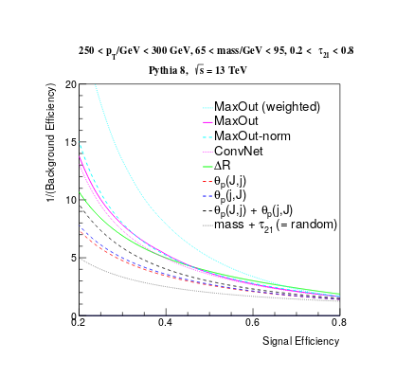
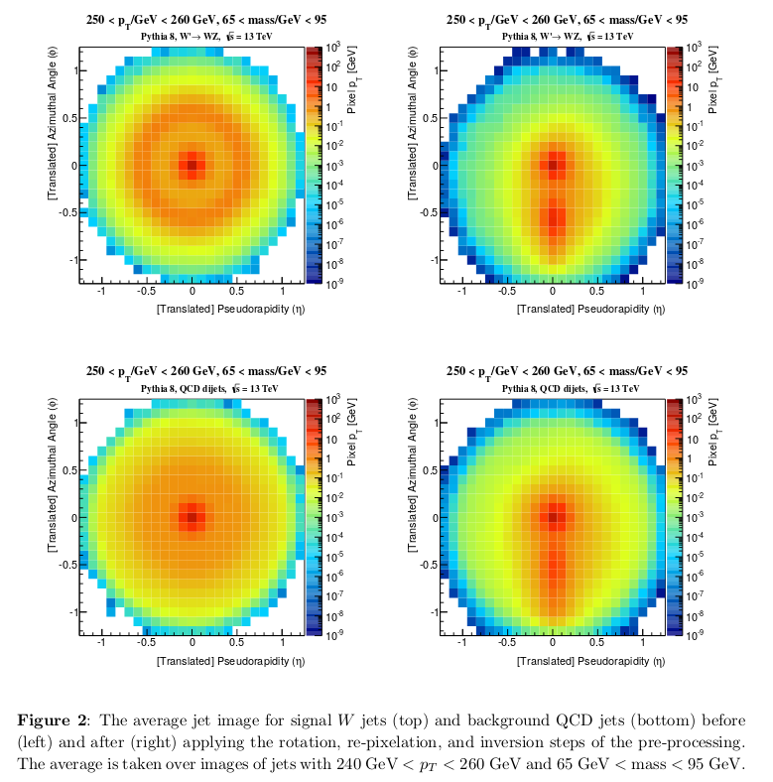
jet images
average signal
Receiver Operating
Characteristic (ROC) curves
for various choices of hyperparameters
average background
https://arxiv.org/pdf/1511.05190.pdf

Slide 41
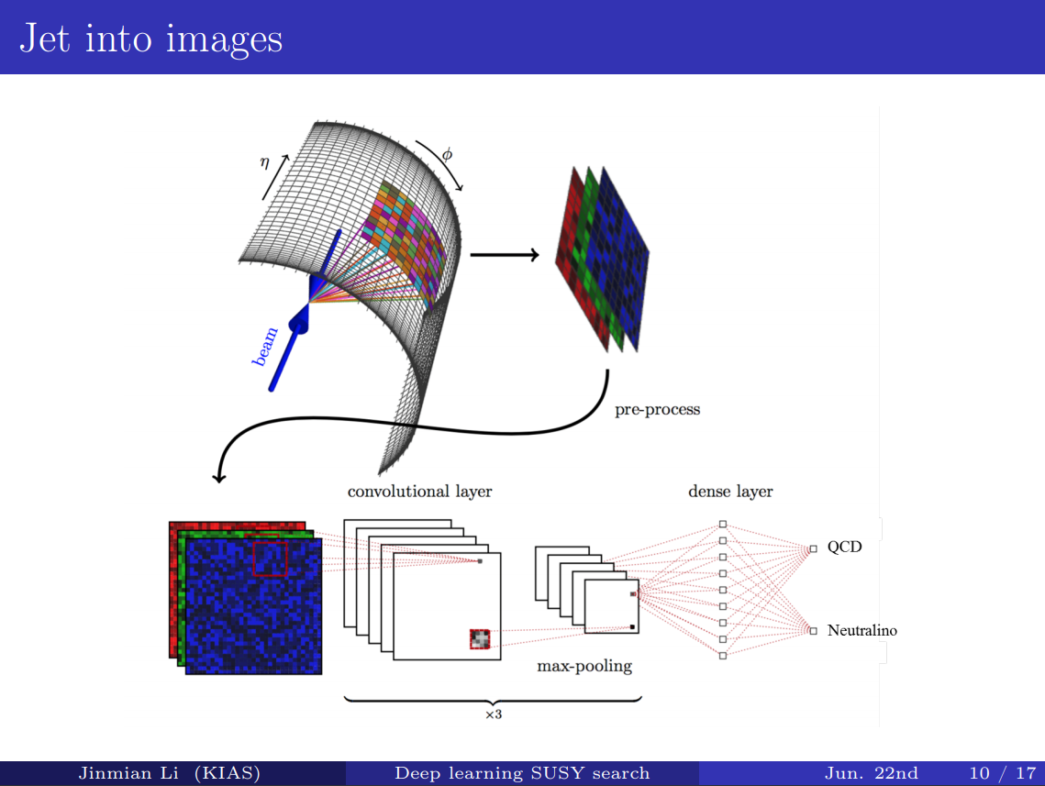

Slide 42
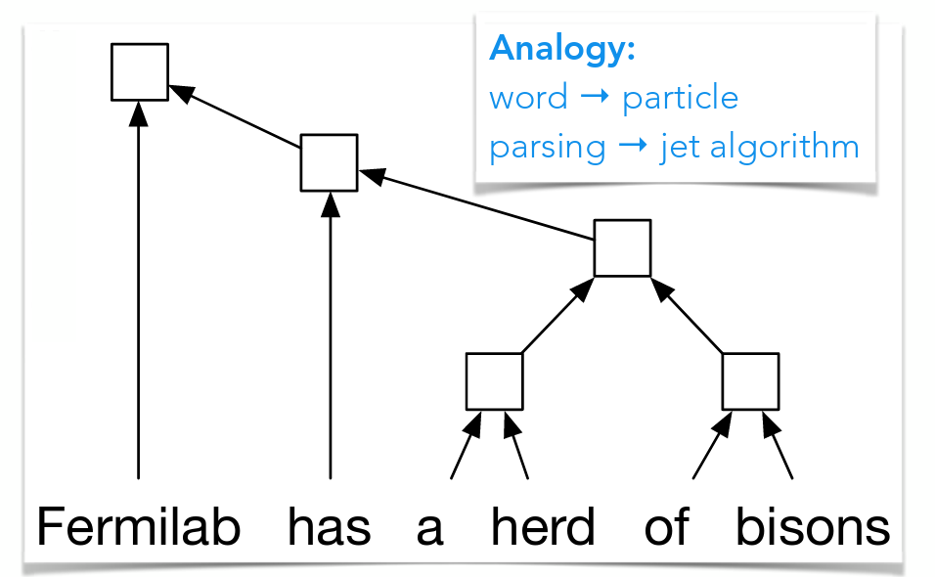
Recursive neural networks for jets
Task: learn a jet classifier
that identifies highly boosted “W” jets
Idea: this “spray of particles” that makes up a jet is somewhat reminescent of the recursive nature of parse trees and recursive neural networks – treat it similar to how you would treat a natural sentence.
See also talk at DS@HEP 2017 workshop
https://arxiv.org/pdf/1702.00748.pdf

Slide 43
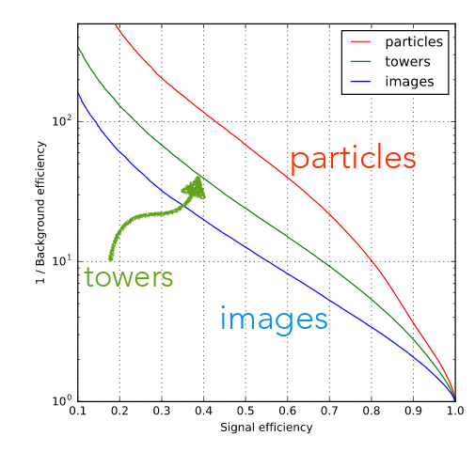
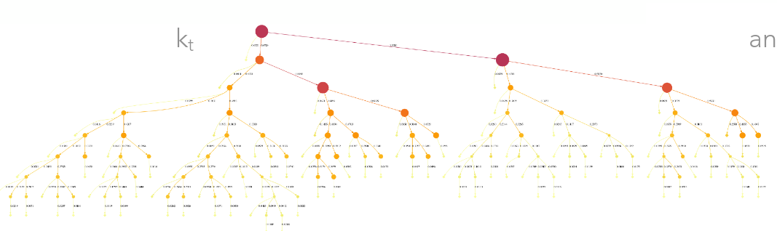
Application (of a similar class of algorithms) in particle physics: jet classification
“QCD-aware recursive neural networks for jet physics”
“better”
Visualisation of k_{t} jet algorithm.
“particles”: recursive network
“images”: convolutional network
ROC curve of W jet tagging example, comparison with jet images algorithm
See also talk at DS@HEP 2017 workshop
https://arxiv.org/pdf/1702.00748.pdf

Slide 44
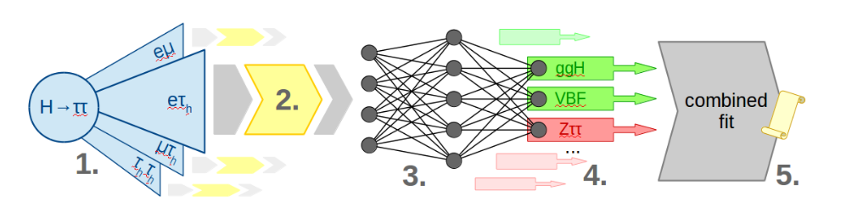
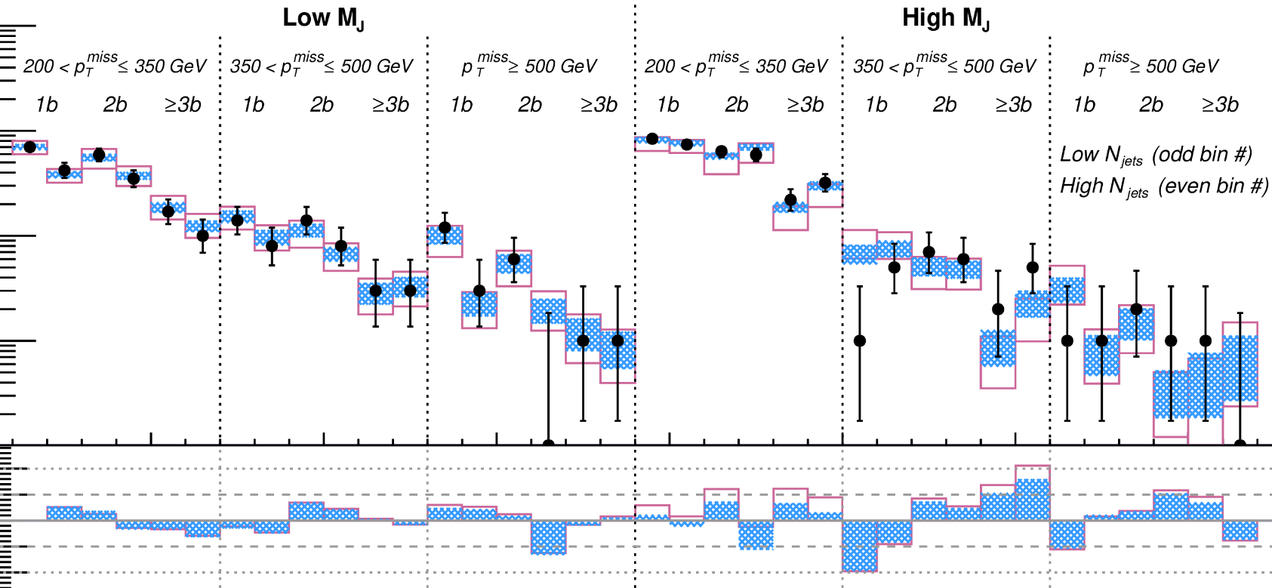
From physics objects to physics results
From these deeply-learned physics objects we then need to arrive at quantitative statements about fundamental physics, like the estimated mass of
a known particle or the level of certainty with which we exclude a certain model
beyond known physics.
Learning a classifier of the “Higgs production mechanism”, then performing a classical, frequentist maximum likelihood fit
Various different physically meaningful, hand-crafted event selections. The final steps of
A search for supersymmetry at the LHC.

Slide 45
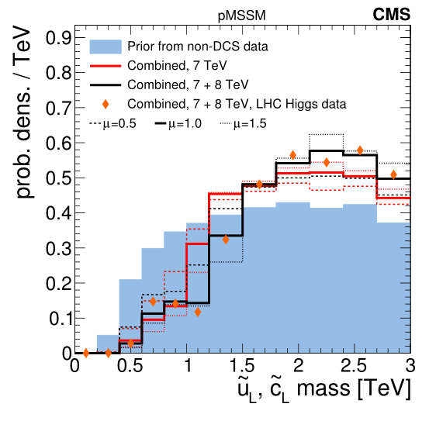
From physics objects to physics results
From these deeply-learned physics objects we then need to arrive at quantitative statements about fundamental physics, like the estimated mass of
a known particle or the level of certainty with which we exclude a certain model
beyond known physics.
arXiv:1606.03577
Our “Bayesian”, “subjective” knowledge about supersymmetry, before (blue area) and after (black and red lines) having directly searched for SUSY.

Slide 46

LHC’s ML Challenges:
Event Simulation
A roughly estimated 75% of the almost 1 Exabyte of LHC data is simulations, not measured data! Simulations for us can be costly. Why? Because we need to
1) Simulate the proton-proton collision. That’s applied, detailed quantum field theory, often at higher perturbation orders.
2) Simulate the “hadronization”, i.e. the forming of particles and particle jets from quarks and gluons.
3) Simulate the response of the detector, using e.g. Geant4 (see below). This is often enormously ressource-heavy, taking easily to 1 CPU hour per event –
And we need > billions of events!
http://geant4.web.cern.ch/

Slide 47
Event generation – Generative models to the rescue?
3) Simulate the response of the detector, using e.g. Geant4 (see below). This is often enormously ressource-heavy, taking easily to 1 CPU hour per event –
And we need > billions of events!
Possibility that generative models might help.
Problem: simulation of LHC collision events is costly
Solution: simulate smaller number of events, train e.g. generative adversarial networks on simulated events and/or real data, so you ideally you would have a hyper-fast generator of an
unbounded number of events (obviously it is not that easy, but Gregor will tell you more).

Slide 48

GANs in Particle Physics:
Fast simulation of ATLAS calorimetry (Calo GAN)
Comparison of shower shape variables, Calo GAN versus full Geant 4 simulation
See also: talk in ACAT 2017
https://arxiv.org/pdf/1705.02355.pdf

Slide 49
Preparing for the Unexpected
Remember in the very first steps of our data processing chain we already had to discard most of the events?
Problem: all our “classical” searches for new physics rely on some kind of idea of what new physics might look like. What if new physics manifests itself in a form that we did not anticipate?
https://arxiv.org/pdf/1811.10276.pdf

Slide 50


Variational autoencoders for anomaly detection
Idea: use an (variational) autoencoder to learn low-dimensional representations of a soup of “Standard Model” events. Apply to real data: flag events with high loss, they seem to be not quite as we expect events to be.

Slide 51
Variational autoencoders for anomaly detection
Idea: use an (variational) autoencoder to learn low-dimensional representations of a soup of “Standard Model” events. Apply to real data: flag events with high loss, they seem to be not quite as we expect events to be.
frequency with which
events from unknown physics are “flagged”
frequency with which
events from known physics are “flagged”

Slide 52


Honorable mentions: ML in particle physics
arxiv:1608.08225
Question: in e.g. computer vision the space of all possible image is enormous! How can machine learning with training samples < 10¹⁰ work at all?
Answer: by exploiting compositeness, locality, symmetries (e.g. ConvNets = translation invariance!), polynomial negative log-likelihoods, etc etc
A dictionary with ML terms and “similar” physics terms.

Slide 53

Honorable mentions: ML in particle physics
arxiv:1608.08225
The question of physical / thermodynamic foundations of (machine) learning arises. Can we hope to improve learning from such analogies?
Though to be fair: attempts at information theoretical groundings are currently
more hotly debated, see e.g. Tishby et al., see e.g. https://arxiv.org/pdf/1703.00810.pdf

Slide 54

Recap: reinforcement learning
(in a single slide)
Reinforcement learning has not yet taken off within particle physics.
Recap reinforcement learning:
Reinforcement learning:
The world is in a state “s” of the set of all states “S”
The agent can perform an action “a” of the set of all actions “A”.
Learn the policy “p: s → a” that maximizes expected future reward “r”.
We should see applications in “control theory” → calibration and maintenance of running detectors. But we do not. Why?

Slide 55
To repeat (I)
Particle physics in the 21st century is an Exabyte-scale endeavour
There is a seemingly endless number of applications of supervised learning problems or all stages of our data processing pipelines. Our data structures are often unusually complex, but typically fewer “layers of abstraction” are to be learned.
We use self-supervised learning techniques for
simulation of data and anomaly detection algorithms.

Slide 56
To repeat (II)
We make use of FPGAs and explore more exotic hardware.
Our theorists are using machine learning to interpolate between their calculations, to find “classes” of solutions, and for simulation.
People ponder the relationship of learning with information theory and statistical physics.
Reinforcement learning for detector control seems an interesting topic for the future.
We are (more than the experts) concerned with
estimating errors on the predictions – see next topic!

Slide 57
Next
Machine Learning in Particle Physics (II) – Uncertainties and Correlations
https://github.com/WolfgangWaltenberger/winterschool

