Slide 1
Universal approximation theorem
The “universal approximation theorem” (Cybenko, 1989, Hornik, 1991) proves, that already with a single hidden layer, we can essentially learn every continuous function (with a few mild assumptions).
So why introduce more than one hidden layer?

Slide 2
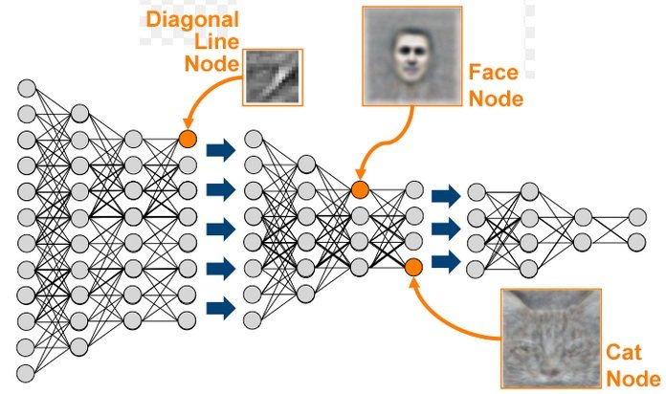
Deep learning = learning abstractions
Because when done right, a deep network can learn “abstract features” of the input data:
increasingly abstract features

Slide 3
Deep learning = hierarchical representation learning
Because when done right, a deep network can learn “abstract features” of the input data:
A layer, evaluated for data = a “representation” of the data

Slide 4

Convolutional layers
Think computer vision: we want to detect a cat,
independent of where she is in the photo: translation invariance!
Answer: convolutional layers: many several small convolution matrices (“filters”, “maps”, “kernels”)

Slide 5
Convolutional layers
Answer: convolutional layers: many several small convolution matrices (“kernels”) that “scan” over the input image, “sharing” the learned weights and thus detect features independent of their position

Slide 6
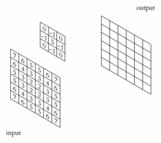
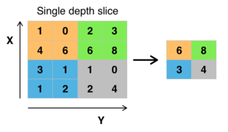
Convolutional layers
Answer: convolutional layers: many several small convolution matrices (“kernels”) that “scan” over the input image, “sharing” the learned weights and thus detect features independent of their position
Max Pooling (subsampling)
Inspired by the “receptive field” in biology
Convolutions

