Slide 1


ÖAW AI Summer School 2019
A super short introduction to
Wolfgang Waltenberger, ÖAW AI Summer, August 2019
With material mostly stolen from: https://cise.ufl.edu/~xiaoyong/materials/pytorch_tutorial.pdf

Slide 2
A pythonic open source deep learning platform that is very well suited for experimental approach and prototyping as well as production.
Easy to build big computational graphs
Automatic computation of gradients for learning
Smoothly switch between CPU and GPU
Pythonic: computational graphs are very dynamic
High execution efficiency, written in C and CUDA
All notebooks of the deep learning session are accessible via github: https://github.com/WolfgangWaltenberger/oeawai
and can be run on binder:
https://mybinder.org/v2/gh/WolfgangWaltenberger/oeawai/master

Slide 3
Pytorch can be thought of as consisting of three levels of abstraction
Tensors represent tensors of any order (e.g. a scalar is a zeroth-order tensor), technically equivalent to numpy arrays, with some additional features like the ability to put it on the GPU. Does not keep track of a “provenance”, or gradients.
Variables represent nodes in a computational graph; stores data and gradient
Models and modules eg. modules for neural networks (layers); allows for composition (a module can be composed of other modules). May store state, learnable weights

Slide 4
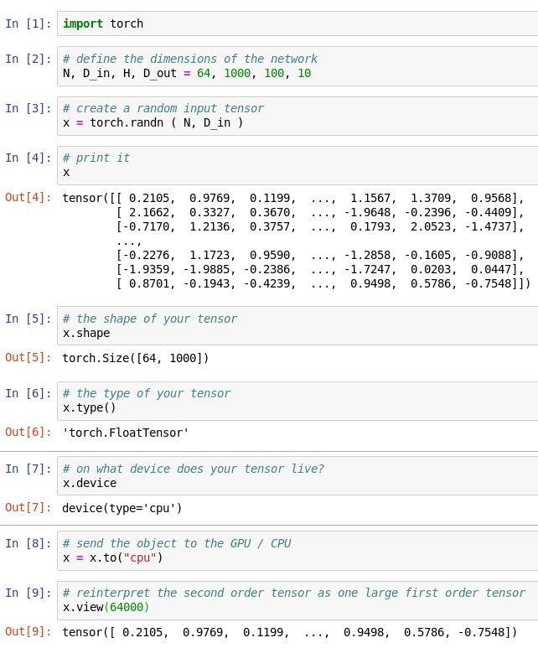
Tensors
Pytorch Tensors behave like
numpy arrays, but are designed to
run also on GPUs.
Drop-in replacement for numpy arrays:
API often exactly the same.
Pytorch can handle tensors of any order
(e.g. 0th order tensor: scalar)
No notion of computational graph,
gradients, not necessarily
tied to deep learning.
the dimensionality of the object
where does the object live? Cpu versus any of the GPUs
Move object to another device
pytorch_tensors1.ipynb

Slide 5
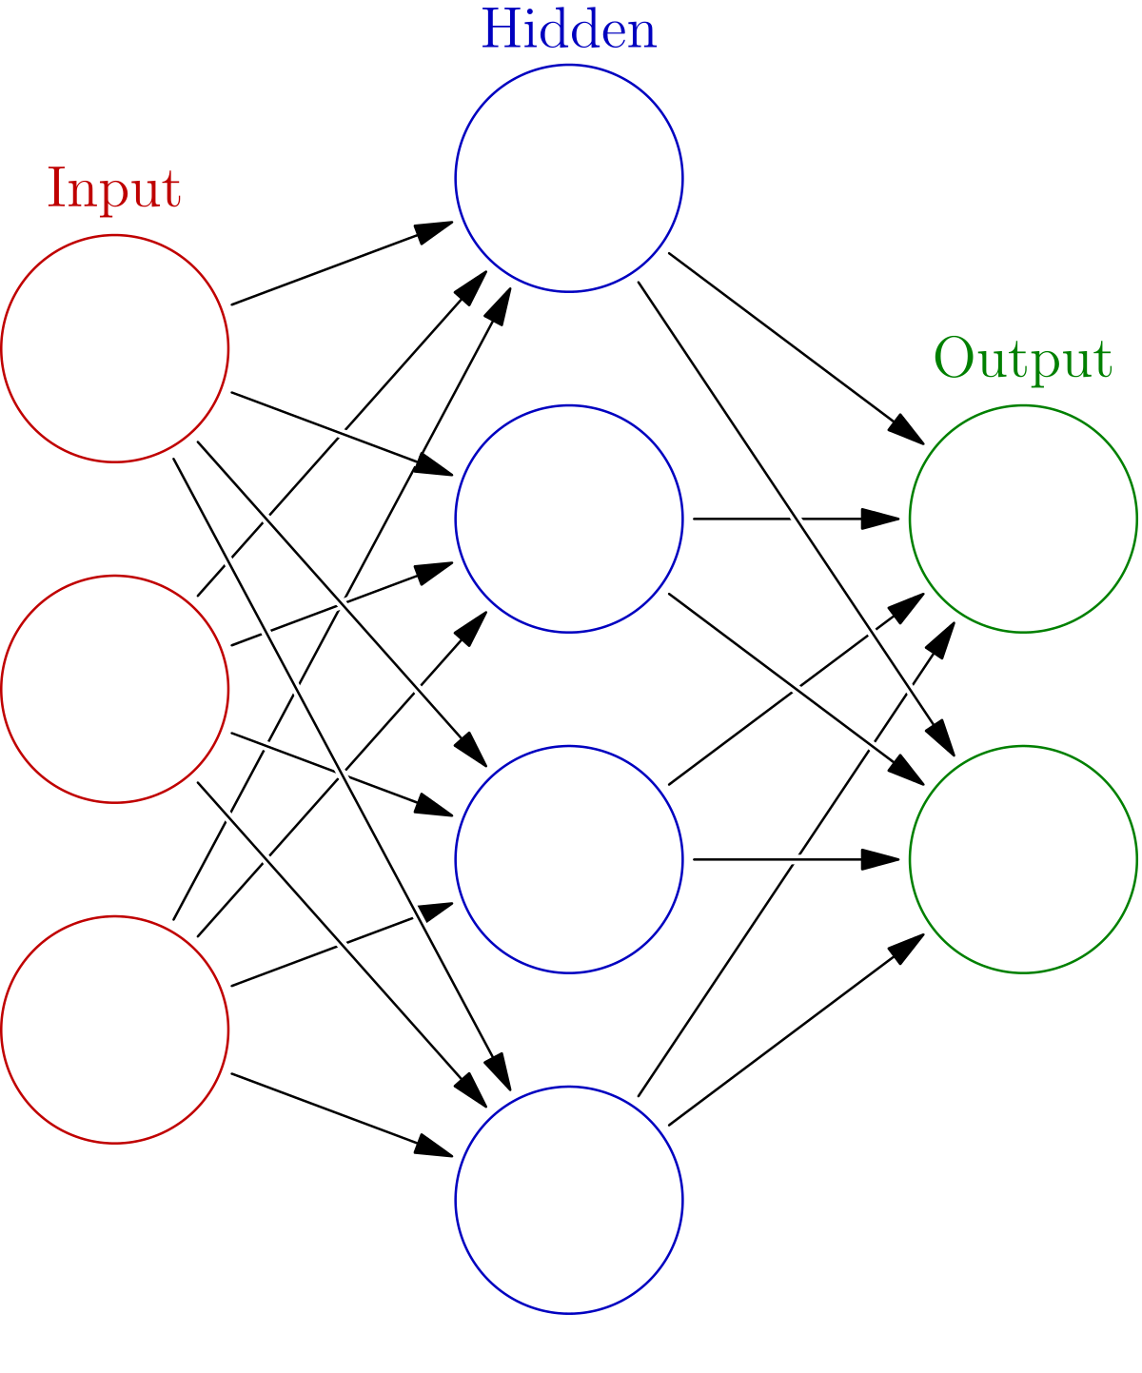
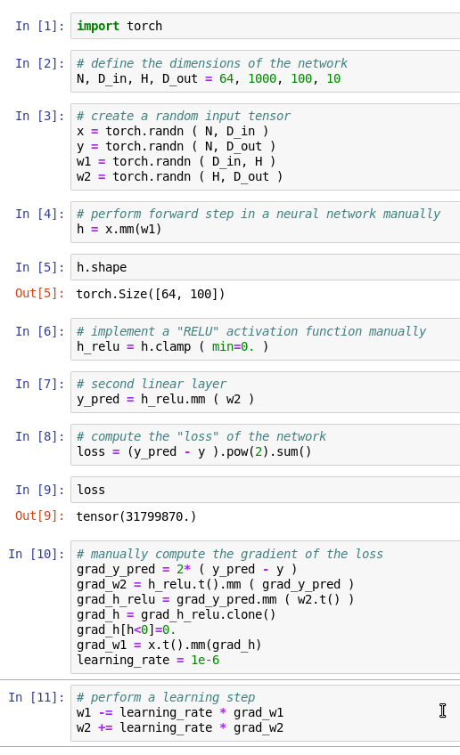
Tensors
Example: a fully-connected network with a
single hidden layer, computing the gradient
“manually”, not automatically.
“clamping” = cutting off the range of tensors. In this case all values < 0. are set to 0.
.mm() = matrix multiplication
pytorch_tensors2.ipynb

Slide 6
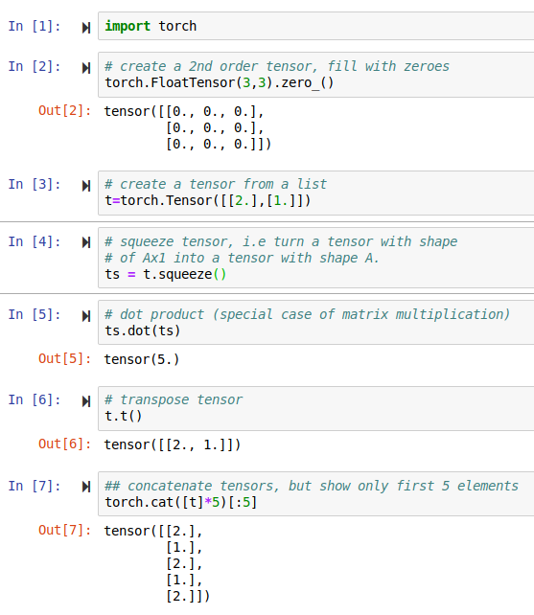
Tensors
Tensors come with
lots of functionality,
like “squeezing”
(removing dimensions
with only one element)
“unsqueezing”, “reshaping”,
“viewing”, “concatenating”,
etc
can also be written as “ts@ts”
pytorch_tensors3.ipynb

Slide 7
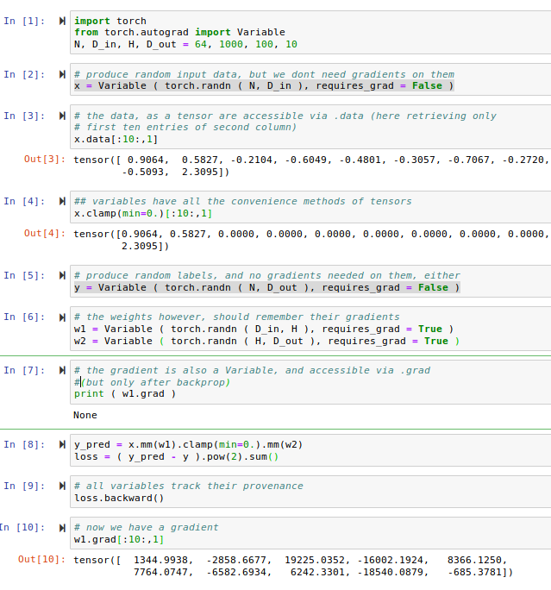
Variables
Variables are nodes in computational graphs that track their provenance, i.e. they know
how they are constructed.
The computation of the gradient comes therefore for free: automatic computation of the gradient → “autograd”.
That way, one writes “differentiable” computer programs. ”differentiable programming” as a new programming paradigm.
Variables implement the same API as tensors.
pytorch_variables1.ipynb

Slide 8
Variables
Show the gradient,
But only first 10 items, second (“,1”) column
pytorch_variables1.ipynb

Slide 9
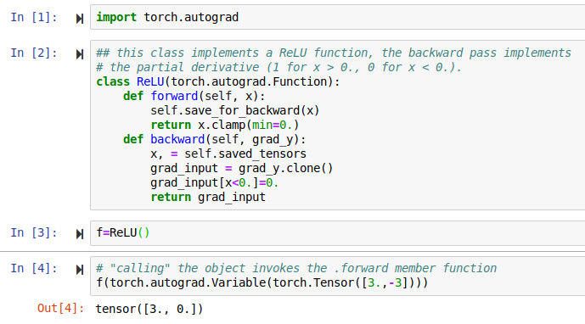
Variables
For “self-made” functions, one needs to implement the “backward” step oneself,
i.e. specify the derivative oneself.
pytorch_variables2.ipynb

Slide 10
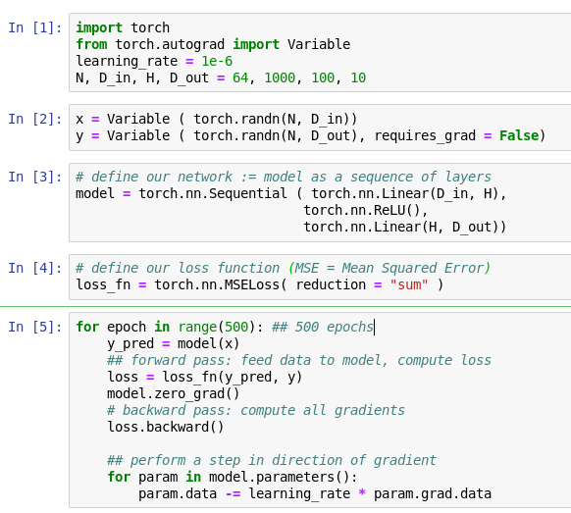
Module: nn
In PyTorch you usually define your neural network (“model”) as a sequence of layers
pytorch_module1.ipynb

Slide 11
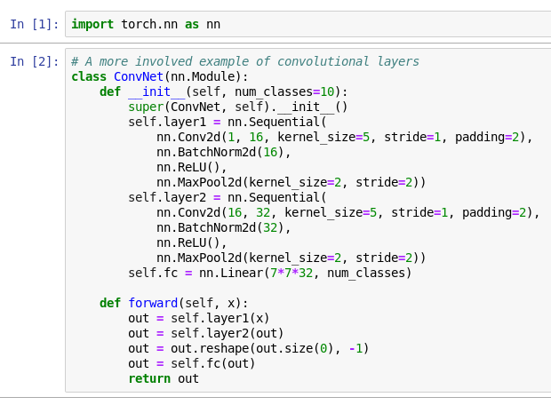
Module: nn
Here is a more involved example of a “differentiable program”
pytorch_module2.ipynb

Slide 12
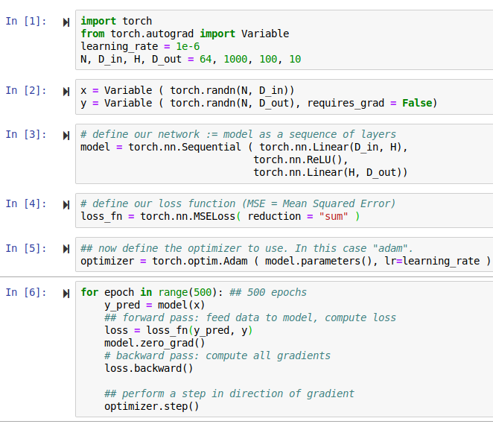
Module: optim
Pytorch optimizers live in the torch.optim module.
pytorch_module3.ipynb

Slide 13
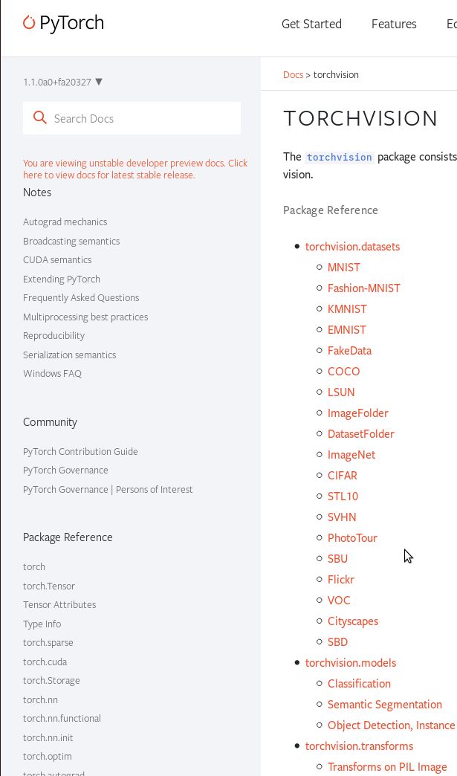
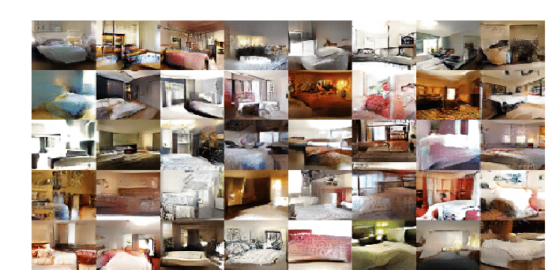
Torchvision
Torchvision is a separate python package:
pip3 install –user torchvision
It contains datasets, models and tools related
to computer vision:
Popular benchmarking datasets:
cifar, coco, lsun, mnist, etc
Default (pre-trained) networks:
alexnet, inception, resnet, vgg, etc
A few tools that are useful mostly for computer vision:
normalize, scale, pad, ….

Slide 14
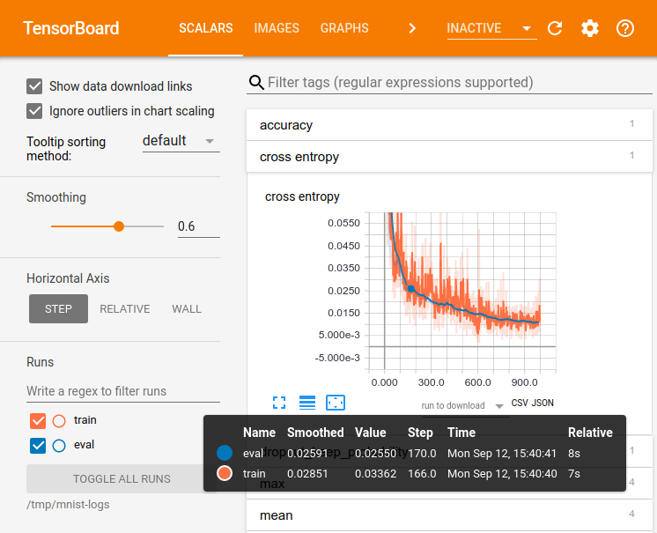
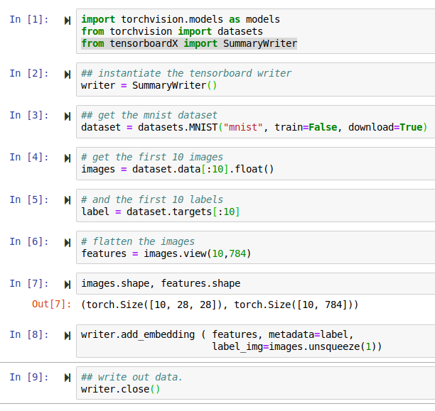
Visualization
TensorboardX
pip3 install –user tensorflow tensorboard tensorboardX
After you ran this code, do:
tensorboard –logdir runs/
pytorch_tensorboard.ipynb

Slide 15

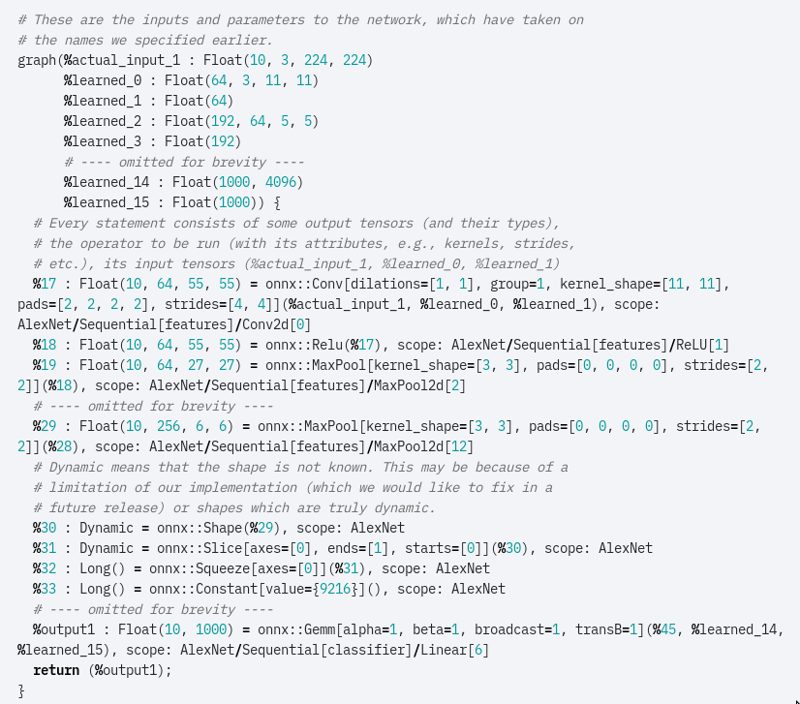





Open Neural Network eXchange
Binary open source file format to
exchange models between tools.
Supported by all major players.

Slide 16
Happy hacking!

