Slide 1
GameJam: Week 2
Team 3 Confirmed

Slide 2
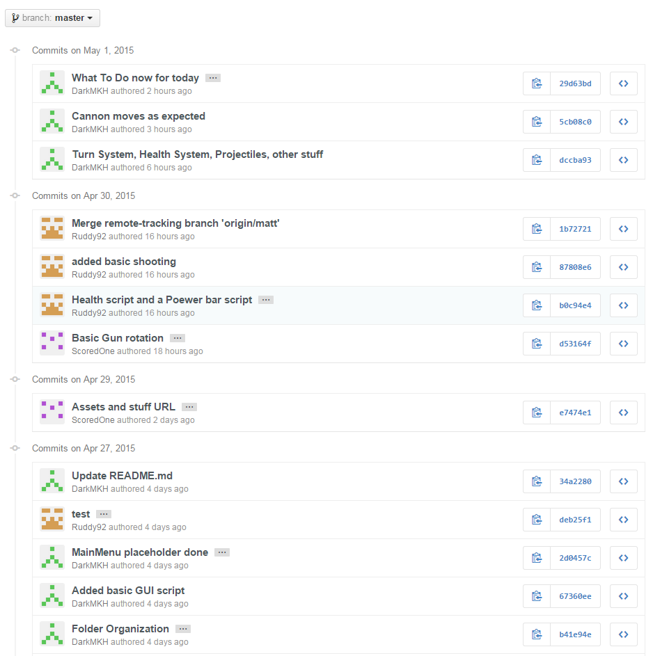
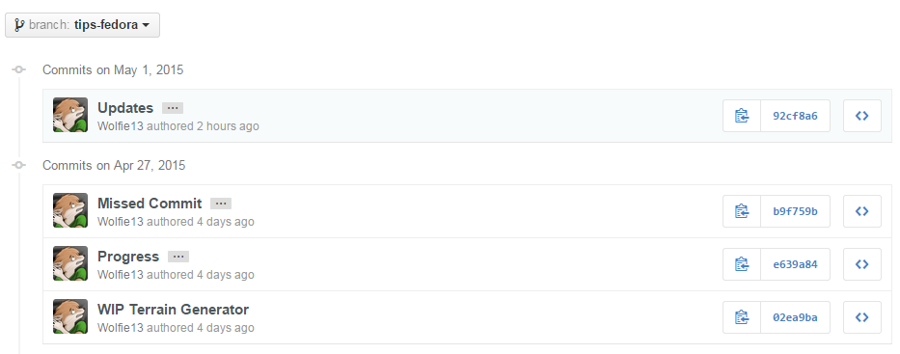
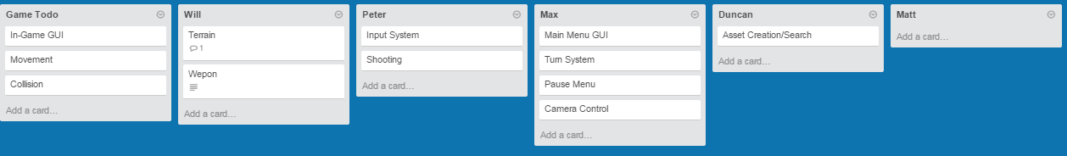
Project Organization
>> Github & Trello
>> Meetings

Slide 3
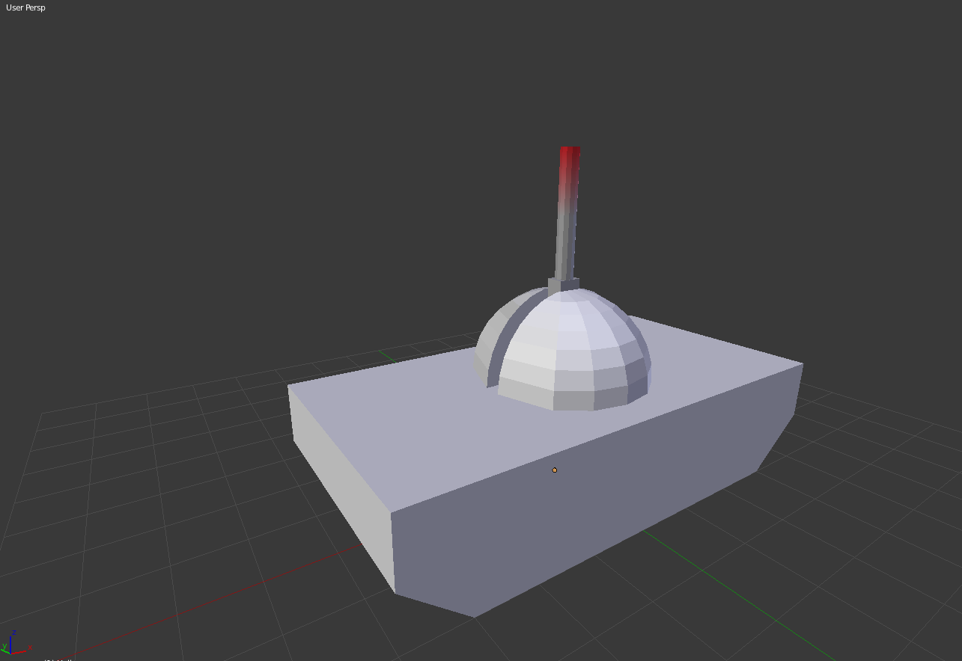
Features To Do
>> SCRUMM Backlog
>> List of features
>> Team Roles

Slide 4
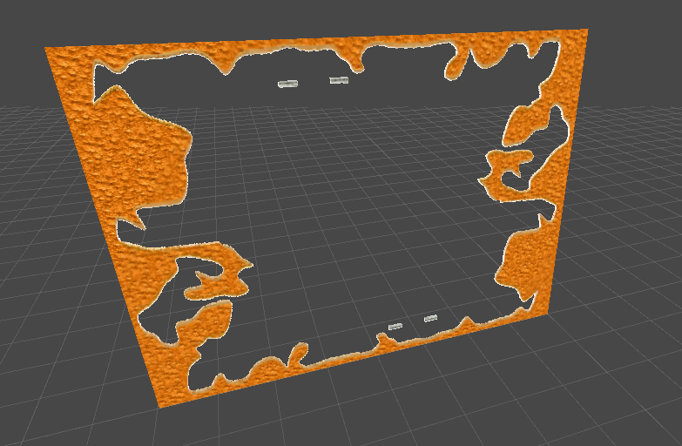
Terrain
>> Lovely
>> Dynamic
>> Original Code
>> “Fun”

Slide 5
System, GUI & Tanks
>> Turn system
>> Health System
>> Turn System GUI
>> Death
>> Input System & Basic Event Driven System
>> Camera Control
>> Main Menu
>> Entity Script & GUI

Slide 6
Project’s Future: Next Week
>> Shooting
>> Systems Integration
>> Advanced Terrain Generation & Realtime Updates
>> Skirmishes
>> Game Over & Victory State
>> Particles Effects
>> Skirmish menu

Slide 7
Thanks for listening

