Slide 1
Overview
Wolframe
Tutorial
Configurator

Slide 2
Wolframe
C++ server
Linux, Windows, FreeBSD, Solaris
Request/answer protocol
Plugable modules for database, scripting, authentication/authorization/auditing, printing, XML filters, functions
SDKs to write modules of the types above

Slide 3
Wolframe
Simple forms in data definition language
Directmap
Table definition language
Lua scripting
Generic dumb client (currently Qt)

Slide 4
Wolframe
Simple Forms
  Map XML to iterators/tables and back
  Typed, typing system is extendable via normalization functions
  Supports structures and arrays
  Data is available as iterators or tables to the data definition language or the scripting modules

Slide 5
Wolframe
Table definition language
  Formulate database operations
  Formulate database transactions
  Access to elements from the data definition with variables, loops, etc.
  Map results back into the tabular structure

Slide 6
Wolframe
Scripting layer
  Currently Lua
  For “hacking” the 5% which don't fit into the other model, e.g.
    Thumbnailing using Freeimage library
    Tree in database and iteration
    Reporting

Slide 7
Wolframe
Qtclient sends requests and gets answers
Form design is done in Qt Designer with dynamic properties on forms or on widgets
Requests and answers are in XML and have a document type

Slide 8
Tutorial
Customers (name, address)
Notes about customer (what, when)
Activities done for customers (name, start and end times)
Simple operations: add, update, delete, view, search, reports

Slide 9
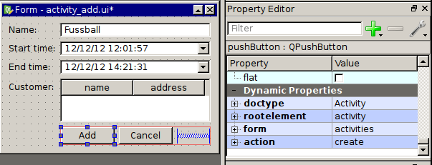
Tutorial
Define what request to generate on click of the button (activity_add.ui):

Slide 10
Tutorial
Request sent to the wolframed server:
<?xml version="1.0" encoding="UTF-8"?>
<!DOCTYPE activity SYSTEM 'Activity.simpleform'>
<activity form="Activity" id="1">
<name>Fussball</name>
<starttime>12:01:57</starttime>
<endtime>14:21:31</endtime>
<customer id=”5”>Hubertus Gloor</customer>
</activity>

Slide 11
Tutorial
The request is matched against the form definition (Activity.simpleform):
FORM Activity
{
activity
{
id ?@int
name string
starttime string
endtime string
customer {
id @int
_ ?string
}
}
}

Slide 12
Tutorial
Distribute the request to the right handler in the server (tutorial.directmap):
createActivity = CreateActivity( xml : Activity );

Slide 13
Tutorial
Definition of what should be done in the DB:
TRANSACTION CreateActivity
BEGIN
DO INSERT INTO Activity( name, starttime, endtime,
customer_id )
VALUES( $(activity/name), $(activity/starttime),
$(activity/endtime), $(activity/customer/id) );
END

Slide 14
Configurator

