Slide 1
Social Network Analysis 658 – B Final Project
Instructor: Prof. Rong Duan
Dun Wang
Huanran
Liye Pan
Tailun Song
Xianqiao Li

Slide 2

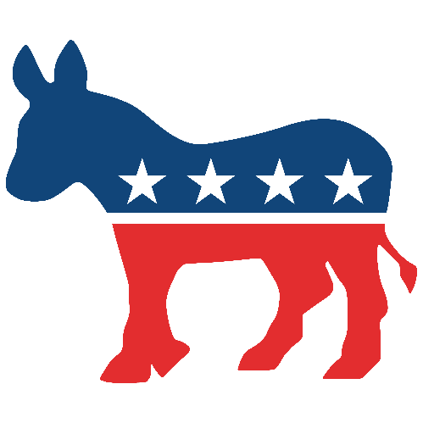

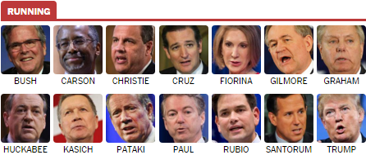
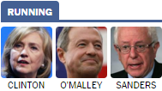
2016 United States Presidential Election
The 45th president of the United States will be elected on Nov. 8 2016
100 votes from Congress, 435 vote from Senators and 3 votes from District of Columbia electors
Winner gets all the votes from winning states
270 votes to WIN
President and VP are elected together
Republican Candidates
Democratic Candidates

Slide 3

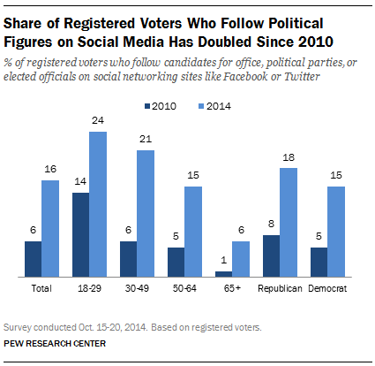
Social Media and Politics
“Candidates in the 2016 U.S. presidential election use more social networks than politicians of the past, in hopes of tapping the millennial market.” -- CIO
Obama used Facebook election to connect with public in 2008.
Marco Rubio broadcasts “Snapchat Stories” at stops along the trail.
Hillary Clinton and Jeb Bush spar over student debt on Twitter.
Rand Paul and Lindsey Graham produce goofy YouTube videos.
Bernie Sanders has attracted nearly two million likers on Facebook.
Both Hillary Clinton and Donald Trump have over 4 million followers on Twitter

Slide 4
Project Purposes
Detect the most influential person in a particular community
Detect relationships between users in a specific geographical location (i.e. States, County, Town etc.)
Unlock any interesting phenomena

Slide 5



Data Collection & Preparation
Process
Use Twitter API and Python code to access politician’s IDs, followers’ IDs of each politician and their respective location information
Set up database on Amazon and store collected data in the database
Link database to MySQL and create table for each politician in MySQL
Randomly sample 1% from the data collected and store in MySQL table
Amazon RDS

Slide 6
We expect that…
A user would follow more than one candidates within the same party
A user would follow more than one candidates from different parties
People living in the same region might have the same political preferences

Slide 7
Data Processing -- random selection
Premise:
Use random group sampling method to select 1% samples from the population
Remove duplicate samples
Compare the difference
Random samples | Remove duplicate samples | Difference | Rate
156863 | 155911 | 952 | 0.61%
156856 | 155822 | 1034 | 0.66%
157602 | 156632 | 970 | 0.62%

Slide 8
Data Processing
Premise:
Compare Hillary’s followers with Trump’s followers
Remove the duplicate followers
Compare the difference
Hillary | Trump | Total Number | Difference | Rate
4,742,474 | 4,181,164 | 8,923,638 | 445,909 | 5%

Slide 9
Data Processing -- random selection
Premise:
Randomly select 1% samples from Hillary’s database and Trump’s
Remove duplicate samples
Compare the difference
Random samples | Remove duplicate samples | Difference | Rate
89181 | 89139 | 42 | 0.047%
89458 | 89414 | 44 | 0.049%
88754 | 88703 | 51 | 0.057%

Slide 10
In Fact
Only a small amount of users follow more than one candidate
Most users’ political preferences are clear

Slide 11
Analysis Process
Getting Location Data
Data Normalization
Data Visualization

Slide 12
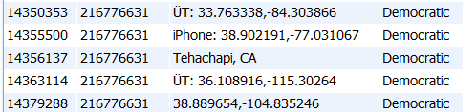


Location Data Normalization
Realized by Fuzzy Lookup in SQL:
But when looking up State of Michigan:

Slide 13
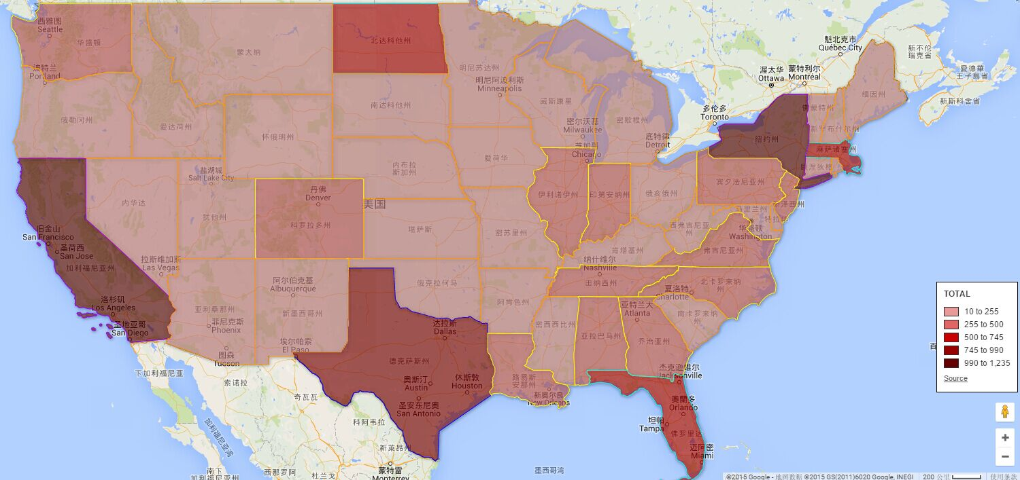
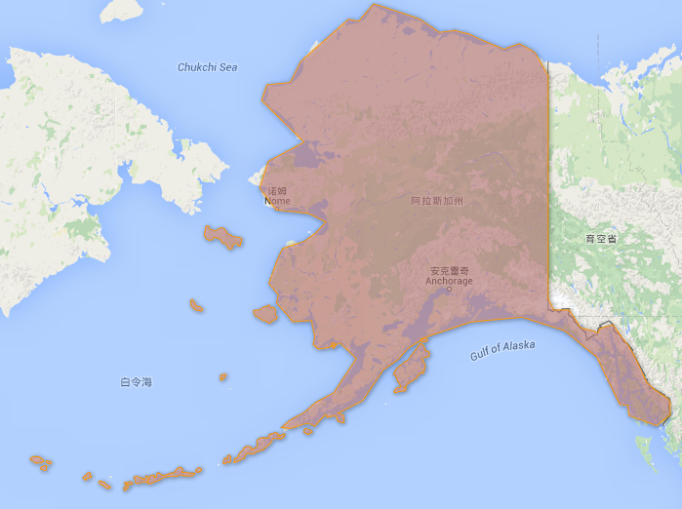
Sample Population Distribution in State Level
https://www.google.com/fusiontables/DataSource?docid=1qdaSGMHckgmVaZMu1P2_nGxyhcONFYapab8cDkDw

Slide 14
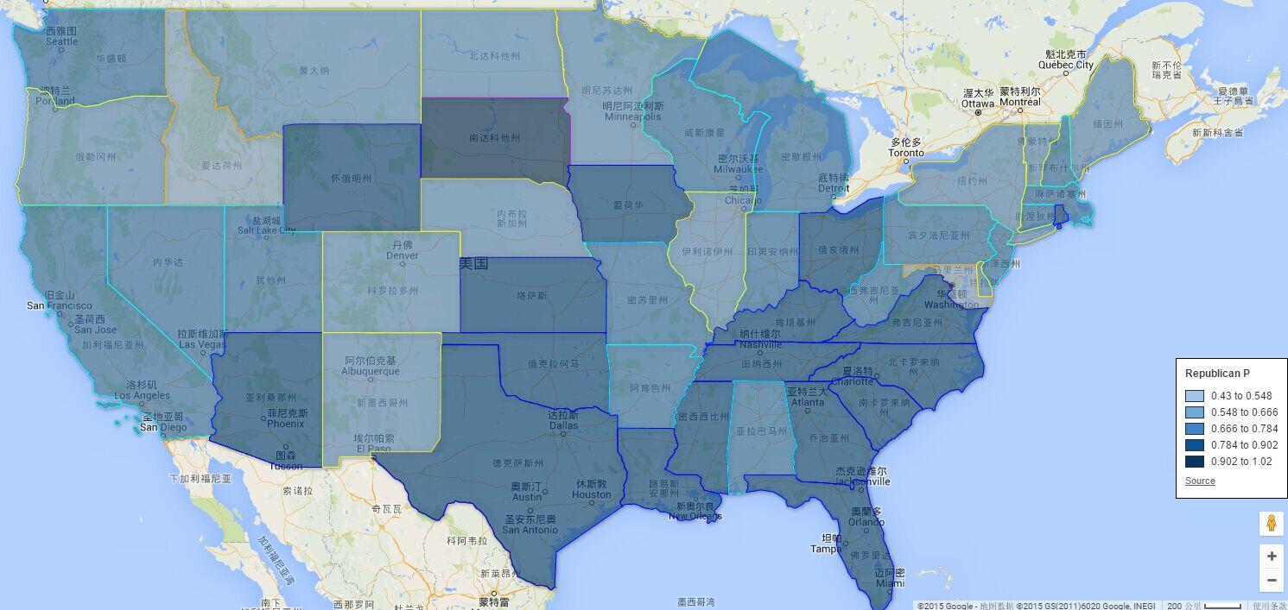
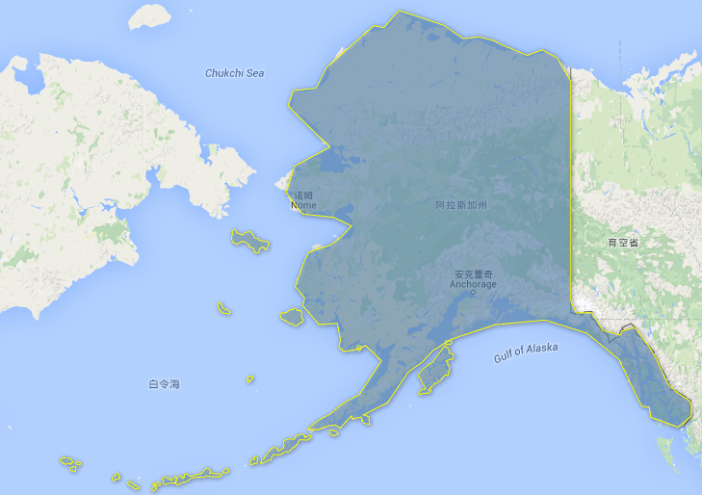
Distribution of Party Preferences in State Level
https://www.google.com/fusiontables/DataSource?docid=1qdaSGMHckgmVaZMu1P2_nGxyhcONFYapab8cDkDw

Slide 15
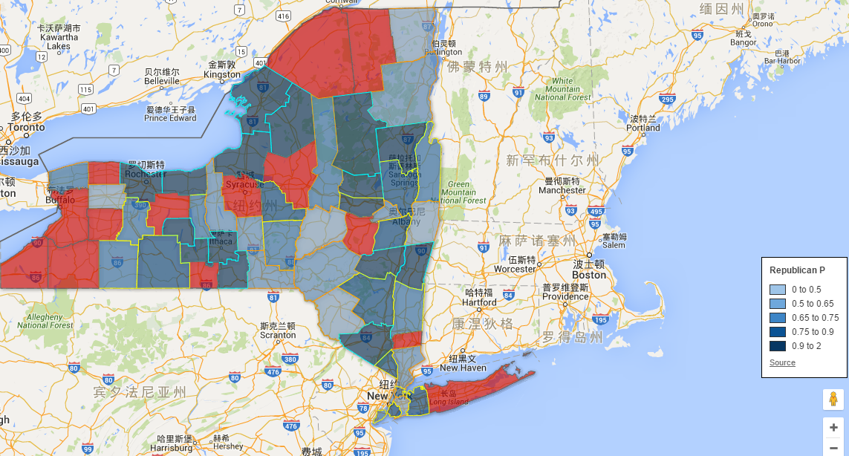
Distribution of Party Preferences in County Level
-- New York State
www.google.com/fusiontables/DataSource?docid=10Hk9tv9zSI-V5nCFxC5A55Wg5cz-BlGwvVLfnWuy

Slide 16
Social network Relationship
Gather the followers’ data in NY, CA
Data includes twitter_id, candidate_id, party

Slide 17
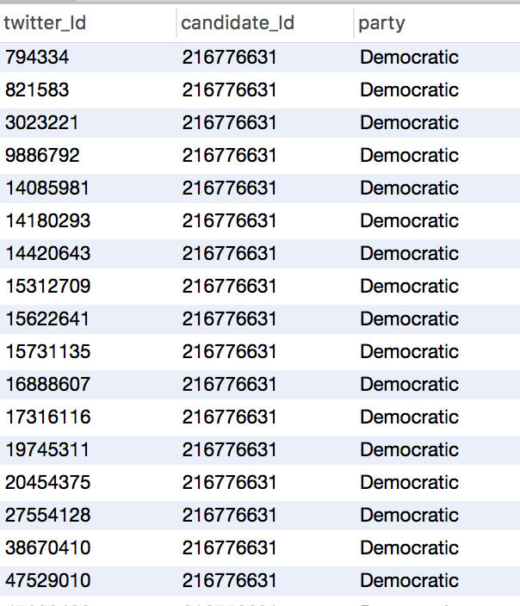
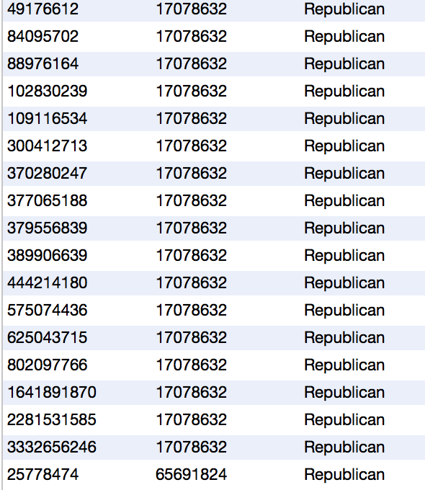
Example

Slide 18
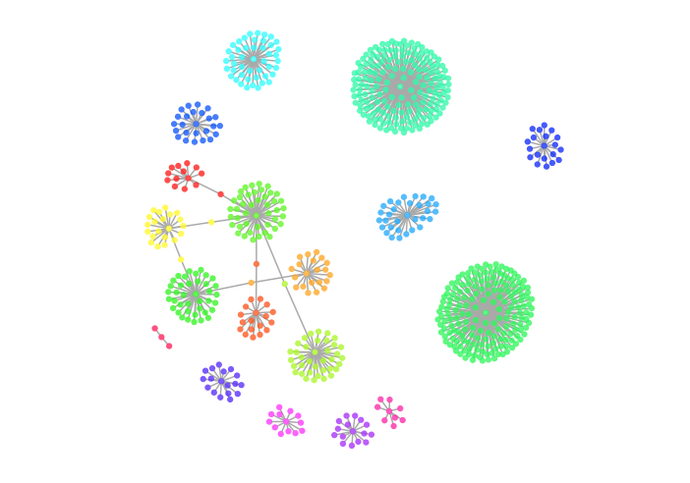
Social Network Relationship in NY
724 accounts in this dataset
Use igraph to plot
Use walktrap.community in igraph to implement community detection.
Only a few accounts follow more than one candidates in democratic party
Trump
Democratic
Hillary

Slide 19
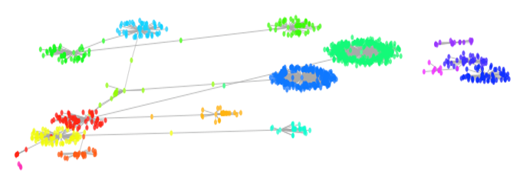
Social network relationship in CA
1148 accounts in this dataset
Some accounts follow more than one candidates

Slide 20
Tools Used
Python, MySQL, Twitter API, Amazon Database
R to draw relationship map
Google fusion table to map the data

Slide 21
Challenges Encountered
Over 15 millions records extracted
More than 50 hours spent
Continuous improvement on coding and its efficiency
Differences in languages used (i.e. Software incompatible with certain languages)

Slide 22
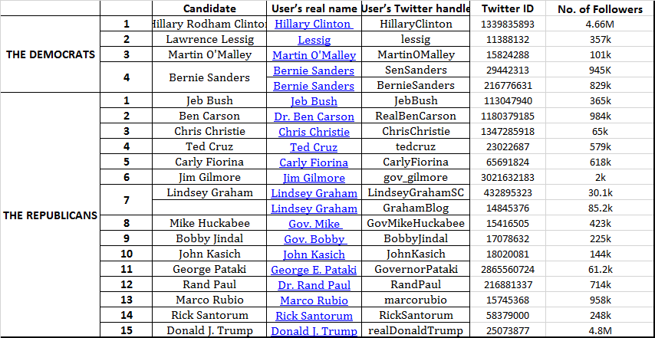

Slide 23
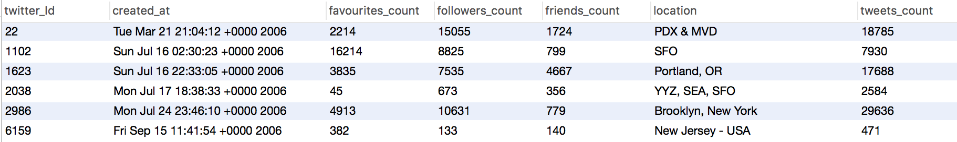
Limitations and Further Use
Gather followers’ other attributes and determine whether a particular account is inactive
For example we can choose two attributes:
Friend density = friends_count/registered days
Active level = tweets_account/registered days
Since these attributes are independent, Naïve Bayes classifier can be used to judge whether the account is fake

Slide 24
Questions?

