Slide 1


L&MT TOOLS RENTAL
2023/10

Slide 2

CONTENTS
4
2
DOCUMENT
DESIGN
3
1
DEMO
INTRO

Slide 3
1
INTRODUCTION?
part
Part 1

Slide 4
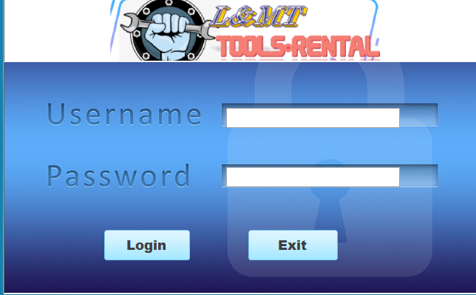
L&MT RENTAL TOOLS？
The proposed system is an all-in-one tool rental and order management platform that comprises four fundamental components: user management, employee management, tool management, and order management. It enables users to register, manage their profiles, and ensures. Employee management facilitates staff onboarding, scheduling, and role-based access control. Tool management maintains an organized catalog of rental tools, while order management covers the entire order lifecycle, from creation to fulfillment. This integrated solution aims to optimize tool rental operations, streamline employee workflows, enhance customer experiences, and maintain accurate inventory records.。

Slide 5
OUR TEAM
Liping Wang, Ting Cheng, Mint
P
A
D
C

Slide 6
2
DESIGN
part
Part 1

Slide 7
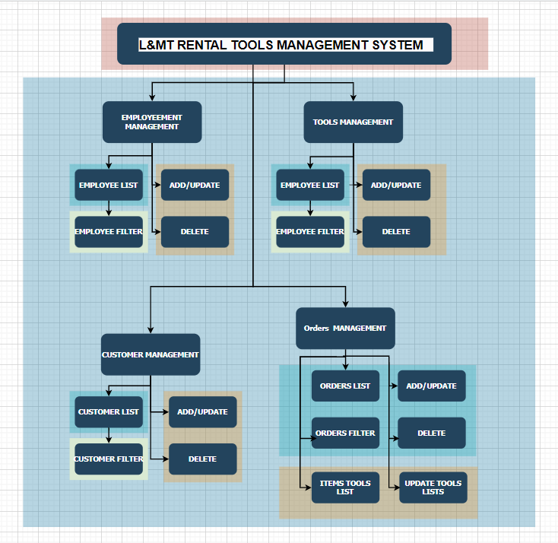
L&MT RENTAL TOOLS？

Slide 8
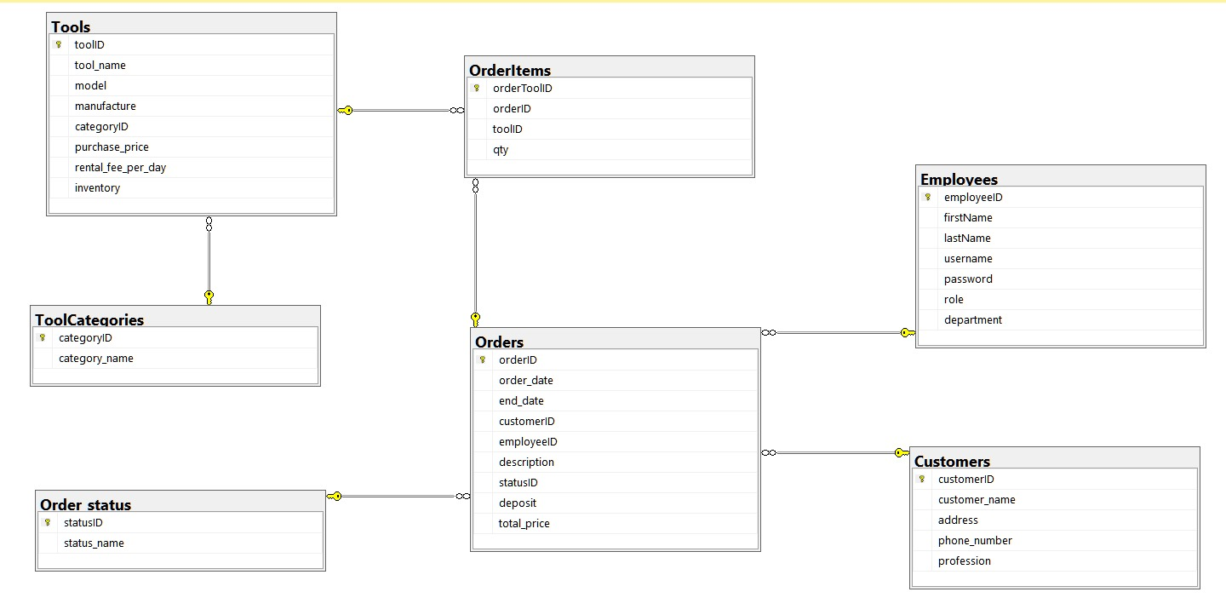
E-R DESIGN

Slide 9
3
APPLICATION
DEMO
part
Part 1

Slide 10

DEMO
INSTALLATION
BACKUP
APPLICATION
DOCUMENT

Slide 11
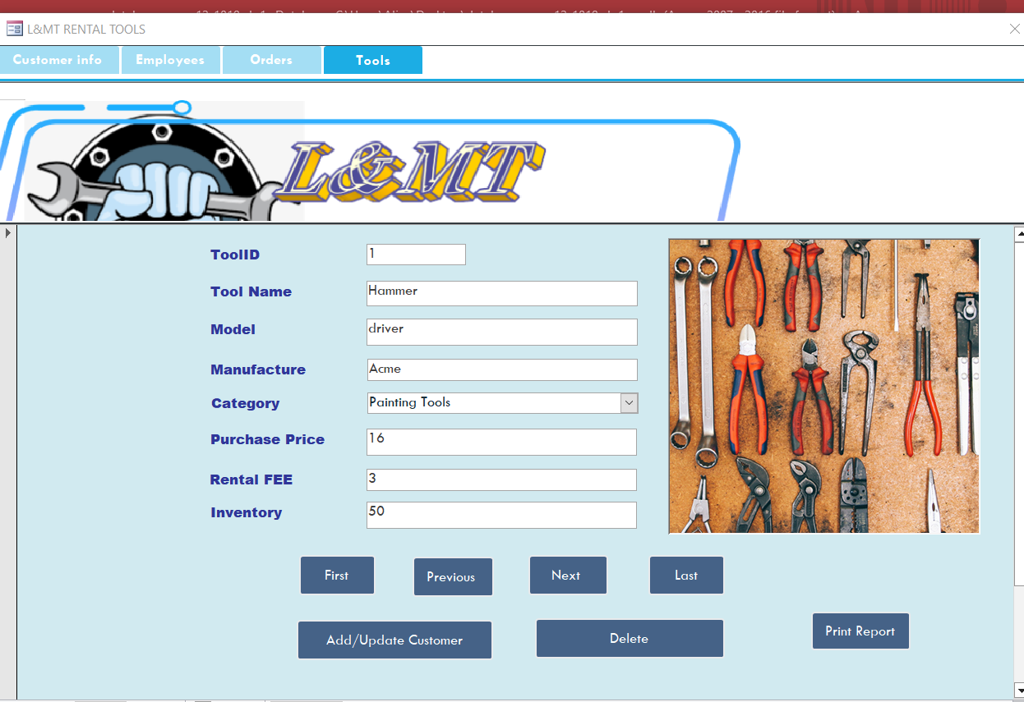
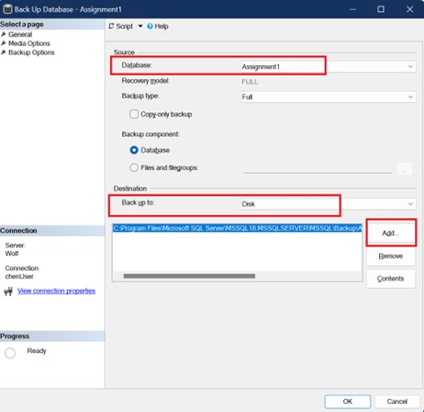
DEMO

Slide 12
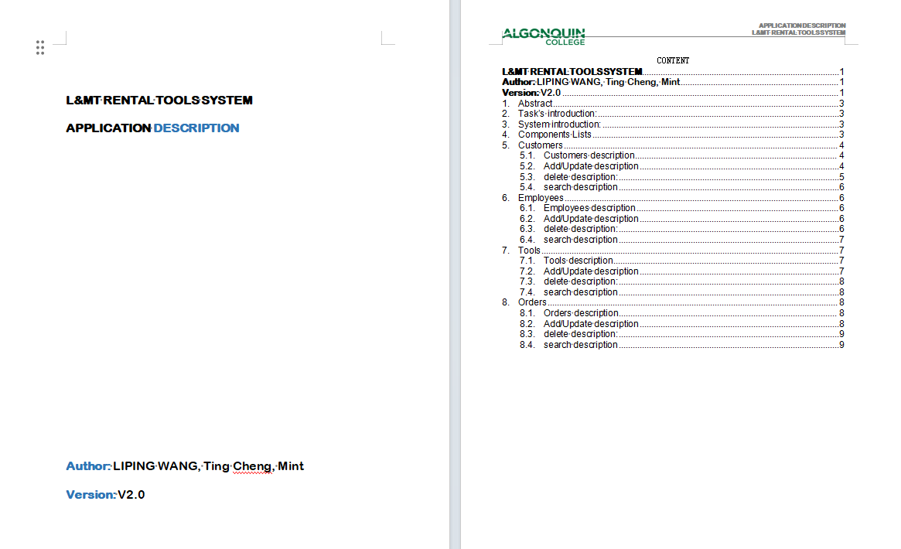
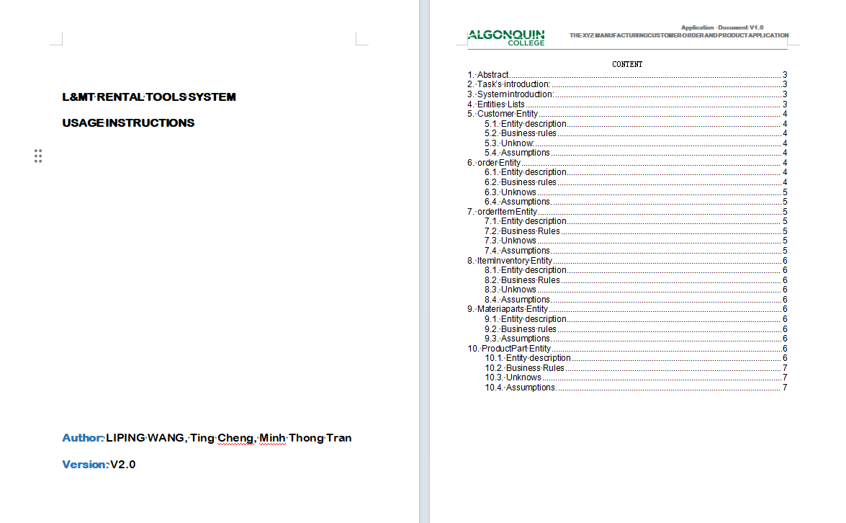
DEMO

