Slide 1
Ch 4 – Representation of Technical Information
Data recording, tabulation
Type of graphs – Picto, Bar, Pie, Line, etc.
Graphs and Plots – Data points, Labeling
Axes locations, Breaks in graphs
Line graphs vs Scatter plots.
Plot types – Linear, Log-log, Semi-log, others.
Curve fitting – Least square, Spline
Curves – Linear, Polynomial, Exponential, etc.
Empirical formulas

Slide 2
Data Representation
Tables : Show sets of data in an organized fashion, to allow easy comprehension.
Plots, Graphs : Visual enhancement to allow further comprehension.

Slide 3
Tables
Although frequently used for numerical data, this is not always the case, e.g., assignments for your engineering topics :
Engr130 – 2nd Research/Presentation Assignment
Engr Topic | Assignees
Mach Number | Mahmoud | Fadi | Wang
Froude Number | Ahmed | Abdo | Cody
Reynolds Number | Jacob | Mohamed | Amer
Bernoulli’s Equation/Principle | Damarius | Dean | Mike
Wet-Bulb Temperature | Ceasar | Justin | Seif
Latent Heat | Rayed | Masood | Khaled
Relative Humidity | Kyle | Darrion | Jon

Slide 4
Tables with Numeric Data
Tables with discrete, non-ordered categories, e.g., count of fruits in a basket :
* “non-ordered” : the order of how the
fruits is listed has no effect to data.
Tables with discrete, ordered categories, e.g., hours worked per day of wk,
Apple | 6
Banana | 4
Grapes | 3
Orange | 5
who | Monday | Tuesday | Wednesday | Thursday | Friday | Saturday | Sunday
Joe | 8.0 | 9.3 | 9.3 | 9.0 | 8.0 | 0.0 | 0.0
Babba | 8.0 | 8.0 | 0.0 | 8.0 | 8.0 | 5.0 | 8.0

Slide 5
Tables with Numeric Data
Tables with discrete, non-ordered categories vs discrete, ordered categories, e.g., percent of time devoted to activities, by age groups :
 | Arts | Sports | Work
18-24 | 15.0% | 28.0% | 9.5%
25-29 | 17.5% | 28.0% | 28.5%
30-39 | 29.0% | 11.5% | 33.0%
40+ | 37.5% | 33.0% | 28.5%

Slide 6
Tables with Numeric Data
Tables showing relations between sets of data, e.g., sets of measured values of 2 variables. These sets may be measurements of
Same variables over time, at fixed time intervals, i.e., trends.
Correlated variables.
etc.
E_{e} | E_{g}
7.0 | 1.3
6.1 | 1.7
5.6 | 1.9
5.3 | 2.0
5.2 | 2.0
5.5 | 1.8
6.9 | 1.2
9.4 | 0.7
11.6 | 0.3
12.2 | 0.1
11.9 | 0.2
10.5 | 0.4
8.4 | 0.9
G | U
9.33E+02 | 2.04E+07
2.09E+01 | 3.72E+03
2.34E+01 | 2.14E+04
1.51E+01 | 2.69E+03
1.66E+01 | 3.31E+03
6.46E+00 | 2.29E+02
6.03E+00 | 8.51E+02
3.09E+01 | 1.20E+05
1.58E+01 | 2.95E+04
6.76E+01 | 1.95E+06
1.66E+02 | 1.10E+07
1.07E+02 | 8.32E+06
5.75E+01 | 7.08E+05
3.55E+02 | 3.63E+07
1.00E+03 | 6.61E+08
1.12E+03 | 2.19E+08
8.51E+02 | 3.09E+08
1.17E+03 | 3.55E+09

Slide 7
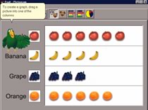
Pictograms
Pretty, but not particularly effective nor useful.
Apple | 6
Banana | 4
Grapes | 3
Orange | 5
*Graph used without permission*

Slide 8
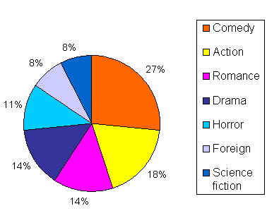
Pie Charts
Pretty, good for show-and-tell, but not particularly useful.
Depending on arrangement of wedges, perception varies.
*Graph used without permission*

Slide 9
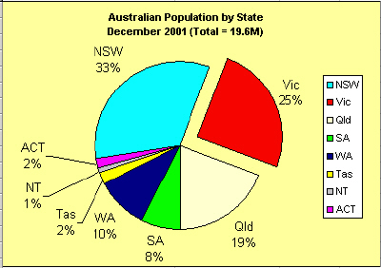
Pie Charts
Wedges “exploded” outward for emphasis.
*Graph used without permission*

Slide 10
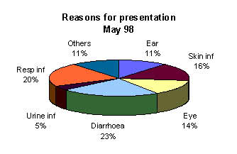
3-D Pie Charts
Prettier, but even harder to compare wedges!
*Graph used without permission*

Slide 11
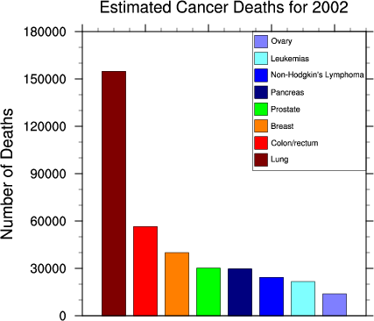
Bar Graphs, aka Histograms
Color-coded bars, or else label on the bars necessary.
Discrete, non-ordered categories/classifications.
Note : categories may be ordered in any way desired.
Cancer Type | # of Death
Breast | 40,000
Colon/rectal | 55,000
Leukemia | 22,000
Lung | 155,000
Non-Hodgkin’s | 25,000
Ovary | 15,000
Pancreas | 29,500
Prostate | 29,800
*Graph used without permission*

Slide 12
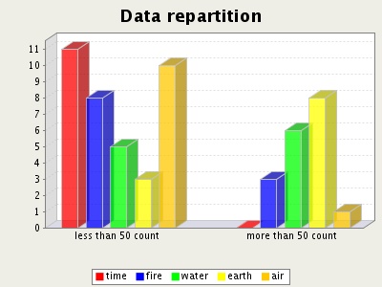
3-D Bar Graphs
3-D does not add information to the graph.
Note use of categories & sub-categories.
*Graph used without permission*

Slide 13
Horizontal Bar Graphs
!!
No rule governing use vertical vs horizontal bars.
*Graph used without permission*
!! Note : “Weekly Total” not a good mix with rest.

Slide 14
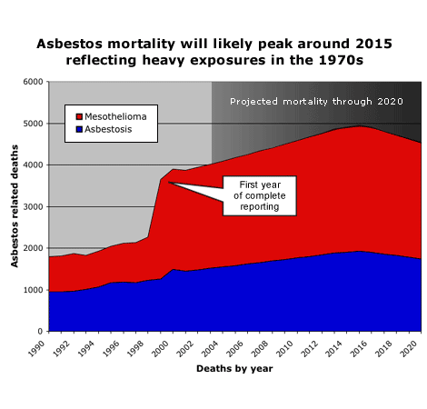
Line Graphs
Common, easy to make, shades not necessary.
Non-discrete, ordered grouping.
Cumulative or overlay?
*Graph used without permission*

Slide 15
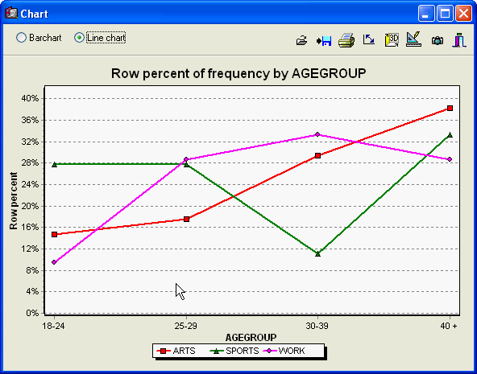
Multi-Line Graphs
Ordered, discrete groups.
Segmented lines.
Data points shown.
Colored points/lines.
Common axis/scale.
 | Arts | Sports | Work
18-24 | 15.0% | 28.0% | 9.5%
25-29 | 17.5% | 28.0% | 28.5%
30-39 | 29.0% | 11.5% | 33.0%
40+ | 37.5% | 33.0% | 28.5%
*Graph used without permission*

Slide 16
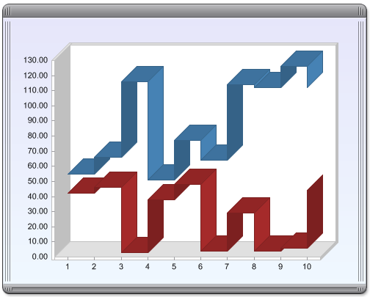
3-D Line Graphs
Like bar graphs, 3-D does not add information to the graph.
*Graph used without permission*

Slide 17
Elements of a Graph
Axes
Horizontal = x-axis, normally “independent” variable.
Vertical = y-axis, normally “dependent” variable.
Either cross “zero” value, or on left/bottom of graph.
Scales
Values/ranges vary depending on date being plotted.
Tic marks and grid lines, spaced evenly, for visual.
Nonlinear scale(s), e.g., log, may be applied.
Multiple x- or y- scale may be used, if appropriate.
Actual data
Data points may be shown explicitly
Lines connecting data points, smooth or segmented.

Slide 18
Examples
*Graphs used without permission*

Slide 19
Examples – Bar Chart
E_{e} | E_{g}
7.0 | 1.3
6.1 | 1.7
5.6 | 1.9
5.3 | 2.0
5.2 | 2.0
5.5 | 1.8
6.9 | 1.2
9.4 | 0.7
11.6 | 0.3
12.2 | 0.1
11.9 | 0.2
10.5 | 0.4
8.4 | 0.9
Measurements for Samples Collected
Measured E Values (J)
Samples

Slide 20
Examples – Bar Chart, Cumulative
E_{e} | E_{g}
7.0 | 1.3
6.1 | 1.7
5.6 | 1.9
5.3 | 2.0
5.2 | 2.0
5.5 | 1.8
6.9 | 1.2
9.4 | 0.7
11.6 | 0.3
12.2 | 0.1
11.9 | 0.2
10.5 | 0.4
8.4 | 0.9
Measurements for Samples Collected
Measured E Values (J)
Samples

Slide 21
Examples – Line Plot, Shared Axis
E_{e} | E_{g}
7.0 | 1.3
6.1 | 1.7
5.6 | 1.9
5.3 | 2.0
5.2 | 2.0
5.5 | 1.8
6.9 | 1.2
9.4 | 0.7
11.6 | 0.3
12.2 | 0.1
11.9 | 0.2
10.5 | 0.4
8.4 | 0.9
Measurements for Samples Collected
Measured E Values (J)
Samples

Slide 22
Examples – Line Plot, With Data Points
E_{e} | E_{g}
7.0 | 1.3
6.1 | 1.7
5.6 | 1.9
5.3 | 2.0
5.2 | 2.0
5.5 | 1.8
6.9 | 1.2
9.4 | 0.7
11.6 | 0.3
12.2 | 0.1
11.9 | 0.2
10.5 | 0.4
8.4 | 0.9
Measurements for Samples Collected
Measured E Values (J)
Samples

Slide 23
Examples – Line Plot, Multiple Axes
E_{e} | E_{g}
7.0 | 1.3
6.1 | 1.7
5.6 | 1.9
5.3 | 2.0
5.2 | 2.0
5.5 | 1.8
6.9 | 1.2
9.4 | 0.7
11.6 | 0.3
12.2 | 0.1
11.9 | 0.2
10.5 | 0.4
8.4 | 0.9
Measurements for Samples Collected
Measured Values for E_{g} (J)
Measured Values for E_{e} (J)
Samples

Slide 24
Examples – Scatter Plot
E_{e} | E_{g}
7.0 | 1.3
6.1 | 1.7
5.6 | 1.9
5.3 | 2.0
5.2 | 2.0
5.5 | 1.8
6.9 | 1.2
9.4 | 0.7
11.6 | 0.3
12.2 | 0.1
11.9 | 0.2
10.5 | 0.4
8.4 | 0.9
Measurements for Samples Collected
Measured Values for E_{g} (J)
Measured Values for E_{e} (J)

Slide 25
Examples – Scatter Plot
E_{e} | E_{g}
7.0 | 1.3
6.1 | 1.7
5.6 | 1.9
5.3 | 2.0
5.2 | 2.0
5.5 | 1.8
6.9 | 1.2
9.4 | 0.7
11.6 | 0.3
12.2 | 0.1
11.9 | 0.2
10.5 | 0.4
8.4 | 0.9
Measurements for Samples Collected
Measured Values for E_{g} (J)
Measured Values for E_{e} (J)
Note : it may not be meaningful to connect “dots”.

Slide 26
Examples – Linear Approximation
E_{e} | E_{g}
7.0 | 1.3
6.1 | 1.7
5.6 | 1.9
5.3 | 2.0
5.2 | 2.0
5.5 | 1.8
6.9 | 1.2
9.4 | 0.7
11.6 | 0.3
12.2 | 0.1
11.9 | 0.2
10.5 | 0.4
8.4 | 0.9
Measurements for Samples Collected
E_{g} = 3.15 – 0.255 E_{e}
Measured Values for E_{g} (J)
Measured Values for E_{e} (J)

Slide 27
Examples – Semi-log Scale
S | N
18.9 | 5.04e2
17.8 | 6.87e2
16.7 | 9.24e2
15.6 | 1.50e3
14.5 | 2.50e3
13.4 | 4.69e3
12.3 | 9.32e3
11.2 | 2.50e4
10.1 | 9.76e4
9.0 | 5.64e5
7.9 | 3.97e6
6.8 | 5.02e7
5.7 | 1.78e9
Stress Level as a function of Cycle to Failure
Stress Level
Cycles to Failure, log N

Slide 28
Examples – Semi-log Scale
S | N | log N
18.9 | 5.04e2 | 2.702
17.8 | 6.87e2 | 2.837
16.7 | 9.24e2 | 2.966
15.6 | 1.50e3 | 3.176
14.5 | 2.50e3 | 3.398
13.4 | 4.69e3 | 3.671
12.3 | 9.32e3 | 3.970
11.2 | 2.50e4 | 4.397
10.1 | 9.76e4 | 4.989
9.0 | 5.64e5 | 5.752
7.9 | 3.97e6 | 6.599
6.8 | 5.02e7 | 7.701
5.7 | 1.78e9 | 9.250
Stress Level as a function of Cycle to Failure
Stress Level
Cycles to Failure, log N

Slide 29
Examples – G & U Line Plot
G | U
9.33E+02 | 2.04E+07
2.09E+01 | 3.72E+03
2.34E+01 | 2.14E+04
1.51E+01 | 2.69E+03
1.66E+01 | 3.31E+03
6.46E+00 | 2.29E+02
6.03E+00 | 8.51E+02
3.09E+01 | 1.20E+05
1.58E+01 | 2.95E+04
6.76E+01 | 1.95E+06
1.66E+02 | 1.10E+07
1.07E+02 | 8.32E+06
5.75E+01 | 7.08E+05
3.55E+02 | 3.63E+07
1.00E+03 | 6.61E+08
1.12E+03 | 2.19E+08
8.51E+02 | 3.09E+08
1.17E+03 | 3.55E+09
3.55E+03 | 1.32E+10
1.07E+04 | 1.29E+11
4.07E+03 | 8.13E+09
3.98E+03 | 3.98E+09
5.62E+03 | 6.17E+09
3.80E+03 | 2.45E+09
4.79E+03 | 6.92E+09
Counts G & U
Counts
Sample Number

Slide 30
Examples – G vs U Scatter Plot
G | U
9.33E+02 | 2.04E+07
2.09E+01 | 3.72E+03
2.34E+01 | 2.14E+04
1.51E+01 | 2.69E+03
1.66E+01 | 3.31E+03
6.46E+00 | 2.29E+02
6.03E+00 | 8.51E+02
3.09E+01 | 1.20E+05
1.58E+01 | 2.95E+04
6.76E+01 | 1.95E+06
1.66E+02 | 1.10E+07
1.07E+02 | 8.32E+06
5.75E+01 | 7.08E+05
3.55E+02 | 3.63E+07
1.00E+03 | 6.61E+08
1.12E+03 | 2.19E+08
8.51E+02 | 3.09E+08
1.17E+03 | 3.55E+09
3.55E+03 | 1.32E+10
1.07E+04 | 1.29E+11
4.07E+03 | 8.13E+09
3.98E+03 | 3.98E+09
5.62E+03 | 6.17E+09
3.80E+03 | 2.45E+09
4.79E+03 | 6.92E+09
Counts U vs G
Counts, U
Counts, G

Slide 31
Examples – Log-log Line Plot
G | U
9.33E+02 | 2.04E+07
2.09E+01 | 3.72E+03
2.34E+01 | 2.14E+04
1.51E+01 | 2.69E+03
1.66E+01 | 3.31E+03
6.46E+00 | 2.29E+02
6.03E+00 | 8.51E+02
3.09E+01 | 1.20E+05
1.58E+01 | 2.95E+04
6.76E+01 | 1.95E+06
1.66E+02 | 1.10E+07
1.07E+02 | 8.32E+06
5.75E+01 | 7.08E+05
3.55E+02 | 3.63E+07
1.00E+03 | 6.61E+08
1.12E+03 | 2.19E+08
8.51E+02 | 3.09E+08
1.17E+03 | 3.55E+09
3.55E+03 | 1.32E+10
1.07E+04 | 1.29E+11
4.07E+03 | 8.13E+09
3.98E+03 | 3.98E+09
5.62E+03 | 6.17E+09
3.80E+03 | 2.45E+09
4.79E+03 | 6.92E+09
Counts G & U
Counts
Sample Number

Slide 32
Examples – Log-log Scatter Plot
G | U
9.33E+02 | 2.04E+07
2.09E+01 | 3.72E+03
2.34E+01 | 2.14E+04
1.51E+01 | 2.69E+03
1.66E+01 | 3.31E+03
6.46E+00 | 2.29E+02
6.03E+00 | 8.51E+02
3.09E+01 | 1.20E+05
1.58E+01 | 2.95E+04
6.76E+01 | 1.95E+06
1.66E+02 | 1.10E+07
1.07E+02 | 8.32E+06
5.75E+01 | 7.08E+05
3.55E+02 | 3.63E+07
1.00E+03 | 6.61E+08
1.12E+03 | 2.19E+08
8.51E+02 | 3.09E+08
1.17E+03 | 3.55E+09
3.55E+03 | 1.32E+10
1.07E+04 | 1.29E+11
4.07E+03 | 8.13E+09
3.98E+03 | 3.98E+09
5.62E+03 | 6.17E+09
3.80E+03 | 2.45E+09
4.79E+03 | 6.92E+09
Counts log(U) vs log(G)
Counts, log(U)
Counts, log(G)

Slide 33
Fitting with Different Types of Lines
Linear (1st order, e.g., y = m x + b)
Polynomials
Quadratic (2nd order, e.g., y = a₀ + a₁ x + a₂ x²)
Cubic (3rd order, e.g., y = a₀ + a₁ x + a₂ x² + a₃ x³)
Higher orders
Spine = piece-wise fitting with smooth connects
Bi-linear, e.g.,
y = a₁₁ x₁² + a₁₂ x₁x₂ + a₁₃ x₁x₃ + a₂₂ x₂² + a₂₃ x₂x₃ + a₃₃ x₃²
Exponential
Others
a₁₁
a₁₁

Slide 34
Other Issues/Considerations
Outliers, e.g., refer to line plot for G vs U, data point 20 appears to be an outlier.
Theory based fitting vs empirical fitting.
Time plots = trends.
Complex plots.

Slide 35


