Slide 1


A Hybrid Recommender System for H&M Fashion Recommendation
CSCE676 Data Mining final project ​Xiaoyun Chu

Slide 2
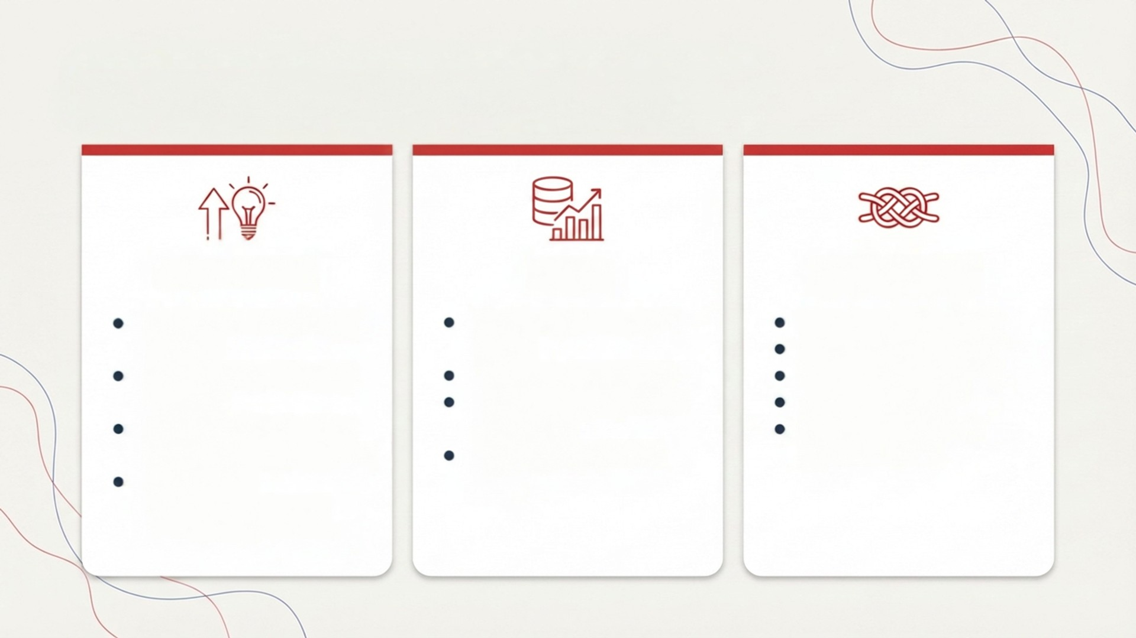
Background
Motivation
Data
Challenges
Large catalog; limited user exposure Personalization improves discovery Better User Experience → higher conversion/retention Personalized recommendations can increase company profits
Files: transaction.csv, customers.csv, articles.csv, images Total users: 1,362,281 Total items: 104,547 Total interactions: 31,788,324
Sparse implicit feedback Massive user-item space Cold Start Problem Need accuracy + low latency at scale

Slide 3
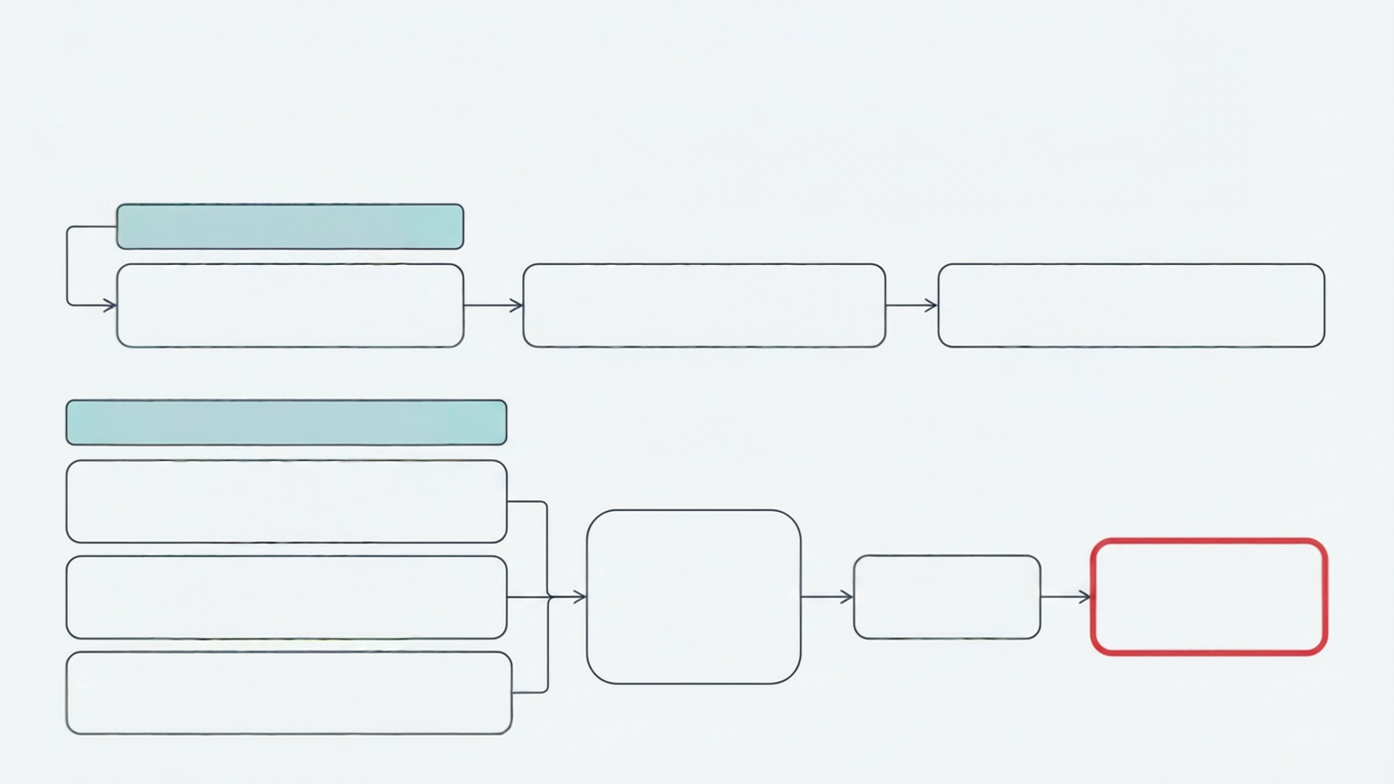
Method: Two-Stage Recommendation Pipeline
Retrieval \rightarrow Ranking \rightarrow Evaluation
1) Retrieval (ItemCF)
User purchases (daily records)
Item-item similarity (co-occurrence / cosine)
Candidate generation (Top-N similar items)
Fast, high-recall
2) Ranking (DNN Ranker)
Collaborative embeddings (Word2Vec / Skip-Gram)
Text-based embeddings (TF-IDF)
DNN ranking model
Ranked list (Top-(K)
Scoring metric: MAP@K
Historical dense features (recency, frequency, price, category)

Slide 4

Conclusion
Key Takeaway
Effective fashion recommendation requires modeling both recency and the long-tail of items. Incorporating a time-decay factor improves responsiveness, while addressing long-tailed distribution enhances discovery. By utilizing a hybrid retrieval + ranking framework, the system achieves greater relevance, diversity, and practical scalability.
Future Work
· Multimodal recommendation: Incorporate image, text, and metadata for richer item representation. · Sequential/time-aware modeling: Evolve to sequence-aware user modeling to capture dynamic fashion preferences. · Multi-objective learning with MMOE: Jointly optimize for clicks, purchases, diversity and business value. · Online A/B testing... Validate performance with business constraints, seasonality, and inventory considerations.

