Slide 1
Web Application Penetration Testing
Ebrahim Hegazy – Www.Security4Arabs.com

Slide 2
About Myself
Ebrahim Hegazy (@Zigoo0)
2009 → Junior Linux System Administrator
2011 → Security Engineer
2013 → Cyber Security Analyst (ThreatIntel)
2014 → Cyber Security Consultant (Pentesting)
2015 → Sr. Systems Security Engineer
2017 → Sr. Cyber Security Consultant
Bug Bounty Hunter since 2013 (Yahoo, Google, Telekom.de, Avira, Paypal, Barracuda, Facebook, Twitter ….. And more.)
Speaker for multiple international security conferences

Slide 3
Course Target?
مشاركة العلم
إثراء المحتوي العربي في هذا المجال
التركيز علي التطبيق العملي في جميع الدروس
إعطاء الفرصة للجميع من خلال مجانية الكورس
كسر الخوف من المصطلحات المعقدة
تنمية مهارات المتدربين بشرح أساسيات أكثر من مجال
صدقة جارية لي ولوالدي رحمه الله

Slide 4
Course Agenda
Downloading & Installing Course Requirements
Linux Basics
BurpSuite and how to use it
Introduction Topics
Web Applications Vulnerabilities (Easy Level)
Web Applications Vulnerabilities (Medium Level)
Advanced Web Applications Vulnerabilities
Real Life Demo (Bug Bounty Hunting)
Conclusion & References

Slide 5
Course Requirements
Installing necessarily browser plugins (Wappalyzer, FlagFox, FoxyProxy, SEO Status PageRank/Alexa Toolbar, Tamper data)
Virtualbox
Ubuntu & Windows
Java & Burp Suite

Slide 6
First Session
Deep dive into data leaks (Haveibeenpwned.com & Shodan.io)
سنقوم في هذا الدرس بشرح كيف تمت عمليات الإختراق علي المواقع العملاقه وكيف تم تسريب مليارات من الحسابات الإلكترونية في الفترة الأخيرة
https://hacked-emails.com/api?q=$Email$

Slide 7
Part (1) - Linux Basics
Introduction to Linux.
Packages & installation process
Command line examples
(man, apt-get, apt-cache, find, curl, wget, touch, >, >>, |, ;, head, tail, grep, cut, sort, nano, &, ps, df, top, files permissions)

Slide 8
Intro to Linux
Open Source Technology
Hackers Friendly
Easy packages installation
Lots of flavors
Etc etc

Slide 9
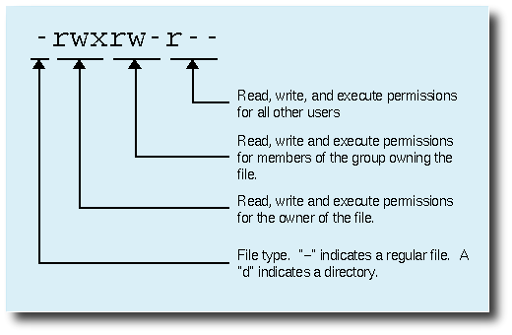
Files Permissions

Slide 10
Your Today Task
Your today task is to:
install LAMP stack
Create a file, allow access to that file to root user ONLY.
You learned how to list processes, can you list p sub-processes?
RHCE (http://muhammedessa.com/portfolio-item/rhel7-rhcsa-rhce/)

Slide 11
Part (1) - Introduction Topics
1- OSI Model in a Nutshell (Life of a Packet)
2- Wireshark & NetworkMiner
3- TCP/UDP/HTTP/HTTPS Protocols
3- Nmap basics
4- HTTP Methods & HTTP Response Types
5- HTTP Headers
6- Web Authentication Methods, Cookies, Sessions
7- Encryption, Encoding, Hashing
10- DNS Basics, A, MX, CNAME Records
11- PTR Records (Reverse DNS) & PassiveDNS (Yahoo or Facebook Example)
12- What happens when I open https://www.facebook.com in my browser?
13- Basic PHP examples (GET vs POST)
14. CORS, CSP & SOP

Slide 12
Encryption, Encoding, Hashing
Hashing: irreversible mathematical function that converts user input into a fixed size output. (used for Integrity checks)
Encryption: converting human readable data/message into cipher-text, so only a person holding the right KEY can decrypt the message. (used for security purposes, authentication and authorization)
Encoding: The purpose of encoding is to transform data so that it can be properly (and safely) consumed by a different type of system.

Slide 13
Hashing
Irreversible (One way function)
Fixed output size
Examples: md4, md5, sha1, sha2 etc
Demo time.

Slide 14
Encoding
The purpose of encoding is to transform data so that it can be properly (and safely) consumed by a different type of system.
Example: base64, rot13, Hex, URL, etc etc
Demo Time!

Slide 15
Encryption
Symmetric: uses the same key to encrypt and decrypt.
Examples: AES, DES, 3DES, TwoFish, BlowFish
Asymmetric: uses public key for encryption and private key for decryption.
Examples: RSA, DH, DSA, ECDH etc
Demo Time! :D

Slide 16
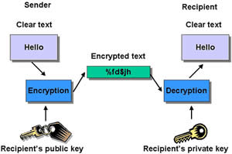
Asymmetric

Slide 17
Encryption Demo
Caesar Cipher (Symmetric)
RSA (Asymmetric)
Certificate Chain
Browser trusted CA’s
Generate your own public & private keys.

Slide 18
Task
Your task for today is to watch this video: https://www.youtube.com/watch?v=eun8LJQ7YZs
What is OCSP? Why we need it?
What is root, Intermediate Certificate?
CISSP All in one exam guide (7)

Slide 19
OSI Model
What happens when I open https://www.google.com/ in my browser?
OSI Model
How HTTPS Works?

Slide 20
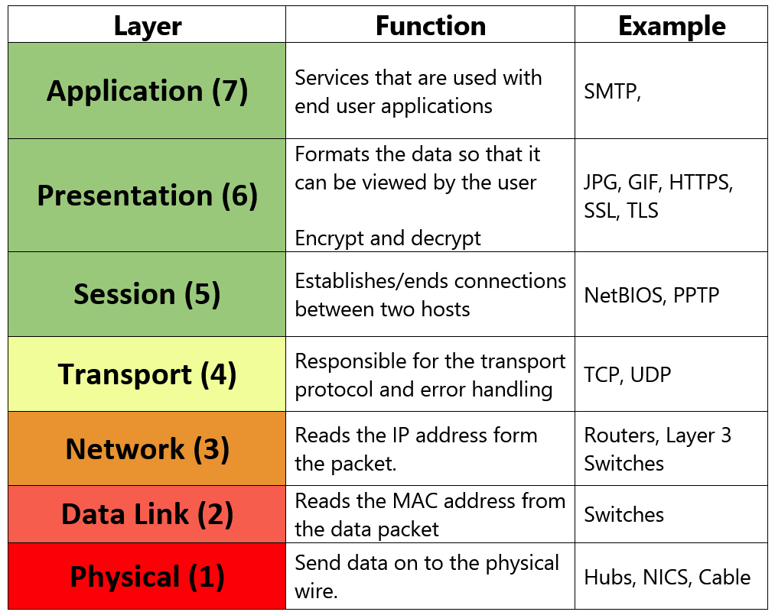

Slide 21
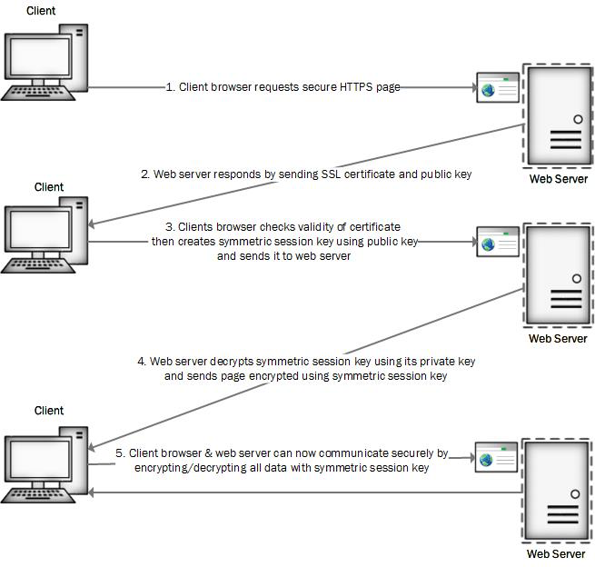

Slide 22
TCP vs UDP
Every packet has:
Source IP, Source Port, Destination IP, Destination Port.
TCP
How it works? Example attack? What is it used for? Example protocols?
UDP
How it works? Example attack? What is it used for? Example protocols?

Slide 23
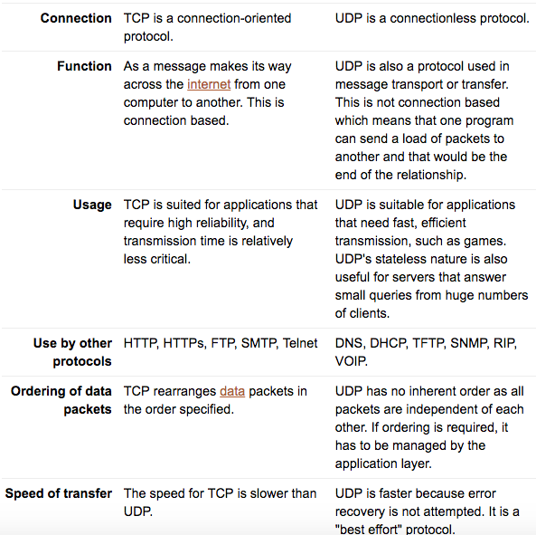

Slide 24
TCP 3 way Handshake demo
Wireshark Demo of how TCP 3 way handshake works.

Slide 25
What is DNS and how it works?
Domain Name System
How it works?
Known attacks
Different Record Types

Slide 26
Known attacks
DNS Poisoning
Subdomain Takeover
DNS Cache Snooping
DNS Amplification Attacks (DDOS)

Slide 27
Different Record Types
A
AAAA
MX
CNAME (Alias → Subdomain Takeover)
PTR
Tools: dig, nslookup, mxtoolbox.com

Slide 28
Nmap
What is Nmap and why we need it?
Nmap basics
Advance Nmap

Slide 29
BurpSuite
What is Burp and why we need it?
A Journey into Burp Tabs
Burp configuration
Get your hands dirty using burp
Burp Documentation: https://portswigger.net/burp/help/contents.html

Slide 30
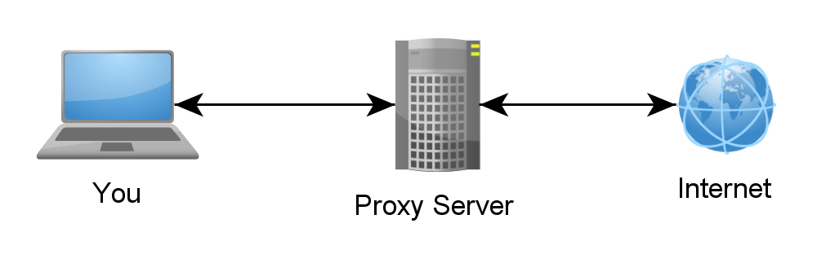
BurpSuite
What is Burp and why we need it?

Slide 31
HTTP Methods, Headers and status codes
HTTP Protocol
HTTP Methods (GET, POST, DELETE, OPTIONS, HEAD ….)
HTTP Request Headers
HTTP Response Headers
HTTP Status Codes
Tasks

Slide 32
Tasks
What is the difference between Cookies and Session
What is 307 status code?
What is WebDav?

Slide 33
PHP GET vs POST
Writing your first GET and POST request (http://www.security4arabs.com/2015/04/03/how-to-start-in-webapps-security/)
Handling user input
Filtering user input
XSS into demo
Client Side vs Server side

Slide 34
XSS (Cross Site Scripting)
Reflected XSS
Stored XSS
Dom based XSS
Demo Time
Google XSS Game
Testphp.vulnweb.com

Slide 35
How to Mitigate XSS
Response Headers
Filter User input
Restrict user input
Client Side vs Server Side.

Slide 36
SOP, CORS, CSP
Same origin policy requires the source Host to be the same protocol, same hostname and same port in order to read responses from other hostname. Every browser plugin has its own SOP (Flash, Java, Silverlight)
Cross Origin Resource Sharing is a response header that allows cross origin requests.
Content Security Policy controls which hostname is able to execute javascript, fonts, css and/or images on the target server.

Slide 37
Advanced XSS
Using XSS an attacker can steal user cookies, modify the page content, inject extra headers and more.
Demo: http://185.45.192.228/stealer-xss/js.js
js.js → the java script code that will steal the user cookies
Demo.php → PHP code to store user cookies and other user information
Logs.txt → user data/cookies will be stored here.

Slide 38
XSSI
Cross Site Scripting Inclusion occurs when a dynamically generated javascript files holds users confidential information.
JavaScript files doesn’t respect the SOP.

Slide 39
Solving XSS challenges.
Before we start, what are:
URL vs URI, Hostname, Domain Name, TLD, Subdomain, Backend, Frontend, and Endpoint.
Client Side & Server Side.
Challenges: http://185.45.192.228/xssChall/
Locating XSS payloads, html5sec.org and so on.
On* event handlers
Testing “ > < with Burp Intruder.
Rapid testing of XSS payloads
String encoding: https://mothereff.in/html-entities

Slide 40
CSRF – Cross-site request forgery
What is CSRF? Example?
DEMO
Auto form submit
CSRF vs SOP
CSRF Tokens and extra headers
Live demo on Twitter
Mitigation Techniques

Slide 41
Lets earn some money!
Bug bounty programs
Bug bounty platforms:
Hackerone, Bugcrowd, SynAck
Vulbox, zerocopter, hackenproof.com
Other BBP (Google, Facebook, Telekom.de)

Slide 42
Lets earn some money!
How to get started with Hackerone
Register
Find a nice target and read the policy
Start to hunt!
Private programs vs Public programs.
How to write a nice report? CVSS? Markdown?
Following up on reports? Any updates?

Slide 43

Following up on reports

Slide 44
Lets earn some money!
Got a bounty, now what?
Tax forms?

Slide 45
Information disclosure
Backup files (zip,tar,tgz,sql,rar,tar.gz…)
Hidden files (.FileName)
Source code repositories (.git, .svn)
Source code files (.old,.bak,.php~,.swp)
JavaScript files
Github repositories (search github)

Slide 46
Information disclosure
https://hackerone.com/reports/396467
Tool to clone git repos to search it locally
Dirsearch tool / Dirbuster
Extending dirsearch list (Bo0om)
Git / SVN extractor
All files are on Github repo @zigoo0

